Slide 3
clc
x=[0:0.5:10]
%x=linspace(0,10,21)
a=5;
y=exp(-a).*sin(x)+10.*sqrt(x)
plot(x,y)
xlabel('x');
ylabel('y');
legend('Simple function')

Slide 4
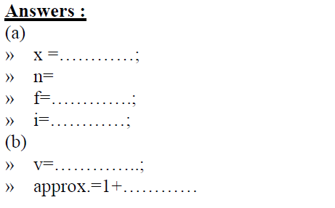

Slide 5
x =pi/4;
n=10;
f=2:2:2*n;
i=1:10;
%(b)
v=(-1).^i.*x.^f./factorial(f);
approx=1+sum(v)
x =pi/4;
n=10;
i=1:10;
%(b)
v=(-1).^i.*x.^(2*i)./factorial(2*i);
approx=1+sum(v)

Slide 6
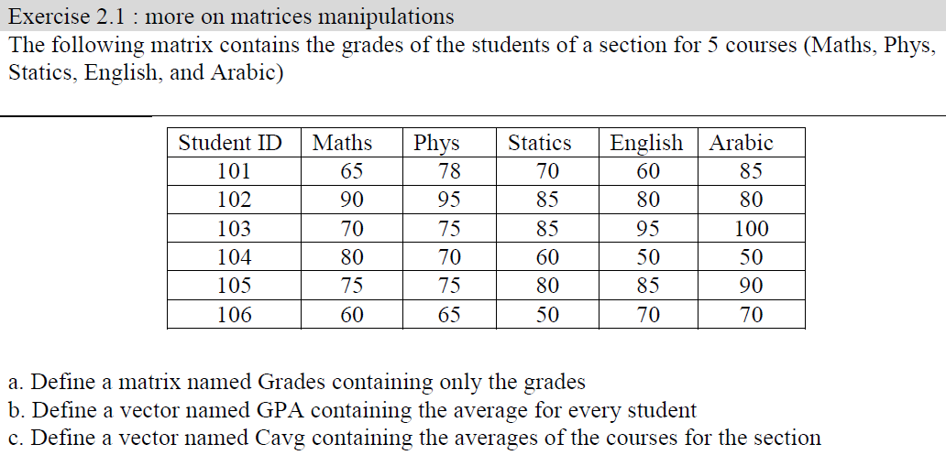
Graded Task

Slide 8
% Exe 2-1
Grades=[65 78 70 60 85;90 95 85 80 80;70 75 85 95 100;80 70 60 50 50;75 75 80 85 90;60 65 50 70 70]
GPA=sum(Grades,2)/5
Cavg=sum(Grades)/5
% Exe 2-2
a=1.55;
t=[0:10]';
d=0.5*a*t.^2;
V=a*t;
Table=[t d V]
plot(t,d)
plot(t,V)

