Slide 1
4. Code Transformation
HTTP://FAC.KSU.EDU.SA/AQUADRI

Slide 2
Coverage
To enable you to better understand how to model in UML.
To enable you to better understand how UML models can be translated to Java code.
To enable you to better understand how to transform Java code into UML diagrams.

Slide 3
Demonstration
Create UML Rose Project.
Add a UML Package.
Create a ‘class’ icon, then name it myClass.
Add an attribute data type String.
Add an operation, name it myOperation.
Add another class and name it MyAssociationClass1
Make a directedAssociation between MyClass and MyAssociationClass, by clicking on the little arrow out of MyClass when keeping the mouse cursor over it.
Click anywhere in the diagram and make a right-click and then click ArrangeAll.

Slide 4
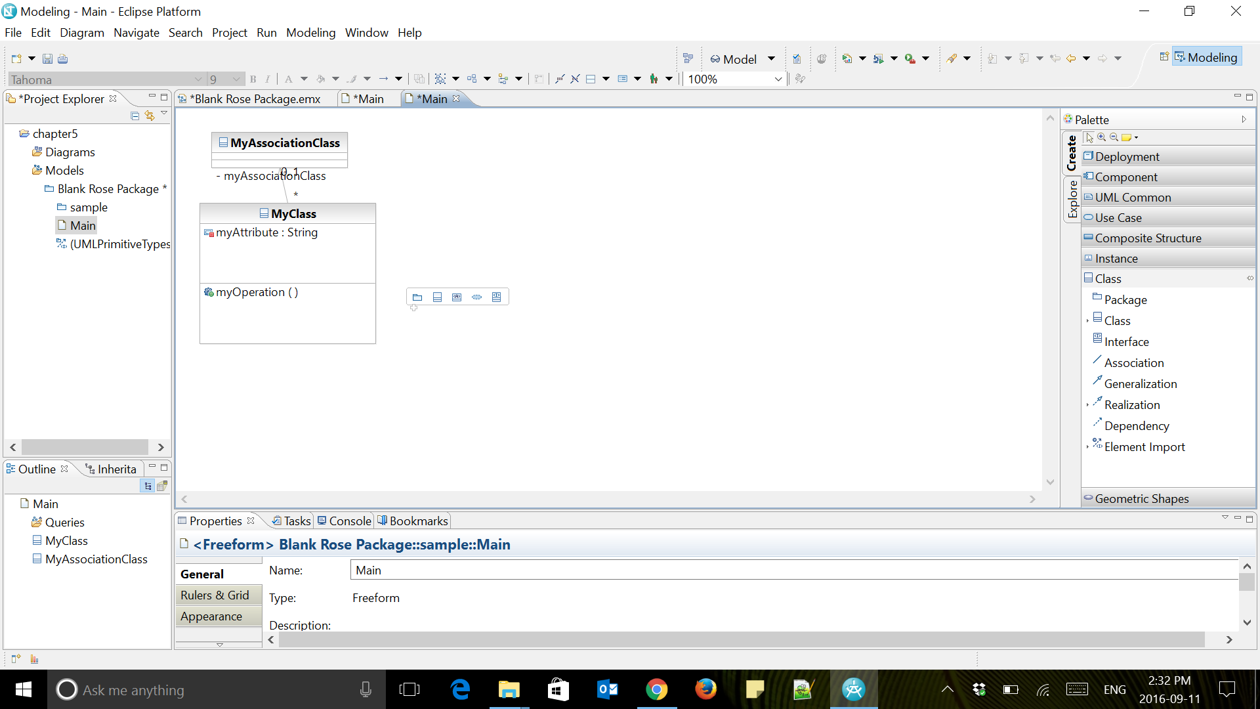

Slide 5
Conversion to Java code:
Click new, then Transformation Configuration.
Give it a name eg:uml2java or u2j
Choose UML to Java as your Transformation Option
Ensure to choose your Project folder for the configuration file destination and click ‘Next’
Select your model in the Source and then click on Create a target Container. This container is where the java code will be put.
Click Finish

Slide 6
Running the Transformation
Double click on the configuration file (if not open) created in your project folder
Click on Run
Change the perspective to Java from the Window Menu
Locate the Java code files and Verify

Slide 7
Reverse Transformation
Create 2 more Java Classes
Start a new transformation configuration, same as previous
This time select Java to UML option to configure the transformation
Ensure to use correct source and targets as being demonstrated.

