Slide 1
Forwarding
Routing and routing tables
Serial interfaces
2nd semester 1439-1440

Slide 2
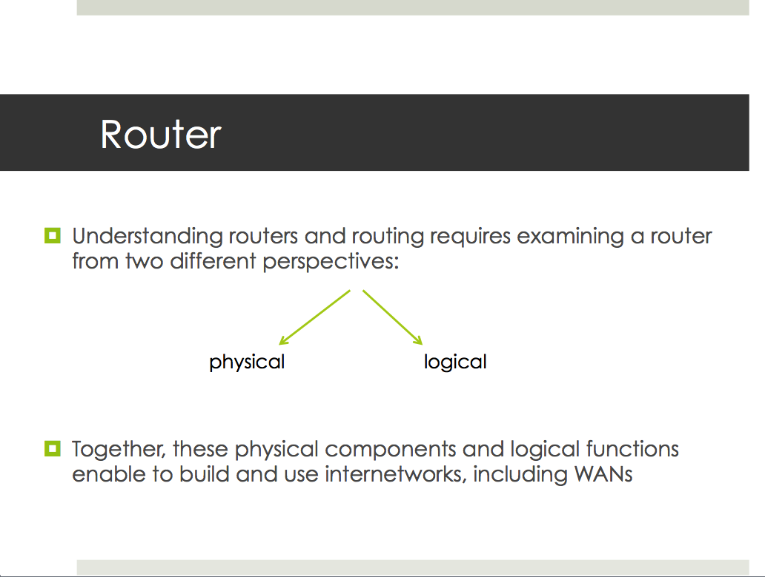
From Lab2 Slides
Our lecture today

Slide 3
Objectives
Explain how routers use information in data packets to make forwarding decisions
Explain the encapsulation and de-encapsulation process used by routers when switching packets between interfaces
Explain Routing concept and routing table entries for directly connected networks, static routes, and dynamic routing protocol.
Configuring router serial interfaces.

Slide 4
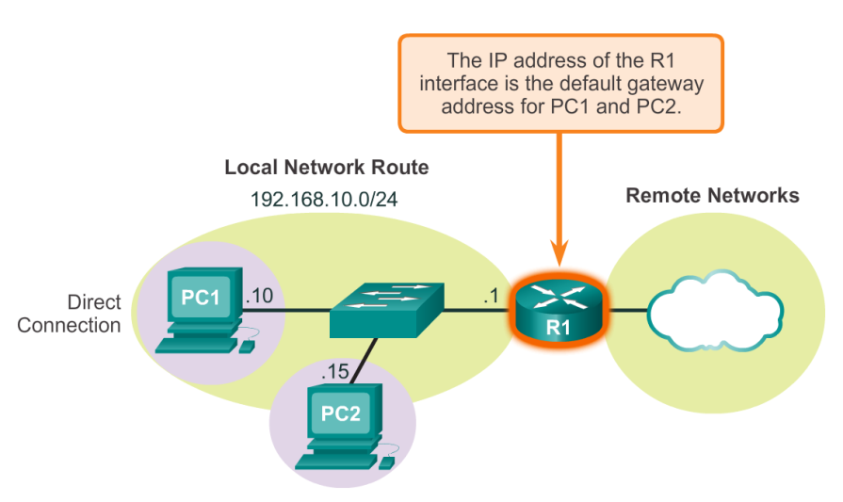
Sending a Packet
A host could send a packet to: itself, local host, or remote host
router
Notes:
Itself - This is a special IP address of 127.0.0.1 which is referred to as the loopback interface. This loopback address is automatically assigned to a host when TCP/IP is running. The ability for a host to send a packet to itself using network functionality is useful for testing purposes. Any IP within the network 127.0.0.0/8 refers to the local host.
The main role of the network layer is to move packets from a sending host to a receiving host.

Slide 5
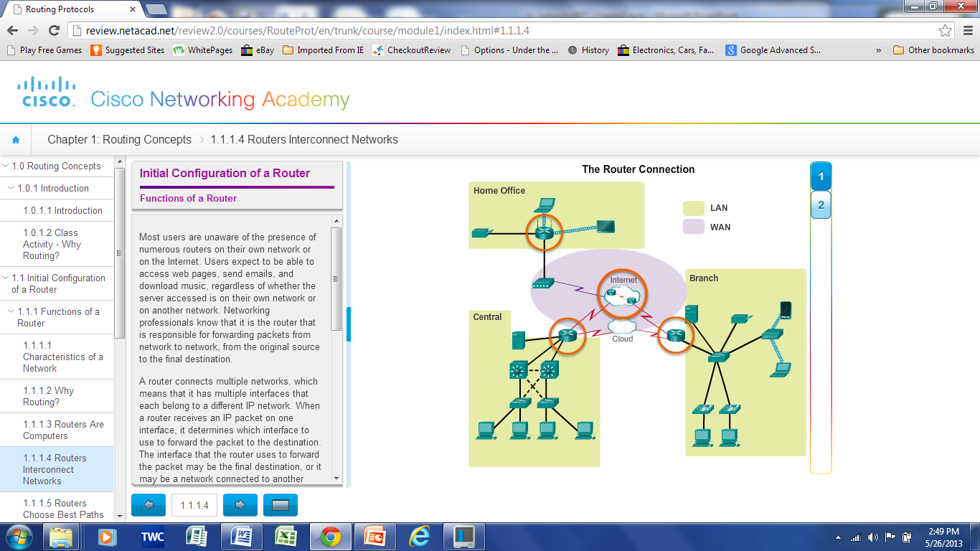
Router
Routers connect multiple networks.
It have multiple interfaces, each on a different IP network.
It is responsible for the routing of traffic between networks.
Notes:
5
Function of a Router
4.1.1.2 Why Routing?

Slide 6
Functions of a Router
To do so, router does two important functions:
Create routing tables which supply a wealth of information about paths to other networks (Routing)
  It helps to determine the best path to send packets
Forward packets toward their destination (Forwarding)
Forwards packet to interface indicated in routing table.
Encapsulates the packet and forwards out toward destination.
Notes:
Forwarding:
When a packet arrives at a router’s input link, the router must move the packet to the appropriate output link .
Routing:
The network layer must determine the best route or path taken by packets as they flow from a sender to a receiver.

Slide 7
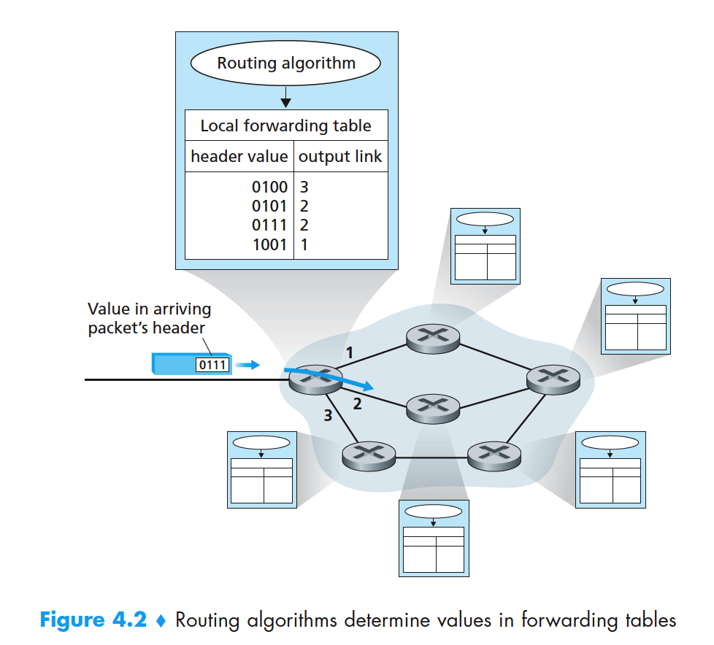
Packet Forwarding Decision
Every router has a routing table. To forward a packet, a router:
Notes:
Depending on the network-layer protocol, the header value could be the destination address of the packet or an indication of the connection to which the packet belongs.
Examining the value of a field in the arriving packet’s header
Then using this header value to index into the router’s routing table.
The value stored in the routing table entry for that header indicates the router’s outgoing link interface to which that packet is to be forwarded.

Slide 8
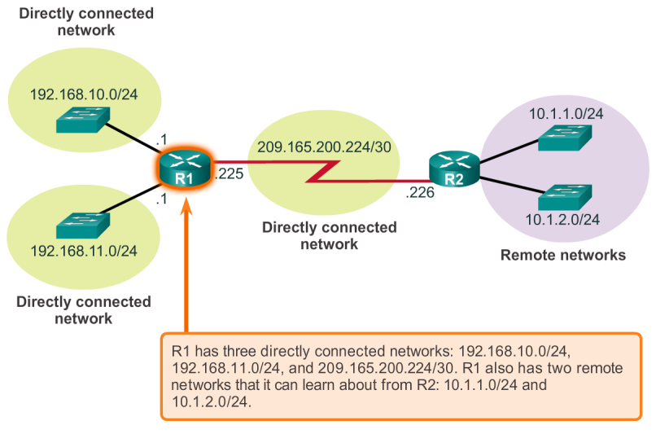
Router Packet Forwarding Decision
Router either forwards packets to directly connected or remote networks

Slide 9
Forwarding

Slide 10
Router Switching Function
A switching function is a process used by a router to accept a packet on one interface and forward it out of another interface.
Notes:
As we know, the primary function of a router is to forward packets toward their destination.
This is accomplished by using a switching function, which is the process used by a router to accept a packet on one interface and forward it out of another interface.

Slide 11
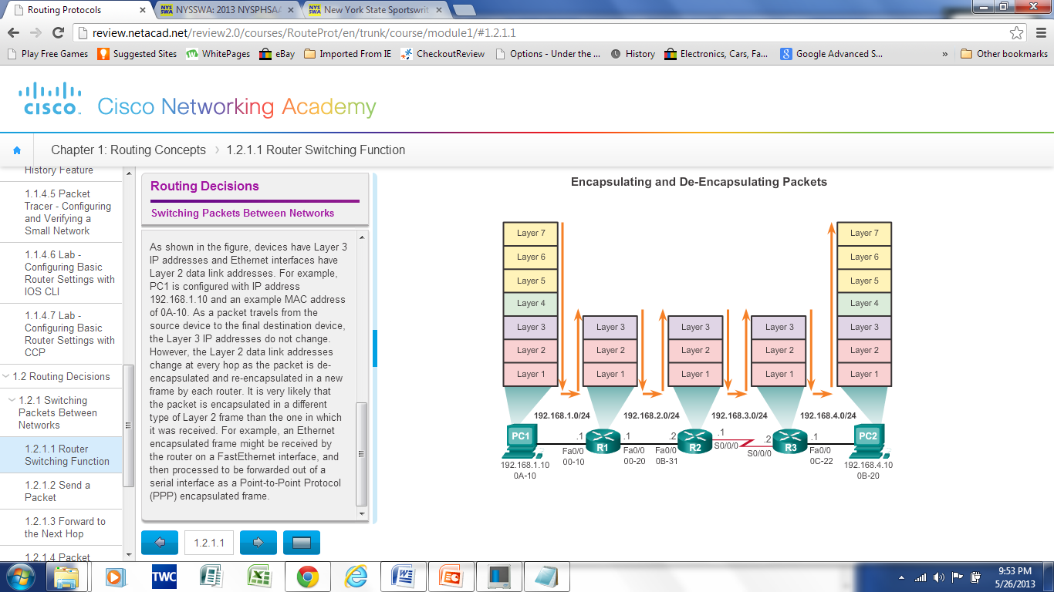
Switching Packets between Networks
Router Switching Functions
A key responsibility of the switching function is to encapsulate packets in the appropriate data link frame type for the outgoing data link.
Notes:
11
4.2.1 Switching Packets between Networks
4.2.1.1 Router Switching Functions
Note: In this context, the term “switching” literally means moving packets from source to destination and should not be confused with the function of a Layer 2 switch.

Slide 12
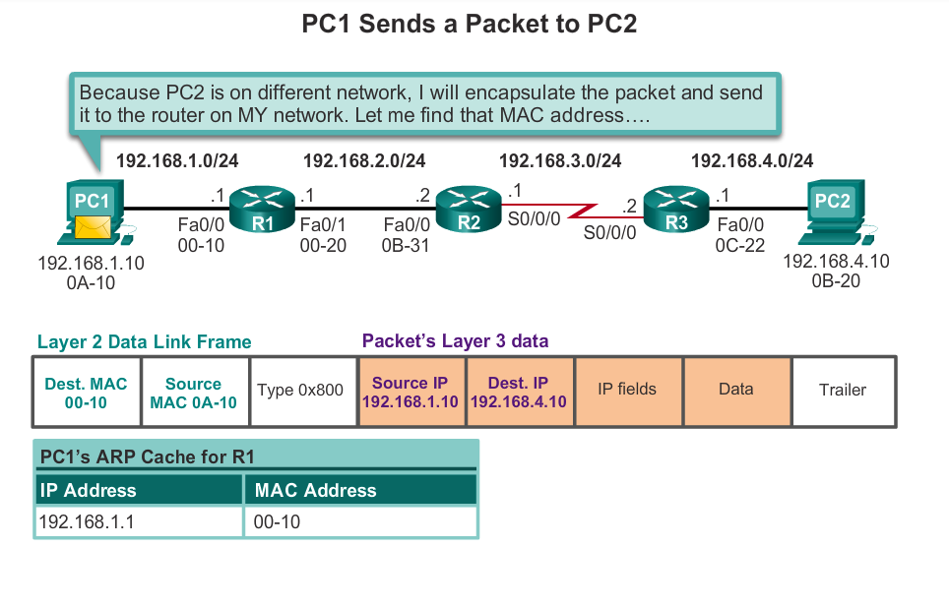
Switching Packets between Networks
Send a Packet
Notes:
12
4.2.1 Switching Packets between Networks
4.2.1.2 Send a Packet

Slide 13
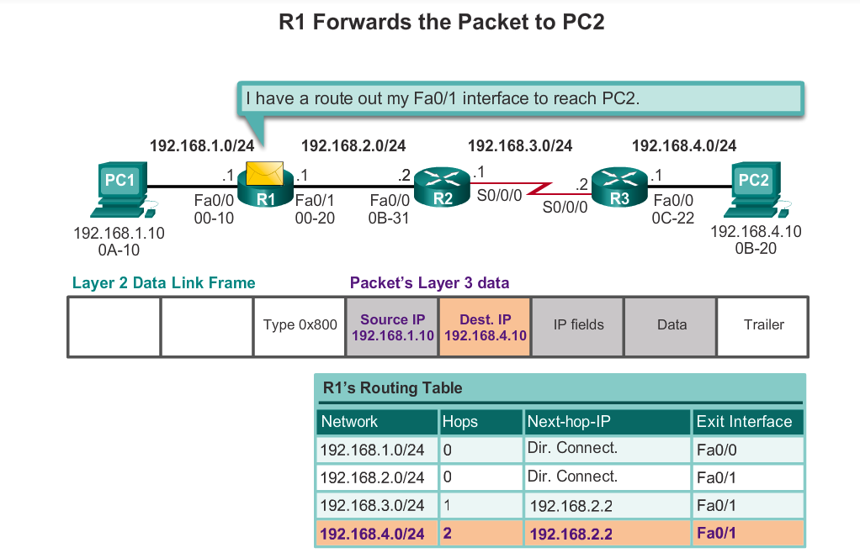
Switching Packets between Networks
Forward to the Next Hop
?
?
MAC
MAC
type
Notes:
13
4.2.1 Switching Packets between Networks
4.2.1.3 Forward to the Next Hop

Slide 14
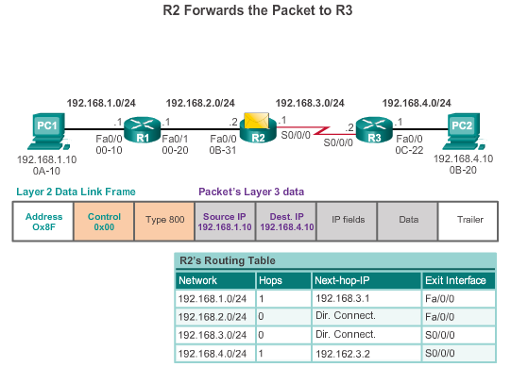
Switching Packets between Networks
Packet Routing
Notes:
14
4.2.1 Switching Packets between Networks
4.2.1.4 Packet Routing

Slide 15
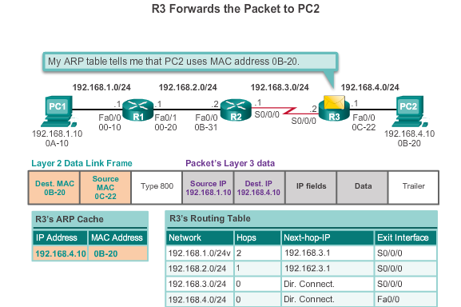
Switching Packets between Networks
Reach the Destination
Notes:
15
4.2.1 Switching Packets between Networks
4.2.1.5 Reach the Destination
4.2.1.6 Activity – Match Layer 2 and Layer 3 Addressing

Slide 16
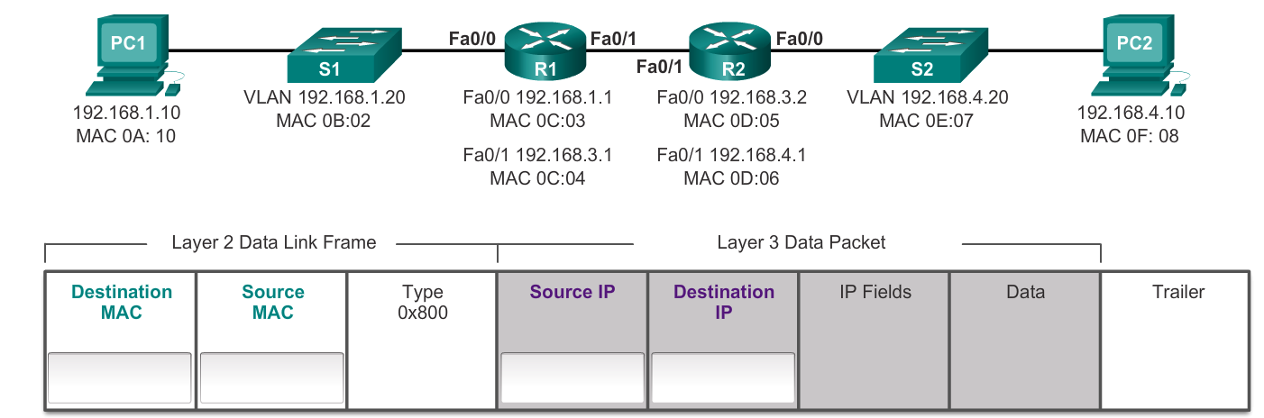
Activity
Pc1 want send a packet to Pc2, fill the required addresses that Pc1 will use to send the packet

Slide 17
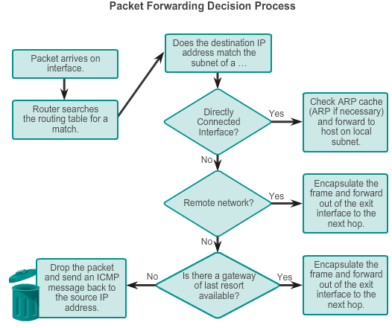
Forwarding Decisions
Notes:
17
4.2.2 Path Determination
4.2.2.1 Routing Decisions

Slide 18
Routing

Slide 19
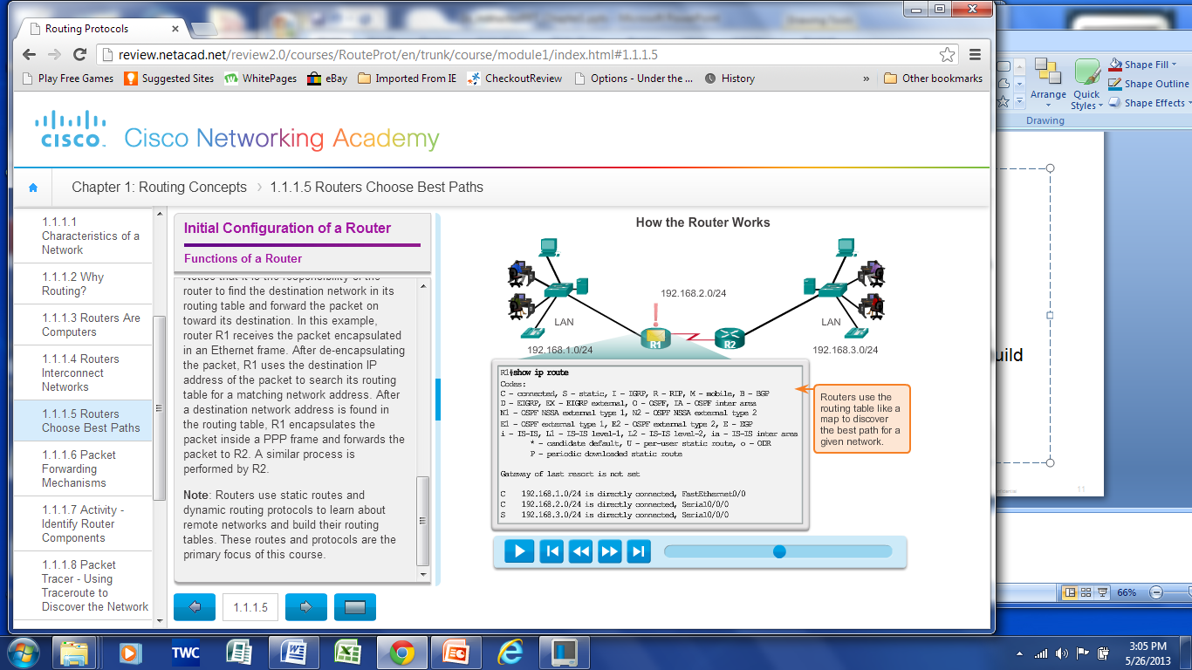

The Routing Table
routing table !
Notes:
19
Functions of a Router
4.1.1.5 Routers Choose Best Paths

Slide 20
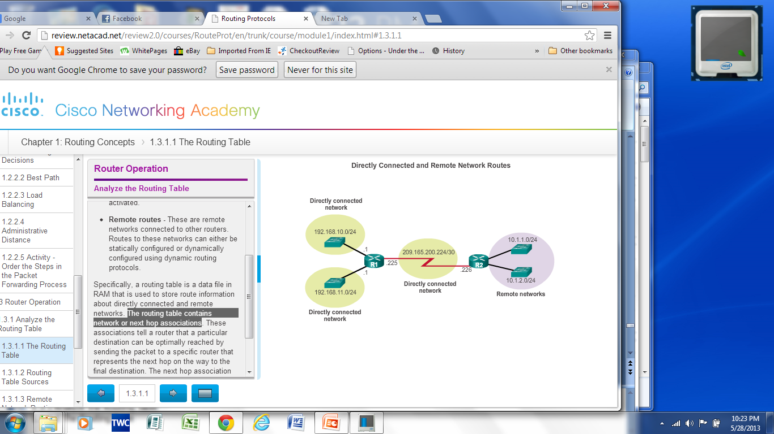
The Routing Table
Routing Table is a file stored in RAM that contains information about
  Directly connected networks
  Remote networks
  Network or next hop associations
What if there are many paths
to a remote network
Notes:
20
4.3 Router Operation
4.3.1 Analyze the Routing Table
4.3.1.1 The Routing Table

Slide 21

Routers Choose Best Paths
Routing table store the best path
  Determine the best path to send packets to remote networks
How a router learns about remote networks
and finds the best path
Routers use static routes and dynamic routing protocols to learn about remote networks and build their routing tables.
Notes:
21
Functions of a Router
4.1.1.5 Routers Choose Best Paths

Slide 22
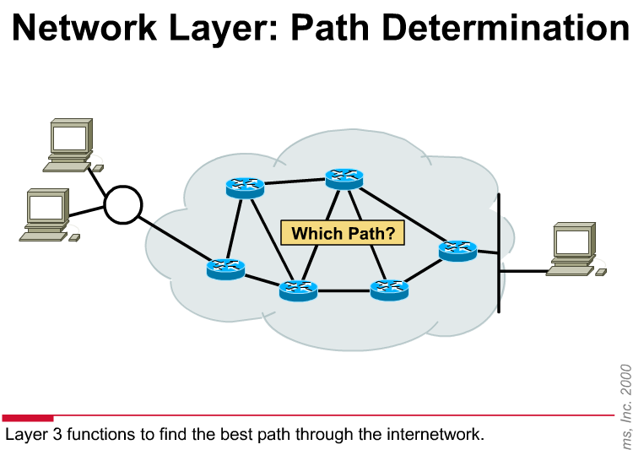
Best Path
Best path is selected by a routing protocol based on the values or metrics of paths.
A metric is the value used to measure the distance to a given network.
Best path to a network is the path with the lowest metric.
Notes:
22
4.2.2 Path Determination
4.2.2.2 Best Path

Slide 23
Best Path
Dynamic routing protocols use their own rules to assign metrics:
  Routing Information Protocol (RIP) - Hop count
  Open Shortest Path First (OSPF) - Cost based on cumulative bandwidth from source to destination
  Enhanced Interior Gateway Routing Protocol (EIGRP) - Bandwidth, delay, load, reliability

Slide 24
Load Balancing
When a router has two or more paths to a destination with equal cost metrics, then the router forwards the packets using both paths equally.
Notes:
24
4.2.2 Path Determination
4.2.2.3 Load Balancing

Slide 25
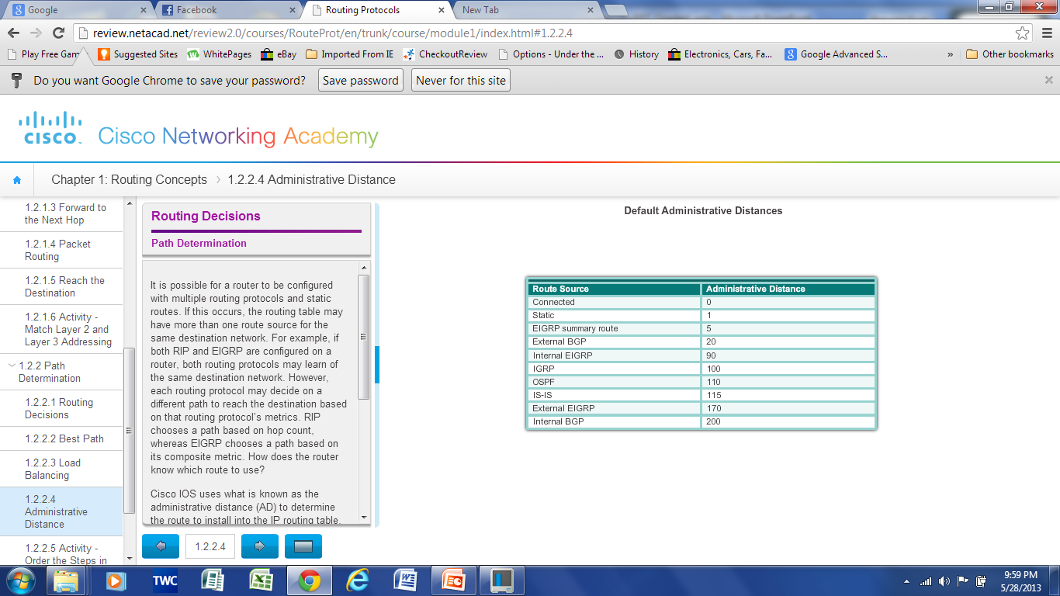
Administrative Distance
If multiple paths to a destination are configured on a router, the path installed in the routing table is the one with the best Administrative Distance (AD).
Administrative Distance is the “trustworthiness”
The Lower the AD the more trustworthy the route.
Notes:
25
4.2.2 Path Determination
4.2.2.4 Administrative Distance

Slide 26
The Routing Table
Routing Table Sources
show ip route command is used to display the contents of the routing table
  Local rote Interfaces –Added to the routing table when an interface is configured. (displayed in IOS 15 or newer)
  Directly connected interfaces -Added to the routing table when an interface is configured and active.
  Static routes - Added when a route is manually configured and the exit interface is active.
  Dynamic routing protocol - Added when EIGRP,OSPF, … are implemented and networks are identified.
Notes:
26
4.3 Router Operation
4.3.1 Analyze the Routing Table
4.3.1.2 Routing Table Sources

Slide 27
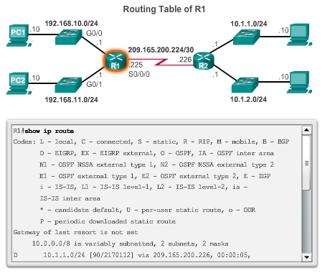
The Routing Table
Routing Table Sources
Notes:
27
4.3 Router Operation
4.3.1 Analyze the Routing Table
4.3.1.2 Routing Table Sources

Slide 28
IPv4 Router Routing Table
192.168.10.0/24
10.1.1.0/24
PC1
.10
G0/0
.1
209.165.200.224 /30
.10
.1
R1
.225
S0/0/0
.226
R2
.10
.1
G0/1
.1
.10
PC2
192.168.11.0/24
10.1.2.0/24
R1#show ip route
Codes: L - local, C - connected, S - static, R - RIP, M - mobile, B - BGP
D - EIGRP, EX - EIGRP external, O - OSPF, IA - OSPF inter area
N1 - OSPF NSSA external type 1, N2 - OSPF NSSA external type 2
E1 - OSPF external type 1, E2 - OSPF external type 2, E - EGP
i - IS-IS, L1 - IS-IS level-1, L2 - IS-IS level-2, ia - IS-IS inter area
* - candidate default, U - per-user static route, o - ODR
P - periodic downloaded static route
Gateway of last resort is not set
10.0.0.0/8 is variably subnetted, 2 subnets, 2 masks
D 10.1.1.0/24 [90/2170112] via 209.165.200.226, 00:00:05, Serial0/0/0
D 10.1.2.0/24 [90/2170112] via 209.165.200.226, 00:00:05, Serial0/0/0
192.168.10.0/24 is variably subnetted, 2 subnets, 3 masks
C 192.168.10.0/24 is directly connected, GigabitEthernet0/0
L 192.168.10.1/32 is directly connected, GigabitEthernet0/0
192.168.11.0/24 is variably subnetted, 2 subnets, 3 masks
C 192.168.11.0/24 is directly connected, GigabitEthernet0/1
L 192.168.11.1/32 is directly connected, GigabitEthernet0/1
209.165.200.0/24 is variably subnetted, 2 subnets, 3 masks
C 209.165.200.224/30 is directly connected, Serial0/0/0
L 209.165.200.225/32 is directly connected, Serial0/0/0
R1#
Notes:
6.2.2.2 IPv4 Router Routing Table

Slide 29
Router Routing Tables
Directly Connected Routing Table Entries
192.168.10.0/24
64.100.0.1
10.1.1.0/24
PC1
.10
G0/0
.1
209.165.200.224 /30
.10
.1
R1
.225
S0/0/0
.226
R2
.10
.1
G0/1
.1
.10
PC2
192.168.11.0/24
10.1.2.0/24
A
B
C
C 192.168.10.0/24 is directly connected, GigabitEthernet0/0
L 192.168.10.1/32 is directly connected, GigabitEthernet0/0
A | Identifies how the network was learned by the router.
B | Identifies the destination network and how it is connected.
C | Identifies the interface on the router connected to the destination network.
Notes:
6.2.2.3 Directly Connected Routing Table Entries

Slide 30
Router Routing Tables
Remote Network Routing Table Entries
192.168.10.0/24
64.100.0.1
10.1.1.0/24
PC1
.10
G0/0
.1
209.165.200.224 /30
.10
.1
R1
.225
S0/0/0
.226
R2
.10
.1
G0/1
.1
.10
PC2
192.168.11.0/24
10.1.2.0/24
D 10.1.1.0/24 [90/2170112] via 209.165.200.226, 00:00:05, Serial0/0/0
A | Identifies how the network was learned by the router.
B | Identifies the destination network.
C | Identifies the administrative distance (trustworthiness) of the route source.
D | Identifies the metric to reach the remote network.
E | Identifies the next hop IP address to reach the remote network.
F | Identifies the amount of elapsed time since the network was discovered.
G | Identifies the outgoing interface on the router to reach the destination network.
Notes:
6.2.2.4 Remote Network Routing Table Entries

Slide 31
Directly Connected Routes
Directly Connected Interfaces
A newly deployed router, without any configured interfaces, has an empty routing table.
RTA#show ip route
Codes: C - connected, S - static, I - IGRP, R - RIP, M - mobile, B - BGP
D - EIGRP, EX - EIGRP external, O - OSPF, IA - OSPF inter area
N1 - OSPF NSSA external type 1, N2 - OSPF NSSA external type 2
E1 - OSPF external type 1, E2 - OSPF external type 2, E - EGP
i - IS-IS, L1 - IS-IS level-1, L2 - IS-IS level-2, * - candidate default
U - per-user static route, o - ODR
Gateway of last resort is not set
RTA#
Currently, no routes in the routing table.

Slide 32
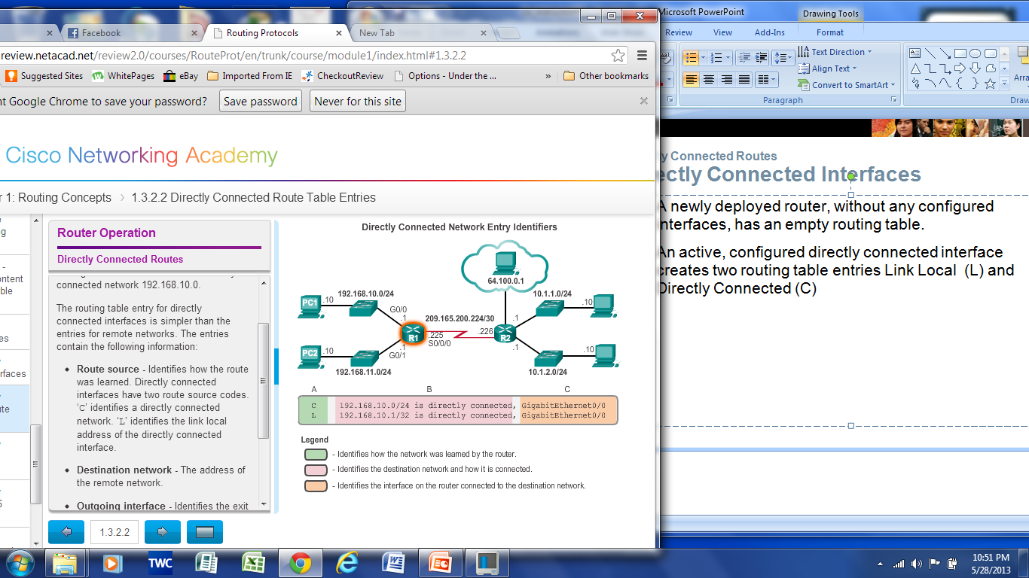
Directly Connected Routes
Directly Connected Interfaces
An active, configured directly connected interface creates two routing table entries Link Local (L) and Directly Connected (C)
4.3.2.2
Notes:
32
4.3 Router Operation
4.3.2 Directly Connected Routes
4.3.2.2 Directly Connected Route Table Entries

Slide 33
Directly Connected Networks and the IP Routing Table
RTA(config)#inter e 0
RTA(config-if)#ip add 192.168.2.1 255.255.255.0
RTA(config-if)#no shutdown
RTA#show ip route
Codes: C - connected,.. <Other codes and gateway information omitted>
C 192.168.2.0/24 is directly connected, Ethernet0
RTA#
Configuring an interface
Adding an ip address/mask to an interface tells the router that it is a member, “Directly Connected” to that network
Notice the route is shown with the subnet mask and the “exit-interface.”
Don’t forget the “no shutdown”
Don’t forget the interface must be in “up” and “up”

Slide 34
Directly Connected Networks and the IP Routing Table
RTA# debug ip routing
RTA(config)#inter e 0
RTA(config-if)#ip add 192.168.2.1 255.255.255.0
RTA(config-if)#no shutdown
00:28:56: RT: add 192.168.2.0/24 via 0.0.0.0, connected metric [0/0]
00:28:56: RT: interface Ethernet0 added to routing table
RTA#show ip route
Codes: C - connected,.. <Other codes and gateway information omitted>
C 192.168.2.0/24 is directly connected, Ethernet0
RTA# undebug all
Viewing the Routing Table Process
Use the “debug ip routing” command to view the Cisco IOS routing table process of adding a directly connected network to the routing table.
When finished, be sure to use “undebug all”
Debug commands are used to view detailed information about Cisco IOS processes – more later.

Slide 35
Directly Connected Networks and the IP Routing Table
RTA# debug ip routing
RTA(config)#inter e 0
RTA(config-if)#shutdown
00:34:38: RT: interface Ethernet0 removed from routing table
00:34:38: RT: del 192.168.2.0 via 0.0.0.0, connected metric [0/0]
00:34:38: RT: delete network route to 192.168.2.0
RTA#show ip route
Codes: C - connected,.. <Other codes and gateway information omitted>
RTA# undebug all
Viewing the Routing Table Process
Directly connected routes will also be removed if the link goes down.
Directly connected routes will only be in the routing table if, it is not administratively down, the line is “up” and protocol is “up”
For serial interfaces, don’t forget the “clock rate” command on the router with the DCE cable – neither interface will be “up” and “up” until both ends are configured correctly.

Slide 36
Directly Connected Networks and the IP Routing Table
RTA#show ip route
Codes: C - connected,.. <Other codes and gateway information omitted>
C 172.16.0.0/16 is directly connected, Serial0
C 192.168.2.0/24 is directly connected, Ethernet0
RTB#show ip route
Codes: C - connected,.. <Other codes and gateway information omitted>
C 172.16.0.0/16 is directly connected, Serial0
C 192.168.1.0/24 is directly connected, Serial1
RTC#show ip route
Codes: C - connected,.. <Other codes and gateway information omitted>
C 10.0.0.0/8 is directly connected, Ethernet0
C 192.168.1.0/24 is directly connected, Serial1
The Routing Tables
Notice that the routers only know about their own directly connected networks.
They are not sharing routing information because we have not configured any static routes or dynamic routing protocols.

Slide 37
Directly Connected Networks and the IP Routing Table
RTA#show ip route
C 172.16.0.0/16 is directly connected, Serial0
C 192.168.2.0/24 is directly connected, Ethernet0
RTA#ping 172.16.0.1
Sending 5, 100-byte ICMP Echos to 172.16.0.1, timeout is 2 seconds:
!!!!!
Success rate is 100 percent (5/5), round-trip min/avg/max = 56/57/60 ms
RTA#ping 172.16.0.2
!!!!!
RTA#ping 192.168.1.1
.....
RTA#ping 192.168.1.2
.....
RTA#ping 10.1.0.1
.....
Routing – Only directly connected hosts (routers)
Routers can only reach networks known about in its own routing table.

Slide 38
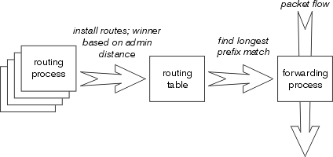
Routing and Forwarding Outline

Slide 39
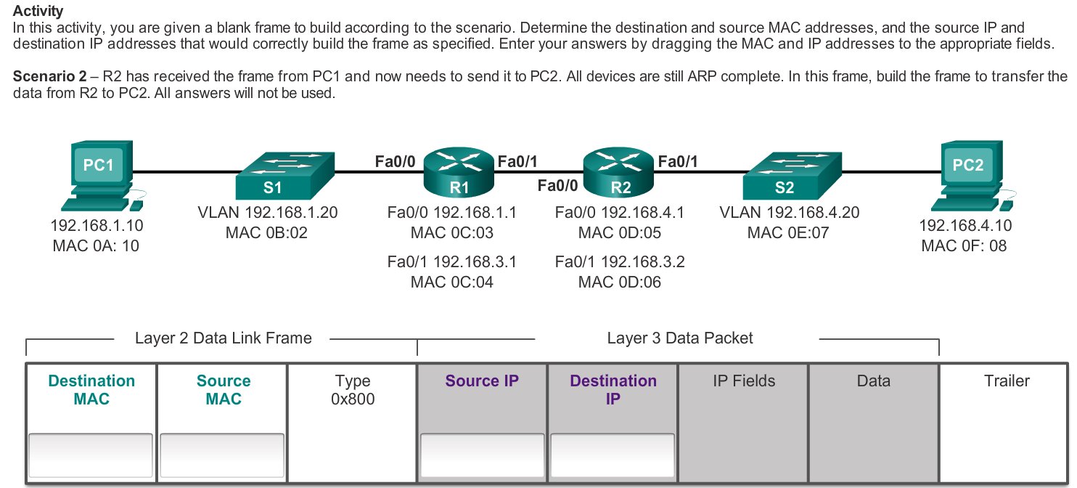

Slide 40
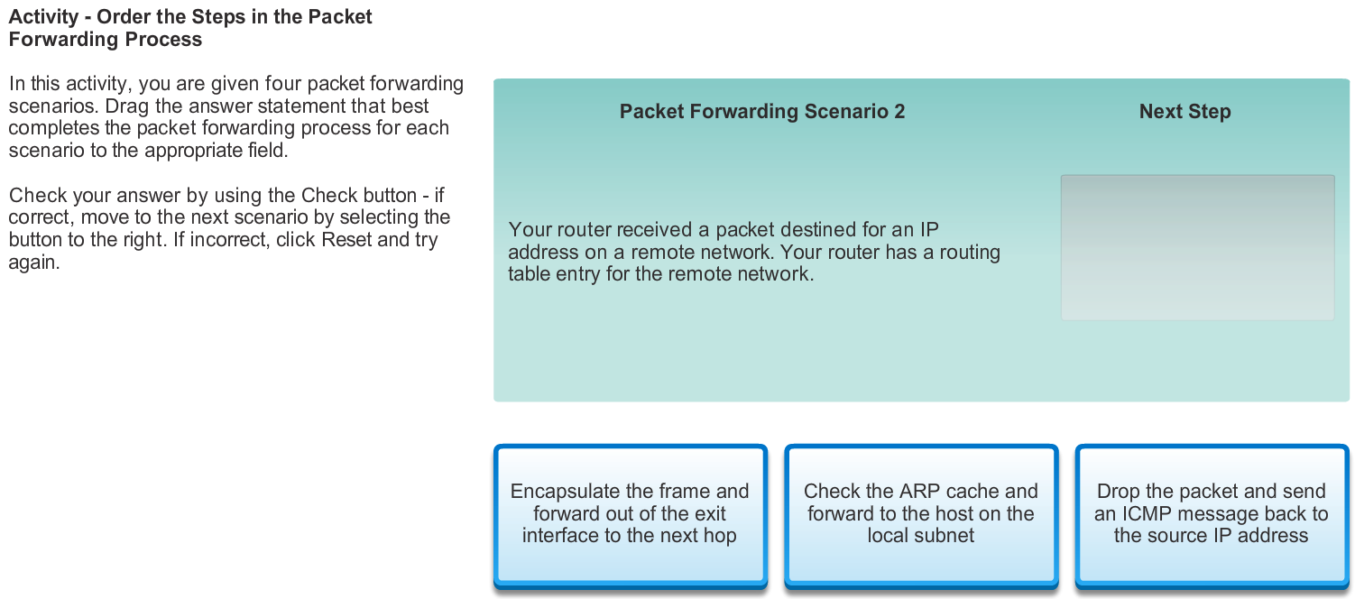

Slide 41
Configuring router serial interfaces

Slide 42
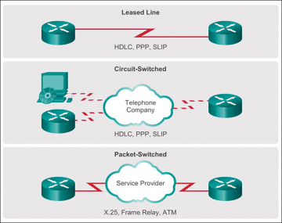
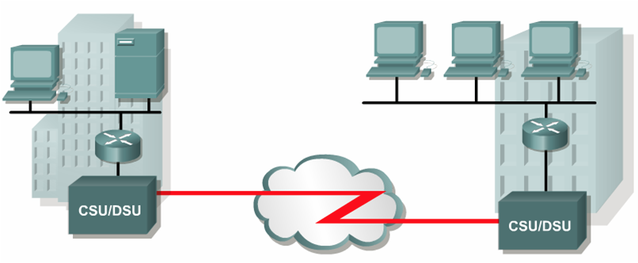
Point-to-point WAN link
The simplest type of WAN link, also called a leased line or leased circuit.
Point-to-point link uses
synchronous serial lines
Notes:
Serial transmission means that the bits of a frame are transmitted one at a time over the physical medium.
In WANs, the serial connections are preferred because
Serial cables can be longer than parallel cables.
Synchronization easier than parallel connections.
Simpler wiring and less cost .
lightning-bolt line between R1 and R2, meaning that a point-to-point WAN link exists
the simplest type of WAN link, called a point-to-point WAN link . A point-to-point WAN link, also called a leased line , leased circuit, or WAN link, connects two devices over a WAN. Leased lines give the devices on each end (typically routers) the ability to send data to each other at the same time. Leased lines are also permanently installed, meaning that the devices can send data to each other at any time.
The definitions of DCE and DTE both bring up the topic of clocking , which is also known as synchronization . The serial links used between two routers typically use synchronous communication, which means that both routers on the ends of the leased line must use the exact same speed for sending and receiving bits. Building hardware that uses the exact same speed is expensive, because creating clocks that run at the exact same speed is expensive.
With WAN links, the clocks need to match exactly, so the two routers synchronize their clocks continually to make sure their clocks run at the same speed.
To synchronize the clocks on the serial interfaces of both routers on the ends of a serial link, a couple of things must happen

Slide 43
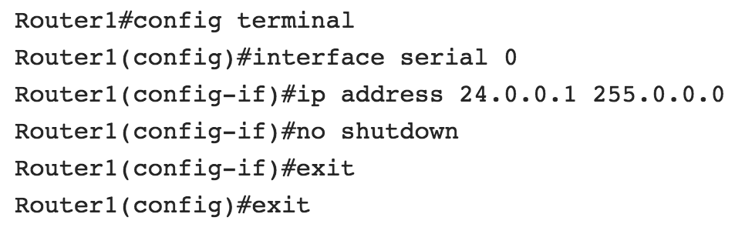
Configuring Serial Interface
The basic configuration of a serial connection is no different than the other types of interfaces

Slide 44
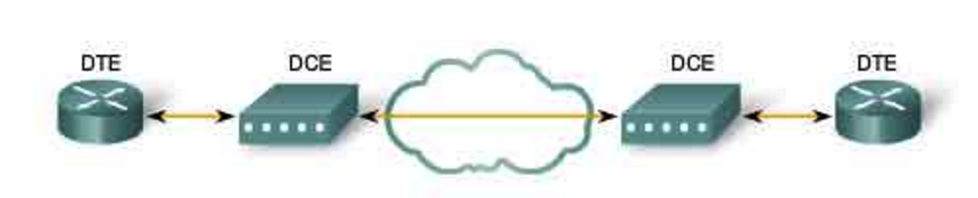
Synchronous Communication
The serial links used between two routers typically use synchronous communication
  both routers on the ends of the leased line must use the exact same speed for sending and receiving bits.
Serial interfaces will usually be attached to a CSU/DSU type of device that provides clocking for the line.
Clocking typically provided by DCEs to routers.
Notes:
Two routers can be made to think they have a leased line between them—without having an actual leased line from the telco—as long as the routers sit relatively close to each other. For example, when building a lab to use for this course, the routers typically sit in the same room. To install the equivalent of a WAN leased line between two routers’ serial interfaces, without having to pay any money to a telco, you can follow these steps
Serial interfaces will usually be attached to a CSU/DSU type of device that provides clocking for the line.
But if you have a back-to-back configuration (for example, one that’s used in a lab/classroom environment), on one end—the data communication equipment (DCE) end of the cable—must provide clocking.

Slide 45
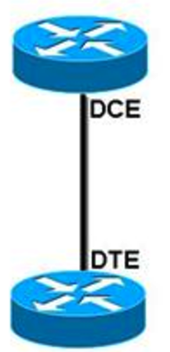
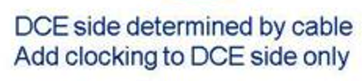
Synchronous Communication
In the lab, to synchronize the clocks on the serial interfaces of both routers on the ends of a serial link, one end must provide clocking.
Notes:
But if you have a back-to-back configuration (for example, one that’s used in a lab/classroom environment), on one end—the data communication equipment (DCE) end of the cable—must provide clocking.

Slide 46
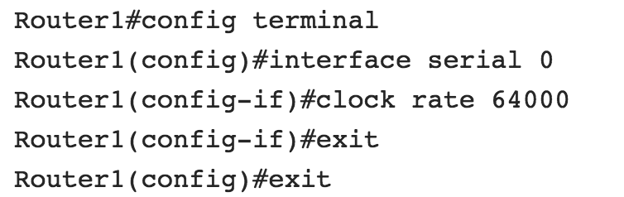
Setting the Clock Rate
The clock speed controls the speed at which data is sent over the connection in bits per second (bps).
Enable clocking on the router that is connected to the DCE cable
Notes:
By default, Cisco routers are all data terminal equipment (DTE) devices, so you must tell an interface to provide clocking if you need it to act like a DCE device. You configure a DCE serial interface with the clock rate command.
The DCE sets and controls the clock speed. So, in the case of a link from a service provider, the provider sets the clock speed, and when you connect to the external CSU/DSU, your serial port accepts the configuration.
In the case of a back-to-back cable, one of the routers plays the role of the DCE, and that device sets the clock speed for the connection. If you are implementing the same type of layout in a lab, check the cable and identify the DCE side of the cable
For two serial interfaces to communicate, you must provide the clock rate. The clock rate provides bit synchronization and has other uses that are beyond the scope of this chapter's purposes. The device that provides this clock rate is the data circuit-terminating equipment (DCE). The other device is denoted as the data terminal equipment (DTE). In the real world, the router is the DTE. The telecom equipment, such as the Frame Relay switch, is the DCE. Because the lab scenario bypasses the telecom equipment, you need to specify which router is the DTE and which one is the DCE; you also need to provide the clock rate. To bypass the telecom equipment, you need to directly connect the routers with a DTE–DCE crossover cable. Each end of this cable is labeled as DTE or DCE. Whichever router is plugged into the DCE end of the cable will need to provide the clock rate.

Slide 47
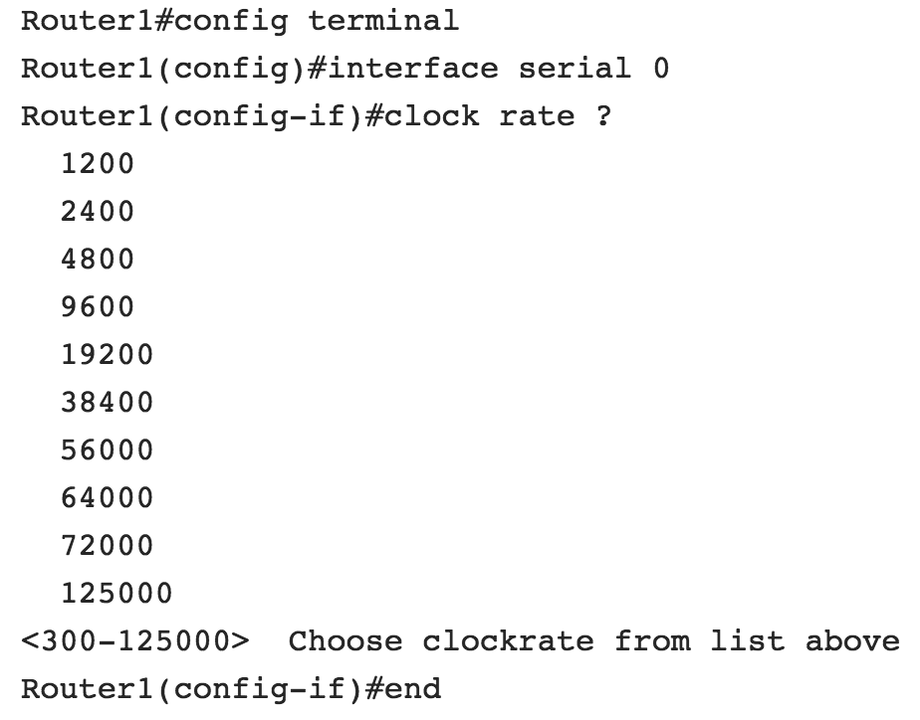
Setting the Clock Rate
To find the clock rates that are available on a router

Slide 48
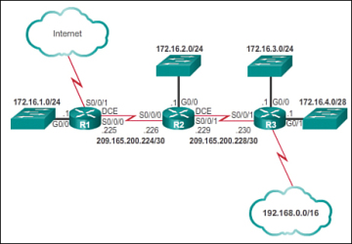
Let’s Build a Following Network

