Slide 1
SWE 434
SOFTWARE TESTING AND VALIDATION
LAB3 – JUNIT
1

Slide 2
LAB AGENDA
More Examples and Practice
2

Slide 3
UNIT TESTING
Required Input and Expected Output.
Input
Output
Unit
3

Slide 4
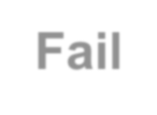
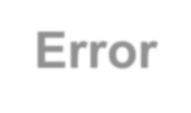
TEST CASE VERDICT
A verdict is the declared result of executing a single test.
We can get the verdict after the assertion statement
Pass: the test case achieved its intended purpose, and the
software under test performed as expected.
Fail: the test case achieved its intended purpose, but the software under test did not perform as expected.
Error: the test case did not achieve its intended purpose.
Potential reasons:
An unexpected event occurred during the test case. The test case could not be set up properly
4

Slide 5
JUNIT METHODS
assertArrayEquals()
Test whether two arrays are equal to each other. In other words, if the two arrays contain the same number of elements, and if all the elements in the array are equal to each other.
assertTrue() + assertFalse()
The assertTrue() and assertFalse() methods tests a single expression to see if its value is either true, or false.
assertNull() + assertNotNull()
The assertNull() and assertNotNull() methods test a single variable to see if it is null or not null
5

Slide 6
EXAMPLE
6

Slide 7
EXCEPTION IN JUNIT
Add parameter to @Test annotation, indicating that a particular class
of exception is expected to occur during the test
Useful for simple cases, but it has its limits:
you can't test the value of the message in the exception, or the
state of a domain object after the exception has been thrown.
7

Slide 8
EXCEPTION IN JUNIT
Catch exception, and use fail( ) if not thrown:
Try{
MethodToBeTested() fail(“Message”)
}
Catch(ExceptionType E){
}
8

Slide 9
EXAMPLE
9

Slide 10
SETUP AND TEARDOWN
For a collection of tests for a particular class, there are often some repeated tasks that must be done prior to each test case or after the end of each use cases:
Set up connection
Database
Clean up
Reset data
Ensures resources are released, test system is in known state for next test case, etc.
Since a test case failure ends execution of a test method at that
point, code to clean up cannot be at the end of the method.
10

Slide 11
SETUP AND TEARDOWN
Setup:
Use the @Before annotation on a method containing code to run before each test case.
Teardown:
Use the @After annotation on a method containing code to run
after each test case.
These methods will run even if exceptions are thrown in the test case or an assertion fails.
11

Slide 12
SETUP AND TEARDOWN ONCE
Setup Once:
Use the @BeforeClass to run a method once only for the entire test class, before any of the tests are executed, and prior to any
@Before method(s)
Teardown Once:
Use the @AfterClass annotation to run after all test case methods
in the class have been executed, and after any @After methods
Useful for starting servers, opening communications, etc. that are
time-consuming to close and re-open for each test.
12

Slide 13
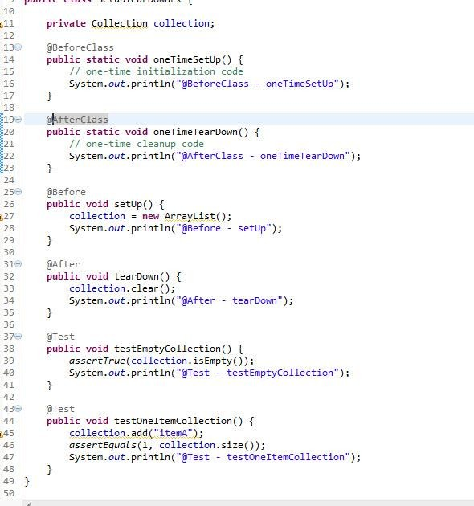
SETUP AND TEARDOWN
13

