Slide 1
Routers and Router Configuration
2nd semester 1436-1437

Slide 2
Routers Outline
What is a router
Router and OSI model
Physical Components of a Router
Router Functions

Slide 3
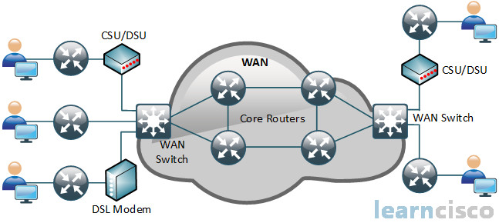
Introduction
Routers are one of the most vital components of any WAN.
Notes:
WANs are constructed of numerous different technologies, including routers, transmission facilities, and line drivers. It is the router’s capability to interconnect networks in a WAN that has made it indispensable.

Slide 4
The purpose of routers
Routers are intelligent network devices designed to interconnect multiple networks.
So, computers on different networks can communicate with each other.
Interconnected networks can be co-located or geographically dispersed.
Networks that are geographically dispersed are usually interconnected via a WAN.
Notes:
M*
different networks → network address , network types…

Slide 5
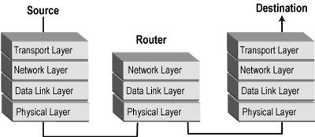
Router and OSI model
A router operates predominantly at the first three layers of the OSI reference model to.
Layer 1, 2, and 3 standards and protocols
Notes:
Routers must use OSI Layer 1, 2, and 3 standards and protocols to perform one of the most basic functions of routers
Communication across the first two layers allows routers to communicate directly with LANs (data link layer constructs).
More importantly, routers can identify routes through networks based on Layer 3 addresses. This enables routers to internetwork multiple networks by using network layer addressing, regardless of how near or far they might be relative to each other.

Slide 6
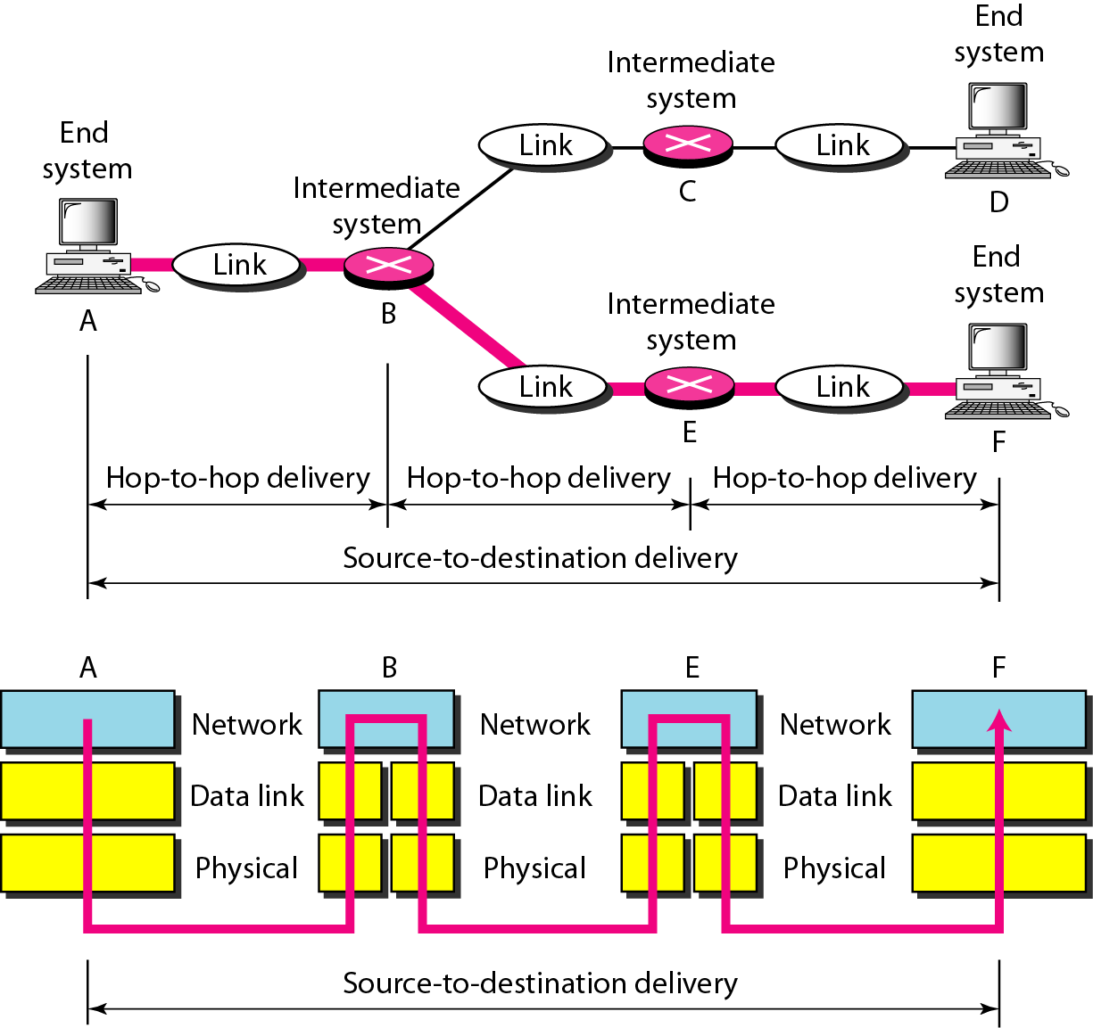
Router and OSI model
Notes:
Routers must use OSI Layer 1, 2, and 3 standards and protocols to perform one of the most basic functions of routers
Communication across the first two layers allows routers to communicate directly with LANs (data link layer constructs).
More importantly, routers can identify routes through networks based on Layer 3 addresses. This enables routers to internetwork multiple networks by using network layer addressing, regardless of how near or far they might be relative to each other.

Slide 7
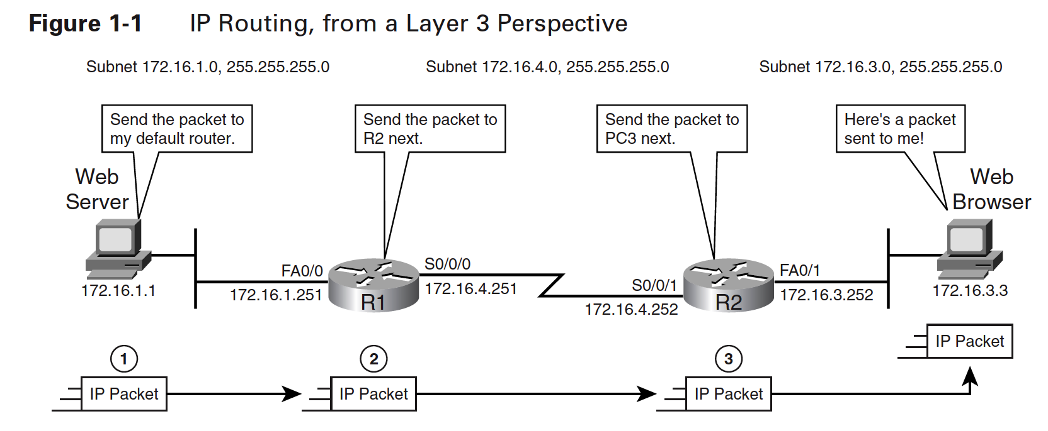
Router and OSI model
Notes:
From the perspective of the OSI network layer—Layer 3—hosts (computers) and routers work together to deliver packets from one host to another. To do so, the host that creates the packet sends the packet to a nearby router. That router might send the packet to a second router, with that second router forwarding the packet to a third router, and so on, until the packet is delivered
to a router that is connected to the same LAN as the destination computer. That last router then sends the packet to the final destination. Figure 1-1 shows just such an example, with the
web server on the left sending a packet back to the PC on the right.
This description focuses on the OSI Layer 3 (network layer) details of how hosts and routers forward packets in an IP network. However, both the hosts and the routers must also be aware of how to use Layer 1 and Layer 2 standards and protocols to send the packets over the various
types of physical networks.

Slide 8
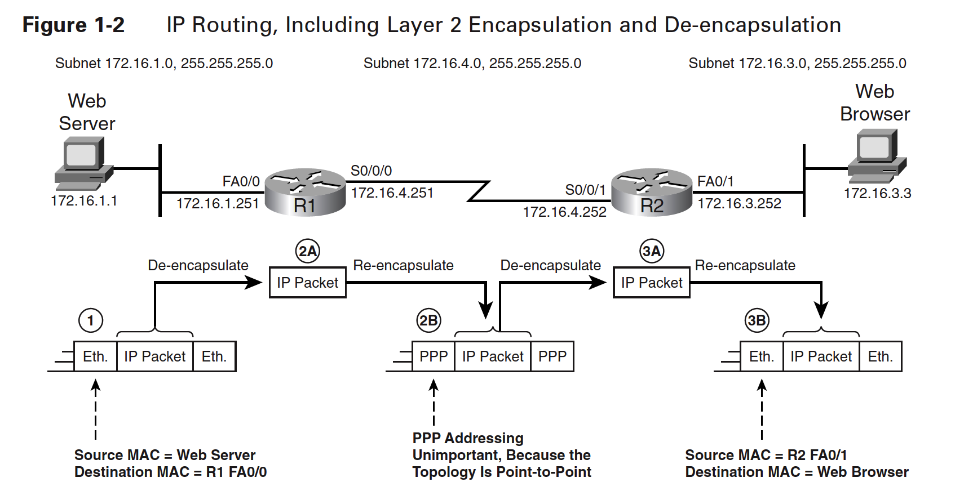
Router and OSI model
Notes:
For example, Figure 1-2 and the descriptions that follow it explain some of the Layer 2 details of the process. Specifically, the example shows the data-link headers and trailers, along with the encapsulation process.
Figure 1-2 focuses on how the hosts and routers need to encapsulate the packet before sending anything over the LAN and WAN links. Hosts and routers must use data-link protocols, such as Ethernet on the LAN and Point-to-Point Protocol (PPP) on WAN links, to forward the packets over the physical links. To use the data links, a router encapsulates the packet into a data-link
frame by putting the packet between a data-link header and trailer. The receiving router removes, or de-encapsulates, the packet.

Slide 9
Router
Understanding routers and routing requires examining a router from two different perspectives:
Together, these physical components and logical functions enable to build and use internetworks, including WANs
physical
logical

Slide 10
Physical Components of a Router
Routers are specialized computers containing the following required components to operate:
Ports and Interfaces
Central processing unit (CPU): Executes operating system instructions
Memory : temporarily and permanently store data to execute operating system instructions, such as system initialization and routing functions.
Notes:
Routers contain many parts, each of which has a specific function
Reference
http://www.ciscopress.com/articles/article.asp?p=2180208&seqNum=4

Slide 11
Router Interfaces and Ports
Routers have specialized ports and network interface cards to interconnect devices to other networks
When talking about routers, the term
interface → refers to physical connectors used for the purpose of forwarding packets.
port → to a physical connector used for managing and controlling a router.
Notes:
References
CHAPTER 1 WANs and Routers

Slide 12
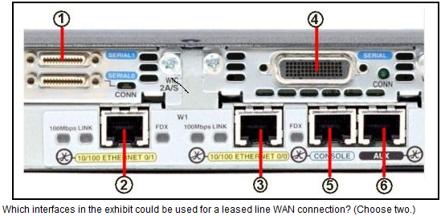
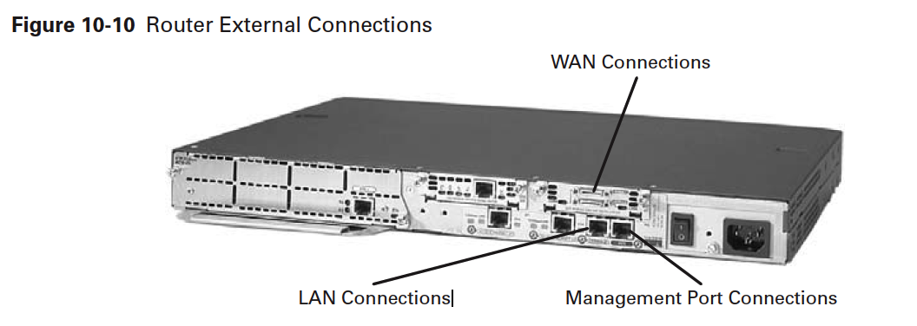
Notes:
LAN interfaces allow the router to connect to the LAN media, which is usually some form of Ethernet. However, it could be some other LAN technology such as Token Ring or ATM.
WAN connections provide connections through a service provider to a distant site or to the Internet. These connections can be serial connections or any number of other WAN interfaces. With some types of WAN interfaces, an external device such as a CSU is required to connect the router to the service provider’s local connection. With other types of WAN connections, the router might be directly connected to the service provider.
The function of management ports is different from that of the other connections. The LAN and WAN connections provide network connections through which frame packets are passed. The management port provides a text-based connection for the configuration and troubleshooting of the router. The common management interfaces are the console and auxilliary ports.

Slide 13
Router Interfaces
These interfaces consist of a socket or jack into which a cable can be easily connected.
Router interfaces : LAN interfaces and WAN interfaces.
LAN interfaces allow the router to connect to the LAN media ( usually Ethernet, Token Ring or ATM).
WAN connections provide connections through a service provider to a distant site or to the Internet (synchronous and asynchronous serial WICs, ISDN BRI WICs, DSL WICs, and Analog Modem WICs).
Notes:
Routers support a wide variety of different types of interfaces because routers need to be able to forward packets over many kinds of physical networks. For example, some routers may have serial interfaces, DSL interfaces, ISDN, cable TV, or other types of WAN interfaces

Slide 14
Router Ports
The management port provides a text-based connection for the configuration and troubleshooting of the router.
Most routers have two management ports:
the console port
the auxiliary port (aux port) . (Some routers do not have aux ports.)
Both ports are meant to allow a terminal, or more likely a PC with a terminal emulator , to log in to the router to issue commands on the router.
These commands may be used to
to configure the router to tell it how to act.
troubleshoot problems or
Notes:
The computer will run a terminal emulation program to provide a text-based session with the router. Through this session the network administrator can manage the device.

Slide 15
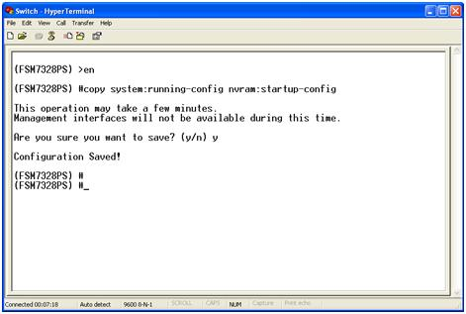
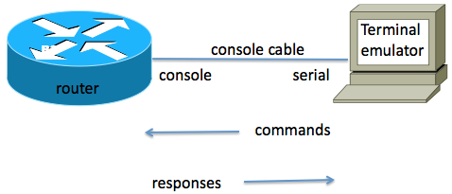
Router Ports
A terminal → a simple device with a display screen and a keyboard, but a terminal is not a PC.
A terminal emulator → software that acts like a terminal
Notes:
Terminals are simple devices that connect to a computer via a cable. The person using the terminal can type on the keyboard, and the terminal sends the text to the computer. The computer responds to what was typed—typically a
command to tell the computer to do something—by sending some text back to the terminal screen so the person knows the results of the command.
Terminal emulator software creates a window on the screen of a PC. When you use that window, any text you type on the keyboard (typically a command) is displayed in the window and sent to some other computer, such as a router. The other computer then executes the command and sends some text messages back to the terminal emulator.

Slide 16
Configuration Files
The network administrator must configure each interface via the router’s console.
Configuration includes:
defining the interface’s address,
the types of protocols that will be used through that interface.
the specific transmission technology
bandwidth available on the network connected to that interface,
The actual parameters that must be defined vary based on the type of network interface.
Notes:
As soon as a router interface is configured, it can be activated. The interface’s configuration identifies the type of transmission facility that it connects to, the interface’s IP address, and the address of the network that it connects to. Upon activation of a port, the router immediately begins monitoring all the packets that are being transmitted on the network attached to the newly activated port. This monitoring allows it to “learn” about network and host IP addresses that reside on the networks that can be reached via that port. These addresses are stored in tables called routing tables. Routing tables correlate the port number of each interface in the router with the network layer addresses that can be reached (either directly or indirectly) via that port.

Slide 17
IOS
Cisco IOS is a Software to run configuration files.
configuration files contain the instructions and parameters that control the flow of traffic in and out of the routers.
The configuration file specifies all the information the router needs to make these decisions.
Notes:
Specifically, by using routing protocols to direct routed protocols and routing tables, routers make decisions regarding the best path for packets.

Slide 18
Router Memories

Slide 19
Router Memories
Routers store data using
Random Access Memory (RAM):
Provides temporary storage for various applications and processes, including:
the running IOS,
the running configuration file,
various tables (i.e., IP routing table, Ethernet ARP table),
and buffers for packet processing.
RAM is referred to as volatile because it loses its contents when power is turned off.

Slide 20
Router Memories
Read-Only Memory (ROM):
Provides permanent storage for
bootup instructions,
basic diagnostic software,
and a limited IOS in case the router cannot load the full featured IOS.
ROM is firmware and referred to as non-volatile because it does not lose its contents when power is turned off.

Slide 21
Router Memories
Non-Volatile Random Access Memory (NVRAM):
Provides permanent storage for the startup configuration file (startup-config).
NVRAM is non-volatile and does not lose its contents when power is turned off.
Flash:
Provides permanent storage for the IOS and other system-related files.
The IOS is copied from flash into RAM during the bootup process.
Flash is non-volatile and does not lose its contents when power is turned off.

Slide 22
Router Functions
Routers perform many functions, some of them:
The selection of best paths for incoming data packets
The switching of packets to the proper outgoing interface
Routers accomplish these functions by building routing tables and exchanging the network information contained within them with other routers.
finding other routers in the network,
learning about potential destination networks and hosts,
discovering and tracking potential routes
Notes:
The logical functions that a router performs are just as important as providing physical interconnectivity
for multiple networks. These functions make the physical interconnections usable.
For example, internetworked communications require that at least one physical path interconnect
the source and destination machines. However, having and using a physical path are two
very different things. Specifically, the source and destination machines must speak a common
language (a routed protocol). It also helps if the routers that lie between them also speak a
common language (a routing protocol) and agree on which specific physical path is the best
one to use.

Slide 23
To sum up
Therefore, some of the more salient functions that a router provides are
Physical interconnectivity
Logical interconnectivity
Route calculation and maintenance
Security

Slide 24
Router Configurations

Slide 25
Outline
Accessing a router for configuration
Command-Line Interface (CLI)
IOS CLI modes
Some Router Configurations

Slide 26
Getting Access to the Router
Most common methods to access the CLI:
Console port
Telnet or SSH
AUX port
Next slide

Slide 27
Command-Line Interface
CLI is the command-line interface of the IOS.
CLI is the primary interface used to configure, manage, and troubleshoot Cisco devices.
It can be accessed through a console, modem, or Telnet connection.
Access by any of these methods is generally referred to as an EXEC session
Notes:
CLI is the acronym used by Cisco to denote the command-line interface of the IOS.
This user interface enables you to directly execute IOS commands, and it can be accessed through a console, modem, or Telnet connection.
Ref
http://www.informit.com/library/content.aspx?b=CCNA_Practical_Studies&seqNum=11

Slide 28
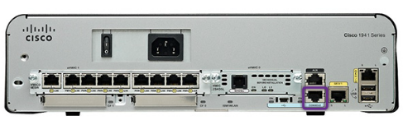
Console Access Method
Console Port
Device is accessible even if no networking services have been configured (out-of-band access)
Need a special console cable
Allows configuration commands to be entered
Should be configured with passwords to prevent unauthorized access
Device should be located in a secure room so console port cannot be easily accessed
Notes:
2.1.2.1 Console Access Method
Out-of-band access refers to access via a dedicated management channel that is used for device maintenance purposes only.
Console
The console port is a management port that provides out-of-band access to Cisco device. Out-of-band access refers to access via a dedicated management channel that is used for device maintenance purposes only. The advantage of using a console port is that the device is accessible even if no networking services have been configured, such as when performing an initial configuration of the networking device. When performing an initial configuration, a computer running terminal emulation software is connected to the console port of the device using a special cable. Configuration commands for setting up the switch or router can be entered on the connected computer.
The console port can also be used when the networking services have failed and remote access of the Cisco IOS device is not possible. If this occurs, a connection to the console can enable a computer to determine the status of the device. By default, the console conveys the device startup, debugging, and error messages. After the network technician is connected to the device, the network technician can perform any configuration commands necessary using the console session.
For many IOS devices, console access does not require any form of security, by default. However, the console should be configured with passwords to prevent unauthorized device access. In the event that a password is lost, there is a special set of procedures for bypassing the password and accessing the device. The device should also be located in a locked room or equipment rack to prevent unauthorized physical access.
In the event that a password is lost, there is a special set of procedures for bypassing the password and accessing the device.

Slide 29
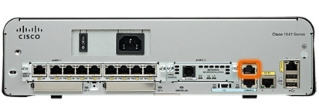
Telnet, SSH, and AUX Access Methods
Telnet
Method for remotely accessing the CLI over a network
Require active networking services and one active interface that is configured
Secure Shell (SSH)
Remote login similar to Telnet, but utilizes more security
Stronger password authentication
Uses encryption when transporting data
Aux Port
Out-of-band connection
Uses telephone line
Can be used like console port
Notes:
2.1.2.2 Telnet, SSH, and AUX Access Methods

Slide 30
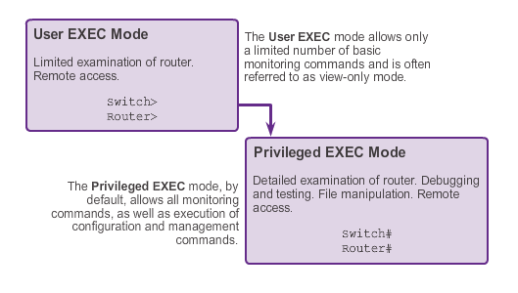
Primary Modes
Two different EXEC sessions exist:
User EXEC level
Privileged EXEC level.
Each level provides a different amount of access to the commands within the IOS.
Notes:
User EXEC provides access to a limited number of commands that allow basic troubleshooting and monitoring of the router.
Privileged EXEC level allows access to all router commands, such as configuration and management settings.
Password protection to the privileged EXEC level is highly recommended to prevent unauthorized configuration changes from being made to the router.
2.1.3.2 Primary Modes
The two primary modes of operation are user EXEC mode and privileged EXEC mode. the privileged EXEC mode has a higher level of authority in what it allows the user to do with the device.
User EXEC Mode
The user EXEC mode has limited capabilities but is useful for some basic operations. This mode is the first mode encountered upon entrance into the CLI of an IOS device.
This is often referred to as view-only mode. The user EXEC level does not allow the execution of any commands that might change the configuration of the device.
By default, there is no authentication required to access the user EXEC mode from the console. However, it is a good practice to ensure that authentication is configured during the initial configuration.
The user EXEC mode is identified by the CLI prompt that ends with the > symbol. This is an example that shows the > symbol in the prompt: Switch>
Privileged EXEC Mode
The execution of configuration and management commands requires that the network administrator use the privileged EXEC mode, or a more specific mode in the hierarchy.
The privileged EXEC mode can be identified by the prompt ending with the #symbol. Switch#
By default, privileged EXEC mode does not require authentication.
Global configuration mode and all other more specific configuration modes can only be reached from the privileged EXEC mode.
Upon initiating an EXEC session on the router, a user is placed in user EXEC mode. This is denoted in the router with the > prompt
To change to the privileged EXEC level, type in the command enable

Slide 31
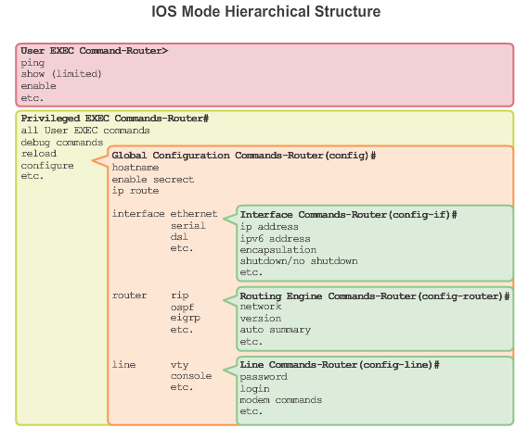
Cisco IOS Modes of Operation
Cisco IOS software is structured in a hierarchical manner
Privileged EXEC mode is composed of various configuration modes:
Global configuration mode
Interface configuration mode
Router configuration mode
Line configuration mode
Notes:
It is important to understand this structure to successfully navigate within Cisco IOS software.
As mentioned previously, there are two EXEC modes: user EXEC and privileged EXEC.
2.1.3.1 Cisco IOS Modes of Operations
In hierarchical order from most basic to most specialized, the major modes are:
User executive (User EXEC) mode
Privileged executive (Privileged EXEC) mode
Global configuration mode
Other specific configuration modes, such as Interface configuration mode.
Each mode has a distinctive prompt

Slide 32
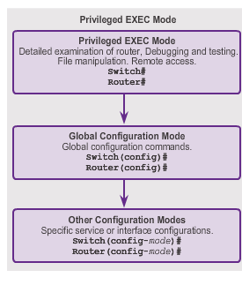
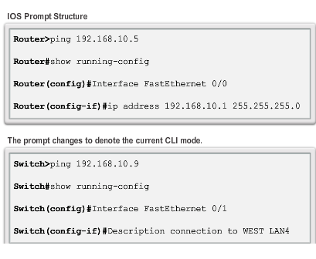
Global Configuration Mode and Submodes
Notes:
2.1.3.3 Global Configuration Mode and Submodes
Global configuration mode and interface configuration modes can only be reached from the privileged EXEC mode.
From global config, CLI configuration changes are made that affect the operation of the device as a whole.
Switch# configure terminal
Switch(config)#
From the global config mode, the user can enter different subconfiguration modes. Each of these modes allows the configuration of a particular part or function of the IOS device.
Interface mode - to configure one of the network interfaces (Fa0/0, S0/0/0)
Line mode - to configure one of the physical or virtual lines (console, AUX, VTY)
To exit a specific configuration mode and return to global configuration mode, enter exit at a prompt. To leave configuration mode completely and return to privileged EXEC mode, enter end or use the key sequence Ctrl-Z.
As commands are used and modes are changed, the prompt changes to reflect the current context.
Within each mode, certain commands are available for execution. Using the context-sensitive help, you can see a list of which commands are available. While navigating the CLI, the router prompt changes to reflect your current position within the CLI hierarchy. Table 2-2 summarizes the main command prompts within the CLI hierarchy.

Slide 33
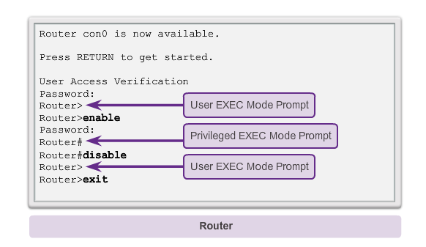
Navigating Between IOS Modes
Notes:
2.1.3.4 Navigating between IOS Modes
The enable and disable commands are used to change the CLI between the user EXEC mode and the privileged EXEC mode, respectively.

Slide 34
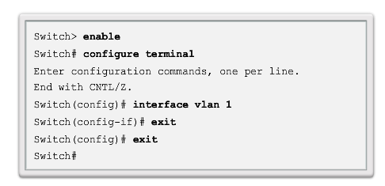
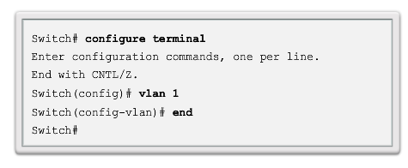
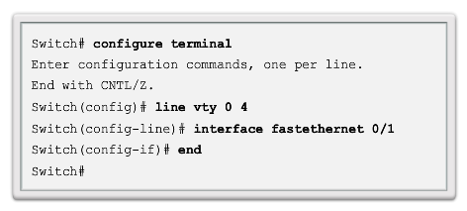
Navigating Between IOS Modes (cont.)
Notes:
2.1.3.5 Navigating between IOS Modes (cont.)
To move from the global configuration mode to the privileged EXEC mode, you enter the command exit.
To move from any submode of the global configuration mode to the mode one step above it in the hierarchy of modes, enter the exit command.
To move from any submode of the privileged EXEC mode to the privileged EXEC mode, enter the end command or enter the key combination Ctrl+Z.
To move from any submode of the global configuration mode to another “immediate” submode of the global configuration mode, simply enter the corresponding command that is normally entered from global configuration mode

Slide 36
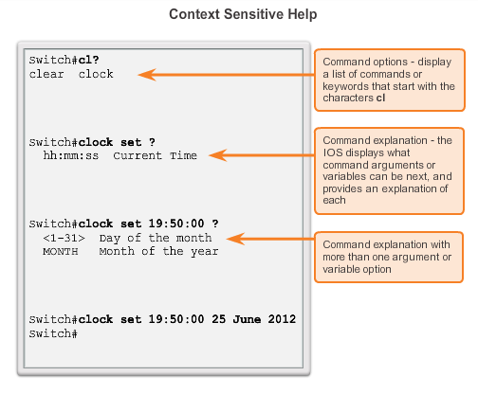
Context-Sensitive Help
Notes:
2.1.4.3 Context Sensitive Help
The IOS has several forms of help available:
Context-sensitive help
Command Syntax Check
Hot Keys and Shortcuts

Slide 37
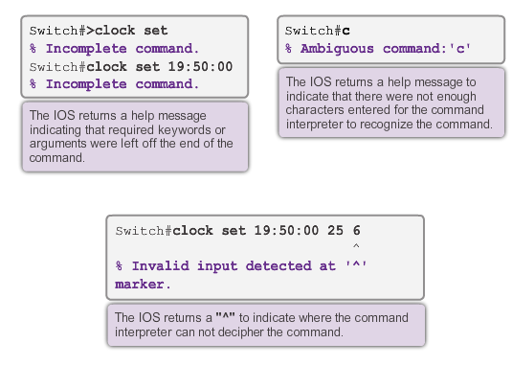
Command Syntax Check
Notes:
2.1.4.4 Command Syntax Check
There are three different types of error messages:
Ambiguous command
Incomplete command
Incorrect command

Slide 38
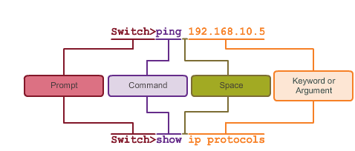
IOS Command Structure
Notes:
2.1.4.1 IOS Command Structure
Each IOS command has a specific format or syntax and can only be executed at the appropriate mode.
The commands are not case-sensitive. Following the command are one or more keywords and arguments.
Unlike a keyword, an argument is generally not a predefined word. An argument is a value or variable defined by the user
Switch> ping IP address
Switch> ping 10.10.10.5
The command is ping and the user defined argument is the 10.10.10.5.
Similarly, the syntax for entering thetraceroute command is:
Switch> traceroute IP address
Switch> traceroute 192.168.254.254
The command is traceroute and the user defined argument is the 192.168.254.254.

Slide 39
Some Router Configurations
Configuring hostname
Disabling DNS Lookup
Banner message
Limiting Access to Device Configurations
Encrypting Password Display
Saving running configuration Files
Enable IP on a Host, a Switch, a Router Interface
Verify Interface Settings

Slide 40
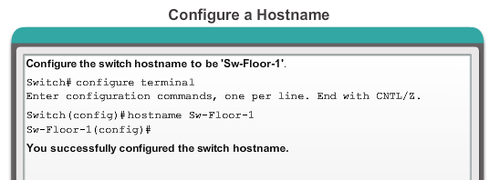
Configuring Hostnames
Hostnames allow devices to be identified by network administrators over a network or the Internet.
Router(config)# hostname NAME
Notes:
2.2.1.4 Configuring Hostnames
Some guidelines for naming conventions:
Start with a letter
Contains no spaces
Ends with a letter or digit
Uses only letters, digits, and dashes
Be less than 64 characters in length

Slide 41
Disabling DNS Lookup
IP domain name lookups or DNS resolution is enabled by default.
To disable DNS resolution, use the following command:
Router(config)#no ip domain-lookup
Disables the router from translating unfamiliar words (typos) into IP addresses.

Slide 42
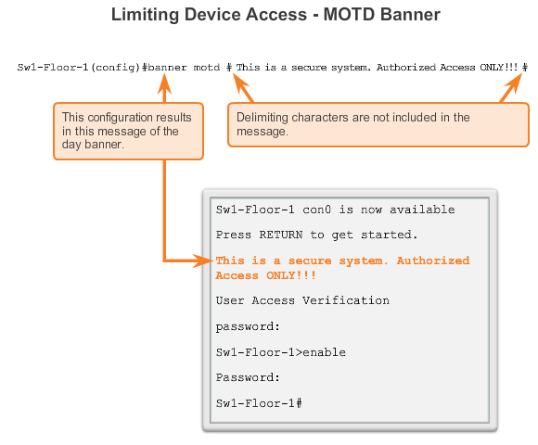
Banner Messages
Notes:
Important part of the legal process in the event that someone is prosecuted for breaking into a device
Wording that implies that a login is "welcome" or "invited" is not appropriate
Often used for legal notification because it is displayed to all connected terminals

Slide 43
Securing Device Access
These are device access passwords:
enable password – Limits access to the privileged EXEC mode
enable secret – Encrypted, limits access to the privileged EXEC mode
console password – Limits device access using the console connection
VTY password – Limits device access over Telnet
Notes:
2.2.2.1 Securing Device Access
Consider these key points when choosing passwords:
Use passwords that are more than eight characters in length.
Use a combination of upper and lowercase letters, numbers, special characters, and/or numeric sequences in passwords.
Avoid using the same password for all devices.
Avoid using common words such as password or administrator, because these are easily guessed

Slide 44
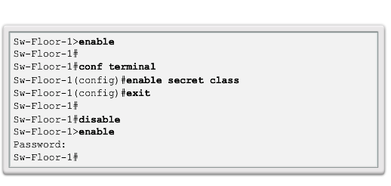
Securing Privileged EXEC Access Mode
Use the enable secret command, not the older enable password command.
The enable secret command provides greater security because the password is encrypted.
Notes:
2.2.2.2 Securing Privileged EXEC Access

Slide 45
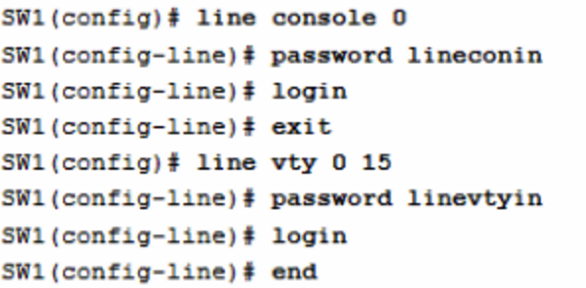
Securing User EXEC Access
Console port must be secured; it reduces the chance of unauthorized personnel physically plugging a cable into the device and gaining device access.
VTY lines allow access to a Cisco device via Telnet. The number of VTY lines supported varies with the type of device and the IOS version.
Notes:
2.2.2.3 Securing User EXEC Access

Slide 46
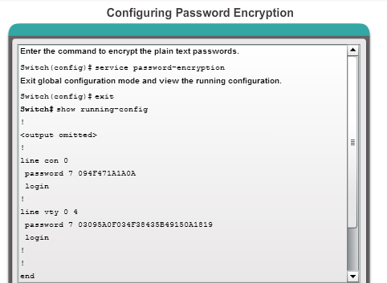
Encrypting Password Display
service password-encryption
Prevents passwords from showing up as plain text when viewing the configuration
Keeps unauthorized individuals from viewing passwords in the configuration file
Once applied, removing the encryption service does not reverse the encryption
Notes:
2.2.2.4 Encrypting Password Display

Slide 47
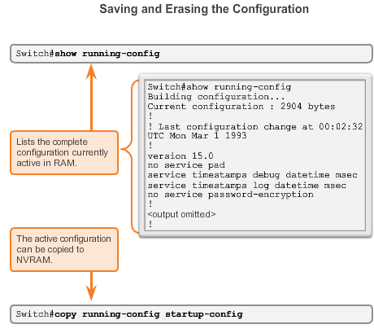
Configuration Files
Notes:
2.2.3.1 Configuration Files
Switch# erase startup-config
After the command is issued, the switch will prompt you for confirmation:
Erasing the nvram filesystem will remove all configuration files! Continue? [confirm]
Confirm is the default response. To confirm and erase the startup configuration file, press . Pressing any other key will abort the process.

Slide 48
Document Network Addressing
Network Documentation should include at least the following in a topology diagram and addressing table:
Device names
Interfaces
IP addresses and
subnet mask
Default gateways
Notes:
48
4.1.2 Connect Devices
4.1.2.3 Document Network Addressing

Slide 49
Default Gateways
To enable network access devices must be configured with the following IP address information
IP address - Identifies a unique host on a local network.
Subnet mask - Identifies the host’s network subnet.
Default gateway - Identifies the router a packet is sent to to when the destination is not on the same local network subnet.

Slide 51
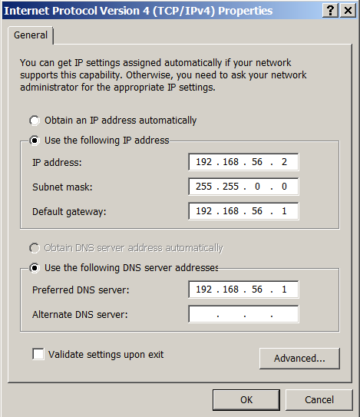
Enable IP on a Host
There are two ways: Static or Dynamic IP addresses

Slide 52
Enable IP on a Host
Statically Assigned IP address –
Host is manually assigned the IP address, subnet mask and default gateway. DNS server IP address can also be assigned.
Used to identify specific network resources such as network servers and printers
Can be used in very small networks with few hosts.

Slide 53
Enable IP on a Host
Dynamically Assigned IP Address –
IP Address information is dynamically assigned by a server using Dynamic Host Configuration Protocol (DHCP)
Most hosts acquire their IP address information through DHCP
DHCP services can be provided by Cisco routers

Slide 54
Enable IP on a Switch
Network infrastructure devices require IP addresses to enable remote management.
On a switch the management IP address is assigned on a virtual interface

Slide 55
Enable IP on a Router Interface
To be available a router interface must be:
Configured with an address and subnet mask .
Activated – by default LAN and WAN interfaces are not activated. Must be activated using no shutdown command.
Other parameters - serial cable end labeled DCE must be configured with the clock rate command.
Optional description can be included.

Slide 56
Configuring Interfaces
STEPS
1. interface type number
2. ip address ip-address mask
3. no shutdown
4. exit

Slide 57
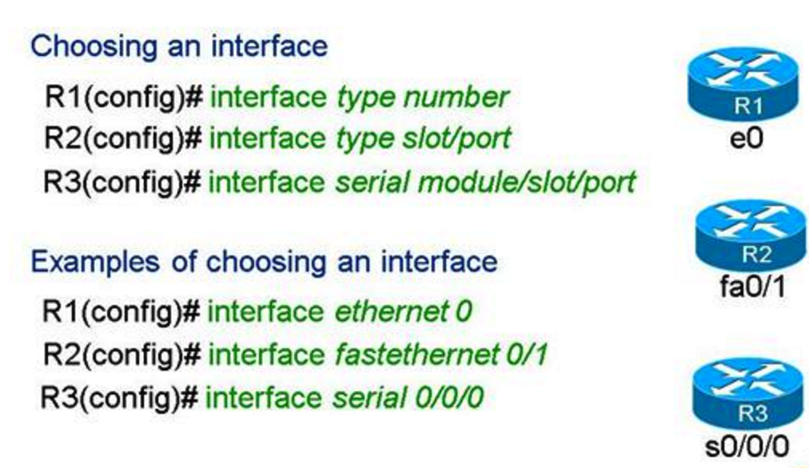
Configuring Interfaces
Notes:
The type of interface includes things such as serial, ethernet, fastethernet, gigabitethernet, atm, tunnel, loopback, etc.
The number, slot/number and module/slot/number are numbers used to uniquely identify an interface on different types of routers.

Slide 58
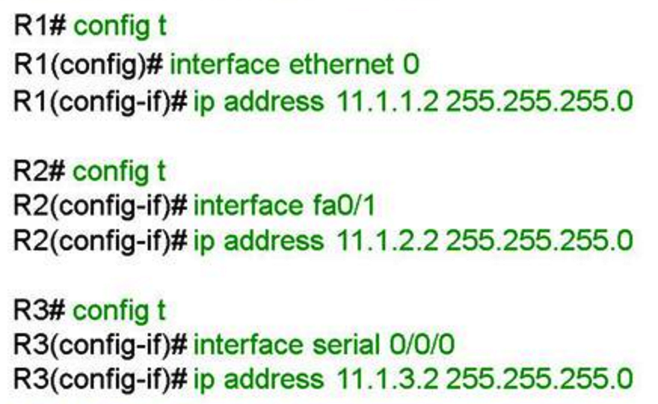
Configuring Interfaces

Slide 60
Verify Interface Settings
Show commands to verify operation and configuration of interface.
show ip interfaces brief
show running-config
Show commands to gather more detailed interface information.
show interfaces
show ip interfaces

Slide 61
