Slide 1
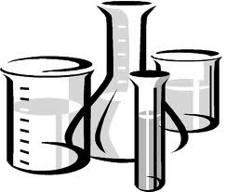
بسم الله الرحمن الرحيم
140 micro
:Lab (2)
Sterilization

Slide 2
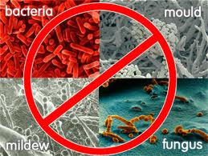
Sterilization :
Process which makes things free of microbes .

Slide 3
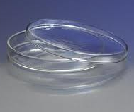
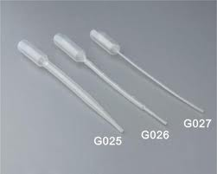
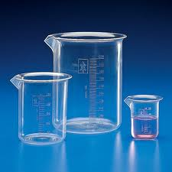
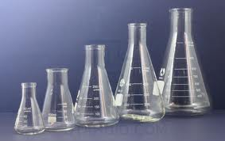
Things that can be sterilized :
Petri dishes
Pipettes
Beakers
Flasks

Slide 4
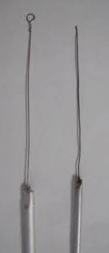
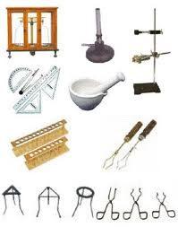
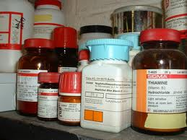
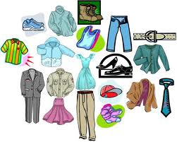
Things that can be sterilized :
Needles
Apparatus
Media
Clothes

Slide 5
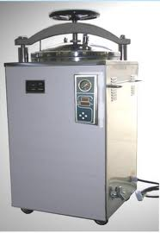
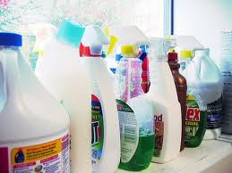
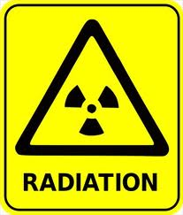
There are 3 different sterilization principles:
1- Heat sterilization
2- Chemical sterilization
3-Radiation sterilization

Slide 6
There are 2 procedures depending on the tolerance of the material used:
Advantages: It is the simplest, most effective and inexpensive method.
1- Heat sterilization
1- Steam sterilization (Autoclaving) or wet .
2-Dry heat sterilization
(hot air oven).

Slide 7
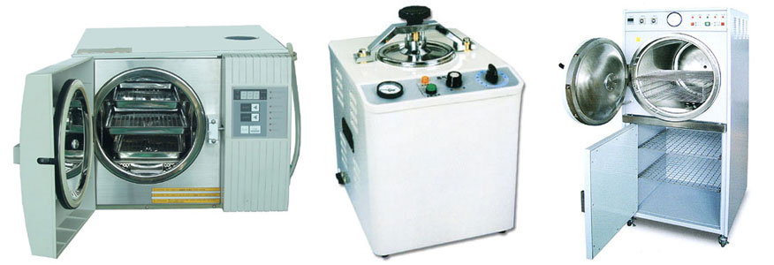
1- Steam sterilization (Autoclaving) or wet :
It includes autoclaves
Used to sterilize culture media, glassware etc.
Usually it operates at 15 lb/sq. inch steam pressure (121.5 C) for 30 min.

Slide 8
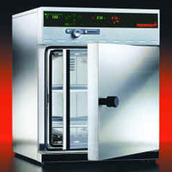
2-Dry heat sterilization
(hot air oven) :
1- It includes oven.
After sterilization wrap them in aluminium foil to avoid recontamination.

Slide 9
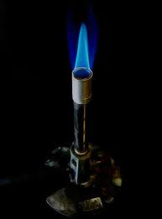
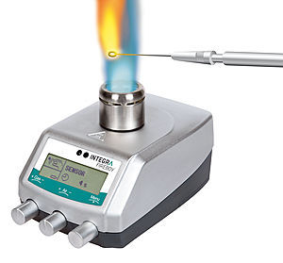
Direct heat :
2- Needles and loops are sterilized.
Bunsen burners , flames

Slide 10
There are 3 different sterilization principles:
1- Heat sterilization
2- Chemical sterilization
3-Radiation sterilization

Slide 11
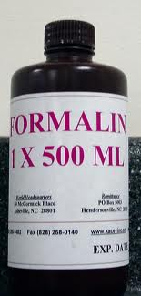
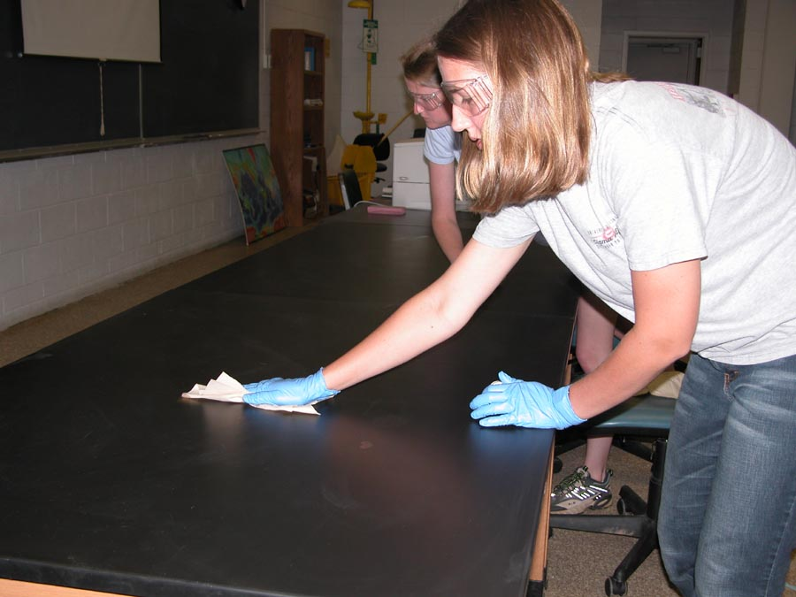
2- Chemical sterilization
50% Dettol
Ethylene oxide and formalin
For sterilizing disposable materials (that can not tolerate high temperatures).
Benches /tables

Slide 12
There are 3 different sterilization principles:
1- Heat sterilization
2- Chemical sterilization
3-Radiation sterilization

Slide 13
Gamma rays,U.V Rays.
3-Radiation sterilization

Slide 14
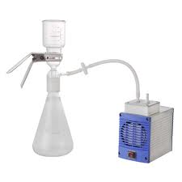
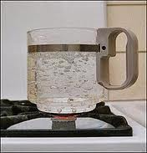
Other sterilization techniques:
Filtration
Boiling
Cold temperature

Slide 15
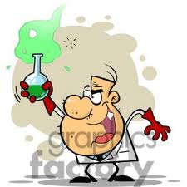
Thanks…
Shroog Al-Shahrani

