Slide 1
SWE 434
SOFTWARE TESTING AND VALIDATION
LAB2 – INTRODUCTION TO JUNIT
1

Slide 2
LAB AGENDA
Unit Testing
Understanding JUnit Framework
Practice JUnit
2

Slide 3
UNIT TESTING
The testing of single entity (class or method). Unit testing is very essential to every software company and developer.
3

Slide 4
UNIT TESTING
Required Input and Expected Output.
Input
Output
Unit
4

Slide 5
AUTOMATION TEST
Taking tool support and executing the test cases by using automation tool is known as automation testing.
Fast Automation runs test cases significantly faster than human resources.
Less investment in human resources: Test cases are executed by using automation tool so less tester are required in automation testing.
More reliable: Automation tests perform precisely same
operation each time they are run.
Programmable: Testers can program sophisticated tests to bring out hidden information.
5

Slide 6
TEST CASE AND TEST EXECUTION SYSTEM
What we need to do for automated testing?
Test Case
“A test case is a small unit of code that tests a
specific method”
INPUT: Actions send to System Under Test (SUT).
OUTPUT: Responses expected from SUT.
VALIDATION: To Check the Test, was successful or not?
Test Execution System
Mechanism to read test scripts, and connect test cases to
System Under Test, for example JUNIT.
Keeps track of test results.
SWE 434 Lab
6

Slide 7
TEST CASE VERDICT
A verdict is the declared result of executing a single test.
We can get the verdict after the assertion statement
Pass: the test case achieved its intended purpose, and the
software under test performed as expected.
Fail: the test case achieved its intended purpose, but the software under test did not perform as expected.
Error: the test case did not achieve its intended purpose.
Potential reasons:
An unexpected event occurred during the test case. The test case could not be set up properly
SWE 434 Lab
7

Slide 8
JUNIT
A unit test framework for Java
Authors: Erich Gamma, Kent Beck
Objective:
“If tests are simple to create and execute, Then programmers will be more inclined to create and execute tests.”
Web site: junit.org
In the lab We are using JUNIT 4
SWE 434 Lab
8

Slide 9
UNIT TESTING IN OTHER LANGUAGES
.Net Languages: NUNIT
Python: unittest
HtmlUnit
SWE 434 Lab
9

Slide 10
FEATURES OF JUNIT
It is an open source framework.
Provides Annotation to identify the test methods.
Provides Assertions for testing expected results.
Provides Test runners for running tests.
JUnit tests can be run automatically and they check their own results and provide immediate feedback.
JUnit tests can be organized into test suites containing
test cases and even other test suites.
JUnit shows test progress in a bar that is green if test is going fine and it turns red when a test fails.
10

Slide 11
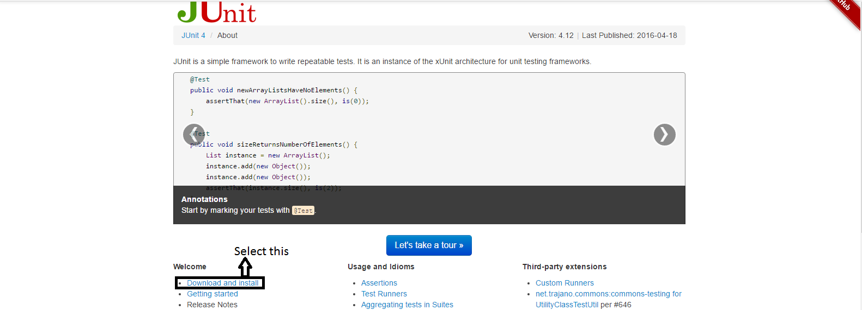
ADD JUNIT 4 TO ECLIPSE
Download JUNIT 4 jar (junit.org)
11

Slide 12
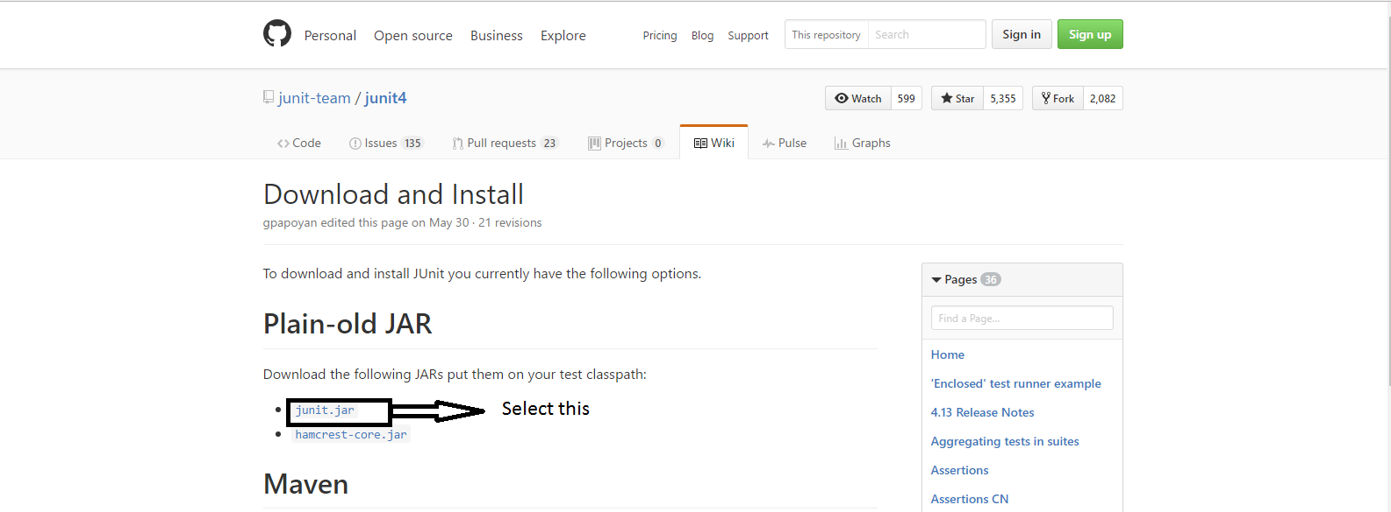
ADD JUNIT 4 TO ECLIPSE
Download JUNIT 4 jar file (junit.org)
12

Slide 13
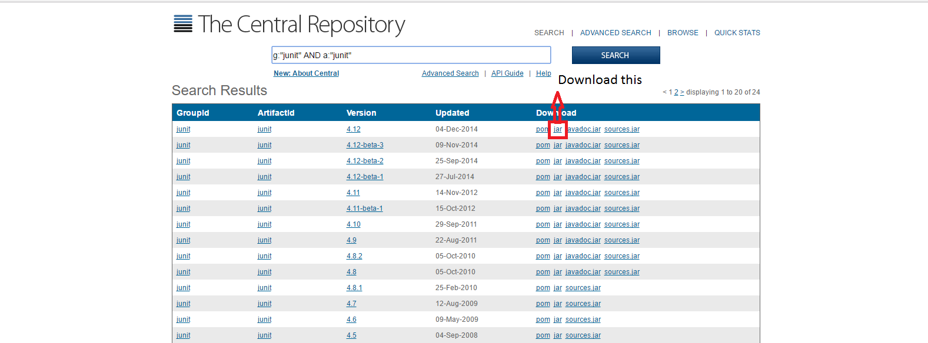
ADD JUNIT 4 TO ECLIPSE
Download JUNIT 4 jar file (junit.org)
12

Slide 14
ADD JUNIT 4 TO ECLIPSE
Download Hamcrest jar from (junit.org)
11

Slide 15
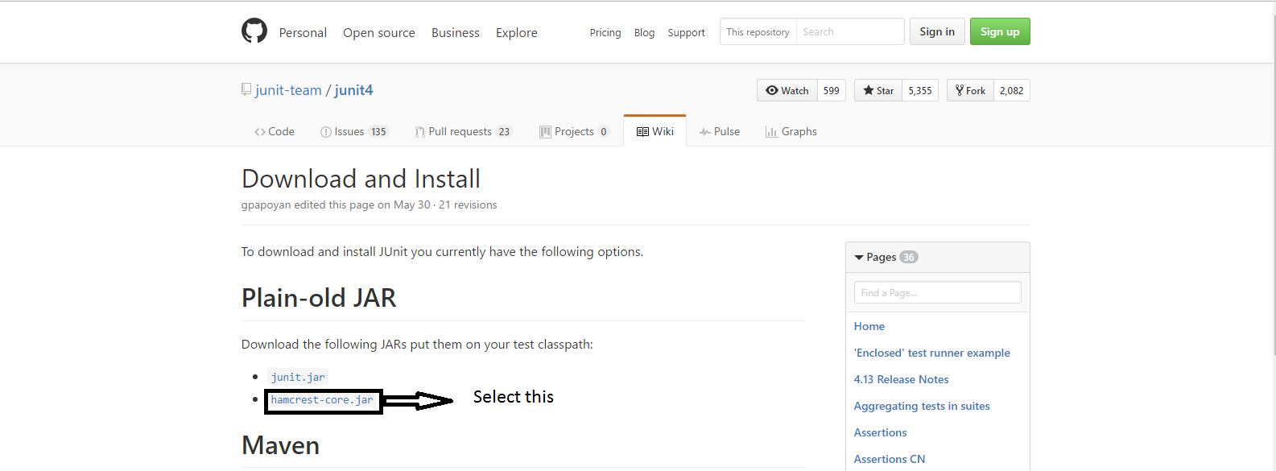
ADD JUNIT 4 TO ECLIPSE
Download Hamcrest jar file (junit.org)
12

Slide 16
ADD JUNIT 4 TO ECLIPSE
Download Hamcrest jar file (junit.org)
12

Slide 17
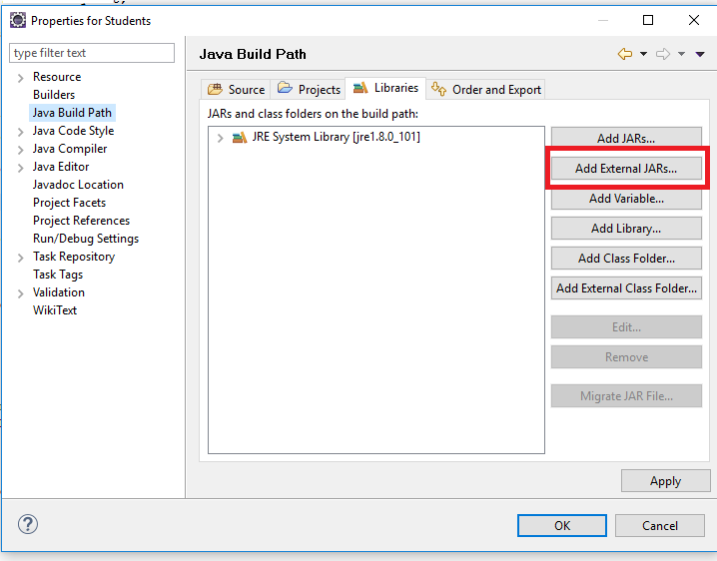
ADD JUNIT 4 TO ECLIPSE
Add the jar file to the java build path
right click on the project and select “Properties”
13

Slide 18
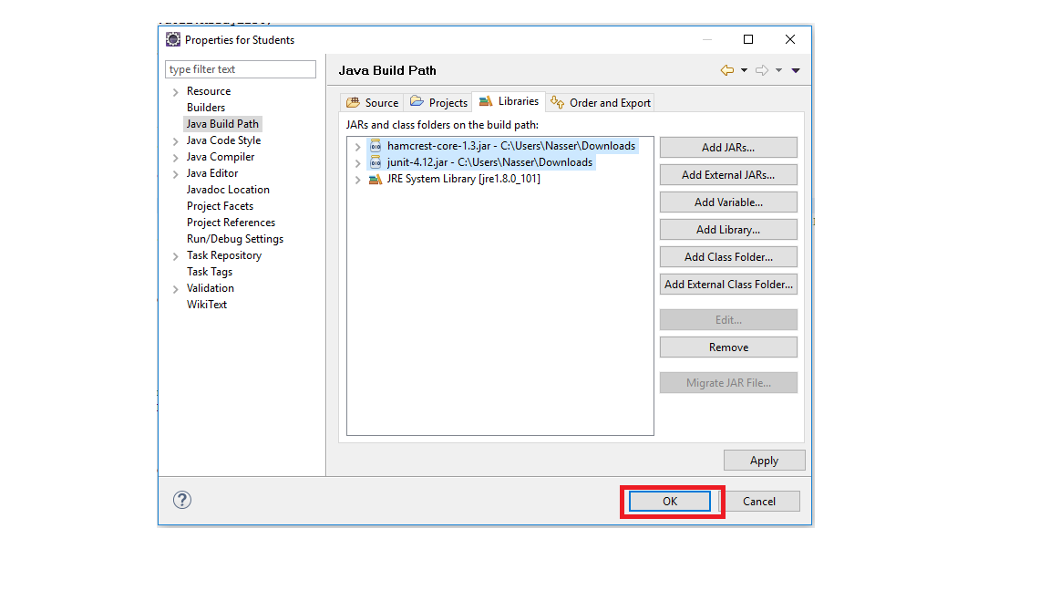
ADD JUNIT 4 TO ECLIPSE
Add the jar file to the java build path
13

Slide 19
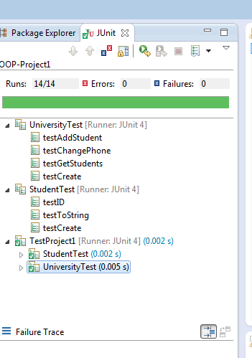
Visual result bar
JUNIT
List of Test Cases
Failure console of JUnit
14

Slide 20
WHEN SHOULD WE USE JUNIT
As the name implies…
for unit testing of small amounts of code
In the test-driven development methodology,
a JUnit test should be written first before any code.
Then, implementation code should be written that would be the minimum code required to get the test to pass – and no extra functionality.
Once the code is written, re-execute the test and it should pass.
Every time new code is added, re-execute all tests again to be
sure nothing gets broken.
15

Slide 21
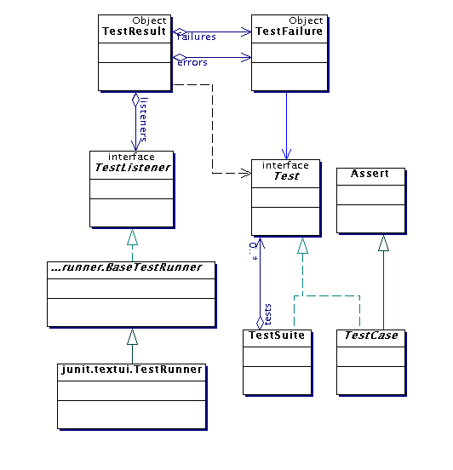
ARCHITECTURAL OVERVIEW
JUnit test framework is a
package of classes that lets you write tests for each method, then easily run those tests
TestRunner runs tests and reports TestResults
You test your class by extending abstract class TestCase
To write test cases, you need to know and understand the
Assert class

Slide 22
ASSERTIONS
A package of methods that checks for various properties:
“equality” of objects
identical object references
null / non-null object references
equality of arrays
The assertions are used to determine the test case verdict
17

Slide 23
ASSERTIONS
Assertions are defined in the JUnit class Assert
If an assertion is true, the method continues executing.
If any assertion is false, the method stops executing at that point,
and the result for the test case will be fail.
If any other exception is thrown during the method, the result
for the test case will be error.
If no assertions were violated for the entire method, the test case
will pass.
All assertion methods are static methods in the class
org.junit.Assert
18

Slide 24
ORGANIZATION OF JUNIT TESTS
Each @Test method represents a single test case that can independently have a verdict (pass, error, fail).
Methods with no annotation are not considered test
cases, and can be used as helper methods.
Normally, all the tests for one Java class are grouped together into a separate class.
Naming convention:
Class to be tested: ClassX
Class containing tests: ClassXTest
19

Slide 25
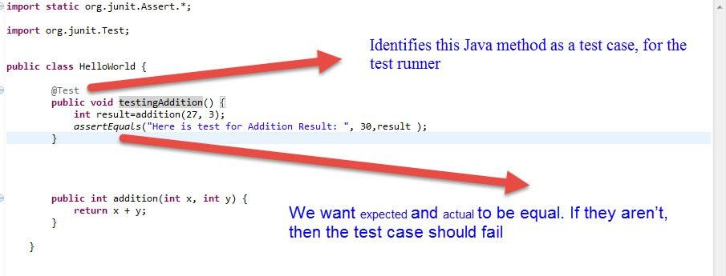
EXAMPLE
20

Slide 26
ASSERT METHODS
assertArrayEquals()
assertEquals()
assertTrue() + assertFalse()
assertNull() + assertNotNull()
assertSame() and assertNotSame()
assertThat()
21

Slide 27
ASSERTION METHOD PARAMETERS
In any assertion method with two parameters, the first parameter is the expected value, and the second parameter should be the actual value.
This does not affect the comparison, but this ordering is
assumed for creating the failure message to the user.
Any assertion method can have an additional String parameter as the first parameter. The string will be included in the failure message if the assertion fails.
Examples:
assertEquals( message, expected, actual)
22

Slide 28
EXAMPLES AND PRACTICE
23

Slide 29
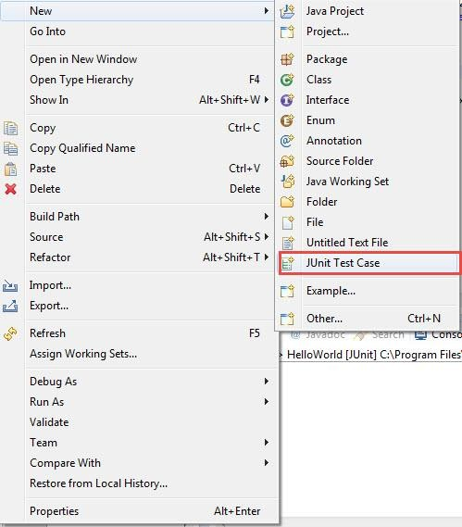
ADD JUNIT TEST CASE
Right click on the project icon
24

Slide 30
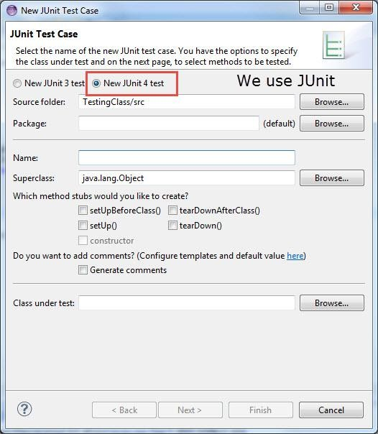
ADD JUNIT TEST CASE
Choose Junit 4
25

Slide 31
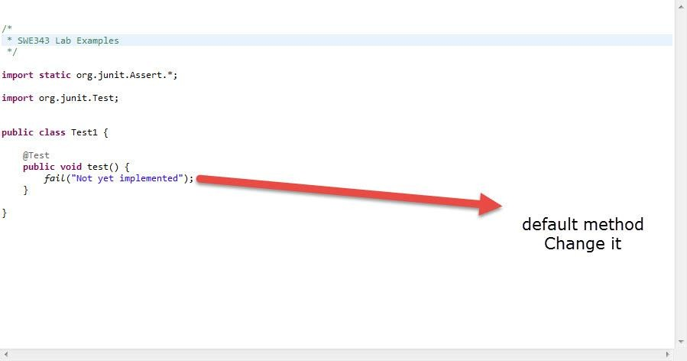
ADD JUNIT TEST CASE
Here where you add the test cases
26

Slide 32
WHAT YOU SHOULD KNOW
What is JUnit, why and when should it be used?
How to create a test case in Junit.
Write assertion methods correctly.
Can determine if the test case passed or failed.
27

Slide 33
NEXT WEEK
Advanced Junit.
More Examples.
Introduction to Code Coverage Tools.
28

