Slide 1
MATLAB TUTORIAL
Guided Task

Slide 2
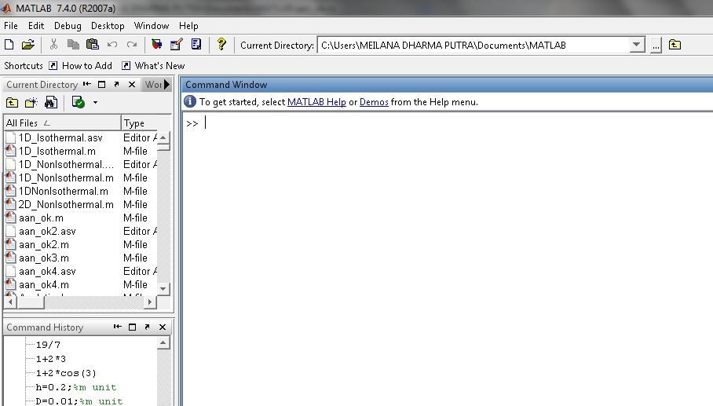

Slide 8
