Slide 1
Enterobacteriaceae Clinical Bacteriology II CLS 413
Lab 1
CLS Department
College of Applied Medical Sciences
King Saud University
Basmah Almaarik

Slide 2
Course Content
Enterobacteriacae
Lactose Fermenters:
Escherichia coli
Klebsiella Pneumoniae
Lactose Non Fermenters
Salmonella
Shigella
Proteus
Other gram –ve bacteria
Pseudomonas, Hemophilus, Vibrio, Campylobacter
Spirochetes
Anaerobes
Clostridia and Bacteroides
Notes:
The genus Pseudomonas belongs to the family Pseudomonadacea
The Genus hemophilus belongs to family Pasteurellaceae

Slide 3
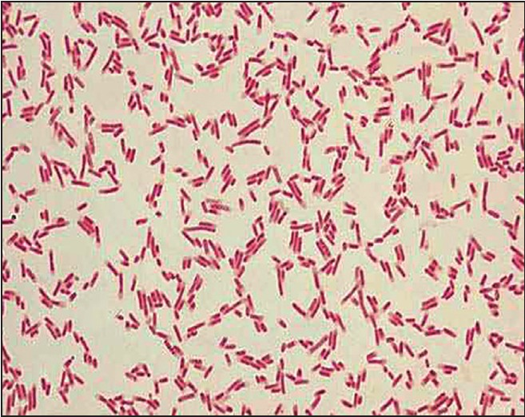
Introduction
Enterobacteriaciae are a large family of Gram-negative rod-shaped bacteria that includes, along with many harmless normal flora, many of the medically significant pathogens
General Characteristics of Enterobacteriacea:
Rod shaped
Gram negative
Catalase positive
Oxidase negative
Facultative anaerobes
Most ferment glucose, some are LF
Most reduce nitrate to nitrite
Gram Negative Bacilli of Escherichia coli from a woman suffering from Urinary tract infection

Slide 4
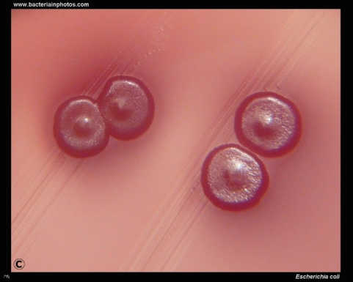
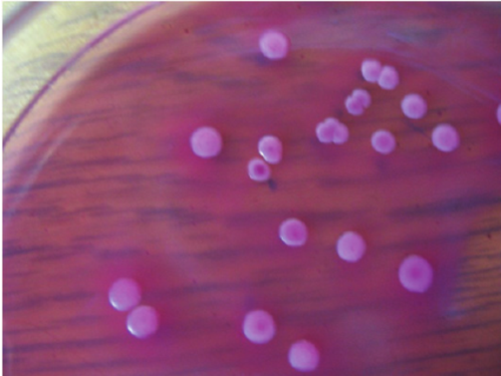
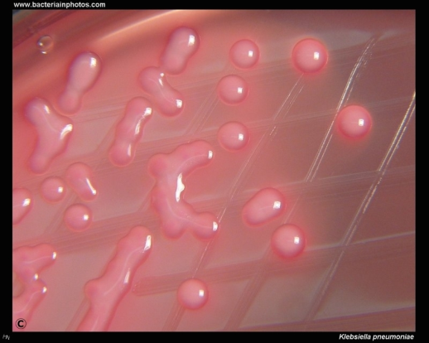
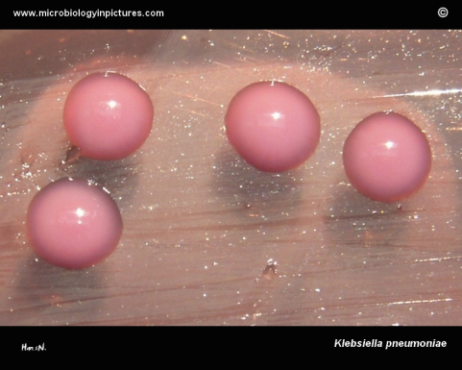
Members of the Enterobacteriaceae Family
◆ E.coli:
◆ lactose fermenter- releases acids as a product
of fermentation. Color (Ph) indicators change
the color of the medium in response to the
acidic environment.
◆ Usually produces dry LF colonies
◆ Motile
◆ Klebsiellah Pneumoniae:
◆ Lactose fermenter
◆ Mucoid LF colonies
Isolated brick-red coloured E. coli colonies surrounded by a precipitated zone on MAC agar
K.pneumoniae growing on MacConkey

Slide 5
Members of the
Enterobacteriaceae Family
◆ Proteus:
◆ Non lactose fermenter (NLF)
◆ Tends to swarm on most culture media
◆ CLED agar prevents swarming
◆ Can produce H2S in sodium thiosulfate-containing media
◆ Motile
◆ Salmonella:
◆ NLF
◆ Produces H2S in sodium thiosulfate-containing media
◆ motile
◆ Shigella:
◆ NLF
◆ Non H2S producer

Slide 6
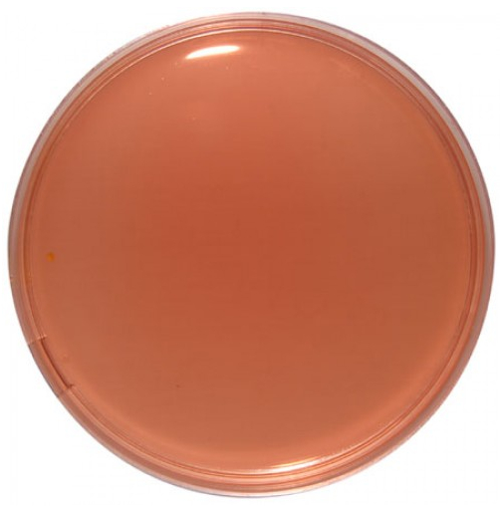
Desoxycholate Citrate Agar (DCA):
Differential and selective.
Selective for gram –ve
Inhibitory substances: sodium desoxycholate
and sodium citrate
Differentiates between LF and NLF
and between H2S producers and non producers
Neutral red is pH indicator H2S producers give black-centered colorless colonies on DCA (salmonella). Shigella sp. produce colorless colonies without a black center.
LFs give pink colonies, while lactose NLFs produce colorless or pale colonies

Slide 7
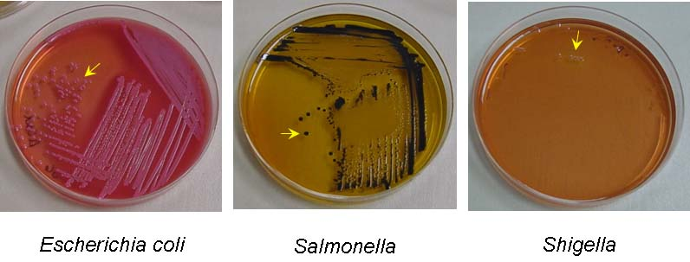
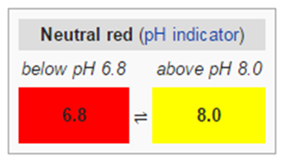
H2S-producers on DCA

Slide 8
Shigella (non H2S producer)
on DCA
Indicator color chart:

Slide 9
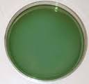
Hektoen Enteric Agar (HE)
◆ Differential and Selective
◆ Selective for gram –ve bacteria (Contains bile
salt inhibitors)
◆ Differentiation based on lactose fermentation
and H2S production
◆ Carbohydrate sources are lactose sucrose and salicin
◆ Bromothymol blue is color indicator
◆ Determines H2S production through sodium thiosulphate(as an H2S source)
◆ H2S producers give clear colonies with black centers (fish eye
colonies)
◆ Lactose fermenters give orange colored colonies (sometimes called salmon colonies). Non fermenters give green-blue colonies

Slide 10
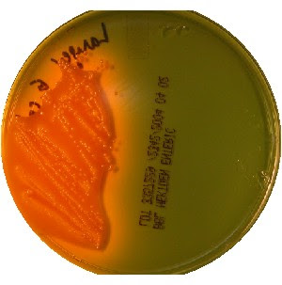
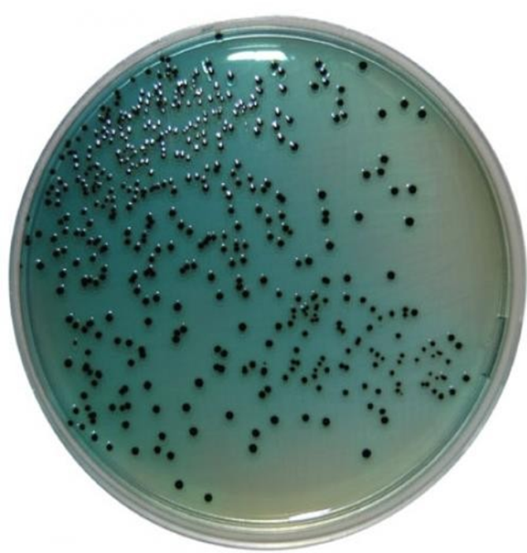
Hektoen Enteric Agar (HE)
E.Coli salmon red colonies on HE
Salmonella colonies with black center
Lac –ve, H2S -ve colonies
on HE
Characteristic Fish-eye Colonies

Slide 11
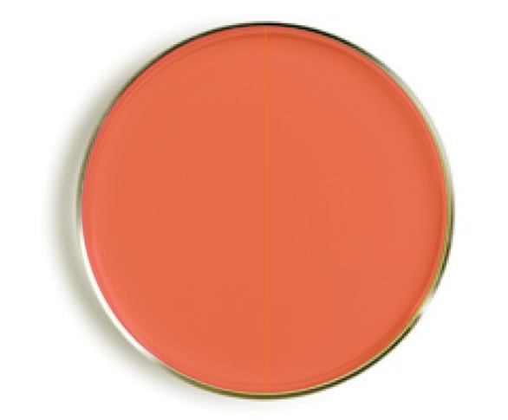
Xylose Lysine Desoxycholate Agar (XLD):
◆ A Selective and differential medium
◆ Sodium desoxycholate is inhibitor
◆ Phenol red: pH indicator
◆ Differentiation: LF, H2S production
◆ Contains xylose ,lactose (sugars) and lysine (amino acid)
◆ LFs produce yellow colonies
◆ H2s producers (salmonella): red colonies with black centers.
◆ Non H2S produces red colonies without black centers
◆ **All enterics, except shigella, ferment xylose→ this explains why proteus –even though it’s NLF- gives yellow colonies on XLD
◆ Salmonella ferments xylose but, does not give yellow colonies
◆ Why? because salmonella decarboxylates lysine in the medium leading to alkaline products (if the environment is alkaline, the plate remains red)

Slide 12
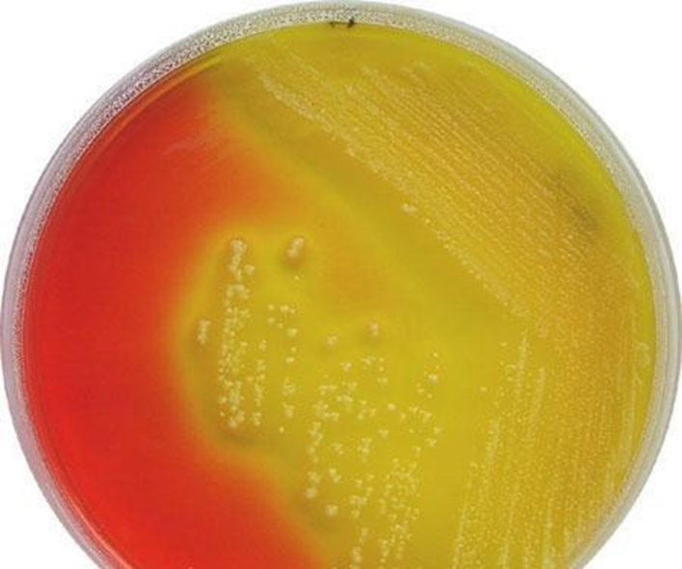
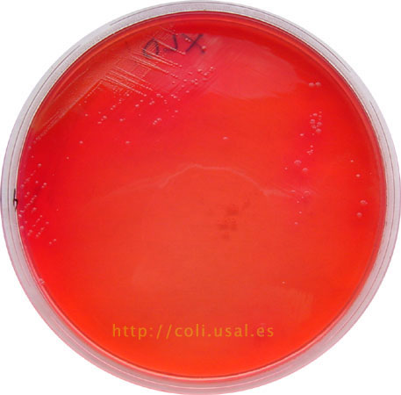
Salmonella on XLD: Lac –, H2S + red colonies with black centers
Xylose Lysine Desoxycholate Agar (XLD):
Lac +ve, H2S - colonies of
on XLD
Shigella on XLD: lac -ve, H2S –ve: red colonies w/out black centers

Slide 13
How To Report a Gram Stain
When reporting a gram stain, you need to describe 2 things:
Whether the cells are gram positive or negative
The shape and arrangement of the cells
Shapes can be (bacilli, cocci, coccobacilli, spirohetes …etc)
Arrangements can be (in chains, in clusters, in pairs (diplococci)..etc)
NEVER mention the name of an organisms when you are asked to comment on a gram stain under the microscope. The gram stain by itself is insufficient to identify an organism. Identification can only be made after doing cultures and biochemical tests

Slide 14
Tasks to be done today
1- Prepare a smear stain it by the gram stain method. View the slide under the microscope.
2- Culture the given organisms on your agar plates. Then incubate at 37 degrees Celsius. Return to the lab within 24 hrs to record your results. Growth patterns may change after that and your plate reading will be inaccurate.
3- View the demonstration plates and prepare a table of growth characteristics (which you will include in your report).
4- Prepare your lab report as described before
Make sure to include pictures of your results in your reports

Slide 15
Describe:
Growth
Color
Lac fermentation
• H2S +/-
Specfic characteristics (mucoid colonies, dry, swarming..etc)

Slide 16
Reports Should Include
Your name
Practical Title
Principle of the test performed
Organism used for experiment
Materials and reagents used (include not just gram stain materials, but also the materials you used to make the bacterial smear)
Procedures (must include procedure of both bacterial smear preparation and gram stain)
Result

Slide 18
Before you leave:
Turn off your microscopes
Turn off the incinerators
Clean your bench with:
disinfectant spray and tissue
Wash your hands
Return lab chair to place

