Slide 1
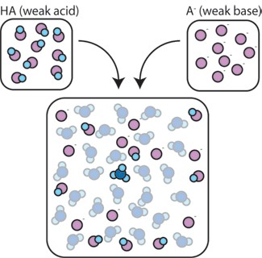
lution
Preparation Of Buffer So
BCH 202 [Practical]

Slide 2
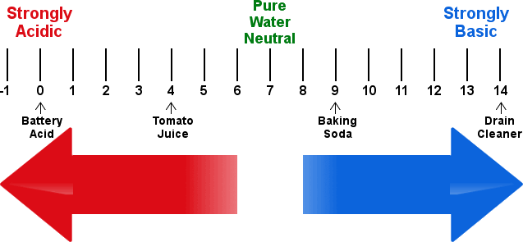
Hydrogen number pH
The formula that describe the acidity of certain solutions by using hydrogen number pH can be defined as: The negative logarithm of the hydrogen ion concentration.
pH= -Log [H+]
■
Notes: the pH increase when the concentration of hydrogen ion decrease and vice versa.

Slide 3
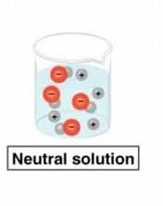
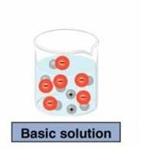
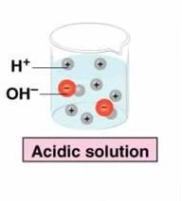

Slide 4
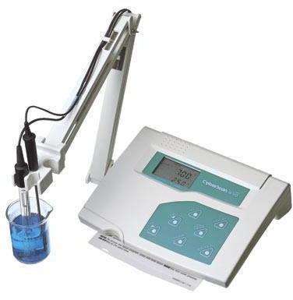
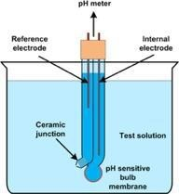
Measuring of hydrogen number:
To measure the hydrogen number in certain solution in very accurate way, we use a special instrument called pH meter.
It’s consist of glass electrode which contain a very thin bulb, blown onto a hard glass tube. which
is sensitive to pH.
The bulb contains a solution of hydrochloric acid and is connected to a platinum lead via silver - silver chloride electrode which is reversible with respect to hydrogen ions.

Slide 5
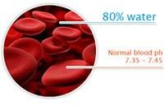
Introduction:
All biochemical reactions occur under strict conditions of the concentration of hydrogen ion.
Biological life cannot withstand large changes in hydrogen ion concentrations which we measure as the pH.
Those solutions that have the ability to resist changes in pH upon the addition of limited amounts of acid or base are called Buffers.

Slide 6
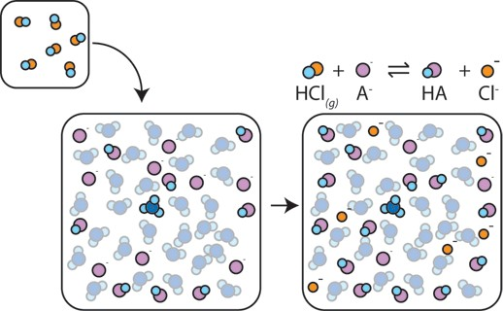
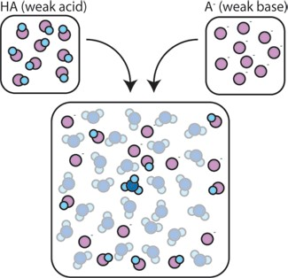
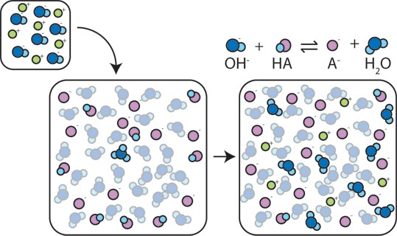
Buffers
are solutions that have the ability to resist changes in pH. upon the addition of limited amounts of
acid or base.
A buffer is made up of a weak acid and its conjugate base. Or a weak base and its conjugate acid .

Slide 7
Mechanism of Action (Buffer):
How buffers can resist the change in pH? Example using [HA/A-] buffer
HA: Weak acid. A-: conjugated base [its salt].
HA⇌H++A-
(a) If H+ is added to this buffer system H+ will react with conjugated base to give conjugate acid.
(b) If OH- is added to this buffer system [HA/A-] OH- will react with conjugated acid to give conjugate base and H2O.
H+
OH-
A-⇌ HA
HA⇌A-+H2O

Slide 8
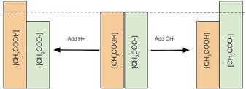
Mechanism of Action (Buffer):
Example:
Buffer system: CH3COOH / CH3COO- , (CH3COOH :acid - CH3COO-: conjugated base)
- When acid [H+] added:
CH3COO- + H+
CH3COOH
- When base [OH] added:
CH3COOH + OH -
CH3COO-
+ H2O
NOTE: It resists pH changes when it’s two components are present in specific proportions.
Thus a buffer can protect against pH changes from added H+ or OH- ion as long as there is sufficient basic and acidic forms respectively. As soon as you run out of one of the forms you no longer have a buffer .

Slide 9
Henderson-Hasselbalch equation:
The Henderson-Hasselbalch equation is an equation that is often used to:
1- To calculate the PH of the Buffer.
2-To prepare Buffer.
- It relates the Ka [dissociation constant] of a weak acid , [HA] concentration Of weak acid ,
[A-] concentration Of conjugate base [salt of the weak acid] components and the pH of the buffer.

Slide 10
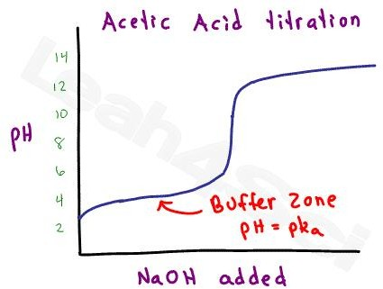
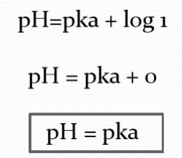
A buffer is best used close to its pKa.[to act as a good buffer the pH of the solution must be
within one pH unit of the pKa].
The buffer capacity is optimal when the ratio of the weak acid to its salt is 1:1; that is, when pH = pKa

Slide 11
Buffer capacity
Quantitative measure of this resistance to pH changes is called Buffer capacity
Buffer capacity can be defined in many ways, it can be defined as:
The number of moles of H+/OH- ions that must be added to one liter of the buffer in order to decrease
/increase the pH by one unit respectively.
Buffer capacity is directly proportional to the buffer concentration.

Slide 12
Practical Part
Buffer solution preparation
Studying the properties of buffer solution

Slide 13
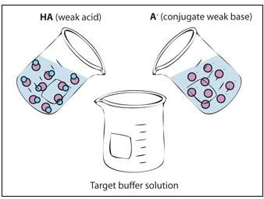
Objectives:
To understand the nature of buffers solutions.
To learn how to prepare buffers.

Slide 14
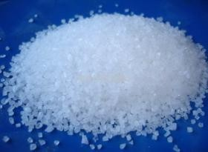
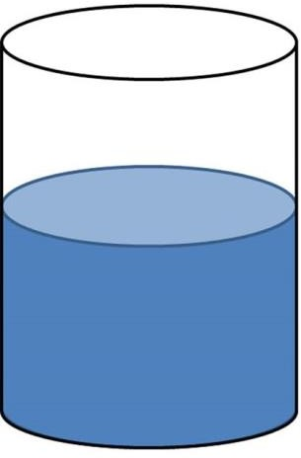
Preparation of phosphate buffer:
Example: Prepare 500ml from phosphate buffer with concentration 0.25M and pH= 7.4, if you know that pKa=7.2))
You are provided with buffer solution content; Monosodium dihydrogen phosphate NaH2PO4 and Disodium hydrogen phosphate Na2HPO4.
Provided:
Pka = 7.2
Final volume of buffer =500ml
pH=7.4
Conc= 0.25M
Required:
Weight (g) of Monosodium dihydrogen phosphate NaH2PO4
Weight (g) of Disodium hydrogen phosphate Na2HPO4
[HA]
[A-]
g ?
g ?
pH 7.4
0.25 M
500 ml
Buffer

Slide 15
Calculations:

Slide 16
Calculations Cont’
2) calculate the weight needed from [A-] to prepare the buffer, No. of mole of [A- ] should be calculated first :
Calculate moles in buffer: No. of mole of ( A-) = molarity of (A-) calculated in buffer X volume (L) volume of buffer
required
= 0.15 X 0.5 = 0.075 mole
Calculate the wight of stock A-: wt in (g) of [A-] = mole X Mw
= 0.075 x 142 = 10.65 g
3- Calculate the weight needed from [HA] to prepare the buffer, No. of mole of [HA ] should be calculated first :
Calculate moles in buffer: No. of mole (of HA) = molarity of ( HA) calculated in buffer X volume (L ) volume of buffer required.
= 0.1 X 0.5 = 0.05 mole
Calculate the wight of stock A-: wt in (g) of [A-] = mole X Mw
= 0.05 x 120 = 6 g

Slide 17
Method
Now take ………..g from NaH2PO4 and ………. g from Na2HPO4 then complete the volume up to 500 ml by addition of water.
Check the pH

Slide 18
(2)Testing for buffering behavior:
Method:
In one beaker add 10ml of 0.25M Phosphate buffer that you have prepared, and in another beaker add 10ml of water.
Measure the pH.
Add 0.5ml from 0.1 M HCl to both solutions.
Measure the pH after the addition.
Phosphate buffer
water

Slide 19
You are provided with acetic acid and sodium acetate.
Prepare 100 ml of a 0.3M acetate buffer pH =5.2 if you know that pK_{a} =4.76.
H.W

