Slide 1
Lab#1
UTP cables

Slide 2
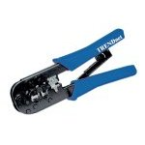
Making connections - Tools
Cat5e cable
RJ45 connectors
Cable stripper
Scissors
Crimping tool

Slide 3
Making connections - Steps
Strip cable end
Untwist wire ends
Arrange wires
Trim wires to size
Attach connector
Check
Crimp
Test

Slide 4
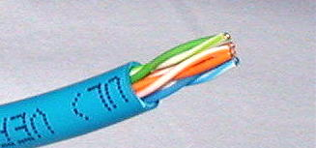
Step 1 – Strip cable end
Strip 1 – 1½” of insulating sheath
Avoid cutting into conductor insulation

Slide 5
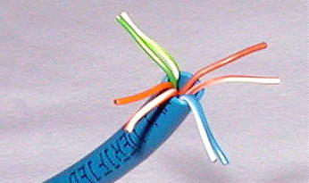
Step 2 – Untwist wire ends
Sort wires by insulation colors

Slide 6
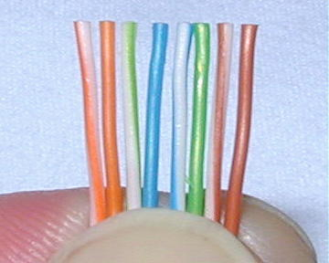
Step 3 – Arrange wires
TIA/EIA 568A: GW-G OW-Bl BlW-O BrW-Br
TIA/EIA 568B: OW-O GW-Bl BlW-G BrW-Br

Slide 7
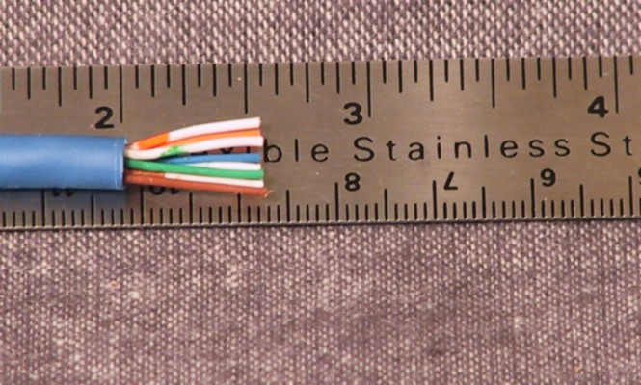
Step 4 – Trim wires to size
Trim all wires evenly
Leave about ½” of wires exposed

Slide 8
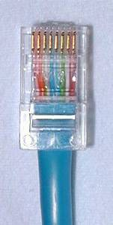
Step 5 – Attach connector
Maintain wire order, left-to-right, with RJ45 tab facing downward

Slide 9
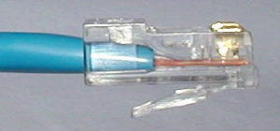
Step 6 - Check
Do all wires extend to end?
Is sheath well inside connector?

Slide 10
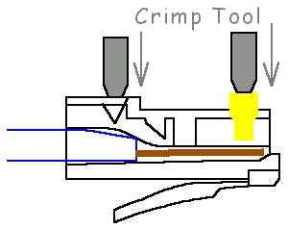
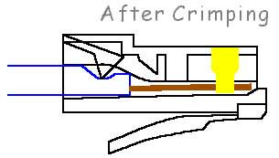
Step 7 - Crimp
Squeeze firmly to crimp connecter
onto cable end (8P)

Slide 11
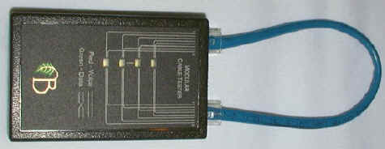
Step 8 – Test
Does the cable work?

Slide 12
Let’s go to work!

