Slide 1
Lab# 6
BCH 220
Hemoglobin and anemia

Slide 2
Objectives:
1- Quantitative determination of hemoglobin in a blood sample.
2- Quantitative determination of glucose 6-phosphate dehydrogenase (G6PD) activity in erythrocytes (hemolysate).
3- Qualitative determination of hemoglobin S (HbS) in blood using a phosphate solubility method.

Slide 3
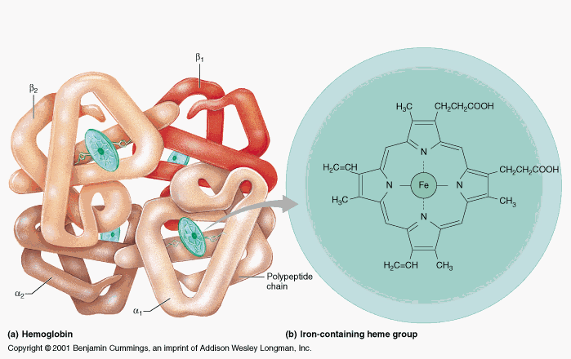
Hemoglobin:
Hemoglobin (Hb),is the iron-containing oxygen-transport metalloprotein in the RBCs (erythrocytes) that transport oxygen from the lungs to the rest of the body and carbon dioxide back to the lungs.
Hb is made up of protein and non-protein parts.
The protein part: 4 subunits of globin protein.
The non-protein part: heme group (iron + Protoporphyrin).

Slide 4
Hemoglobin Synthesis
The circulation blood of normal adult contain about 750 g of Hb and of this about 7 – 8 g are degraded daily.
The globin part of Hb can be reutilized only after catabolism into its constituent amino acid.
The free heam is broken down into bile pigment which is excreted.
Iron alone is reutilized in the synthesis of Hb.
The rate of Hb synthesis (Rate of RBC formation) depends on:
The amount of oxygen reaching the blood.
Capacity of the blood to carry oxygen ,which in turn depend on the amount of circulating hemoglobin

Slide 5
Therefore, hemoglobin synthesis is stimulated by anoxia, whether due to oxygen deficiency or due to anemia.
There is a strong evidence that the marrow response to the stimulus of hypoxia is dependent upon erythropoietin.
Erythropoietin is a glycoprotein hormone formed in kidney in response to decrease oxygen carrying capacity (hypoxia or anoxia), in order to stimulate the erythropoiesis
Notes:
Anoxia is the worst and is a complete lack of oxygen to the brain. Hypoxia is a reduced supply of oxygen making its way into the brain

Slide 6
The role of some factor affecting on the native of haemoglobin:
Vitamins and cofactor: Biotin (B7), pantothenic acid (B5), folic acid (B9), coenzyme A and pyrodixal phosphate are essential for haem synthesis .
Trace metals : Only copper and cobalt are known to play a role .
(Copper is playing a role in the absorption of iron while Cobalt is essential constituent of vitamine B12 (Cobalamin) )
Glucose -6-phsphatase dehydrogenase (G6PD)

Slide 7
Normal haemoglobin Hb conc.: for men: 14 - 18 g/dl, for women : 12 - 16 g\dl
Level of Hb is associated with polycythemia and dehydration.
⬇ Level of Hb is associated with anemia.

Slide 8
Anemia :
It is in general decrease in the amount of RBC or the normal amount of Hb in blood. It can also be defined as a lowered ability of the blood to carry oxygen.
There are many types of anemia:
1- Anemia caused by blood loss.
2- Anemia caused by decreased or faulty red blood cell production. (Sickle cell anemia
Iron-deficiency anemia and Vitamin-deficiency anemia)
3- Anemia caused by destruction of red blood cells.(hemolytic anemia).
Notes:
Vitamin-deficiency anemia may occur when vitamin B12 and folate are deficient. These two vitamins are needed to make red blood cells. Conditions leading to anemia caused by vitamin deficiency include:
Megaloblastic anemia: Vitamin B12 or folate or both are deficient
Pernicious anemia: Poor vitamin B12 absorption
Anemia Caused by Destruction of Red Blood Cells

Slide 9
Quantitative Determination of G6PD Deficiency in Hemolysed RBC sample

Slide 10
Glucose-6-phosphate dehydrogenase, deficiency is a genetic disorder that occurs almost exclusively in males. This condition mainly affects red blood cells, which carry oxygen from the lungs to tissues throughout the body. In affected individuals, a defect in an enzyme called glucose-6-phosphate dehydrogenase causes red blood cells to break down prematurely. This destruction of red blood cells is called hemolysis.
The most common medical problem associated with glucose-6-phosphate dehydrogenase deficiency is hemolytic anemia, which occurs when red blood cells are destroyed faster than the body can replace them. This type of anemia leads to paleness, yellowing of the skin and whites of the eyes (jaundice), dark urine, fatigue, shortness of breath, and a rapid heart rate.

Slide 11
Importance of G6PD
G6PD is the enzyme responsible for the initial deviation of glucose into pentose
phosphate pathway to form 6-phosphogluconate. This pathway provides NADPH2 in the erythrocyte for the conversion of oxidized to reduced glutathione and for other reactions such as reduction of methemoglobin.[see the fig. in the next slid].
Deficiency of G6PD:
1- The enzyme deficiency may cause haemolysis.
2- The cells accumulate methemoglobin and are deficient in reduced glutathione which is necessary for cell integrity. (Haemolysis will cause, dark urine and jaundice).
3- The deficiency of G6PD may also produce neonatal jaundice.

Slide 12
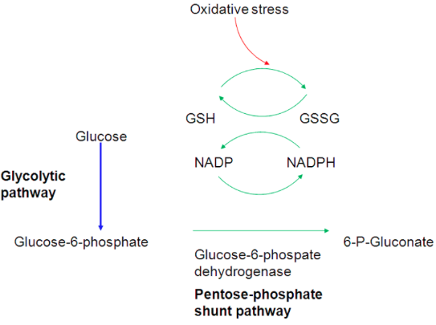
GSH is necessary for cell integrity by neutralizing free radicals that cause oxidative damage.

Slide 13
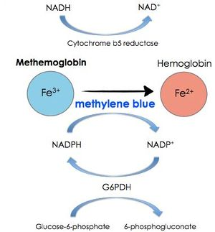

Slide 14
Qualitative determination of hemoglobin S (HbS) in blood.
(Sickle cell test)

Slide 15
Hemoglobin S (Hgb S), is an abnormal type of hemoglobin that you can inherit from parents.
Sickle cell test , is a simple and rapid method for detection of the presence of hemoglobin-S in blood.
In normal adults, 95% or more of the hemoglobin is present as hemoglobin A (HbA).
-Hemoglobin-S, can be inherited in the homozygous state (S/S) produce sickle cell anemia , or in heterozygous ,also called sickle cell trait (A/S) ), usually don’t exhibit symptoms of the sickle cell anemia disease (unless under extreme hypoxia).
-A point mutation in the Hb β gene is responsible for the sickling of RBCs seen in sickle cell anemia .The abnormality is due to Substitution of non polar valine for a charged Glutamic acid in position 6 in the β chain .
Notes:
Hgb S causes red blood cells to become stiff and abnormally shaped. Instead of having a normal round, disk shape, these red blood cells become sickle-shaped, or crescent-shaped. These cells don't live as long as normal red blood cells. Because of their shape, they get stuck inside small blood vessels. These problems cause symptoms of sickle cell disease.

Slide 16
Individuals with Hb-S will be at high risk when exposed to conditions of low
oxygen tension such as surgery, high altitude or athletics which may results in
serious and fatal clinical complications. In order to avoid or minimize these clinical
complications, it is important to screen the individuals for the presence of Hb-S.
Hemoglobin A
Hemoglobin A2
Hemoglobin F

Slide 17
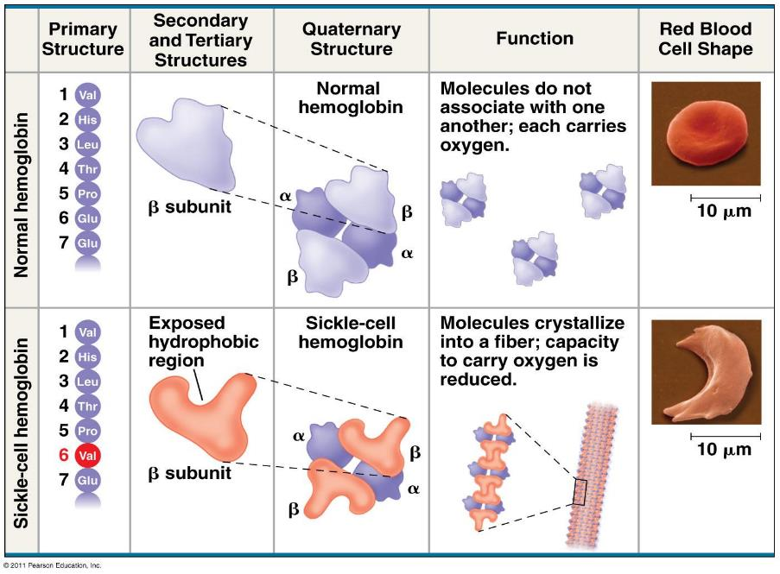

Slide 18
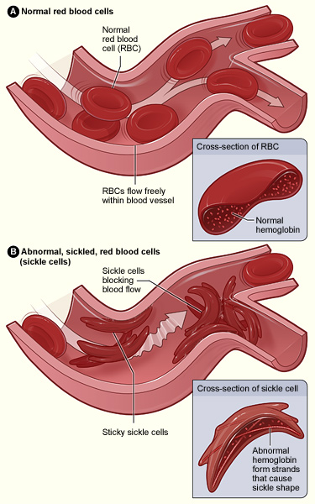

Slide 19
Principle:
Erythrocytes are lysed (by saponin) and the released hemoglobin is reduced (by dithionite) in phosphate buffer.
Reduced HbS is characterized by its very low solubility , So that in the presence of HbS, the solution become turbid and the lines behind the test tube will not be visible while, if no HbS was present the clear solution will permit the lines to be seen through the test tubes.

Slide 20
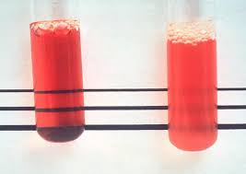
Results:
_
+

