Slide 1
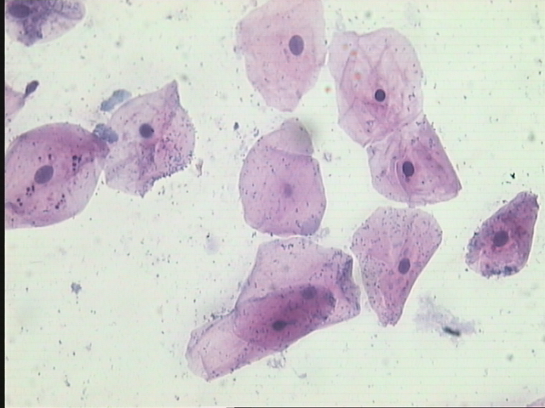
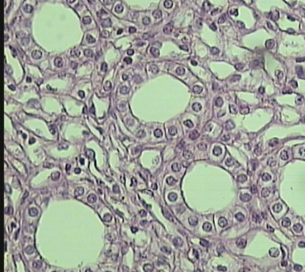
THE EPITHELIAL TISSUE
Lab 2 ZOO 103

Slide 2
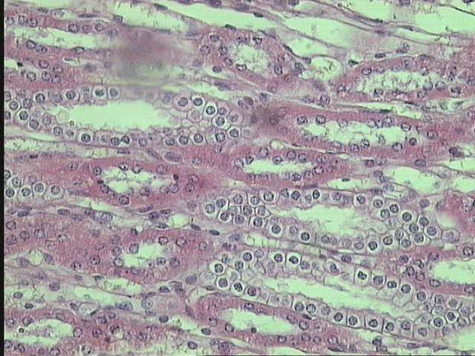
Structure
They are closely packed cells.
Specialized to cover external surfaces or line internal cavities.
Epithelial cells are packed tightly
together, with almost no intercellular spaces.

Slide 3
Rest on Basement Membrane
thin sheet of connective tissue
provides structural support to the epithelium
binds it to neighboring structures
There are lots of tight junctions and
It provides tissues with strength and stability.
They also have the ability of Renewal (Stem and germinative cells)

Slide 4
Functions
Permeability
Sensations
Secretions
Protection

Slide 5
Types of Epithelial Tissue

Slide 6
Number of layers
simple epithelium
(one layer)
stratified epithelium
(more than one layer)
squamous epithelium
cuboidal epithelium
columnar epithelium
Squamous, cuboidal, columnar
Skin of Toad
( Frog )
Bowman’s capsule
Side view
Lining of
Mouth
Top view
Intestine
Stomach
Thyroid gland
Collecting tubule

Slide 7
Types of Epithelial Tissue
Epithelial tissue can be divided into two groups depending on their function of which it is composed.
Glandular epithelium
Neuro-epithelium
Covering “surface” epithelium.
epithelium of cells specialized to produce
secretion
(Goblet cell)
Simple Stratified

Slide 8
Simple epithelium
Its subdivided according to the shape and function of its cells.
Squamous epithelium
They have the appearance of thin, flat plates.
They tends to have horizontal flattened, elliptical nuclei.
They form the lining of cavities such as the mouth, blood vessels, heart and lungs and outer layers of the skin.
Wall of blood vessels = Endothelium
Wall of peritoneum and pleura = Mesothelium

Slide 9
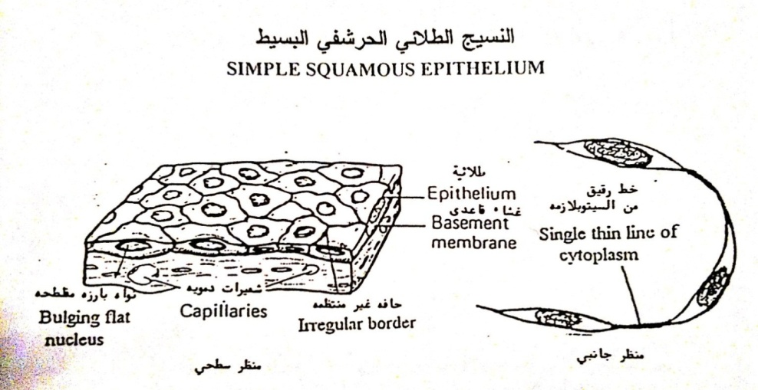
Squamous epithelium

Slide 10
Simple Cuboidal Epithelium
Cuboidal cells are roughly square or cuboidal in shape.
Each cell has a spherical central nucleus.
It is found in glands and ducts.
They are found lining of kidney tubules.
They constitute the germinal epithelium which produces the egg cells in the ovary and the sperm cells in the testes.

Slide 11
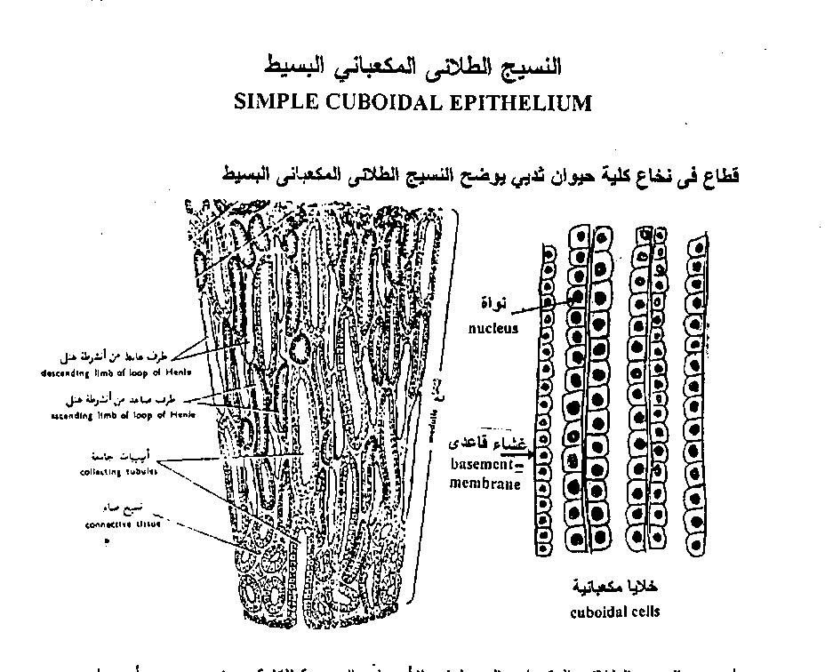
Simple Cuboidal Epithelium

Slide 12
Simple Columnar Epithelium
The cells are elongated and column-shaped.
The nuclei are elongated and are usually oval and basal.
Its form the lining of the stomach and intestines.
Some columnar cells are specialized for sensory reception such as “sensory epithelium” in the nose, ears and the taste buds.
Goblet cells (unicellular glands) are found between the columnar epithelial cells of the duodenum. They secrete mucus or slime, a lubricating substance which keeps the surface smooth.
They may be ciliated or non-ciliated

Slide 13
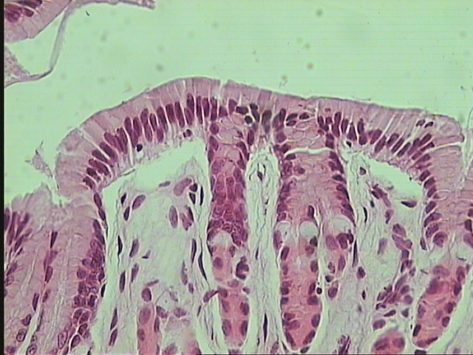
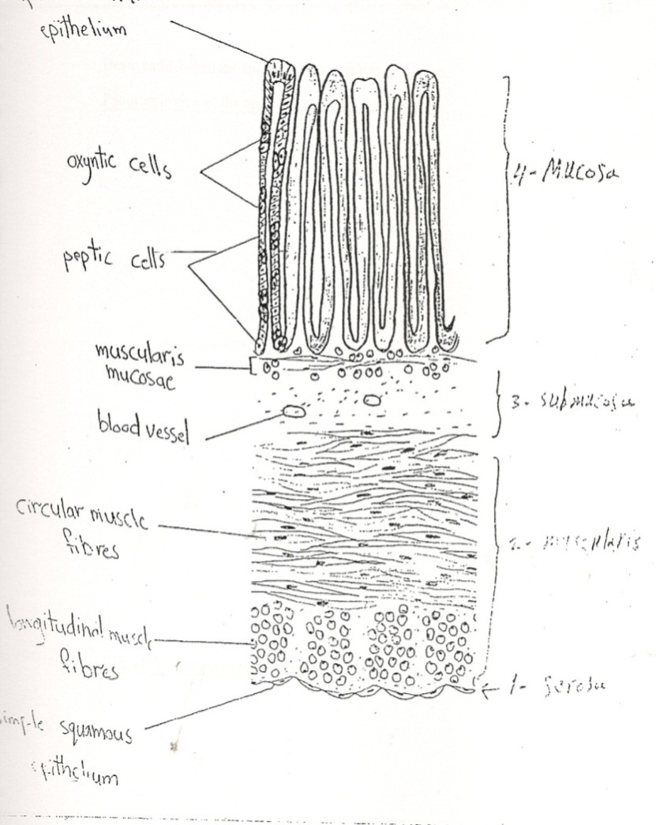
Simple Columnar Epithelium

Slide 14
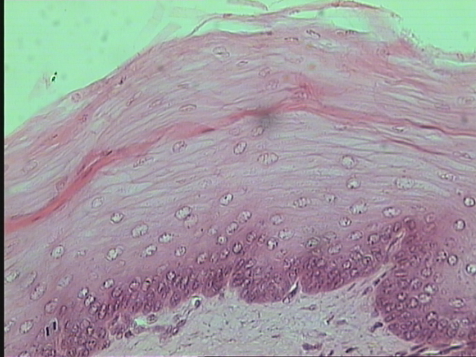
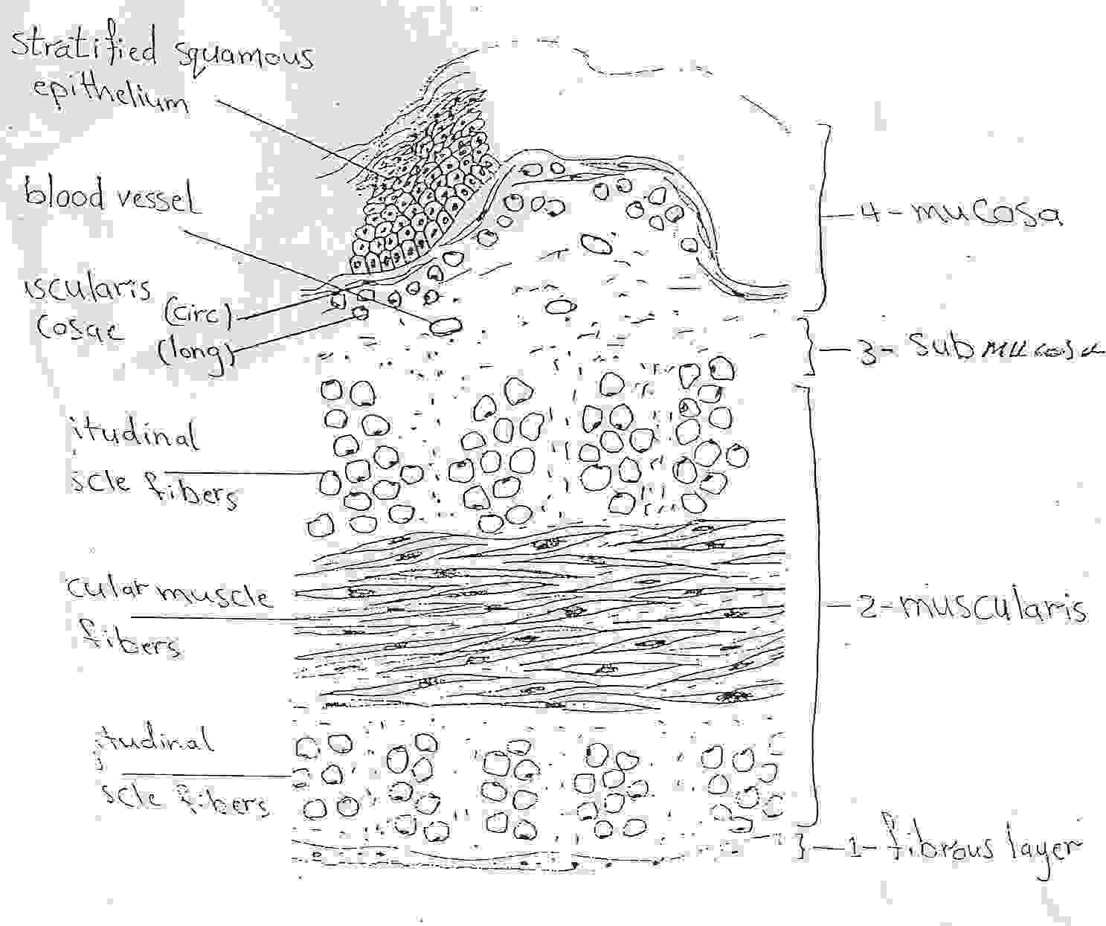
Stratified squamous epithelium

Slide 15
Glandular Epithelium
Epithelium of cells specialized to produce secretion. All glands are composed of epithelium.
Secretion – Exocytotic release of products, not metabolic wastes.
Columnar and cuboidal epithelial cells often become specialized as gland cells which are capable of synthesizing and secreting certain substances such as enzymes, hormones, milk, mucus, sweat, wax and saliva.

Slide 16
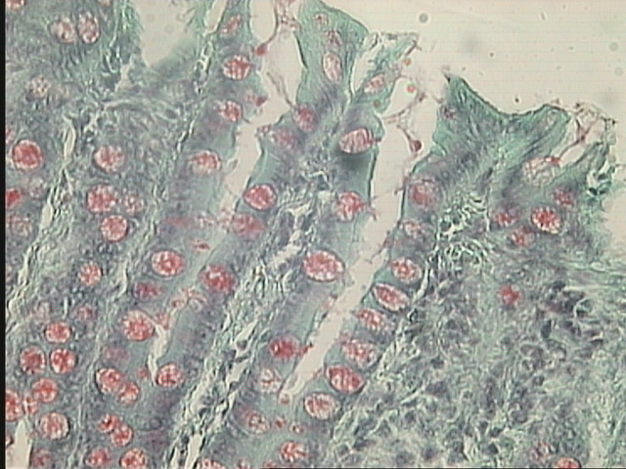
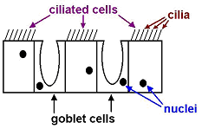
2
1
Glandular Epithelium

Slide 17
Under The Microscope

Slide 18
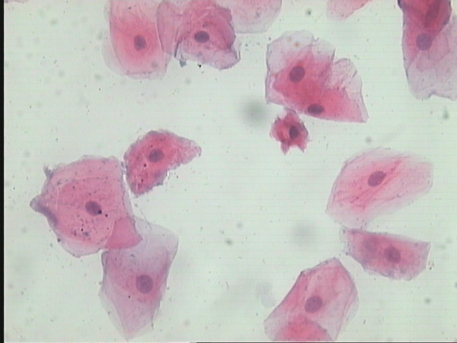
1
2
3
Simple Squamous Epithelium ( Lining of mouth )
1- Cell membrane
2- Cytoplasm
3- Nucleus

Slide 19
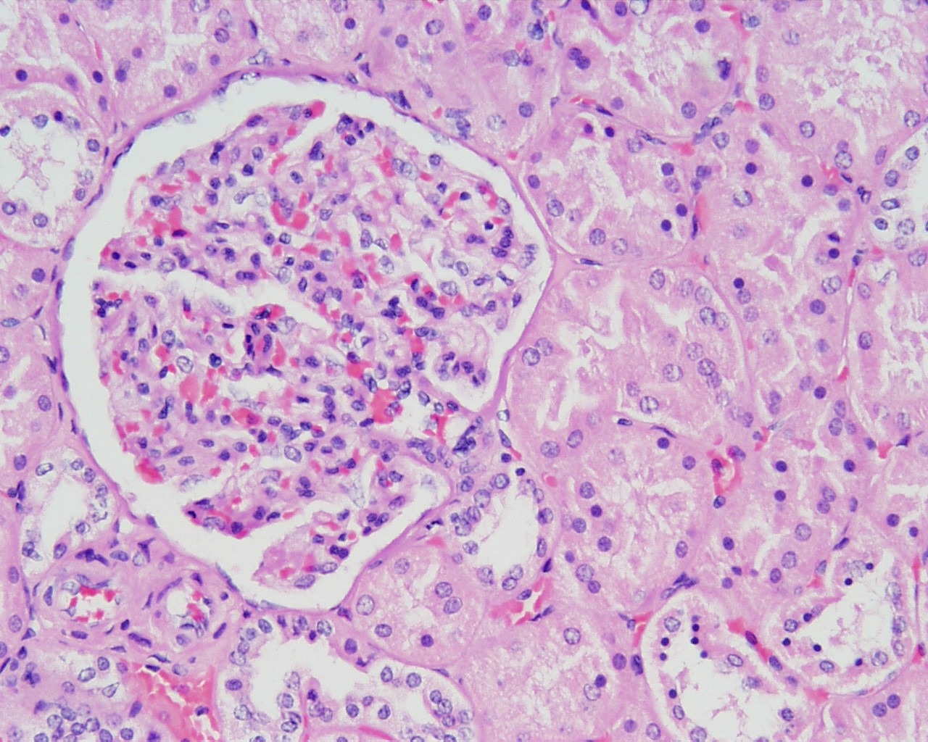
Squamous Epithelium
Side view
Bowman’s capsule
glomerulus
Simple Squamous Epithelium
(Bowman’s capsule )

Slide 20
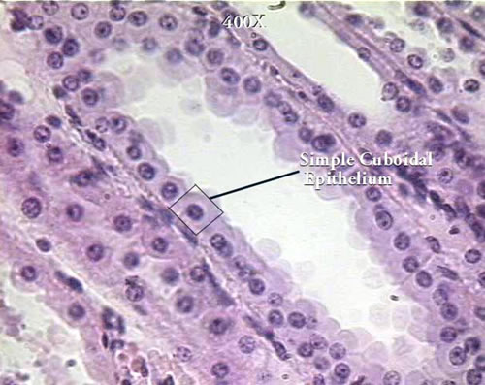
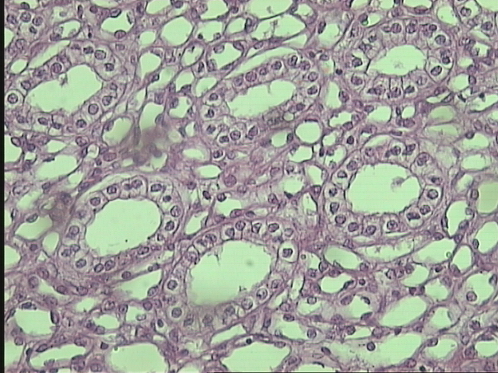
1
3
4
2
T.S of (collecting tubule (in the kidney
T.S of Thyroid gland
Simple Cuboidal Epithelium
1-Nucleus
2-Basement membrane
3-Cuboidal cell
4-Collecting Tubules

Slide 21
2
1
3
T.S of intestine
Simple Columnar Epithelium
1-Nucleus
2-Plasma membrane
3-Basement membrane

Slide 22
4
3
2
1
Stratified Squamous Epithelium
1-Basement membrane
2-Malpighian Layer
3-Spongy Layer
Cells 4-Squamous

Slide 23
2
1
Epithelium tissues (Goblet cells )
1-Goblet cells
2-Villi

Slide 24
Thank you
for your attention

