Slide 1
Macromedia Flash mx-2
CT1514

Slide 2
Motion Guide Layer
What is Motion Guide Layer?
Controls the movement of objects in a Motion tween animation
How to create a Motion Guide Layer?
Click on the
How to draw a Motion path on the Guide Layer?
Sing either the pencil tool or the line tool

Slide 3
Motion Guide Layer
Note: the created motion Guide layer will guide a selected layer ( an usually appears above that layer).
How to make it guide another layer or several layers? (Hint: Drag-drop)

Slide 4
Working with the (Library Panel)
Every created symbol in the current session is saved into the library panel
You can import any already designed image as symbol to the library panel from (File → import to library)

Slide 5
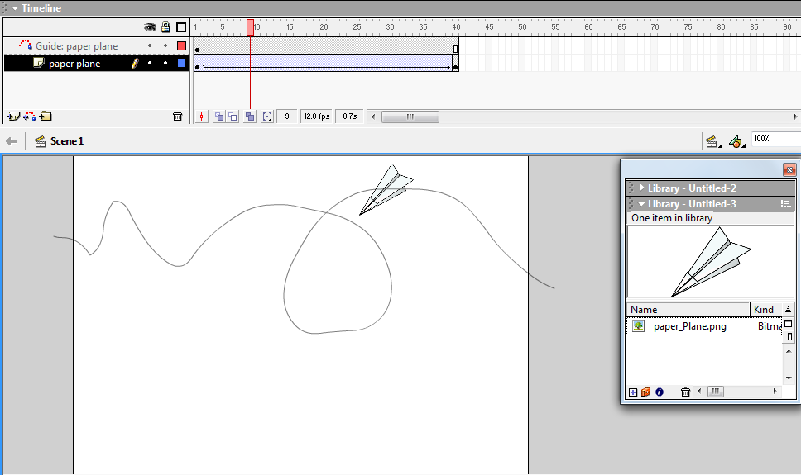
Example 1: Motion Guide Layer

Slide 6
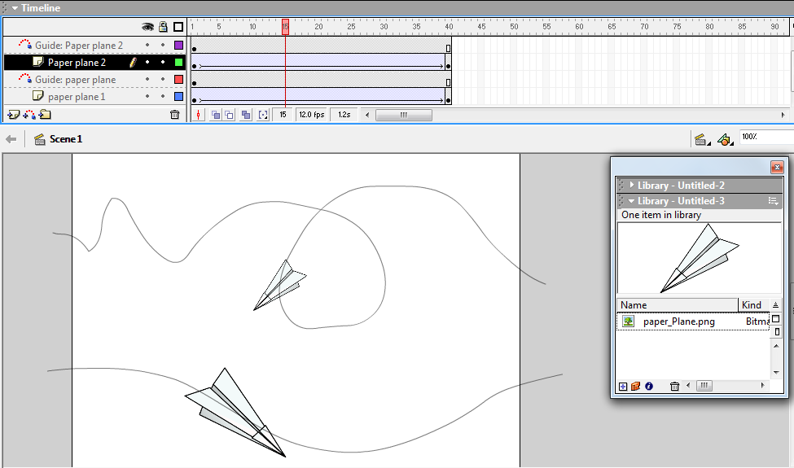
Example 2: Motion Guide Layer

Slide 7
Mask Layer
For spotlight effects and transitions, use a mask layer to create a hole through which underlying layers are visible.
A mask item can be a filled shape, a type object, an instance of a graphic symbol, or a movie clip.
Group multiple layers under a single mask layer to create sophisticated effects.

Slide 8
Example 3
Open a 550X400 new project
Name the current layer “Spot light” and do the following:
On frame (0) insert a keyframe, draw a circle, and convert it to a symbol.
On frame(30) insert a keyframe then move the circle to the opposite end.
On frame (60) insert a keyframe then move the circle back to its original position
Apply Motion tween on the frames (0) and (30)
Add new layer and name it “Text” and type a text (Welcome).
Make the “Spot light” layer a Mask layer (Right click →Mask)
Drag the “Text” layer under the “Spot light “ layer
Your time line will be as following:

Slide 9
Grouping Objects
You can group any number of object into one object using:
Ctrl+G or
Modify → Group
The objects to be grouped can be:
Images
Shapes
Symbols
Texts

Slide 10
Introduction To Action Scripts
How to Stop your movie from Repeating?
stop();

Slide 11
Introduction To Action Scripts: Automatic Stop
How to Stop your movie from Repeating Automatically at a certain time?
1-insert keyframe at that certain time
2-Go to the Action panel then type:
Stop();
Note that: Actions are the same as changes, can be applied on a Keyframe only Not a normal frame

Slide 12
Introduction To Action Scripts: Manual Stop
How to Stop your movie at any time Manually?
1-Create a button or clickable text on a separate layer
2-Highlight your button or clickable text then type the following Script:
on(press){
stop();
}

Slide 13
Introduction To Action Scripts: Manual Play
How to Play your movie at any time Manually?
1-Create a button or clickable text on a separate layer
2-Highlight your button or clickable text then type the following Script:
on(press){
play();
}

Slide 14
How to Create a Clickable Button?
Add a new layer (for each button)
Draw the button
Type the button text and place it on top of the button
Group (Button + Text) together using ctrl+G
Convert the grouped object into a button symbol
Select the grouped object then go to the action panel to type the script

Slide 15
How to Create a Clickable Text?
Add a new layer (for each clickable)
Type the button text
Convert the text to a button symbol
Select the text then go to the action panel to type the script

Slide 16
How to Create a Clickable Image?
Add a new layer (for each Image)
Import the image to library then drag it to stage
Type the image text and place it on top of the image
Group (image + Text) together using ctrl+G
Convert the grouped object into a button symbol
Select the grouped object then go to the action panel to type the script

