Slide 1
Files and Streams

Slide 2
Objectives
Learn about the classes that support file input/output
Understand the concept of abstraction and how it related to the file I/O model
Connecting files and streams
Learn how to read sequential text files
Learn how to write sequential text files
Text files = streams of characters perhaps with special characters (often the end of line character) that mark the end of a line.

Slide 3
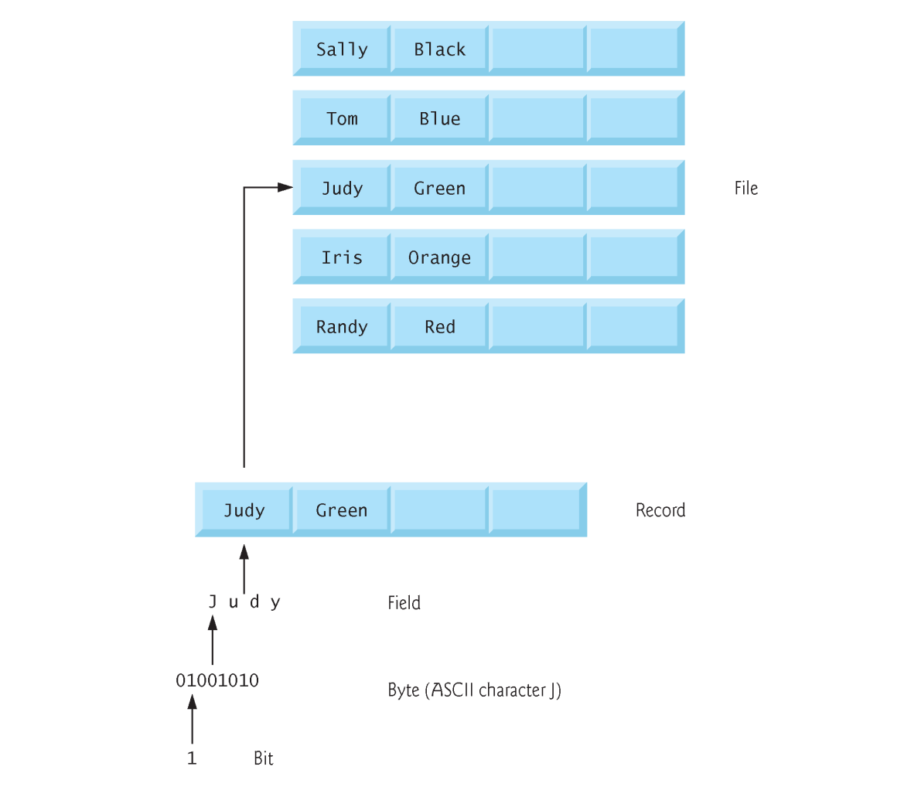
Data Hierarchy

Slide 4
The Directory Class
Common methods of the Directory class
  Exists (path designation)
  CreateDirectory (path designation)
  Delete (path designation)
Code that uses some of the Directory methods
Dim dir As String = "C:\VB 2005\Files\"
If Not Directory.Exists(dir) Then
Directory.CreateDirectory(dir)
End If

Slide 5
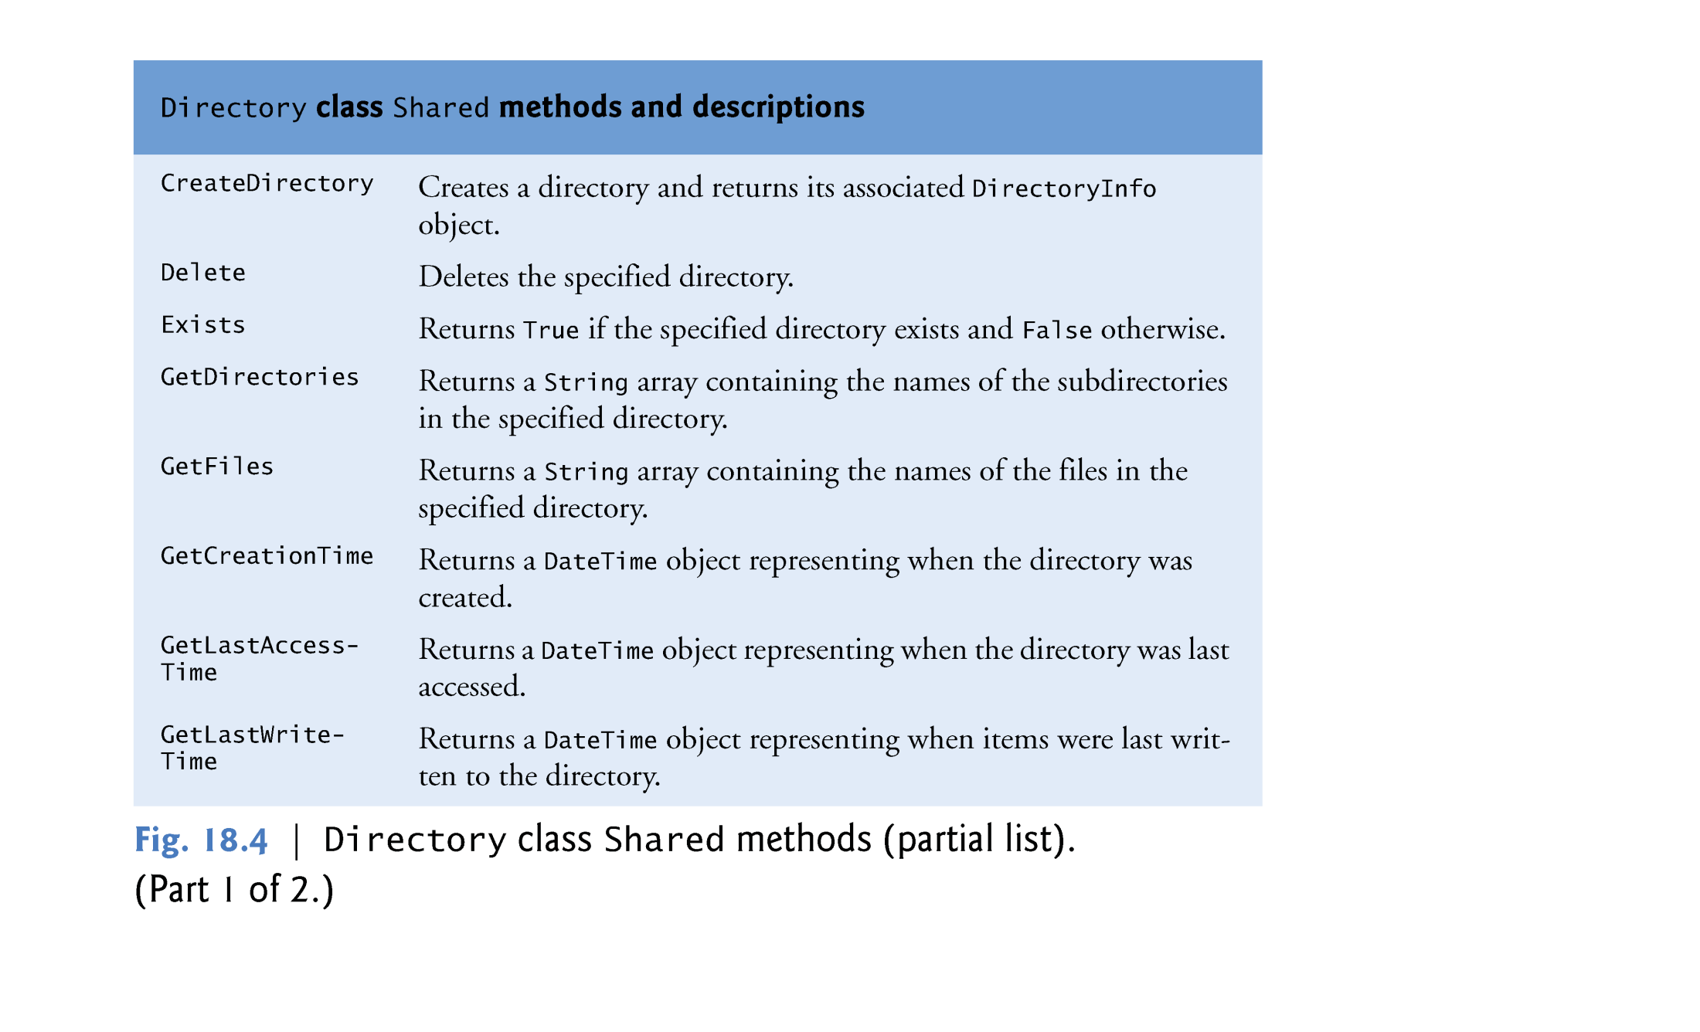
The Directory Class

Slide 6
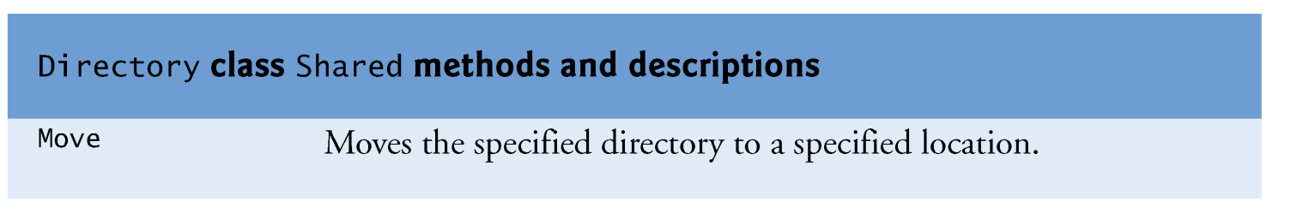
The Directory Class

Slide 7
The File Class
Common methods of the File class
  Exists (path)
  Delete (path)
  Copy (source, dest)
  Move (source, dest)
Code that uses some of the File methods
Dim path As String = dir & "Products.txt"
If File.Exists(path) Then
File.Delete(path)
End If

Slide 8
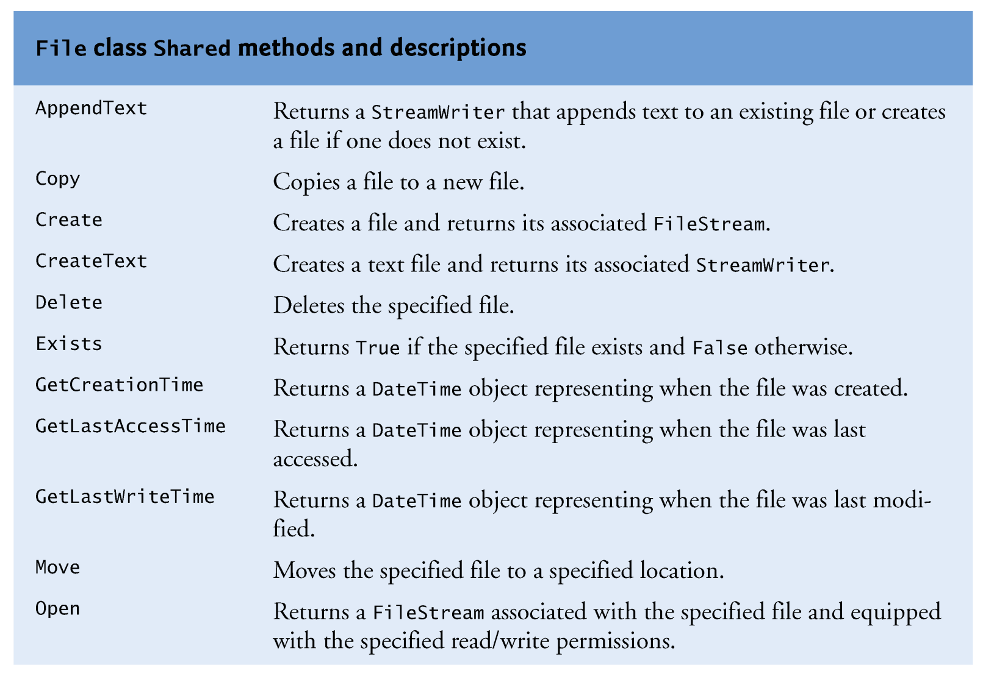
The File Class

Slide 9
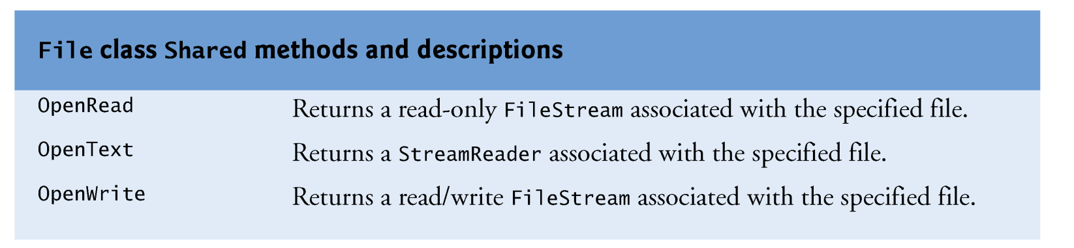
The File Class

Slide 10
Introduction to Files and Streams
System.IO classes are used to work with files and streams
You can work with two kinds of files – text files (containing only characters) and binary files
In this Lecture Set, we discuss text files in detail – we present material on binary files later but will not discuss them in this course

Slide 11
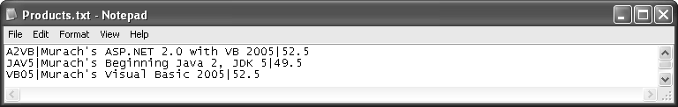

Text vs Binary Files
A text file displayed in a text editor
A binary file displayed a text editor

Slide 12
Introduction to Processing Textual Data
One way to process textual files is from beginning to end using sequential access
This type of file is called a sequential file
Sequential files can be categorized into roughly three types
  Free-form files have no particular format
  Fields in a delimited file are separated with a special character called a delimiter
  In a fixed-field file, each field occupies the same character positions in every record
There are other types of files in addition to sequential files: binary files; direct (random or indexed) access files

Slide 13
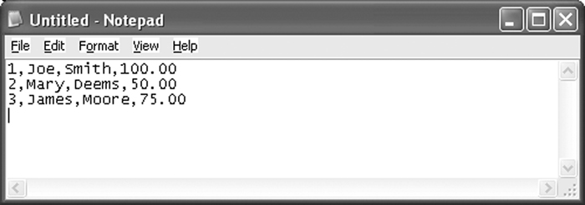
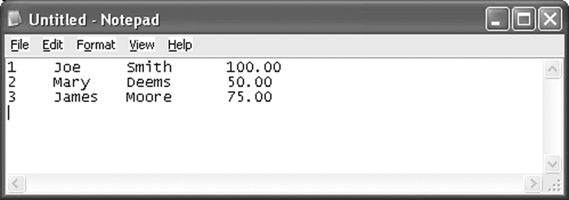
Introduction to Processing Textual Data
Delimited file
Fixed-field file

Slide 14
The Object Framework
For files, the object is an instance of a class that provides an abstract view of a file. This view is modeled by a Stream class (StreamReader or StreamWriter classes).
The stream abstraction (methods and data stores) of a file that you program against
(reading and writing an entire file, a line at a time, or a field at a time)
The actual, physical file to be manipulated
The connection – via creation of a streamReader or streamWriter object

Slide 15
The Stream-File Connection
When you program the manipulation of files, you are really programming “against” the stream abstraction:
  FileStream
  StreamReader
  StreamWriter
  BinaryReader
  BinaryWriter

Slide 16
Establishing Connections
There are several different ways to establish file-stream connections
  Create a FileStream object
Dim path as String = “C:\VB 2005\Files\Products.txt
Dim fs as New FileStream(path, FileMode.create, _
FileAccess.Write)
  2. Create a StreamReader object
3. Create a StreamWriter object
The results of using these techniques are similar – they all result in the creation of (or opening of) a stream (fs) against which all subsequent file operations are written

Slide 17
The FileStream Class
The syntax for creating a FileStream object
New FileStream(path, FileMode, FileAccess, share]])
Members in the FileMode enumeration
  Append – opens a file if it exists and place the write pointer at the end of the file
  Create – Creates a new file. If file exists it is overwritten
  CreateNew – Creates a new file. If file already exists an exception is thrown
  Open – Opens an existing file. If file does not exist, an exception is thrown
  OpenOrCreate – Opens a file if it exists or creates a new file if it does not exist
  Truncate –Opens an existing file and truncates it to zero bytes (erases its contents)

Slide 18
The FileStream Class
Members in the FileAccess enumeration
  Read
  ReadWrite
  Write
Members in the FileShare enumeration
  None
  Read
  ReadWrite
  Write
Common method of the FileStream class
  Close()
Example
Dim path as String = “C:\VB 2005\Files\Products.txt
Dim fs as New FileStream(path, FileMode.create, FileAccess.Write)

Slide 19
The StreamReder Class
The StreamReader and StreamWriter classes belong to the System.IO namespace
Sequential files can be read one character at a time, one line at a time, or the entire file can be read at once
Sequential files are typically read into a string or an array
Closing a file disconnects the application from the file

Slide 20
The StreamReder Class
  The StreamReader constructor accepts one argument – the path and filename of the sequential file to open.
  Dim CurrentReader As StreamReader = _
  New System.IO.StreamReader( _
  "C:\Demo.txt")
  The Close method closes a sequential file.
  Always close files when processing is complete to prevent loss of data
  Open files also consume system resources
  Example:
  CurrentReader.Close()

Slide 21
The StreamReder Class
The Close method closes an open file.
The Peek method gets the next character without actually reading the character. The method returns the Integer code point of the character that will be read. The method returns -1 if there are no more characters to read
The Read method reads a single character or many characters. Without arguments, the Read method returns the Integer code point of the character read
The ReadLine method reads a record. The carriage return at the end of the record is discarded. The method returns a String containing the characters read.
The ReadToEnd method reads from the current file position to the end of the file. The method returns a String containing the characters read

Slide 22
Reading Entire Content of File

Slide 23
Reading a Sequential File One Record at a Time
Dim CurrentReader As New _
System.IO.StreamReader("C:\Demo.txt")
Dim CurrentRecord As String
CurrentRecord = CurrentReader.ReadLine()
Do Until CurrentRecord = Nothing
' Statements to process the current record.
CurrentRecord = CurrentReader.ReadLine()
Loop
CurrentReader.Close()

Slide 24
The StreamWriter Class
The StreamWriter class of the System.IO namespace writes a sequential file
The constructor accepts one argument – the file to write
Example:
  Dim CurrentWriter As New _
  System.IO.StreamWriter("C:\Demo.txt")
  ' Statements to write the file.
  CurrentWriter.Close()

Slide 25
The StreamWriter Class
The NewLine property contains the character(s) that mark the end of the line
The Close method closes the sequential file
  It's imperative to close a sequential file once writing is complete to prevent loss of data
The Write method writes a character or array of characters
The WriteLine method writes data terminated by the character(s) stored in the NewLine property
If the data type passed to Write or WriteLine is not a string, these methods will call toString
  Individual variables must be concatenated and separators must be used

Slide 26
StreamWriter Example
Code that writes data from a collection of Product objects to a text file
Dim textOut As New StreamWriter( _
New FileStream( path, _
FileMode.Create, FileAccess.Write))
For Each product As Product In products
textOut.Write(product.Code & "|")
textOut.Write(product.Description & "|")
textOut.WriteLine(product.Price)
Next
textOut.Close()

Slide 27
Writing a Freeform File
A freeform file can be written all at once as follows:
  Dim StringData As String = "Freeform text"
  Dim CurrentWriter As New _
  System.IO.StreamWriter("C:\Demo.txt")
  CurrentWriter.Write(StringData)
  CurrentWriter.Close()

Slide 28
Writing a Delimited File
Write an array of Integers
  Public Shared Sub WriteIntegerList( _
  ByRef argArray() As Integer, _
  ByVal argFile As String)
  Dim CurrentStream As New StreamWriter(argFile)
  Dim CurrentIndex As Integer
  For CurrentIndex = 0 To argArray.GetUpperBound(0)
  CurrentStream.Write(argArray(CurrentIndex))
  If CurrentIndex <> _
  argArray.GetUpperBound(0) Then
  CurrentStream.Write(",")
  End If
  Next
  CurrentStream.Close()
  End Function

Slide 29
Exception Handling
VB.NET has an inbuilt class that deals with errors. The Class is called Exception.
When an exception error is found, an Exception object is created. The coding structure VB.NET uses to deal with such Exceptions is called the Try … Catch structure.
In the coding area for your button, type the word Try. Then hit the return key on your keyboard. VB.NET completes the rest of the structure for you:
    Try
    Catch ex As Exception
    End Try

Slide 30
Exception Handling
The Try word means “Try to execute this code”.
The Catch word means “Catch any errors here”.
The ex is a variable, and the type of variable is an Exception object.
When you run your program, VB will Try to execute any code in the Try part. If everything goes well, then it skips the Catch part. However, if an error occurs, VB.NET jumps straight to Catch.

Slide 31
Exception Handling
FileName = “C:\test10.txt”
fs = new FileStream(FileName, FileMode.Open, FileAccess.Read)

Slide 32
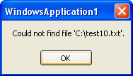
Exception Handling
Because ex is an object variable, it now has its own Properties and methods.
One of these is the Message property. Run your program and test it out. Click your button.
You should see the following error message:

Slide 33
Exception Handling
The point about this new message box is that it will not crash your program. You have handled the Exception, and displayed an appropriate message for the user.
If you know the kind of error that a program might throw, you can get what Type it is from the Error message box you saw earlier. This one:

Slide 34
Click the View Details links under Actions to see the following:

Slide 35
Exception Handling
The first line tells us the Type of Exception it is: System.IO.FileNotFoundException
You can add this directly to the catch part. Previously, you were just catching any error that might be thrown: Catch ex As Exception
But if you know a “file not found” error might be thrown, you can add that to the Catch line, instead of Exception: Catch ex As System.IO.FileNotFoundException
You can keep the Exception line as well. (You can have as many Catch parts as you want.) This will Catch any other errors that may occur:
Try
fs = new FileStream(FileName, FileMode.Open, FileAccess.Read)
Catch ex As System.IO.FileNotFoundException
MsgBox(“Can’t find this file”)
Catch ex As Exception
MsgBox(ex.Message)
End Try

Slide 36
Exception Handling
There is one last part of the Try … Catch Statement that VB.NET doesn’t add for you → Finally:
    Try
    Catch ex As Exception
    Finally
    End Try
The Finally part is always executed, whether an error occurs or not. You typically add a Finally part to perform any cleanup operations that are needed.
For example, you may have opened a file before going into a Try … Catch Statement. If an error occurs, the file will still be open. Whether an error occurs or not, you still need to close the file. You can do that in the Finally part.

