Slide 1
Object-Oriented Programming: Inheritance
Chapter 2

Slide 2
Introduction
Inheritance is a form of software reuse in which a new class is created quickly and easily by absorbing an existing class’s members and customizing them with new or modified capabilities.
With inheritance, you can save time during program development and build better software by reusing proven, high-quality classes.

Slide 3
Introduction
When creating a class, rather than declaring completely new members, you can designate that the new class inherits the members of an existing class.
The existing class is called the base class, and the new class is the derived class.

Slide 4
Introduction
A derived class can add its own instance variables, Shared variables, properties and methods, and it can customize methods and properties it inherits.
Therefore, a derived class is more specific than its base class and represents a more specialized group of objects.

Slide 5
Base Classes and Derived Classes
Inheritance enables an is-a relationship.
In an is-a relationship, an object of a derived class also can be treated as an object of its base class.
For example, a car is a vehicle.
The next slide lists several simple examples of base classes and derived classes—base classes tend to be more general and derived classes tend to be more specific.
Base-class objects cannot be treated as objects of their derived classes—although all cars are vehicles, not all vehicles are cars (the other vehicles could be trucks, planes or bicycles, for example)

Slide 6
Base Classes and Derived Classes

Slide 7
Example: CommunityMember Inheritance Hierarchy

Slide 8
Base Classes and Derived Classes
Each arrow in the inheritance hierarchy represents an is-a relationship.
As we follow the arrows upward in this class hierarchy, we can state, for instance, that “an Employee is a CommunityMember” and “a Teacher is a Faculty member.”
A direct base class is the class from which a derived class explicitly inherits.
An indirect base class is inherited from two or more levels up in the class hierarchy.

Slide 9
Declaration of Base Class and Derived Class
Public Class BaseClass
End Class
--------------------
Public Class DerivedClass Inherits BaseClass
End Class

Slide 10
Example
Person
m_Name
SSN
Student
Derived Class | Base Class
Class Student Inherits Person Private m_ClassGroup As String P ublic Sub New(ByVal N As String, ByVal S As Integer, ByVal G As String ) MyBase.New(N, S) m_ClassGroup = G End Sub Public Property ClassGroup() As String Get ClassGroup = m_ClassGroup End Get Set(ByVal value As String) m_ClassGroup = value End Set End Property End Class | Class Person Private m_Name As String Private SSN As Integer P ublic Sub New(ByVal N As String, ByVal S As Integer) m_Name = N SSN = S End Sub Public Property Name() As String Get Name = m_Name End Get Set(ByVal value As String) m_Name = value End Set End Property End Class
M_classGroup

Slide 11
Inheritance Rules
By default, all classes are inheritable unless marked with the NotInheritable keyword.
Visual Basic allows only single inheritance in classes; that is, derived classes can have only one base class.
To prevent exposing restricted items in a base class, the access type of a derived class must be equal to or more restrictive than its base class.

Slide 12
Inheritance Modifier
Visual Basic introduces the following class-level statements and modifiers to support inheritance:
Inherits statement — Specifies the base class.
NotInheritable modifier — Prevents programmers from using the class as a base class.
MustInherit modifier — Specifies that the class is intended for use as a base class only. Instances of MustInherit classes cannot be created directly; they can only be created as base class instances of a derived class.

Slide 13
Constructer
Constructors are not inherited, so class Student does not inherit class Person’s constructor.
In fact, the first task of any derived-class constructor is to call its direct base class’s constructor to ensure that the instance variables declared in the base class are initialized properly.
Ex. MyBase.New(N, S)
If the code does not include call to the base-class constructor, Visual Basic implicitly calls the base class’s default or parameterless constructor.

Slide 14
Private member
In inheritance, Public members of the base class become Public members of the derived class.
A base class’s Private members are not inherited by its derived classes.
Derived-class methods can refer to Public members inherited from the base class simply by using the member names.
Derived-class methods cannot directly access Private members of their base class.
A derived class can change the state of Private base-class instance variables only through Public methods provided in the base class and inherited by the derived class.

Slide 15
Overriding Properties and Methods in Derived Class (Polymorphism)
By default, a derived class inherits properties and methods from its base class.
If an inherited property or method has to behave differently in the derived class it can be overridden.
Overriding means define a new implementation of the method in the derived class.

Slide 16
Overriding Properties and Methods in Derived Class
The following modifiers are used to control how properties and methods are overridden:
Overridable — Allows a property or method in a class to be overridden in a derived class.
Overrides — Overrides an Overridable property or method defined in the base class.
NotOverridable — Prevents a property or method from being overridden in an inheriting class. By default, Public methods are NotOverridable.
MustOverride — Requires that a derived class override the property or method. When the MustOverride keyword is used, the method definition consists of just the Sub, Function, or Property statement.
MustOverride methods must be declared in MustInherit classes.

Slide 17
The MyBase Keyword
The MyBase keyword behaves like an object variable that refers to the base class of the current instance of a class.
MyBase is frequently used to access base class members that are overridden or shadowed in a derived class.
Class BaseClass
Public Overridable Function CalculateShipping(
ByVal Dist As Double, ByVal Rate As Double) As Double
Return Dist * Rate
End Function
End Class

Slide 18
The MyBase Keyword
The following list describes restrictions on using MyBase:
MyBase refers to the immediate base class and its inherited members. It cannot be used to access Private members in the class.
MyBase is a keyword, not a real object.
The method that MyBase qualifies does not have to be defined in the immediate base class.
You cannot use MyBase to call MustOverride base class methods.

Slide 19
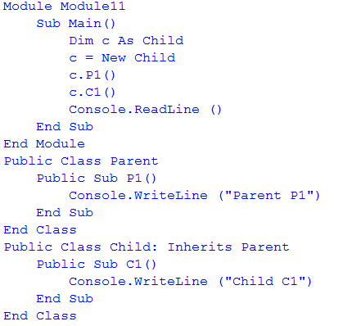
Examples

Slide 20
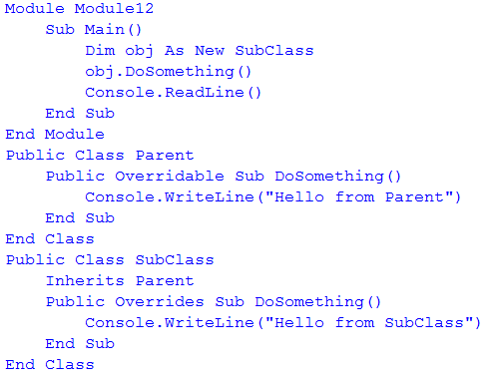
Examples

Slide 21
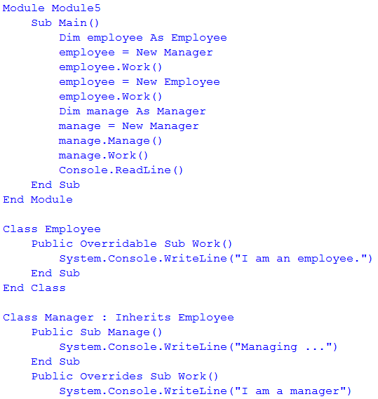
Example

Slide 22
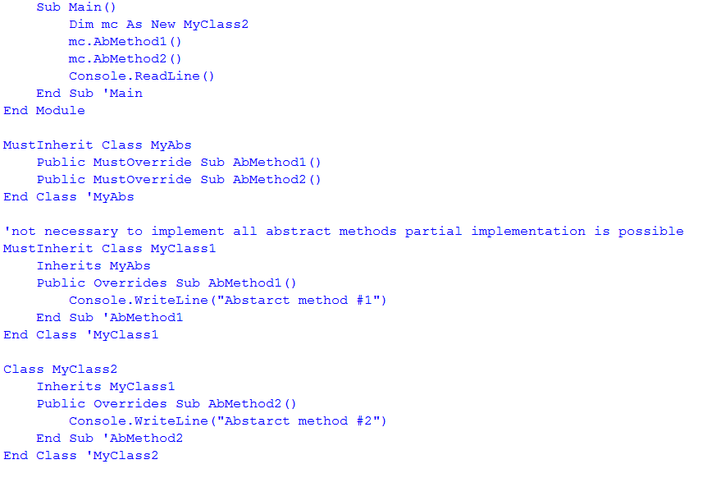
Example

