Slide 1
Introduction
l.Ghadah R. Hadba

Slide 2
Computer Graphics Vs. Image Processing Vs. Image Editing
Computer Graphics :refers to processing of creating a new image from Geometry , Lighting parameters , Materials and Textures .Using a Computer or any other digital media (using languages such as: OpenGL)
Image Processing: is the process of manipulating an image acquired through some device . The image too often will be acquired from photographs, scanners , medical equipments (using environments such as: MATLAB)
Image editing enable a person to manipulate visual images on a computer. (using editing programs such as: Adobe Photoshop, Adobe illustrator)

Slide 3
Images Types
Image editing Programs can be divided based on picture type they deal with.
There is 2 basic types for pictures
Bitmap Images
Vector Images

Slide 4
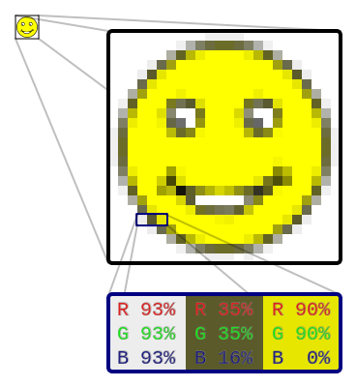
Picture Types: Bitmap Images
A representation of a two-dimensional ,finite set ,of digital values (pixels)
Pixel value typically represents (gray level, color, opacities…etc
Editing bitmap images means editing the prosperities of it’s pixels (NOT editing an item or a shape in this image)
Zooming in and out may lead to image distortion or lose in some of it's details
Affected by the number of pixels per inch(Resolution)
(How?)

Slide 5
Picture Types: Vector Images
Consist of geometrical primitives such as points, lines, curves…etc which are all based on mathematical expressions.
Editing vector images and Zooming in and out means recalculate the mathematical expressions with the new values (re-draw the vector image)
Not Affected by the resolution
(Why?)

Slide 6
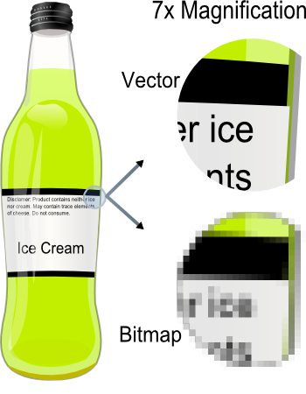
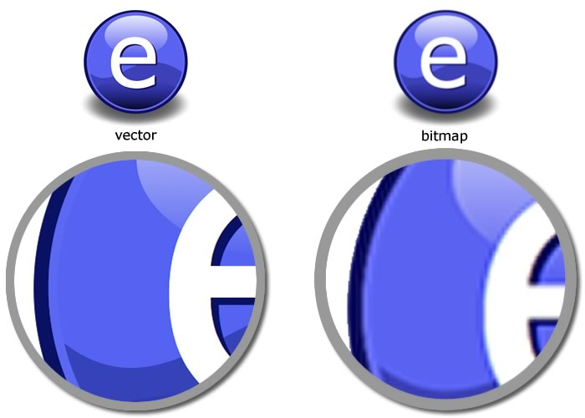
Bitmap Vs. Vector Images
Example (1)
Example (2)

Slide 7
Introduction to Adobe photoshobe

Slide 8
Introduction
What type for images does Photoshop deal with?
What type should I choose for my final Photoshop image?
The file is too big for transmitting over internet!!
The image quality is bad after printing it!!
….

Slide 9
Adobe Photoshop CS4
Adobe Photoshop is primarily a raster bitmap editor.
Adobe Illustrator is primarily a vector graphics editor.
The recent versions of bitmap editors, such as Photoshop support vector-like tools (e.g. editable paths), and
vector editors such as Adobe Illustrator are gradually adopting tools and approaches that were once limited to bitmap editors (e.g. blurring).[1]

Slide 10
Photoshop Picture Formats
Pic | Use | Description | extinction | Picture Format
 | Commercial Presses | Consist of 2 parts: Scripted description that tell printer how the final image should be A preview picture of the content | (.eps) | Encapsulated PostScript(EPS)
 | Presses -maintaining quality | Is a high-quality file format. Now its owned by Adobe System Compress images without losing any of its’ values. | (.tif/.tiff) | Tagged Image File Format(TIF/TIFF)
 | Internet Images-Designing Icons | Very small size images Good quality Used basically in the Internet Support transparency | (.png) | Portable Network Graphic (PNG)
Vector file format

Slide 11
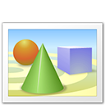
Photoshop Picture Formats
Pic | Use | Description | extinction | Picture Format
 | Saving Images –transforming images through internet-printing using home printers | Compress images with losing in its’ values. Support(24-bit color) 16 million color | (.jpg) | Joint Photographic Experts Group(JPEG/JPG)
 |  | Support Animation Support(8-bit color) 256 color Most popular extension in the internet | (.gif) | Graphical Interchange Format(GIF)
 |  | Image file created by Adobe Photoshop, may include image layers ,adjustment layers, layer masks, annotation notes, and other Photoshop-specific elements Enable editing | (.psd) | Adobe Photoshop Document (PSD)

Slide 12
File → Save AS

Slide 13
Colors Format
Grayscale | CMYK | RGB
Use 256 gray level (0: black-255: white) | Consist of 4 colors(Cyan, Magenta, Yellow, Black) Used with CMYK printers | Basic color system Consist of 3 colors( Red-Green-Blue)

Slide 14
Image → Mode

Slide 15
RGB
CMYK
Grayscale
Example of applying different color modes on an image

