Slide 1

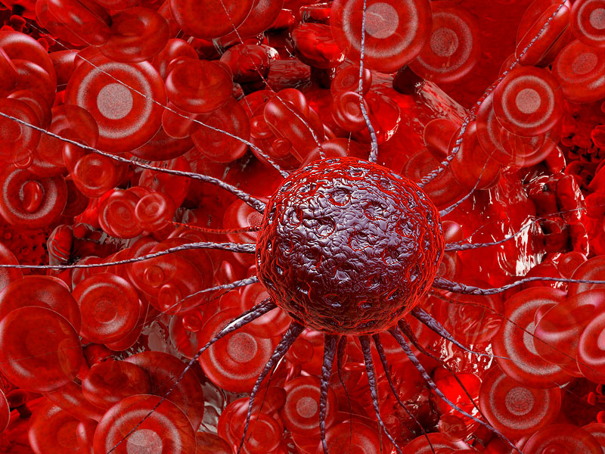
Cancer..
CHS 232
Lecture 5
Mrs. Lamis Al-Sayyari

Slide 2
Outline..
Introduction about cancer disease
What is the cancer
Type of cancer
What is Breast cancer
SIGNS AND SYMPTOMS
CAUSES AND RISK FACTORS
Complications
GENERAL CARE
HOME CARE
Prevention

Slide 3
Cancer…
Cancer is a common condition and a serious health problem. More than one in three people will develop some form of cancer during their lifetime.

Slide 4

What is Cancer ?..
Cancer is the name given to a collection of related diseases. In all types of cancer, some of the body’s cells begin to divide without stopping and spread into surrounding tissues.
Cancer is a universal disease that affects persons without regard to race, gender, socioeconomic status, or culture.
Different forms of cancer strike specific age , ethnic, and gender groups with varying frequency and severity

Slide 5


The most common sites of fatal cancer ..
Women:
Lungs
Breasts
Colon
Rectum
Men:
Lung
Prostate
Colon
rectum

Slide 6
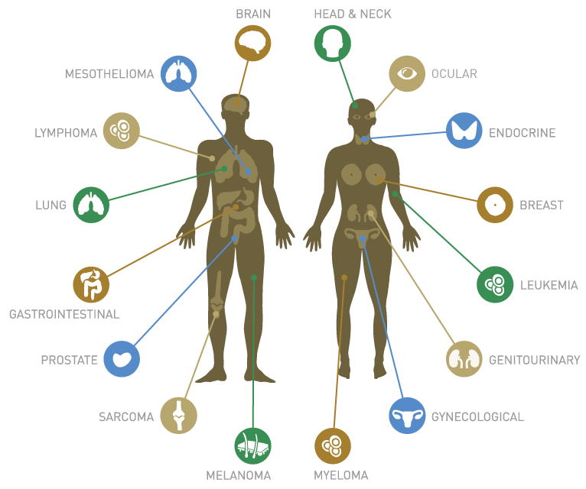

Slide 7
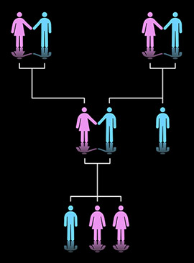
Some cancers like : stomach, breast cancer, rectum, uterus, and lung occur in a familial pattern.
The causes of cancer include immunosupperssive drugs and viruses (adenoviruses, papovaviruses, herpes viruses, human T-cell lymphoma-leukemia virus, Epsteinbarr virus, and hepatitis B virus)

Slide 8

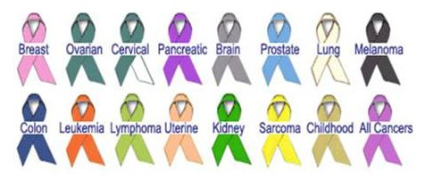
Terminology…
Doubling time: means length of time for division of all tumor cells present.
Direct invasion of contiguous organs or local spread: tumor cell can invade a structure such as uterus ; spreading from one organ to another.
Metastasis : spread of cancer from a primary site of origin to distant organs by lymphatics or blood vessels
Common sites of metastasis are the lung , liver , bones, brain

Slide 9

characteristic | Benign tumor | Malignant tumor
Structure and differention | Typical of tissue origin | Atypical of tissue origin
Rate of growth | Usually slow | May be slow, rapid, or very rapid
progression | Slowly progressive ( may remain stationary; may regress); rarely fatal if treated | Usually progressive; almost always fatal if untreated
Mode of growth | Expansion (encapsulated) | Infiltration and/or metastasis
Tissue destruction | No | Common (ulceration and necrosis)
Recurrence | Rare | Common
Prognosis | May be fatal if inaccessible | Fatal if uncontrolled

Slide 10
STAGING AND GRADING OF CANCER
The purpose of cancer staging and grading is to describe the extent of the malignant so that the physician can plan treatment.
Staging should be done during the pretreatment phase of disease and after surgery if that one of the prescribed treatments.
Clinical staging includes physical examination and evaluation of biopsy specimens.

Slide 11
STAGING AND GRADING OF CANCER
The generally used staging system (INM) is based on measurement of primary used tumor (size, depth of penetration, invasion of adjacent structures) lymph node involvement (presence, extent, and location); and metastatic spread (presence of distant metastases).

Slide 12
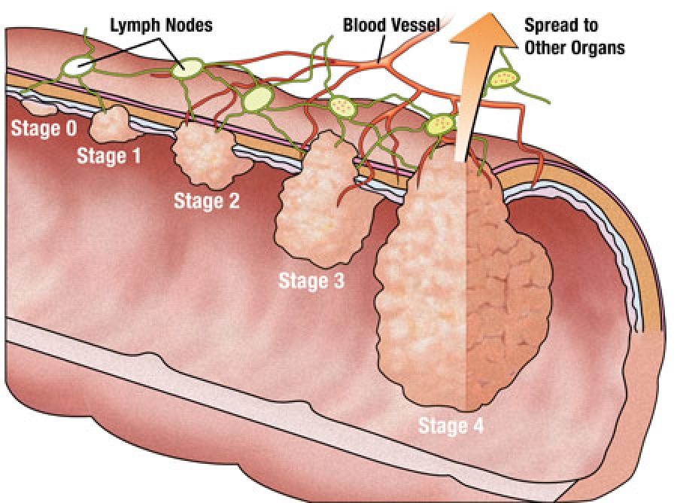
Stages

Slide 13
STAGING AND GRADING OF CANCER
Grading is histologic classification of a tumor, which is useful in determining prognosis. Cancers usually are classified as 1 (well differentiated) to 4 (poorly differentiated). The more poorly differentiated a tumor is, the less it looks like normal cells and the poorer the prognosis.
Notes:
Well-differentiated cancer cells look more like normal cells and tend to grow and spread more slowly than poorly differentiated or undifferentiated cancer cells

Slide 14
Types of Cancer:
Carcinomas: cancers of epithelial cell
Sarcomas: cancer of bone, muscle , or connective tissue.
Leukemias : cancers of blood-forming organs
Lymphomas: cancers of infection-fighting organs

Slide 15
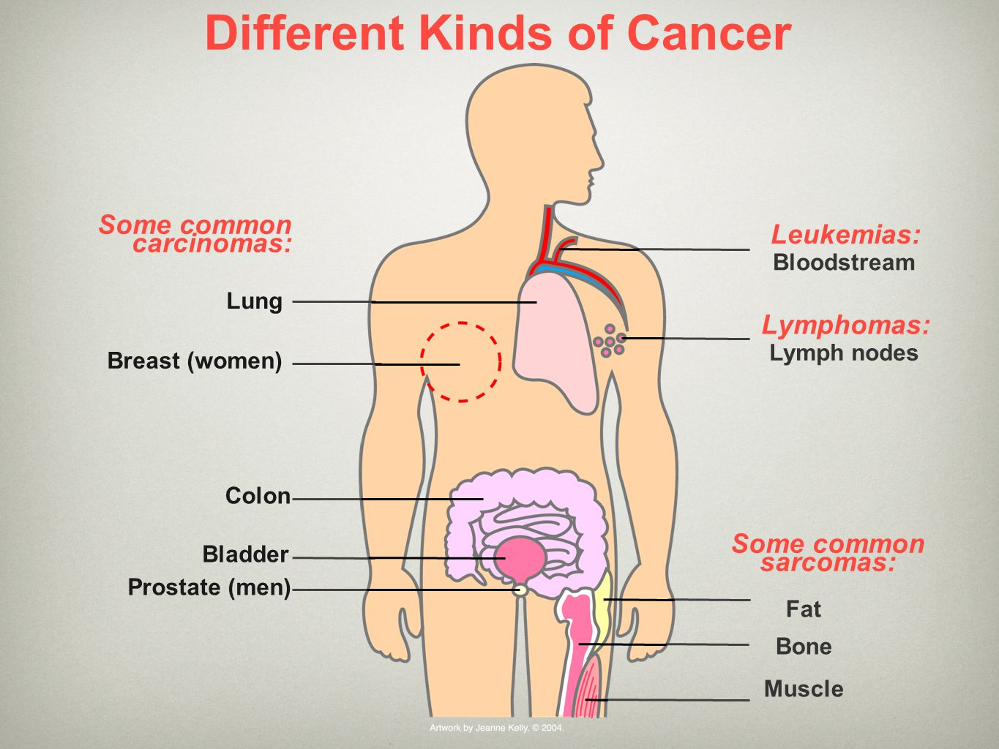

Slide 16


Brest cancer..

Slide 17
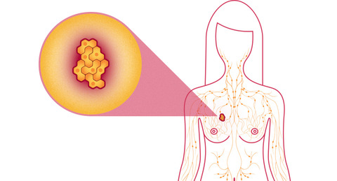
What is Brest Cancer..?
Definition : Breast cancer is a disease in which malignant (cancer) cells form in the tissues of the breast and divide and grow without control. The damaged cells can invade surrounding tissue, but with early detection and treatment, most people continue a normal life.

Slide 18
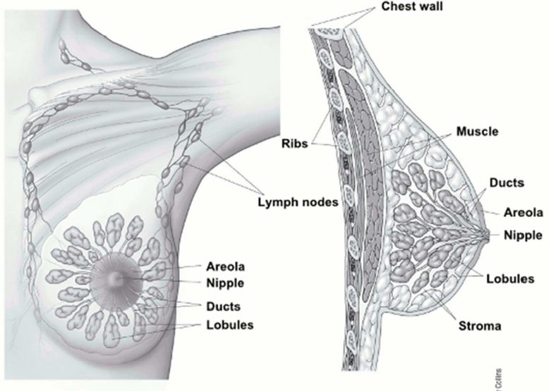
The normal Breast
A woman's breast is made up of glands that can make breast milk (lobules), small tubes that carry milk from the lobules to the nipple (ducts), fatty and connective tissue, blood vessels, and lymph vessels.

Slide 19
The lymph system of the breast
The lymph system is one of the main ways breast cancer spreads. Normally, lymph nodes are small, bean-shaped tissues that contain a certain kind of immune system cell (cells that fight infections). Lymph nodes are connected by vessels (like small veins) that carry a clear fluid called lymph instead of blood.
Most of the lymph vessels of the breast drain into:
Lymph nodes under the arm (axillary nodes)
Lymph nodes around the collar bone (supraclavicular and infraclavicular lymph nodes)
Lymph nodes inside the chest near the breast bone (internal mammary lymph nodes)

Slide 20
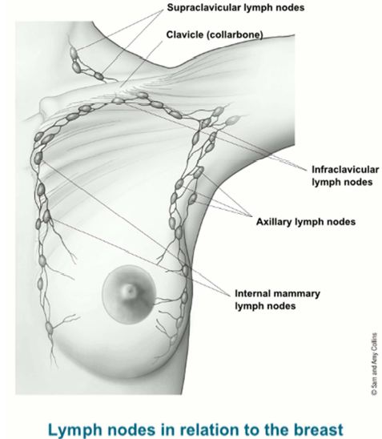

Slide 21
Lymph nodes in relation to the breast
Most breast cancers begin in the cells that line the ducts.
Fewer breast cancers start in the cells lining the lobules
Cancers can also start in cells of the other tissues in the breast. These are called sarcomas and lymphomas and are not really thought of as breast cancers.

Slide 22
Lymph nodes in relation to the breast
Breast cancer cells can travel in lymphatic vessels and begin to grow in lymph nodes. If cancer cells spread to lymph nodes, there is a greater chance that the cells have also spread to other places in the body. The chance goes up the more lymph nodes with cancer there are. Since cancer in lymph nodes doesn’t always cause the nodes to get larger, doctors often remove one or more lymph nodes to check for cancer spread.
The treatment plan will depend on whether or not cancer is found in the lymph nodes.

Slide 23

Video..
https://www.youtube.com/watch?v=NueGqrKnNcE
https://www.youtube.com/watch?v=VsviAPGfPUo
..

Slide 24
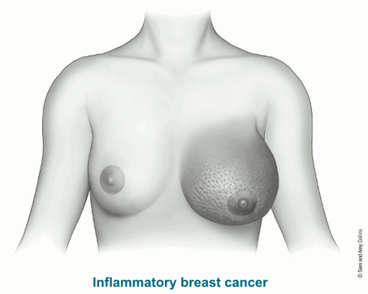
Breast cancer is believed to be a systemic disease , with the possibility of occult distant metastases occurring early in the disease with or without lymph node involvement.

Slide 25

HOW DO I KNOW IF I HAVE BREAST CANCER?...

Slide 26
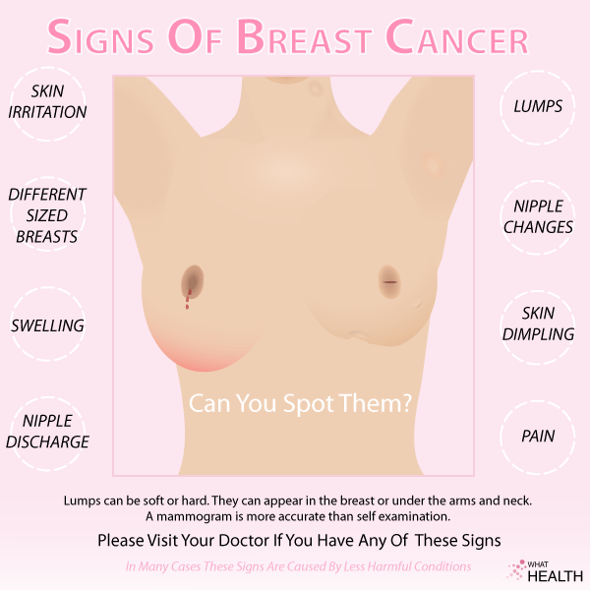
BREAST CANCER SIGNS & SYMPTOMS

Slide 27
BUT …… WHY DOES IT HAPPEN ?

Slide 28
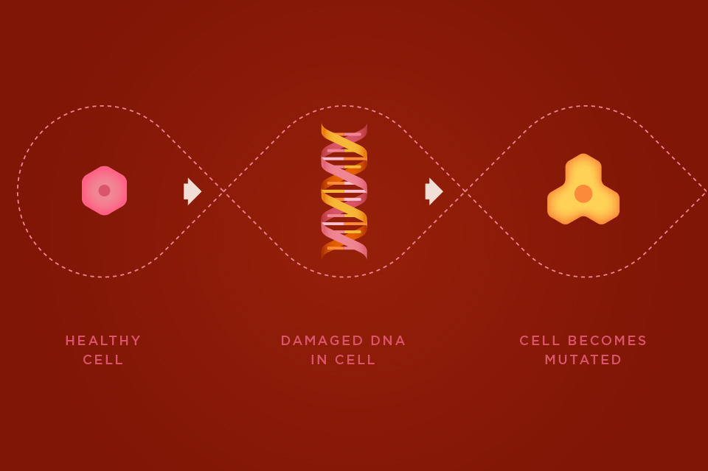
IT HAPPENS WHEN ….

Slide 29
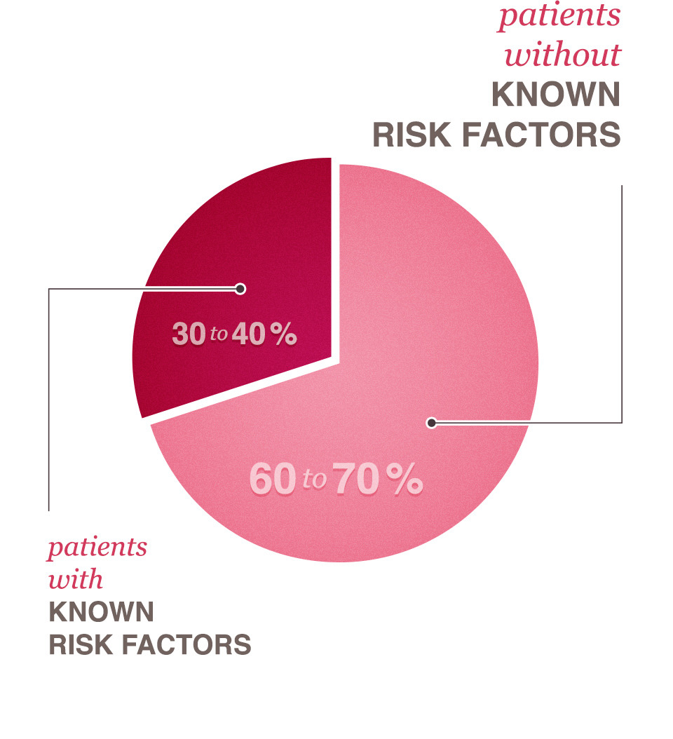
IT HAPPENS WHEN ….
Women with certain risk factors are more likely than others to develop breast cancer. A risk factor is something that may increase the chance of getting a disease. Some risk factors can be avoided. But most risk factors can’t be avoided.
Having a risk factor does not mean that a woman will get breast cancer. Many women who have risk factors never develop breast cancer.

Slide 30
Risk factors you cannot change
Gender: Breast cancer is much more common in women than in men.
Age: risk goes up with age.
Genetic risk factors: Inherited changes (mutations) in certain genes like BRCA1 and BRCA2 can increase the risk.
Family history: Breast cancer risk is higher among women whose close blood relatives have this disease.
Personal history of breast cancer: A woman with cancer in one breast has a greater chance of getting another breast cancer (this is different from a return of the first cancer).
Race: Overall, white women are slightly more likely to get breast cancer than African-American women. African-American women, though, are more likely to die of breast cancer.

Slide 31
Risk factors you cannot change
Dense breast tissue: Dense breast tissue means there is more gland tissue and less fatty tissue. Women with denser breast tissue have a higher risk of breast cancer.
Certain benign (not cancer) breast problems: Women who have certain benign breast changes may have an increased risk of breast cancer. Some of these are more closely linked to breast cancer risk than others.
Lobular carcinoma in situ: In this condition, cells that look like cancer cells are in the milk-making glands (lobules), but do not grow through the wall of the lobules and cannot spread to other parts of the body. It is not a true cancer or pre-cancer, but having LCIS increases a woman's risk of getting cancer in either breast later.

Slide 32
Risk factors you cannot change
Menstrual periods: Women who began having periods early (before age 12) or who went through menopause (stopped having periods) after the age of 55 have a slightly increased risk of breast cancer.
Breast radiation early in life: Women who have had radiation treatment to the chest area (as treatment for another cancer) as a child or young adult have a greatly increased risk of breast cancer.
Treatment with DES: Women who were given the drug DES (diethylstilbestrol) during pregnancy have a slightly increased risk of getting breast cancer.

Slide 33
Breast cancer risk and lifestyle choices
Not having children or having them later in life: Women who have not had children, or who had their first child after age 30, have a slightly higher risk of breast cancer.
Certain kinds of birth control: Studies have found that women who are using birth control pills or an injectable form of birth control called depot-medroxyprogesterone acetate (DMPA or Depo-Provera®) have a slightly greater risk of breast cancer than women who have never used them.
This risk seems to go back to normal over time once the pills are stopped.
Using hormone therapy after menopause: Taking estrogen and progesterone after menopause (sometimes called combined hormone therapy) increases the risk of getting breast cancer.
This risk seems to go back to normal over time once the hormones are stopped.

Slide 34
Breast cancer risk and lifestyle choices
Not breastfeeding: Some studies have shown that breastfeeding slightly lowers breast cancer risk, especially if breastfeeding lasts 1½ to 2 years.
Alcohol: The use of alcohol is clearly linked to an increased risk of getting breast cancer. Even as little as one drink a day can increase risk.
Being overweight or obese: Being overweight or obese after menopause (or because of weight gain that took place as an adult) is linked to a higher risk of breast cancer.

Slide 35
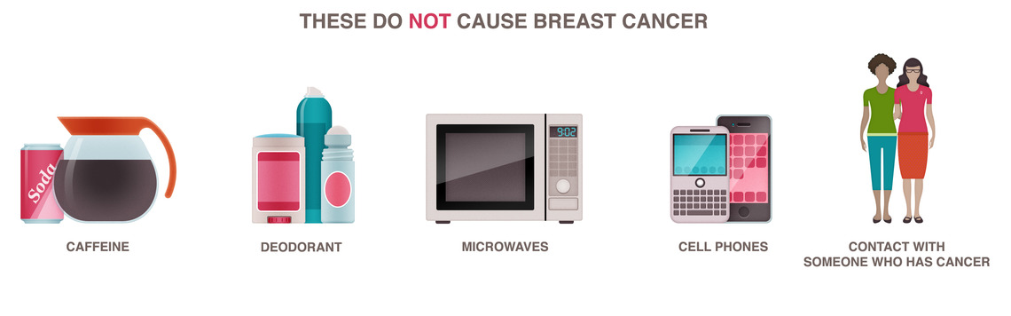

Certain factors have been studied without finding a link to breast cancer:

Slide 36
Is having a risk factor, or even several mean that a woman will get breast cancer??
Although many risk factors may increase your chance of having breast cancer, it is not yet known just how some of these risk factors cause cells to become cancer. Hormones seem to play a role in many cases of breast cancer, but just how this happens is not fully understood.

Slide 37
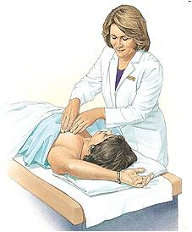
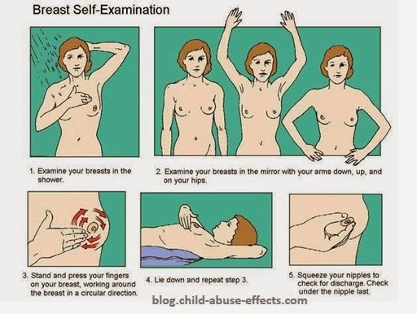
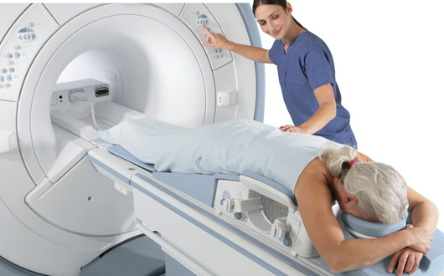
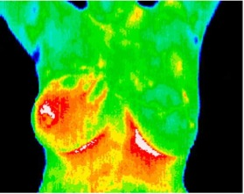
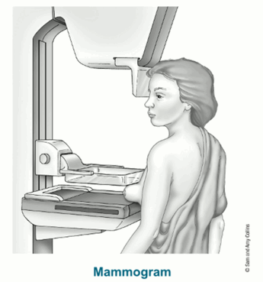
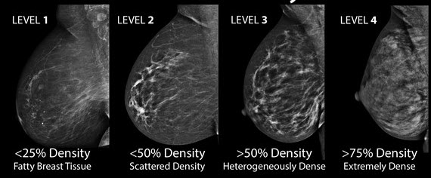
Types of standard screening techniques of breast cancer
The term screening refers to tests and exams used to find a disease like cancer in people who do not have any symptoms. The goal is to find cancers before they start to cause symptoms.
Match!:
Breast Self exam
Clinical breast exam
Mammography
Ultrasound
Magnetic Resonance imaging (MRI)
Thermography

Slide 38
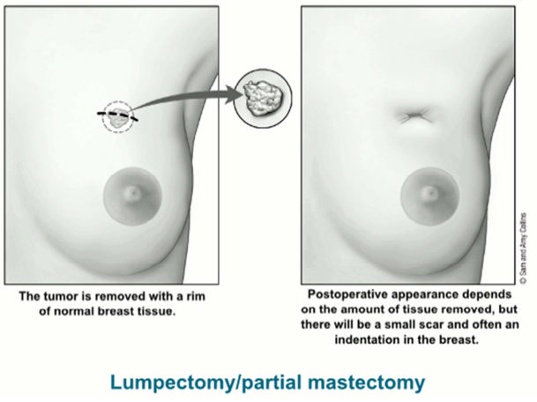
Treatment of Cancer
The main types of treatment for breast cancer are:
Surgery
Radiation
Chemotherapy Chemo can be used either before or after surgery for early-stage breast cancer. This is to kill any cancer cells that may have spread but are too small to be seen by exam or tests.
Hormone therapy
Targeted therapy
Bone-directed therapy

Slide 39
Possible side effects of chemotherapy:
The side effects of chemo depend on the type of drugs used, the amount given, and the length of treatment:
Hair loss
Loss of appetite or increased appetite
Nausea and vomiting
A higher risk of infection (from low white blood cell counts)
Stopping of menstrual periods
Easy bruising or bleeding (from low blood platelet counts)
Being very tired (called fatigue, often caused by low red blood cell counts or other reasons)

Slide 40
Metastases
Hypercalcemia
Spinal cord compression
Brachial plexopathy
Pleural effusion
Pathologic fracture
Lymphedema
Complications
Of BC

Slide 41
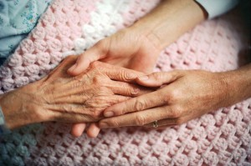
GENERAL CARE
General care for cancer patient addresses issues such as :
Loss of appetite
Nausea and vomiting
Stomatitis
as a result of cancer and its treatment and the effects of cancer on the mind, body and spirit .
The patient and caregiver should know the problems and how to manage them .

Slide 42
Nausea and vomiting
Eat crackers
Choose cold food
Avoid salty, sweet and spicy food
Stay away from food odors
Eat lightly
Try relaxation therapy
Take antiemetic as prescribed
Loss of appetite
Talk a walk before mealtime
Avoid drinking liquids before meals
Eat with family and friends
Eat a variety of food
Eat small and frequent meals
Supplements

Slide 43
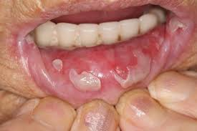
Stomatitis
It is inflammation of the lining of the mouth may occur 7 to 14 days after the beginning of cancer chemotherapy or radiation therapy .
Can be prevented or alleviated
Use cocoa butter
Drink cool beverages
Wear dentures only during meals
Maintain good oral hygiene

Slide 44

HOME CARE
General information :
Give the patient and the caregiver verbal and written instructions .
Provide them with the name and telephone number of a physician or nurse to call .

Slide 45

HOME CARE
Psychological care
Encourage discussion of feelings and emotions
Encourage discussion about side effects of the treatments
Stress the importance of verbalizing feelings about the impact of losing a body part
Encourage the patient to seek counseling
Follow-up care
Stress the importance of regular visits
Encourage the patient to talk with another cancer survivor

Slide 46

Prevention
Can breast cancer be prevented?
Assess the patient level of knowledge about :
Risk factor
Preventive measures
Sign and symptoms
Clarify any myths or misconceptions
Review primary prevention guidelines :
Smoking
Sunlight
Radiation
Occupational hazard
Alcohol
Nutrition

Slide 47
Prevention
-perform monthly self-examination after menstrual period
-regular clinical breast examination every 3 years for women age 20-39, and every year for women 40 and older
-mammography every 1 to 2 years for ages 40-49, and every year for ages 50 and older

Slide 48

Prevention
Breast cancer
Yearly mammograms after age 40
Monthly breast self examination
Yearly clinical breast examination

Slide 49

Facts about Breast Cancer in the United States
: Breast cancer, or cancer of breast, is the most common malignancy among American women. One of seven women will have breast cancer in her lifetime.

Slide 50
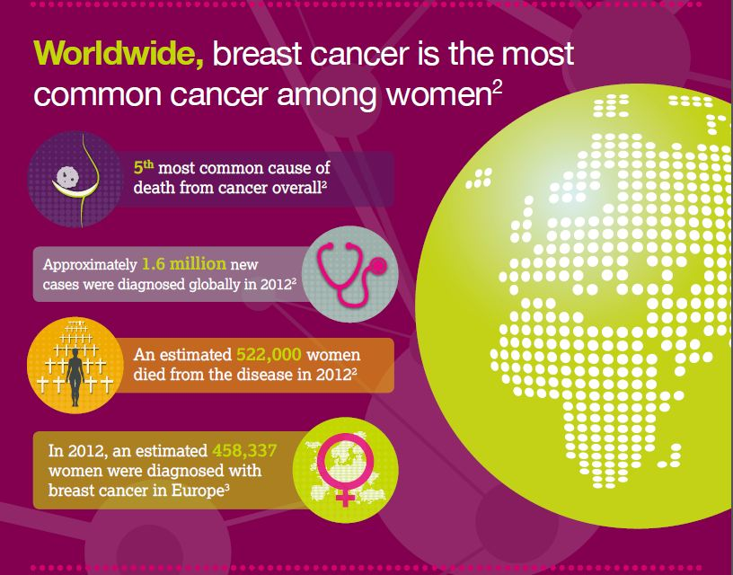

Slide 51
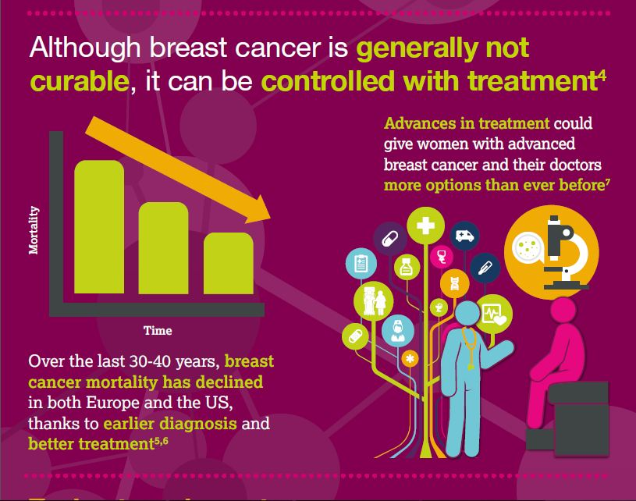

Slide 52
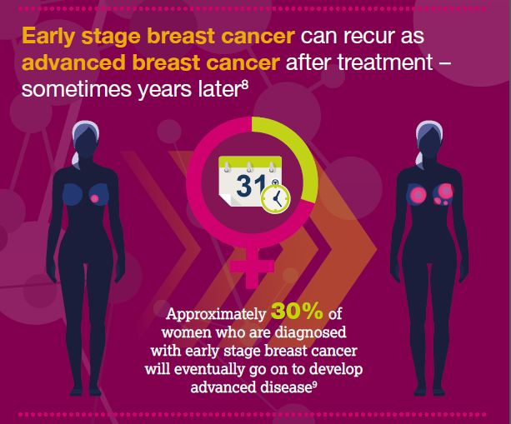

Slide 53
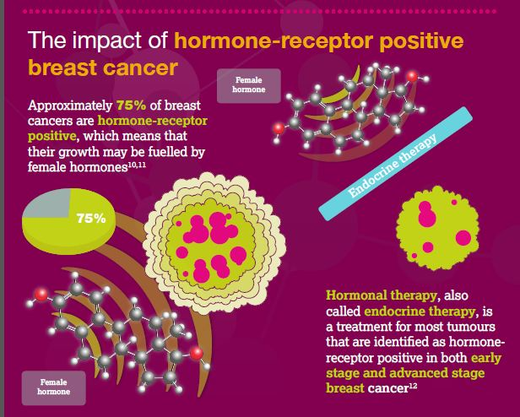

Slide 54
IN KSA:
The most common malignancy seen at KFSH&RC for female is breast cancer. comprising 15.4% of all cases, as compared to 13.9% of all neoplasms diagnosed in the U.S.A. It affects mostly women under the age of 50, while in the U.S.A., those more than 50 years of age are most frequently affected.
Colorectal cancer is ranked the 1st among Saudi males.

Slide 55
IN KSA:
For all sites, the age-specific incidence rate (AIR) increased with age for both Saudi males and females. The median age at diagnosis for men was 58 years; range (0 -122) and 51 years for women; range (0-112).
Between January 01 and December 31, 2012, the total number of cancer incident cases reported to the Saudi Cancer Registry (SCR) was 14,846. Overall cancer was more among women than men; it affected 7,048 (47.5%) males and 7,798 (52.5%) females.
The total incident cases reported among children (0-14 years) between January and December 2012 were 851. The reported incidents show that cancer was more common among boys than girls. The leading cancer among Saudi children was Leukemia.

Slide 56
Ten Most Common Cancers among Saudis by sex, 2012

Slide 57
Percentage Distribution of Cancer Incidence among Saudis by Sex according to Age Group

Slide 58

Thank You ..

Slide 59
References:
http://www.cancer.org/acs/groups/cid/documents/webcontent/003037-pdf.pdf
http://www.chs.gov.sa/Ar/HealthRecords/CancerRegistry/CancerRegistryReport202012.pdf

