Slide 1
Health Needs and Problems of Childhood, adolescence & adulthood
CHS 232 Lecture 7
Mrs. Lamis Al-Sayyari

Slide 2
Adulthood
Definition of the word adult:
Having attained full size and strength; grown up; mature
A person who is fully grown or developed.
There are three stages of adulthood: early adulthood, middle adulthood, and late adulthood

Slide 3
Physical Development of Adults

Slide 4
Physical Development of Adults
Because of the dramatic physical developments that take place in adolescence, it may seem that less attention is placed on physical development in the adult years.

Slide 5
Physical Development of Early Adulthood
Early adulthood takes place roughly between the ages of 20 to 35.
In early adulthood, a person may continue to add a bit of height and weight.
Hormonal changes also continue to occur, but the effects are less pronounced than they were during adolescence.
In terms of physical development, this period is the least dramatic.

Slide 6
What are young adult health issues
The health care issues of young adulthood largely mirror those of adolescents.
Relative to older age groups, young adults are generally very healthy and rates of chronic disease are low.
As with adolescents the major health issues relate to behaviors – such as substance use, sexual behavior, driving habits, diet and exercise – that influence health in the short and/or long term.

Slide 7
Physical Development of Middle Adulthood
Takes place roughly between the ages of 35 and 65.
In middle adulthood, we may start to see more noticeable changes again.
One of the most noticeable changes is the loss of skin elasticity.
In middle adulthood,
women will also go
through a process called
menopause and
lose the ability to reproduce

Slide 8
Physical Development of Late Adulthood
At some time around the age of 65, we enter the world of late adulthood.
More profound negative effects of aging will begin to take its toll on seniors’ bodies.

Slide 9
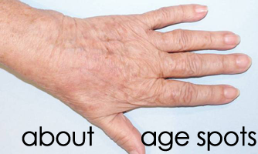
Physical Development of Late Adulthood
This is the final stage of physical change. Those wrinkles will become more noticeable and development of brown age spots on the skin starts to develop.
Reaction time begins to slow

Slide 10
Psychological and Emotional Development of Adults

Slide 11
Psychological and Emotional Development of Adults
In early adulthood, these changes are going to be more noticeable than the physical ones.
Finding one’s place in the world.
Independence -> independent choices -> emotional consequences -> impact on one’s view of who he is.

Slide 12
Psychological and Emotional Development of Adults
Important life decisions are made about collage and career.
Marriage and family formation typically occurs during early adulthood.
Emotional and psychological well-being is often tied to how successful they are at forming these relationships.

Slide 13
What are young adult health issues
Compared to adolescents, for example, young adults have higher rates of substance use, including alcohol, tobacco and marijuana use, and drinking and driving, as well as higher rates of obesity, motor vehicle crash mortality.

Slide 14
Psychological and Emotional Development of Adults
Now that we are leaving early adulthood, it is time to face that midlife crisis!
During middle adulthood, adults go through a whole other set of stressors: Perception of who they have become.

Slide 15
Psychological and Emotional Development of Adults

Slide 16
Psychological and Emotional Development of Adults
Parent-child relationships begin to change as children grow up, and becoming caregivers to aging parents.
The realization of having less time ahead to make life turn the way they want it to

Slide 17
Psychological and Emotional Development of Adults
Past regrets plays an important role in the emotional and psychological well-being during middle adulthood.
The good news:
More life experience,
Concern for the world around us,
Understanding of one’s self, leading to:
Stability and confidence to face these challenges head-on.

Slide 18
Common Health and Developmental Problems of the Middle Aged Adult
Middle adults are faced with stressors, such as the challenges of raising a family, paying their mortgages, facing layoffs at the office, learning to use technology that is continually changing, or dealing with chronic health ailments.

Slide 19
Common Health and Developmental Problems of the Middle Aged Adult
Circulatory diseases
Diseases of the heart and circulation cardiovascular and cerebrovascular are for most adults the biggest risks to life.
They account for at least around 30% of the annual total, every year. Many who die of circulatory diseases are under the age of 65.

Slide 20
Common Health and Developmental Problems of the Middle Aged Adult
Obesity
Obesity is becoming one of the most important contributors to ill-health.
Excessive eating and decreased physical activity are the two leading causes of obesity among middle aged adults
Obesity in middle adulthood is casually related to diabetes mellitus, hypertension, and osteoarthritis, and should any of these health problems already exist, obesity can intensity their effect

Slide 21
Common Health and Developmental Problems of the Middle Aged Adult
Hypertension:
Hypertension, a persistent elevation of the systolic pressure above 140 mm Hg and the diastolic above 90 mm Hg, tends to occur more frequently among older people, and is primarily attributable to inelasticity of the arteries

Slide 22
Common Health and Developmental Problems of the Middle Aged Adult
Menopause
Menopause is the time in a woman's life when her period stops. It usually occurs naturally.
It is defined as occurring 12 months after the last menstrual period and marks the end of menstrual cycles.
Menopause can happen in age 40s or 50s, but the average age is 51 in the United States.

Slide 23
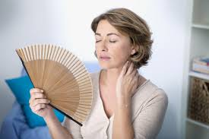
Common Health and Developmental Problems of the Middle Aged Adult
Menopause Symptoms include:
A change in periods - shorter or longer, lighter or heavier, with more or less time in between (despite irregular periods, pregnancy is possible).
Hot flashes and/or night sweats
Trouble sleeping
Vaginal dryness
Mood swings
Night sweats
Trouble focusing
Less hair on head, more on face
Thinning hair and dry skin
Loss of breast fullness

Slide 24
Menopause
Menopause is a natural biological process. Although it also ends fertility, a lady can stay healthy, vital and sexual.
Even so, the physical symptoms, such as hot flashes, and emotional symptoms of menopause may disrupt sleep, lower energy or — for some women — trigger anxiety or feelings of sadness and loss.

Slide 25
Causes of menopause
1. Natural decline of reproductive hormones.
As women approach their late 30s, their ovaries start making less estrogen and progesterone — the hormones that regulate menstruation — and fertility declines.
In their 40s, their menstrual periods may become longer or shorter, heavier or lighter, and more or less frequent, until eventually — on average, by age 51 — they have no more periods.

Slide 26
Causes of menopause
2. Hysterectomy
3. Chemotherapy and radiation therapy
4. Primary ovarian insufficiency:
About 1 percent of women experience menopause before age 40 (premature menopause). Menopause may result from primary ovarian insufficiency; when your ovaries fail to produce normal levels of reproductive hormones .

Slide 27
Complications of menopause
After menopause, the risk of certain medical conditions increases. Examples include:
Heart and blood vessel (cardiovascular) disease.
Osteoporosis: Due to loss of bone density at a rapid rate. Postmenopausal women with osteoporosis are especially susceptible to fractures of their hips, wrists and spine.
Urinary incontinence
Sexual function
Weight gain because metabolism slows.

Slide 28
Psychological and Emotional Development of Adults
Finally, we enter late adulthood, which comes with its own unique set of emotional and psychological strain.

Slide 29
Psychological and Emotional Development of Adults
Late adulthood involves a mixture of gains and losses.
On one hand, there's the freedom of retirement, grown children, and fewer responsibilities.
On the other hand, there's concern about physical health, and the realization of one's mortality and the potential for social isolation.

Slide 30
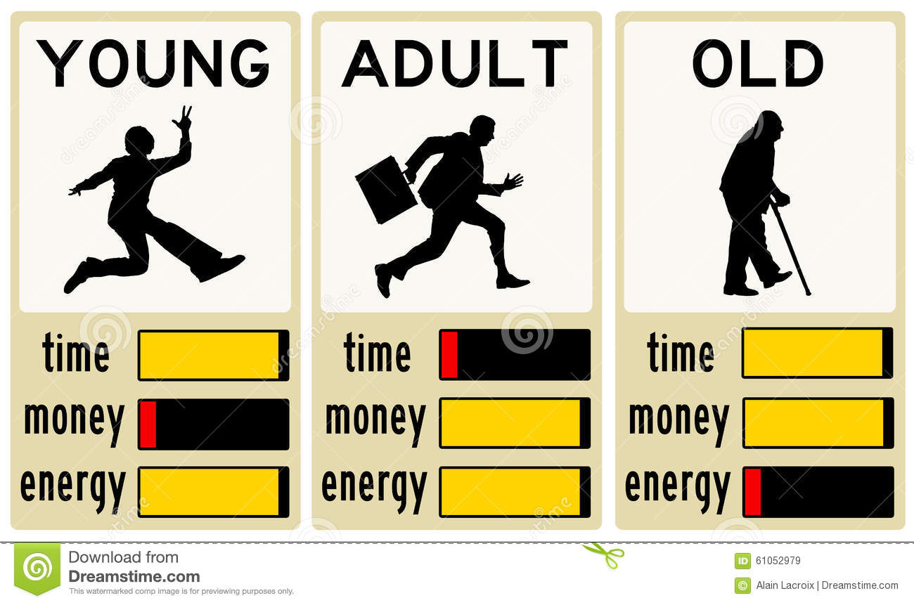
Cycle of Life

Slide 31
7 Health Challenges of Aging
Obesity and Metabolic Syndrome
About three-fourths of adults aged 60 and older are overweight or obese.
Obesity is related to type 2 diabetes, cardiovascular disease, breast and colon cancer, gall bladder disease, and high blood pressure

Slide 32
7 Health Challenges of Aging
Arthritis
Arthritis affects nearly half the elderly population and is a leading cause of disability.
"Old injuries from playing weekend warrior or high school football, and years of wearing high-heeled shoes catch up with us," says Brangman*.
"And arthritis in the knees is the price we pay for walking upright on two legs.“
*Sharon Brangman, MD, AGSF, spokeswoman for the American Geriatrics Society

Slide 33
7 Health Challenges of Aging
Osteoporosis and Falls
Osteoporosis and low bone mass affect almost 44 million adults age 50 and older, most of them women.
According to the National Osteoporosis Association, osteoporosis is not part of normal aging. Healthy behaviors and treatment, when appropriate, can prevent or minimize the condition.
In a given year, more than one-third of adults age 65 and older experience a fall

Slide 34
7 Health Challenges of Aging
Cancer
Risk for developing most types of cancer increases with age.
Lung cancer accounts for more deaths than breast cancer, prostate cancer, and colon cancer combined. Brangman's advice: "Stop smoking."

Slide 35
7 Health Challenges of Aging
Cardiovascular Disease (CVD)
Leading cause of death
Affects more than one-third of men and women in the 45- to 54-year age group, and the incidence increases with age.
A healthy lifestyle can reduce the risk of heart disease by as much as 80%

Slide 36
7 Health Challenges of Aging
Vision and Hearing Loss
Age-related eye diseases -- macular degeneration, cataract, diabetic retinopathy, and glaucoma

Slide 37
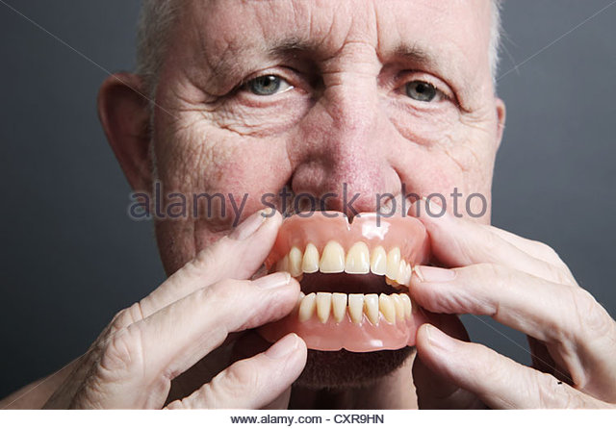
7 Health Challenges of Aging
Teeth
Unfortunately, the people who haven't had a lifetime of good health care and healthy practices are at risk for losing their teeth."

Slide 38
Mental Challenges of Aging
Memory loss
Alzheimer’s disease
Depression
"When you get older, you're dealing with life-change issues," says Crowel*. "Kids leaving home, health problems, loss of parents and friends, and retirement become issues. We notice that all the basketball players are younger than us, and the music and ads are for a younger demographic." He advises anticipating and preparing for the changes to come.
* Raymond L. Crowel, PsyD, vice president for mental health and substance abuse services for Mental Health America in Alexandria, Va.

Slide 39
"If I'd known I was going to live this long, I'd have taken better care of myself." So said Eubie Blake, the great ragtime composer and pianist who was still performing at the age of 99, the year before his death.

Slide 40
Why study needs and problems of people?
Needs are psychological or physiological insufficiencies that provoke some type of behavioral response.
Recognize physical changes in adults as a normal and natural process
Detail changes in psychological and emotional as being heavily influenced by external criteria
Provides a knowledge foundation for the process of needs assessment

Slide 41
Why study health needs of different ages?
When encountering a patient or any member of the community, all the health needs that we’ve learned of his age group come to the mind and should help in understanding the voluntary and most importantly the involuntary behaviors and the hidden motives to any behavior carried out by this person.
Also it helps in developing the most suitable health behavior plan fit for each person

Slide 42
References
http://www.amchp.org/AboutAMCHP/Newsletters/Pulse/Archive/2014/JulyAugust2014/Pages/Feature-4.aspx
https://www.cliffsnotes.com/study-guides/psychology/psychology/developmental-psychology-age-13-to-65/development-in-early--middle-adulthood
http://www.webmd.com/menopause/guide/menopause-basics?page=2
www.mayoclinic.org http://www.mayoclinic.org/diseases-conditions/menopause/basics/definition/con-20019726

Slide 43
Thank You!
Simple exercise: need assessment of different age groups of patients, what to consider?? Assignment: Obtain all the health issues of adults than can be addressed by health education specialists

