Slide 1
Eye Health

Slide 2
Eye Health
Healthy vision is accomplished through healthy eyes and good nutrition is vital to healthy eyes.
The eye is made of various structures working in concert to focus light rays from objects into images and send them to the brain via electrical impulses.
Eye health is highly dependent on healthy neurologic and cardiovascular systems.

Slide 3
The eye is made of?!

Slide 5
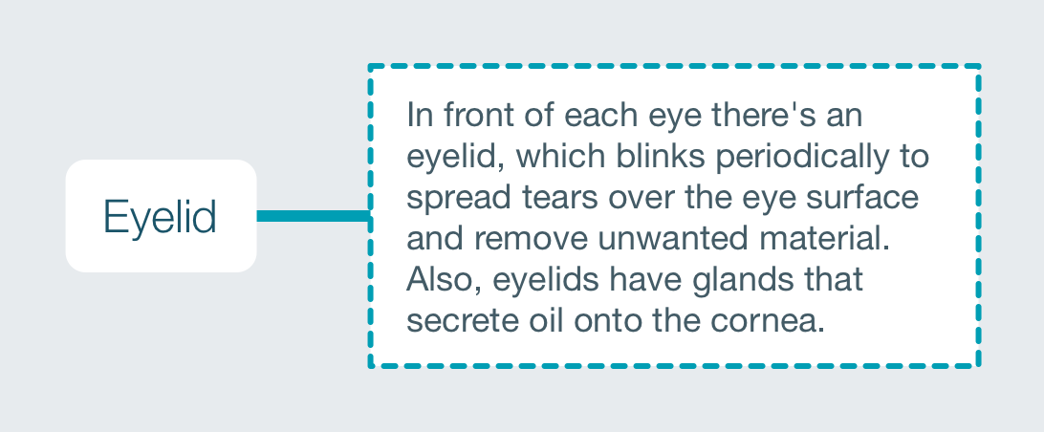

Slide 8
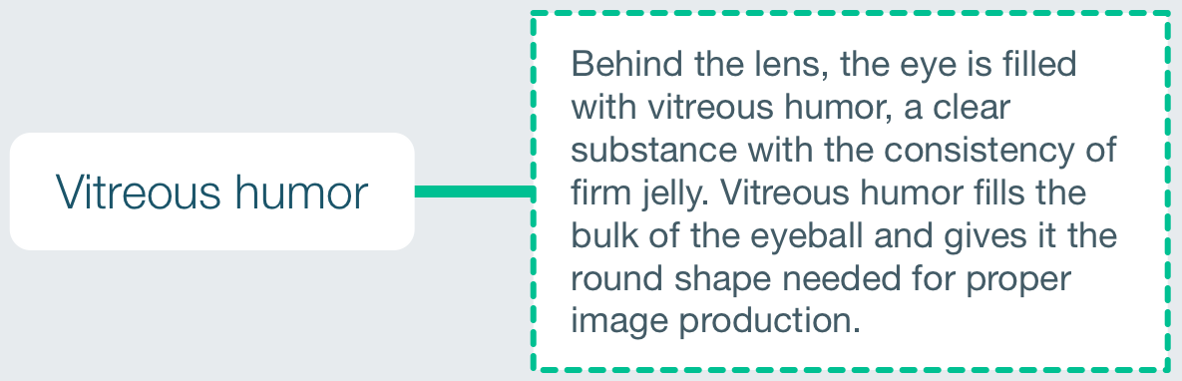

Slide 10
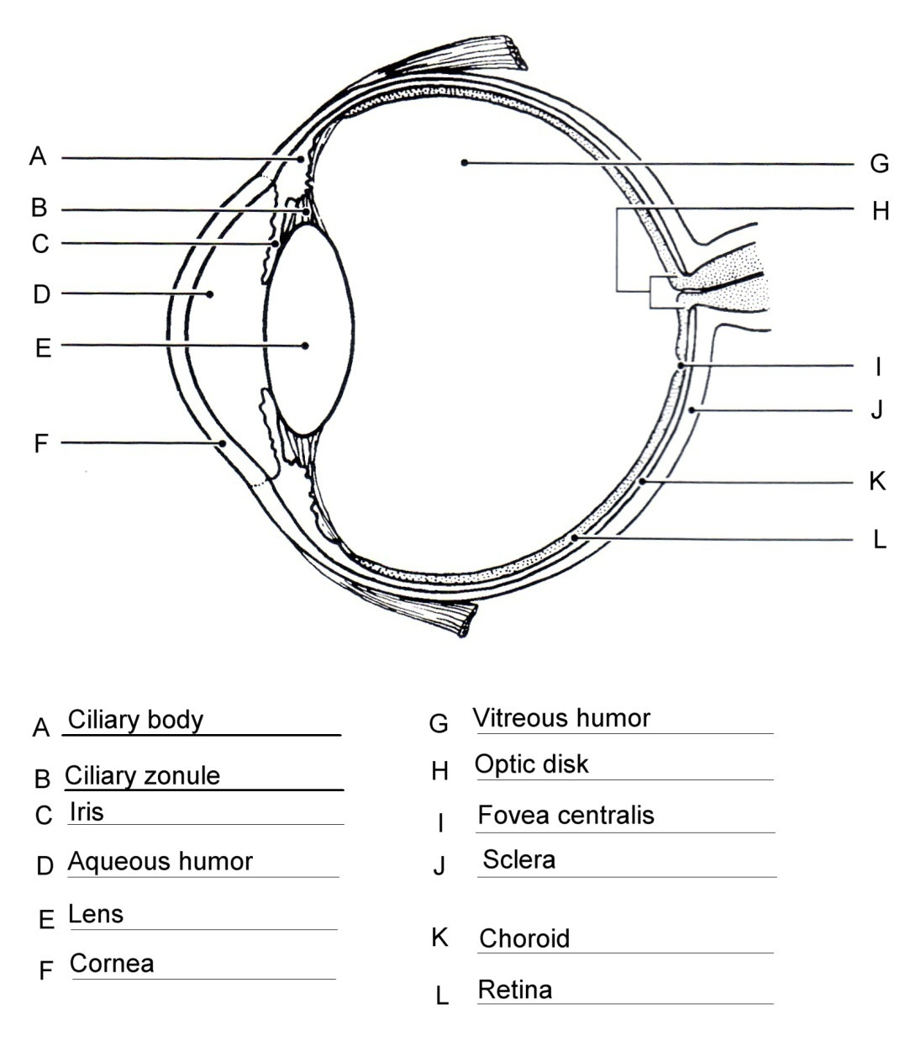
Anatomy of the Eye

Slide 11
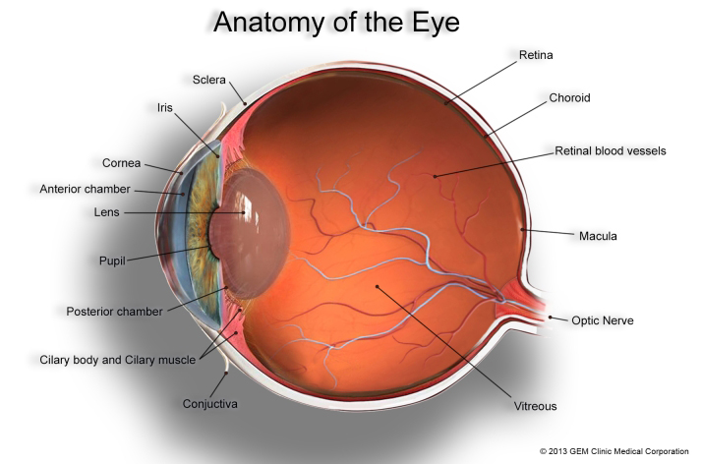

Slide 12
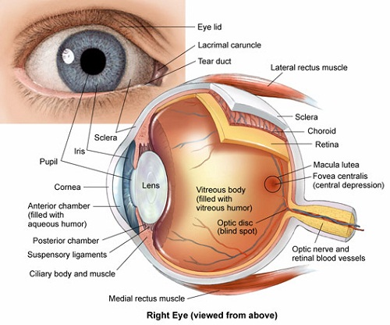

Slide 13
Video till 3:44 min
https://www.youtube.com/watch?v=nbwPPcwknPU&feature=youtu.be

Slide 14
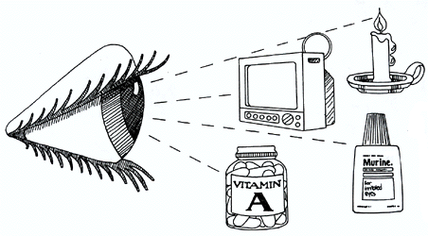
How the human eye works?!

Slide 15
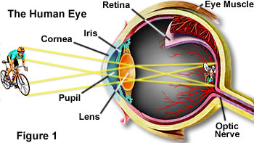
The eye sees by a process known as “Refraction”

Slide 17
What is the refraction?
When a person looks at an object, light rays bouncing off that object hit the cornea, which bends them toward the center of the retina by a process known as “Refraction”. These bent light rays then go through the pupil and are adjusted by the lens. If the eye is focusing properly, the rays then fall onto the retina as a clear, upside-down image. This image is captured by the photoreceptors and then transferred via the nerve fiber to the optic nerve, which connects to the brain where the image is interpreted.

Slide 18
video from 3:44 to the end
https://www.youtube.com/watch?v=nbwPPcwknPU&feature=youtu.be

Slide 19
When the eye does not properly focus light rays from the image, the result is a refractive error. There are two types of refractive errors:
Spherical aberration: occurs when the focused image falls either in front of the retina (myopia) or behind the retina (hyperopia).
Astigmatism: occurs when light waves interfere with each other as their distance from the central axis increases so that the image becomes blurry anywhere except in the middle.
Astigmatism is usually caused by an irregularly shaped cornea, it can occur alone or with myopia or hyperopia.
Myopia, hyperopia, and astigmatism can all usually be corrected with eyeglasses, contact lenses, or refractive surgery such as LASIK.
Presbyopia: is a disease occurs when the lens of the eye can no longer focus on near images because of age -related stiffness, most people develop presbyopia at around age 40.

Slide 20
Nearsightedness (Myopia)
Things in the distance look blurry. Doctors call it myopia. People are more likely to have it if:
One or both of the parents have it
You do lots of close-up reading
Nearsightedness can make it harder to drive, play sports, or see a blackboard or TV.
Symptoms include blurred vision, squinting, and fatigue.
Glasses, contacts, or surgery in some cases.

Slide 21
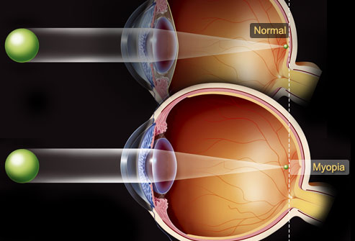
Nearsightedness: What Happens
The cause is usually an eyeball that's too long.
Or it can result from an oddly-shaped cornea or lens.
Light rays focus just in front of the retina, instead of directly on it.
This sensitive membrane lines the back of the eye (seen in yellow) and sends signals to the brain through the optic nerve.
Nearsightedness often develops in school-age children and teens, so they may need to change glasses or contacts frequently as they grow.
It usually stabilizes by the early 20s.

Slide 22
Farsightedness (Hyperopia)
Most people are born with mild farsightedness and outgrow it in childhood.
See distant objects well, but books, knitting, and other close objects are a blur.
This problem runs in families.
Symptoms include trouble with reading, blurry vision at night, eyestrain, and headaches.
Glasses or contacts.
Some people get surgery for it.

Slide 23
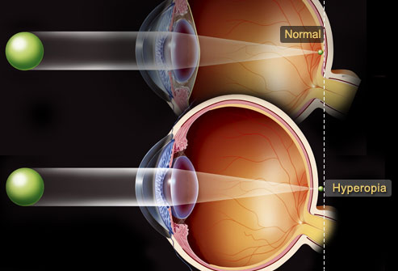
Farsightedness: What Happens
This problem results from an eyeball that’s too short or an oddly-shaped lens or cornea. Light rays focus behind your retina and close objects look blurry. Your distance vision might be fuzzy, too. Severely farsighted children often have crossed eyes (strabismus) or lazy eye (amblyopia) and may have trouble reading. That’s one reason eye doctors recommend vision exams for young children.

Slide 24
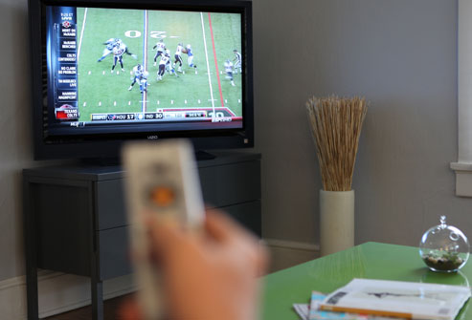
Presbyopia
Trouble reading fine print is a sign of aging. It's called presbyopia, which means "old eye" in Greek.
Most people start to notice it in their 40s The eyes' lenses become less flexible and can't change shape to focus on objects at reading distance.
The solution: Wear reading glasses or bifocals, which correct both near and distance vision.

Slide 25
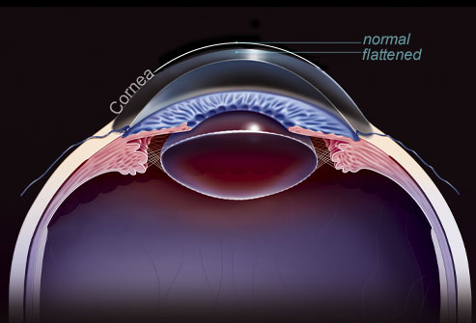
Astigmatism
If you have astigmatism in one or both eyes, your vision may be out of focus at any distance.
It happens when the cornea, the clear “window” that covers the front of the eye, isn’t shaped right.
Light rays can’t focus on a single point on your retina. Instead they scatter to many places.
Glasses or contact lenses correct it.
Surgery may be an option.
Symptoms include blurred vision, headaches, fatigue, and eye strain.

Slide 26
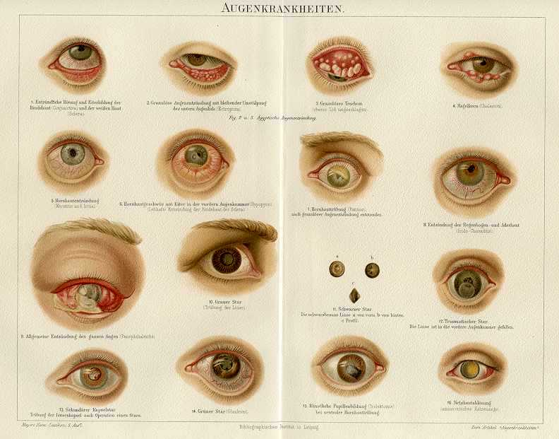
Diseases of the eye

Slide 27
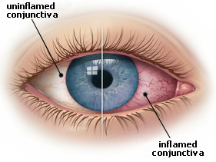
Diseases of the eye
1- skin cancer: since the eyelids, and the rest of the facial skin, have more lifetime sun exposure than other parts of the body, they are at increased risk of developing cancer. It can be treated by removing the lesion surgically.
2- conjunctivitis: it is an inflammation of the conjunctiva. The most common causes of conjunctivitis include allergies, dry eyes, and viral infection.

Slide 28
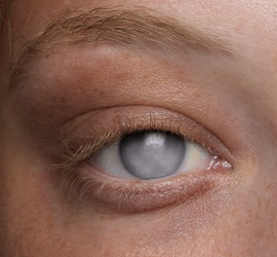
Diseases of the eye
3- clouded corneas: both infection and injury can produce scars that leave the cornea cloudy. clouded corneas reduce the amount of light that enters the eye.

Slide 29
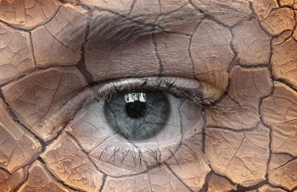
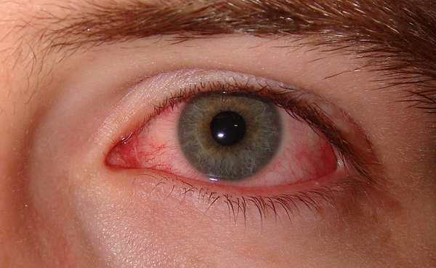
Diseases of the eye
4-dry eye: can be caused by numerous rheumatologic and auto-immune diseases such as rheumatoid arthritis. Dry eyes can occur by many medications and it can be treated with artificial tear drops.

Slide 30
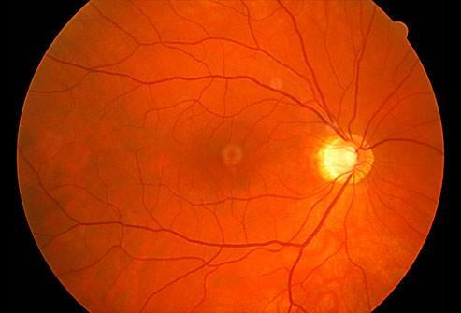
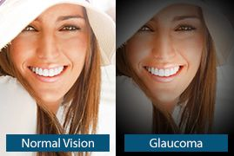
Diseases of the eye
5-glaucoma: if the aqueous humor is either produced too quickly or drained too slowly, pressure inside the eye can become elevated. Also, glaucoma can cause permanent vision loss. Treatments includes prescription medications, laser treatments, and surgery.

Slide 31
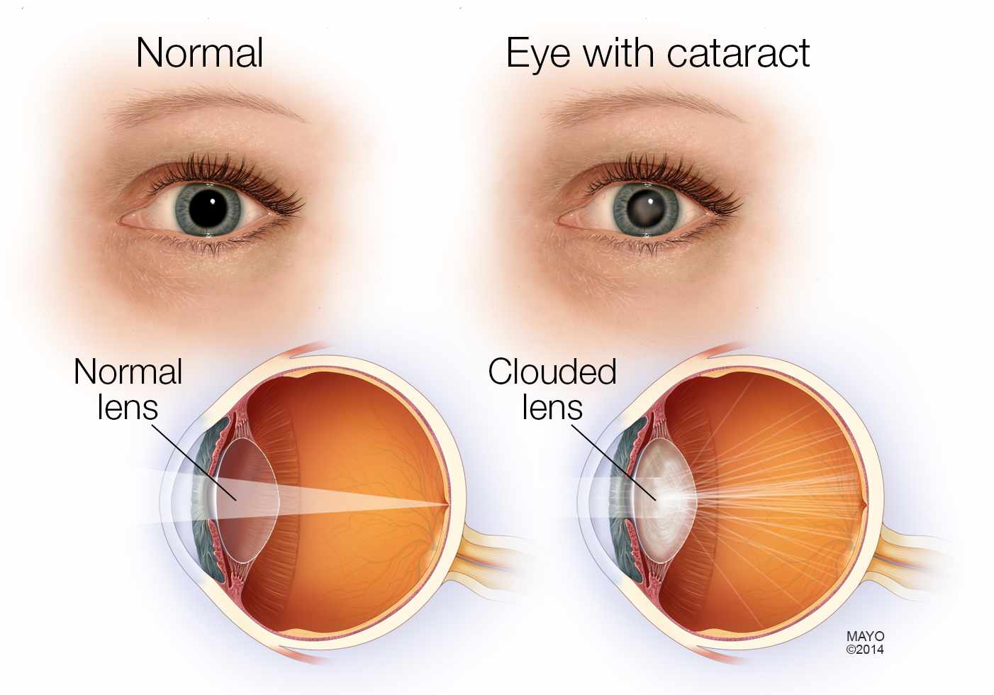
6-cataracts: a cataracts occurs when the lens becomes cloudy as a result of normal aging, the only cure for cataracts is surgery.

Slide 32
Diseases of the eye
7- floaters: the vitreous humor can pull away from the back of the eye and form floaters, which are small condensations that appear as black spots or cobwebs in one’s vision.

Slide 33
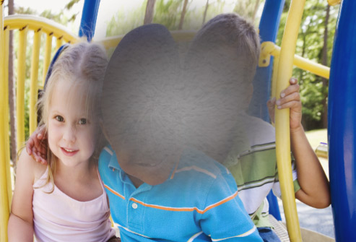
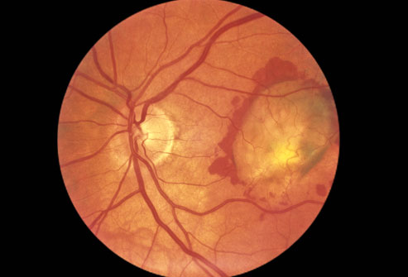
Diseases of the eye
8- macular degeneration: it occurs when the macula (which is responsible for central vision) becomes diseased, distorting central vision. Also, it is a significant cause of blindness. Treatments include laser treatments, surgery, and injection of prescription medications into the eye.

Slide 34
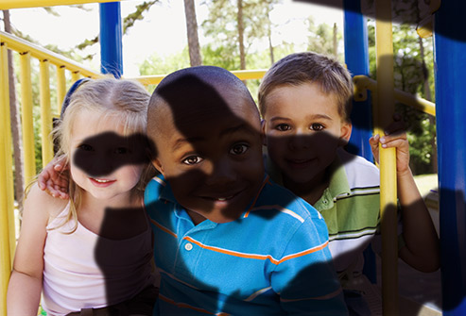
Diseases of the eye
9- systemic disease: the health of the eye is also affected by systemic disease (eg, diabetes, hypertension).
Diabetic Retinopathy
The damage involves
tiny blood vessels in
the retina

Slide 35
Common eye problems
Eyestrain
Anyone who reads for hours, works at a computer, or drives long distances knows about this one.
It happens when you overuse your eyes.
They get tired and need to rest, just like any other part of your body.

Slide 36
Common eye problems
Computer Vision Syndrome
It isn’t one specific problem. Instead, it includes a whole range of eye strain and pain.
Research shows that between 50% and 90% of people who work at a computer screen have at least some symptoms.
Working adults aren't the only ones affected. Kids who stare at tablets or use computers during the day at school can have issues, too, especially if the lighting and their posture are less than ideal.

Slide 37
Common eye problems
How Do Computers Affect Vision?
When you work at a computer, your eyes have to focus and refocus all the time. They move back and forth as you read. You may have to look down at papers and then back up to type. Your eyes react to changing images on the screen to create so your brain can process what you’re seeing. All these jobs require a lot of effort from your eye muscles. And to make things worse, unlike a book or piece of paper, the screen adds contrast, flicker, and glare.
Computer work gets harder as you age and the lenses in your eyes becomes less flexible.

Slide 38
Common eye problems
What Are the Symptoms of Computer Vision Syndrome?
You may notice:
Blurred vision
Double vision
Dry, red eyes
Eye irritation
Headaches
Neck or back pain
If you don’t do anything about them, it could affect more than your eyes. You could also have issues with your work performance.

Slide 39
Common eye problems
Red Eyes
Happen when the eyes’ surface is covered in blood vessels that expand when they’re irritated or infected. That gives the eyes the red look.
Eyestrain can do it, and so can a late night, a lack of sleep, or allergies. If an injury is the cause, it needs to be checked by the doctor.
Red eyes could be a symptom of another eye condition, like conjunctivitis (pinkeye) or sun damage from not wearing shades over the years. If over-the-counter eye drops and rest don’t clear it up, a doctor should be consulted.

Slide 40
Common eye problems
Night Blindness
Characterized by Difficulty seeing at night
It’s a symptom, not a problem in its own right. Nearsightedness, cataracts, keratoconus, and a lack of vitamin A all cause a type of night blindness that doctors can fix.
But some people are born with this problem or it might develop from a degenerative disease involving the retina, and that usually can’t be treated

Slide 41
Common eye problems
Colorblindness
Characterized by not being able to see certain colors, or can’t tell the difference between them (usually reds and greens). It happens when the color cells in the eye (cone cells) are absent or don’t work.
Most people who have it are born with it, but you can get it later in life from certain drugs and diseases. Men are much more likely to be born with it than women.
There’s no treatment if they’re born with it, but special contacts and glasses can help some people tell the difference between certain colors.

Slide 42
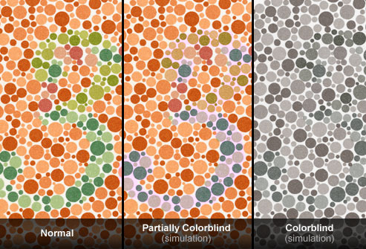
Common eye problems
Colorblindness

Slide 43
Common eye problems
Excess Tearing
It has nothing to do with people’s feelings. Their eye might be sensitive to light, wind, or temperature changes.
The best way to protect their eyes is by shielding them or wearing sunglasses (go for wraparound frames -- they block more wind than other types).
Tearing may also signal a more serious problem, like an eye infection or a blocked tear duct.

Slide 44
Common eye problems
Problems With Contact Lenses
Rules for handling contact lenses:
Wash your hands before you touch them
Never wet them by putting them in your mouth. That can make an infection more likely.
Make sure your lenses fit properly, so they don’t scratch your eyes.
Use eye drops that say they're safe for contact lenses.
Never use homemade saline solutions. They aren’t sterile and could cause an infection.
Don't sleep with them in. Doing so raises the risk of infection.
If you do everything right and still have problems with your contacts, see your eye doctor. You might have allergies, dry eyes, or just be better off with glasses. Once you know what the problem is, you can decide what’s best for you.

Slide 45
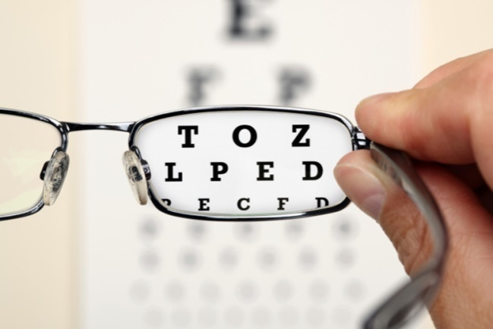
Healthy Eyes: The Basics
HOW?

Slide 47
Take a 20-Second Computer Break
Staring at a computer (or any digital screen) won’t hurt your eyes, but it can make them feel tired and dry.
Surprisingly, we blink about half as often when we’re looking at a screen.
Follow the 20/20/20 rule: Every 20 minutes, look at least 20 feet away for at least 20 seconds.
Also, place your screen so it’s about 25 inches away and slightly below eye level.
Cut glare by moving light sources or using a screen filter.

Slide 49
Always Wear Sunglasses
UV radiation can hurt your eyes just like it does your skin.
Effects add up and can cause problems like cataracts, cornea burns, and even cancer of the eyelid.
Whenever you’re outside -- even on cloudy days -- wear sunglasses or contacts that block 99% to 100% of UV-A and UV-B rays.
Protective lenses don’t have to be expensive, just check the label.
Hats block exposure, too.
Snow, water, sand, and concrete all can reflect UV rays.

Slide 50
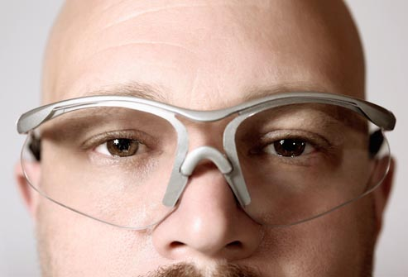

Slide 51
Use Safety Glasses at Work and Play
Nearly half of all eye injuries happen at home, not on a job site.
Use safety glasses whenever a project might send debris flying or splash hazardous chemicals.
Protective eyewear may prevent 90% of sports-related eye injuries. Lenses should be made of polycarbonate plastic -- which is 10 times more impact resistant than other materials.
Some sports with the most injuries are baseball/softball, racket sports, lacrosse, and basketball.

Slide 53
Eat for Your Heart and Your Eyes
Foods that help circulation are good for your heart, eyes, and vision.
Choose heart-healthy foods like citrus fruits, dark leafy greens, and whole grains.
Foods rich in zinc -- beans, peas, peanuts, oysters, lean red meat, and poultry -- can help eyes resist light damage.
And carrots do help eyesight: The vitamin A in them is important for good vision.
Other nutrients that help eyes include beta-carotene (found in many yellow or orange fruits and veggies), and lutein and zeaxanthin (found in leafy greens and colorful produce).

Slide 54
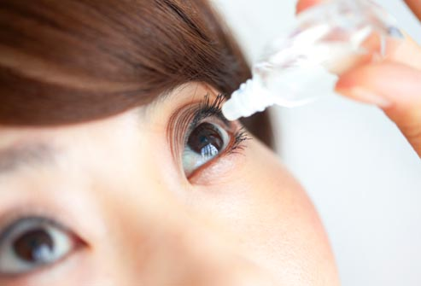

Slide 55
Don’t Ignore Eye Problems
If your eyes are itchy or red, soothe them with cold compresses, antihistamines, or eye drops.
If you feel grittiness, like there’s sand in your eye, rinse with clean water or saline.
See a doctor if symptoms continue, or if you have eye pain, secretions, swelling, or sensitivity to light.
Other reasons to see a doctor: dark floating spots, flashes of light, or any time you can't see normally.

Slide 56
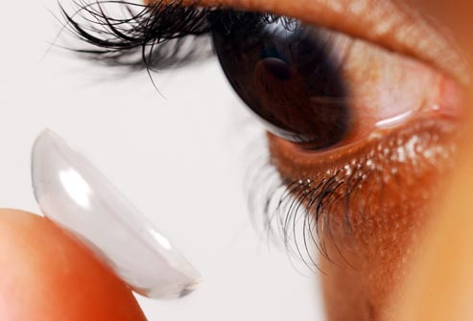

Slide 57
Clean Your Contact Lenses
Take care of your eyes by taking care of your contacts. Always wash your hands before handling lenses.
Use only cleaners and drops approved by your eye doctor.
Clean, rinse, and dry the case each time you remove the lenses, and replace it every two to three months.
Don’t wear lenses when you're swimming or using cleaning products like bleach.
Don’t leave daily wear lenses in while you sleep, even for a nap. And don’t wear lenses longer than recommended.

Slide 58
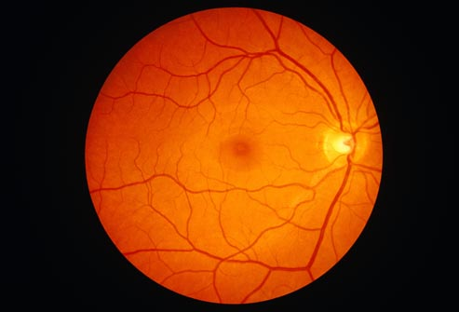

Slide 59
Know Your Health History
Many seemingly unrelated health conditions can affect your eyes.
High blood pressure and diabetes can reduce blood flow to the eyes.
Immune system disorders in the lungs, thyroid glands, or elsewhere can inflame eyes, too.
Other threats include multiple sclerosis, aneurysms, and cancer.
Tell your eye doctor about any current or past health issues, including family members with eye problems or serious illnesses.

Slide 60
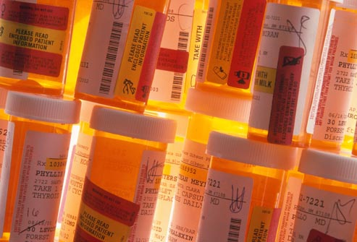

Slide 61
Read Drug Labels
Many types of drugs, or combinations of drugs, can affect your vision.
Be on the lookout for possible side effects from various medications used to treat different conditions.
Tell your doctor if you notice issues like dry or watery eyes, double vision, light sensitivity, puffy or droopy eyelids, and blurred vision.

Slide 62
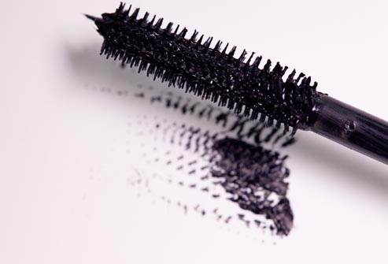

Slide 63
Throw Away Old Eye Makeup
Bacteria grow easily in liquid or creamy eye makeup. Throw out products after 3 months.
If you develop an infection, immediately get rid of all your eye makeup and see a doctor.
If you tend to have allergic reactions, try only one new product at a time.
Never share cosmetics and don't use store samples.
Clean your face thoroughly before and after using makeup, and don’t apply cosmetics inside lash lines.

Slide 64
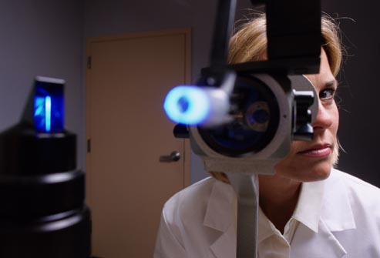

Slide 65
Get Regular Eye Exams
You should get your eyes checked regularly, even if you don't wear glasses.
Ask your doctor how often.
It will be at least every other year from ages 18-60, or every year if you're older, wear contact lenses, or have risk factors like diabetes, high blood pressure, or a family history of eye disease.

Slide 66
Eye Exams: When Do You Need Them?
If you’re 40 and have vision issues, you should see an ophthalmologist or optometrist every 2 to 4 years. Go every 1 to 3 years between 55 and 65 and then yearly after that. Visit more often:
If you have a condition like diabetes or high blood pressure
When you start to have age-related eye problems, typically around age 40
The doctor can keep an eye on your eye health and check for any vision changes.

Slide 67
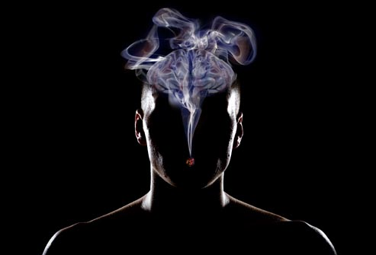

Slide 68
Stop Smoking
If you smoke, stop. Smoking means a dramatic increase in incidence of macular degeneration as well as raising your risk of developing cataracts and aggravating uncomfortable dry eyes.
It also builds up plaque in your bloodstream and weakens arteries.
This not only raises your risk of a heart attack, but it can damage the retina and cause vision loss.
The good news is that after you quit, your risk of eye disease is about the same as for non-smokers.

Slide 69
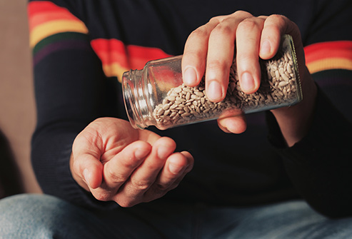
10 Foods That Are Good for Your Eyes

Slide 70
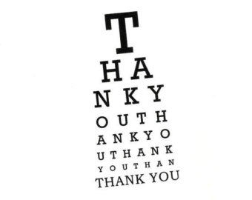

Slide 71
References
Life Extension (2013). Disease Prevention and Treatment - Fifth Edition (Kindle Locations 42233-42276). BookBaby. Kindle Edition.
www.webmed.com

