Slide 1
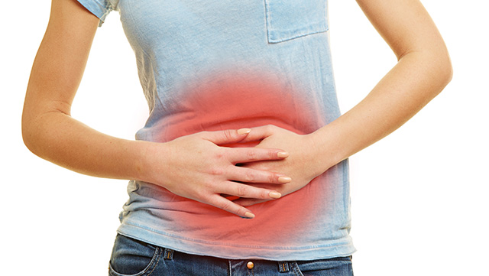
Irritable bowel syndrome
CHS 232

Slide 2
What is irritable bowel syndrome?
Irritable bowl syndrome(IBS): is a very common gastrointestinal disorder, estimated to be present in about 11-15% of the global population.
IBS is a functional disorder
It has not been consistently linked to tissue damage or other biological markers that can be tested clinically
It is thought to be largely under diagnosed.

Slide 4
Typical IBS symptoms:
Chronic abdominal pain.
Bloating.
Varying bouts of diarrhea.
Constipation.
Discomfort associated with IBS typically flares for 2-4 days
Other symptoms not associated with gastrointestinal system: headache, backache and lethargy.
IBS does not increase risk to higher diseases like colon cancer

Slide 5
diagnosis
No tests can actually confirm whether or not someone has IBS, which is why tracking symptoms is so important.
Several other diseases that may be associated with IBS symptoms include:
Abuse of laxatives or antacids.
Use of sorbitol or other artificial sweeteners.
Lactose intolerance.
Inflammatory bowel disease.
Malabsorption syndrome, such as celiac disease.
Tumors of the digestive system.

Slide 6
Types of (IBS)
IBS-Diarrhea
IBS-Constipation

Slide 7
Types of (IBS)
There are three types of irritable bowel syndrome, or IBS. They include:
IBS with constipation. This comes with stomach pain and discomfort, bloating, abnormally delayed or infrequent bowel movement, or lumpy/hard stool.
IBS with diarrhea . This comes with stomach pain and discomfort, an urgent need to move your bowels, abnormally frequent bowel movements, or loose/watery stool.
IBS with alternating constipation and diarrhea.
There are about an equal number of people with IBS in each category. There is also evidence that most people with IBS will alternate between types over time.

Slide 8
Factors may cause IBS:
No one knows the exact cause of IBS while experts have an inclination that these factors are involved in causing IBS :
Stress.
Genetics
Depression.
Food sensitivities.
Small intestinal bacterial overgrowth.
Hormonal fluctuations.
Altered bacterial growth.

Slide 9
Disrupted brain-gut communication
Some evidence suggests that altered communication between the brain and gut in IBS.
Stress and anxiety appear to contribute, at least in part, to gut hypersensitivity called “stress hormones” .
Levels and activity of the neurotransmitter serotonin in particular appear to be somewhat abnormal in people with IBS.

Slide 10
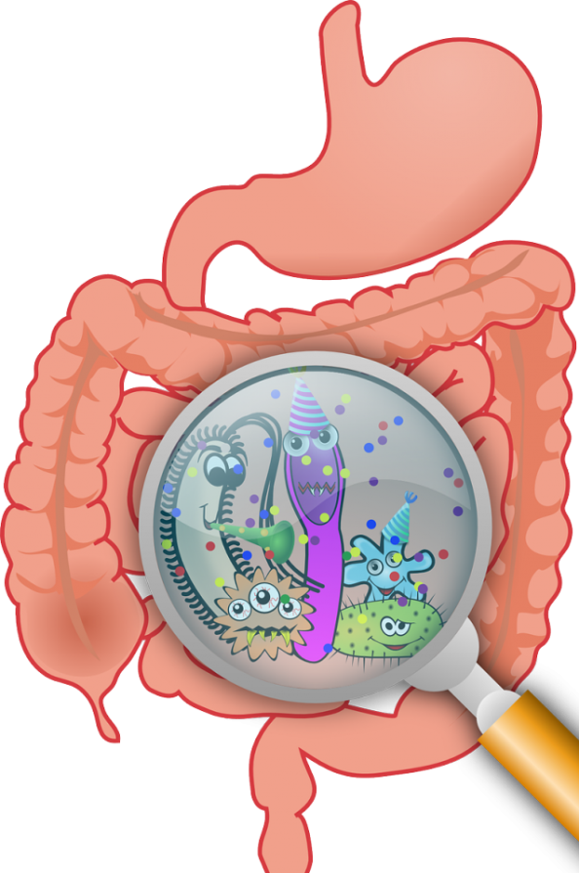
Small intestinal bacterial overgrowth (SIBO):
Is a condition characterized by overgrowth of microbes in the small intestine.
As a result, fermentation of food begins before it has been thoroughly digested and absorbed, which can lead to gas formation
SIBO is more common in people with motility disturbances, low stomach acid production, and bowel obstruction.

Slide 11
Medications that may contribute to IBS development.
Proton pump inhibitors (e.g, omeprazole [Prilosec®]), which are used to treat heartburn, can alter intestinal barrier function, affect intestinal microflora, and are known to have a positive association with IBS.
many common analgesics, such as non-steroidal anti-inflammatory drugs (NSAIDs), are known to damage the intestinal epithelium, an important barrier against harmful substances. This tissue damage may compromise intestinal permeability.

Slide 12
Gluten sensitivities
Gluten is a protein component of some grains, especially wheat.
Sensitivity to gluten is common and is associated with a spectrum of symptoms ranging in severity from minor skin conditions to severe gastrointestinal compromise in the case of celiac disease.

Slide 13
Post-infectious IBS.
Some cases of IBS arise following a gastrointestinal infection, usually with a bacterial or parasitic pathogen . This is called post-infectious IBS, or PI-IBS.
Symptoms of PI-IBS typically resemble IBS-D.

Slide 14
Hormone fluctuations
Some evidence suggests a potential role for sex hormone imbalance(s) in IBS.
For example, women often experience worsening of IBS symptoms near menstruation, which coincides with natural changes in sex hormone levels.

Slide 15
Treatment
IBS treatment aims to reduce the symptoms such as diarrhea, constipation and abdominal cramping.
You can naturally treat IBS symptoms by avoiding common allergens and inflammatory foods, adding enzymes and supplements to your diet, reducing stress, and exercising.

Slide 16
Bulking agents
Bulking agents (dietary fiber) are frequently used to treat both subtypes of IBS. Insoluble fiber facilitates defecation by reducing transit time, or the time it takes for the remains of ingested food to be excreted.
While defecation generally alleviates IBS symptoms, a potential side effect of fiber supplements is bloating

Slide 17
Laxatives
Laxatives and stool softeners are commonly used to treat IBS-C . These treatments typically provide rapid relief, but are not recommended for long-term use as they can cause electrolyte imbalances

Slide 18
Balancing hormones
Women who hadn't gone through menopause may experience IBS symptoms around menstruation period which is related to fluctuation in sex hormones levels.
Blood tests are used to assess hormone levels and working with physicians to balance hormones levels for a solution.

Slide 19
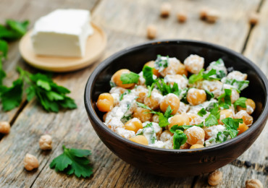
Dietary consideration
Reducing caffeine and fatty food
Following certain diet help with the symptoms of IBS.

Slide 20
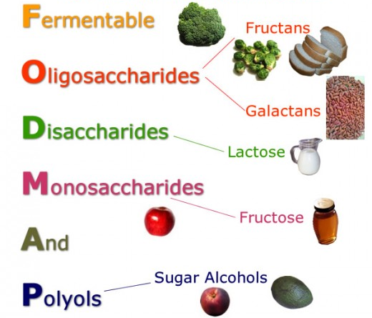
FODMAP’s
Fermentable, oilgosaccharides,
disaccharides, monosaccharide's and polyols
Low FODMAP diet allow under digested carbohydrates to reach lower GI tract ( large intestines) and decrease in abdominal pain.
The under digested carbohydrates stimulates growth of pathogenic microbes which leads to gas, diarrhea and constipation.
Foods to avoid are wheat, onions, garlic( fructo-, oilgosaccharides) , milk (lactose), honey(fructose)

Slide 23
Gluten free
Gluten is found in grains ( wheat, breads, pasta).
Gluten free diet is required for patients with celiac disease.
Gluten free diet is similar to low FODMAP’s diet because they both restrict gluten and manage food sensitivity.
IBS patients who don't have celiac disease, adding gluten might worsen their abdominal pain, bloating fatigue and stool consistency.

Slide 24
Food sensitivity and IBS
Food allergy or sensitivity is an inappropriate immune response to components of food. The immune system attacks the food by antibodies to identify pathogens which triggers the immune system response, which lead to tissue inflammation and dysfunction.
In a study, IBS patients were tested for IgG (Immunoglobulin G ) antibodies against certain food and they were on a diet that excluded food that IgG positive and there was an improvement which reversed the troublesome food that were introduced.

Slide 25
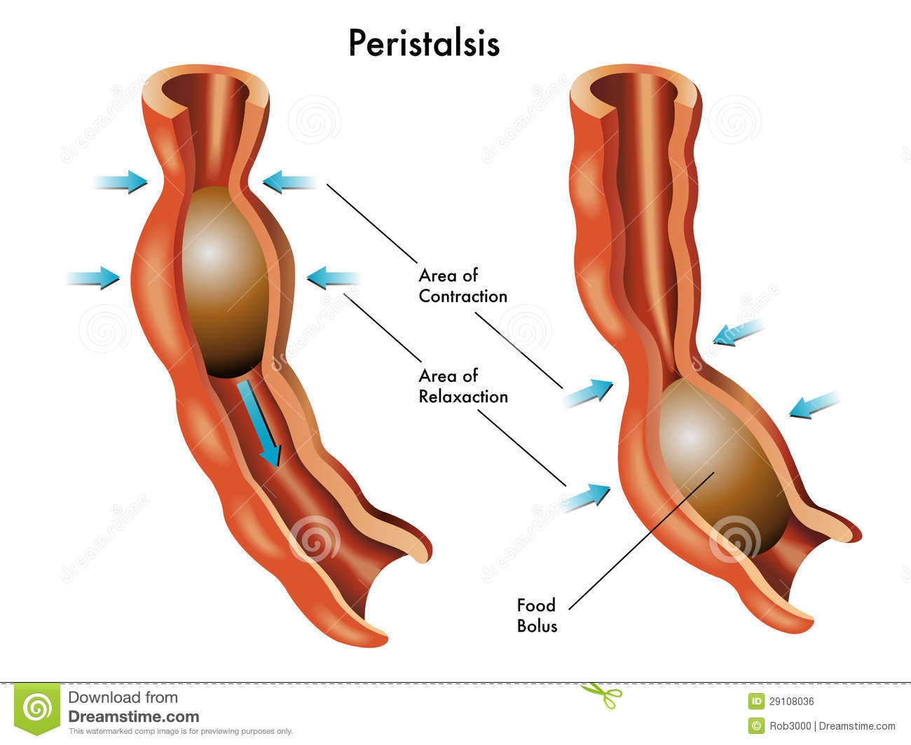
Immediate relief from constipation predominant IBS
Some cases of IBS are caused by insufficient peristalsis which means there is not enough colon contractile activity to completely evacuate the bowels.

Slide 26
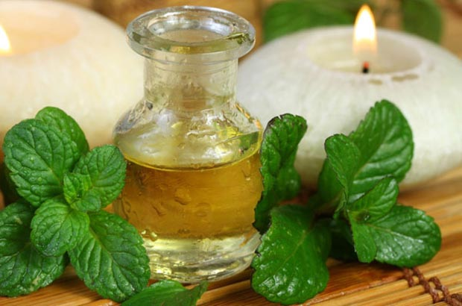
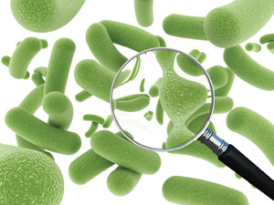
Cont. Immediate relief from constipation predominant IBS
Instead of reverting to laxatives, there are specific nutrients that if taken at the right time, can induce healthy colon peristaltic action without producing adverse effects.
Peppermint Oil/Caraway Oil
Peppermint oil is a natural antispasmodic.
Probiotics:
Probiotics are microorganisms that may provide health benefits to their host when administered at sufficient levels.

Slide 27
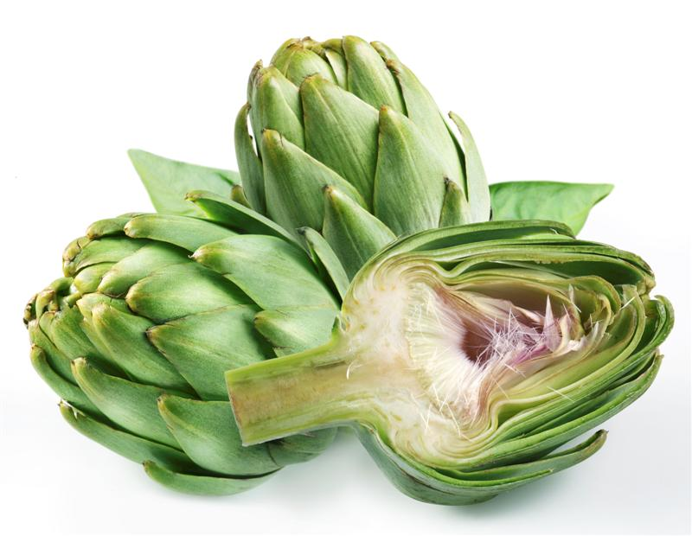
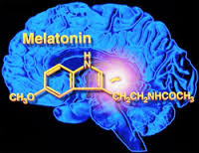
Cont. Immediate relief from constipation predominant IBS
Artichoke
Artichoke leaf has been used since Roman times as a traditional medicine that supports digestive function, it has been shown to promote the production of bile that helps digest dietary fats and reduce spasms and flatulence.
Melatonin
Melatonin is a multifunctional hormone that exhibits a variety of beneficial effects in gastrointestinal disorders independent of its more widely known effects on sleep.

Slide 28
Lifestyle Considerations
Stress Reduction:
Stress associated with early life adverse events is implicated in the etiology of IBS, about 50% of individuals who seek IBS treatment have depression or anxiety.
That means IBS may cause stress, and stress may contribute to IBS symptoms.
So stress reduction by improvements in mood and quality of life or by psychological therapies reduces the severity of IBS.

Slide 29
Lifestyle Considerations
Exercise:
Exercise is also beneficial for IBS patients, it helps to improve quality of life and reduce IBS severity.

