Slide 1
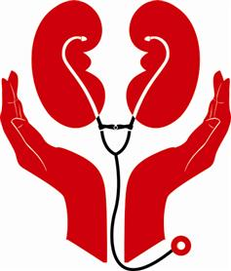
Kidney Health Renal Failure
CHS 232
Mrs. Lamis Al-Sayyari

Slide 2
Why Are the Kidneys So Important?

Slide 3
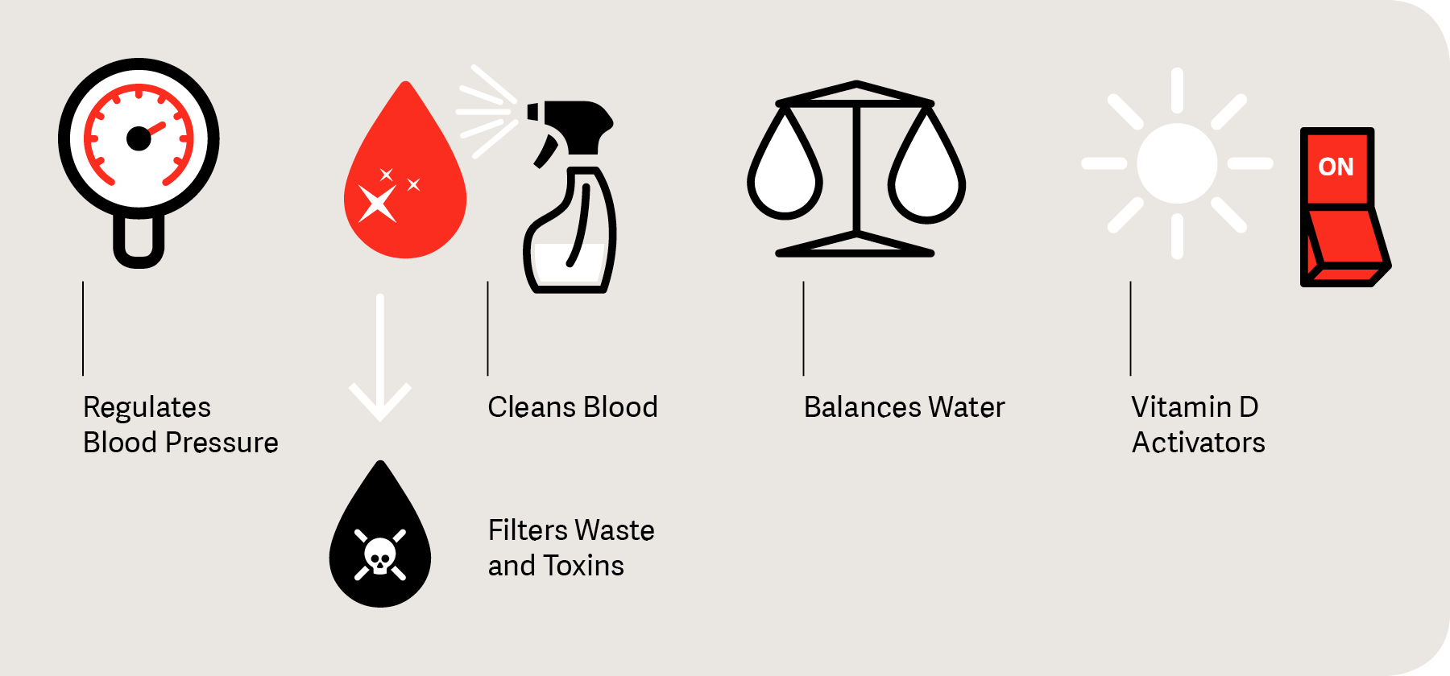
Why Are the Kidneys So Important?
The kidneys are important because they keep the composition, or makeup, of the blood stable, which lets the body function. They:
prevent the buildup of wastes and extra fluid in the body
produce an active form of vitamin D that promotes strong, healthy bones
keep levels of electrolytes stable, such as sodium, potassium, and phosphate
make hormones that help
regulate blood pressure
make red blood cells
bones stay strong

Slide 4
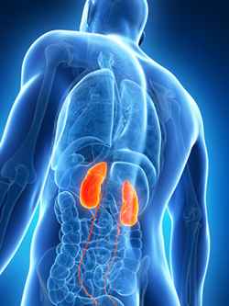
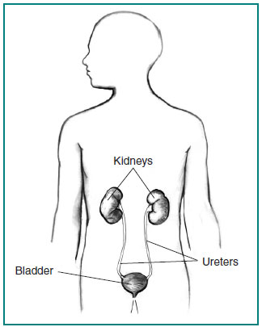
Where Are the Kidneys and How Do They Function?
There are two kidneys, each about the size of a fist, located on either side of the spine at the lowest level of the rib cage.

Slide 5
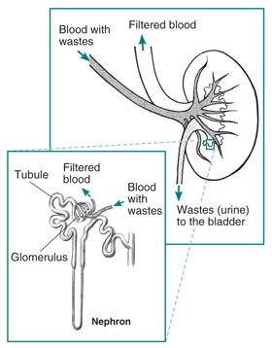
Where Are the Kidneys and How Do They Function?
Each kidney contains up to a million functioning units called nephrons.
A nephron consists of a filtering unit of tiny blood vessels called a glomerulus attached to a tubule.

Slide 6
Where Are the Kidneys and How Do They Function?
When blood enters the glomerulus, it is filtered and the remaining fluid then passes along the tubule.
In the tubule, chemicals and water are either added to or removed from this filtered fluid according to the body's needs, the final product being the urine we excrete.

Slide 7
The kidneys perform their life-sustaining job of filtering and returning to the bloodstream about 200 quarts of fluid every 24 hours.
About two quarts are removed from the body in the form of urine, and about 198 quarts are recovered.
The urine we excrete has been stored in the bladder for anywhere from 1 to 8 hours.

Slide 8
Common Kidney Problems
The kidneys may be affected by diseases such as diabetes and high blood pressure. Some kidney conditions are inherited (run in families), others are congenital.
Diabetes is a disease in which your body does not make enough insulin or cannot use normal amounts of insulin properly. This results in a high blood sugar level, which can cause problems in many parts of your body. Diabetes is the leading cause of kidney disease.
High blood pressure (also known as hypertension) is another common cause of kidney disease and other complications such as heart attacks and strokes. High blood pressure occurs when the force of blood against your artery walls increases.

Slide 9
Common Kidney Problems
Kidney stones (nephrolithiasis): Minerals in urine form crystals (stones), which may grow large enough to block urine flow. It's considered one of the most painful conditions. Most kidney stones pass on their own but some are too large and need to be treated.
There are many possible causes of kidney stones, including an inherited disorder that causes too much calcium to be absorbed from foods and urinary tract infections or obstructions.

Slide 10
Common Kidney Problems
Polycystic kidney disease is the most common inherited kidney disease.
It is characterized by the formation of kidney cysts that enlarge over time and may cause serious kidney damage and even kidney failure.

Slide 11
Common Kidney Problems
Urinary tract infections occur when germs enter the urinary tract and cause symptoms such as pain and/or burning during urination and more frequent need to urinate.
These infections most often affect the bladder, but they sometimes spread to the kidneys, and they may cause fever and pain in your back.

Slide 12
Common Kidney Problems
Drugs and toxins can also cause kidney problems. Using large numbers of over-the-counter pain relievers for a long time may be harmful to the kidneys.
Certain other medications, toxins, pesticides and "street" drugs such as heroin and crack can also cause kidney damage

Slide 13
Common Kidney Problems
Acute renal failure (kidney failure): A sudden worsening in kidney function. Dehydration, a blockage in the urinary tract, or kidney damage can cause acute renal failure, which may be reversible.
Chronic renal failure : A permanent partial loss of kidney function. Diabetes and high blood pressure are the most common causes.
End stage renal disease (ESRD): Complete loss of kidney function, usually due to progressive chronic kidney disease. People with ESRD require regular dialysis for survival.

Slide 14
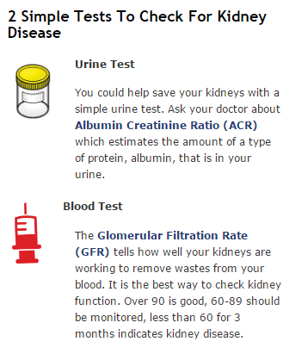
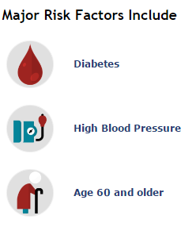

Slide 15
Warning Signs of Kidney Disease
There are six warning signs of kidney disease:
High blood pressure.
Blood and/or protein in the urine.
A creatinine and Blood Urea Nitrogen (BUN) blood test, outside the normal range. BUN and creatinine are waste that build up in your blood when your kidney function is reduced.
A glomerular filtration rate (GFR) less than 60. GFR is a measure of kidney function.
More frequent urination, particularly at night; difficult or painful urination.
Puffiness around eyes, swelling of hands and feet.

Slide 16
Kidney Failure

Slide 17
Kidney Failure
Kidney failure means the kidneys are no longer working well enough to do their job. Treatment is needed to replace the work the damaged kidneys have stopped doing. The treatments for kidney failure are:
Hemodialysis
Peritoneal dialysis
Kidney transplant

Slide 18
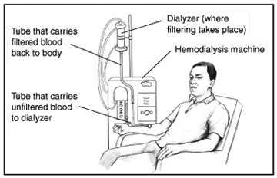
Hemodialysis
Hemodialysis uses a machine to filter your blood outside your body.
First, a dialysis nurse places two needles into the arm. A pump on the hemodialysis machine draws the blood through one of the needles into a tube.
The tube takes the blood to a filter, called a dialyzer. Inside the dialyzer, the blood flows through thin fibers that are like straws.
The wastes and extra fluid leave the blood through tiny holes in the fibers.
Then, a different tube carries the filtered blood back to the body through the second needle.

Slide 19
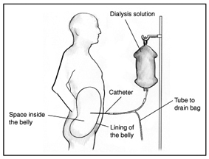
Peritoneal Dialysis
Peritoneal dialysis, uses the lining of the abdomen, or belly, to filter your blood inside your body.
A doctor places a soft tube called a catheter in the belly a few weeks before the start of peritoneal dialysis. The body empties dialysis solution from a plastic bag through the catheter into the empty space inside the belly.
The dialysis solution soaks up wastes and extra fluid from the body.
After a few hours, the used dialysis solution is drained into another bag.
Then starting over with a fresh bag of dialysis solution

Slide 20
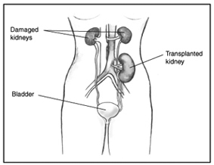
Kidney Transplant
A kidney transplant places a healthy kidney from another person into the body.
The kidney may come from someone who has just died.
There is usually awaiting list for kidney transplant
A family member or friend might be able to give a kidney.
Notes:
s

Slide 21
Kidney Transplant
The new kidney takes over filtering the blood.
The damaged kidneys usually stay where they are.
The new kidney is placed in the front lower abdomen, on one side of the bladder.
The body normally attacks anything that shouldn’t be there, such as bacteria.
The body will think the new kidney shouldn’t be there so medicines called immunosuppressants need to be taken to keep the body from attacking the new kidney.

Slide 22
How will kidney failure affect life?
Less energy and may feel depressed. Physical problems may include
ankle or belly swelling
stomach sickness
throwing up
loss of appetite
feeling tired
weakness
confusion
headaches
Having kidney failure does not have to mean giving up hobbies, work, social activities, or time with family.

Slide 23
What can you do for your kidneys?
Keep fit and active
Keeping fit helps to reduce your blood pressure and therefore reduces the risk of Chronic Kidney Disease.
The concept “on the move for kidney health” is a worldwide collective march involving the public, celebrities and professionals moving across a public area by walking, running and cycling

Slide 24
What can you do for your kidneys?
Keep regular control of your blood sugar level
About half of people who have diabetes develop kidney damage, so it is important for people with diabetes to have regular tests to check their kidney functions.

Slide 25
What can you do for your kidneys?
Monitor your blood pressure
Although many people may be aware that high blood pressure can lead to a stroke or heart attack, few know that it is also the most common cause of kidney damage.

Slide 26
What can you do for your kidneys?
Eat healthy and keep your weight in check
This can help prevent diabetes, heart disease and other conditions associated with Chronic Kidney Disease.
Reduce your salt intake. The recommended sodium intake is 5-6 grams of salt per day (around a teaspoon)

Slide 27
What can you do for your kidneys?
Maintain a healthy fluid intake
Drinking 1.5 to 2 liters (3 to 4 pints) of water per day.
Consuming plenty of fluid helps the kidneys clear sodium, urea and toxins from the body which, in turn, results in a “significantly lower risk” of developing chronic kidney disease.
the right level of fluid intake for any individual depends on many factors including gender, exercise, climate, health conditions, pregnancy and breast feeding.
In addition, people who have already had a kidney stone are advised to drink 2 to 3 liters of water daily to lessen the risk of forming a new stone.

Slide 29
What can you do for your kidneys?
Do not smoke
Smoking slows the flow of blood to the kidneys. When less blood reaches the kidneys, it impairs their ability to function properly.
Smoking also increases the risk of kidney cancer by about 50 percent.

Slide 30
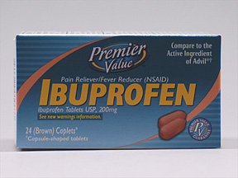
What can you do for your kidneys?
Do not take over-the-counter pills on a regular basis
Common drugs such non-steroidal anti-inflammatory drugs like ibuprofen are known to cause kidney damage and disease if taken regularly.
Such medications probably do not pose significant danger if the kidneys are relatively healthy and they are used for emergencies only, but if we are dealing with chronic pain, such as arthritis or back pain, it should be controlled without putting the kidneys at risk.

Slide 31
What can you do for your kidneys?
Get your kidney function checked if you have one or more of the ‘high risk’ factors
you have diabetes
you have hypertension
you are obese
one of your parents or other family members suffers from kidney disease

Slide 33
References
https://www.kidney.org/kidneydisease/howkidneyswrk#where
https://www.niddk.nih.gov/health-information/kidney-disease/kidney-failure
http://www.worldkidneyday.org/faqs/take-care-of-your-kidneys/8-golden-rules/
http://www.webmd.com/urinary-incontinence-oab/picture-of-the-kidneys#1

