Slide 1
Chapter Ten
Pricing:
Understanding and Capturing Customer Value
Copyright ©2014 by Pearson Education, Inc. All rights reserved

Slide 2
Pricing: Understanding and Capturing Customer Value
Topic Outline
What Is a Price?
Major Pricing Strategies
Other Internal and External Considerations Affecting Price Decisions
Copyright ©2014 by Pearson Education, Inc. All rights reserved

Slide 3
What Is a Price?
Price is the amount of money charged for a product or service. It is the sum of all the values that consumers give up in order to gain the benefits of having or using a product or service.
Price is the only element in the marketing mix that produces revenue; all other elements represent costs
Copyright ©2014 by Pearson Education, Inc. All rights reserved

Slide 4
Major Pricing Strategies
Copyright ©2014 by Pearson Education, Inc. All rights reserved

Slide 5
Major Pricing Strategies
Customer Value-Based Pricing
Value-based pricing uses the buyers’ perceptions of value, not the sellers cost, as the key to pricing
Value-based pricing is customer driven
Cost-based pricing is product driven
Price is considered before the marketing program is set
Copyright ©2014 by Pearson Education, Inc. All rights reserved

Slide 6
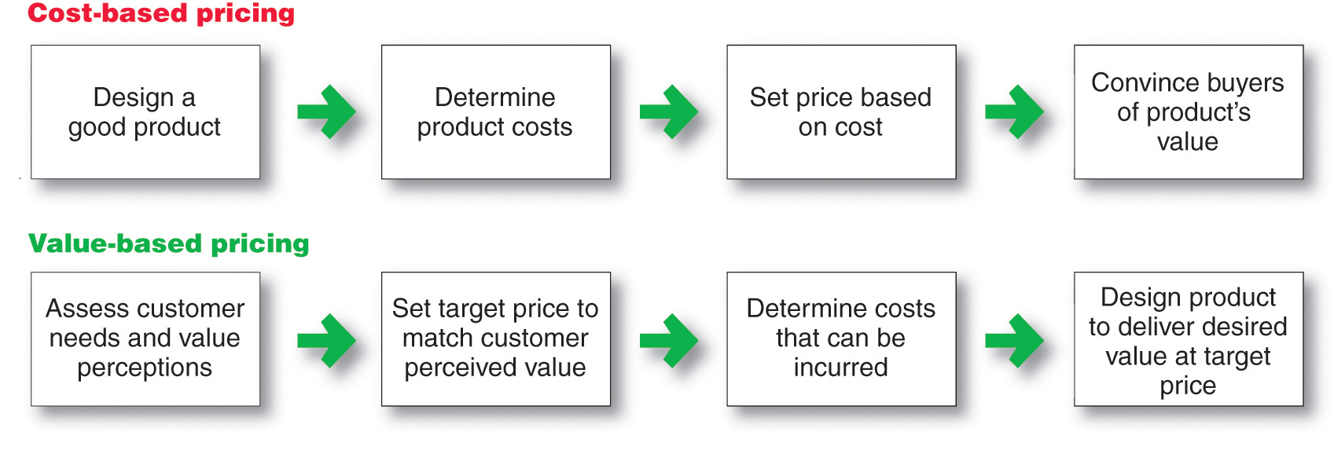
Major Pricing Strategies
Customer Value-Based Pricing
Copyright ©2014 by Pearson Education, Inc. All rights reserved

Slide 7
Major Pricing Strategies
Customer Value-Based Pricing
Good-value pricing
offers the right combination of quality and good service at a fair price
Copyright ©2014 by Pearson Education, Inc. All rights reserved

Slide 8
Major Pricing Strategies
Customer Value-Based Pricing
Everyday low pricing (EDLP) charging a constant everyday low price with few or no temporary price discounts
Copyright ©2014 by Pearson Education, Inc. All rights reserved

Slide 9
Major Pricing Strategies
Customer Value-Based Pricing
High-low pricing charging higher prices on an everyday basis but running frequent promotions to lower prices temporarily on selected items
Copyright ©2014 by Pearson Education, Inc. All rights reserved

Slide 10
Major Pricing Strategies
Customer Value-Based Pricing
Value-added pricing attaches value-added features and services to differentiate offers, support higher prices, and build pricing power
Copyright ©2014 by Pearson Education, Inc. All rights reserved

Slide 11
Major Pricing Strategies
Cost-Based Pricing
Cost-based pricing setting prices based on the costs for producing, distributing, and selling the product plus a fair rate of return for effort and risk
Cost-based pricing adds a standard markup to the cost of the product
Copyright ©2014 by Pearson Education, Inc. All rights reserved

Slide 12
Major Pricing Strategies
Cost-Based Pricing
Fixed costs are the costs that do not vary with production or sales level
Rent
Heat
Interest
Executive salaries
Copyright ©2014 by Pearson Education, Inc. All rights reserved

Slide 13
Major Pricing Strategies
Cost-Based Pricing
Variable costs are the costs that vary with the level of production
Packaging
Raw materials
Copyright ©2014 by Pearson Education, Inc. All rights reserved
Notes:
.

Slide 14
Major Pricing Strategies
Cost-Based Pricing
Total costs are the sum of the fixed and variable costs for any given level of production
Copyright ©2014 by Pearson Education, Inc. All rights reserved

Slide 15
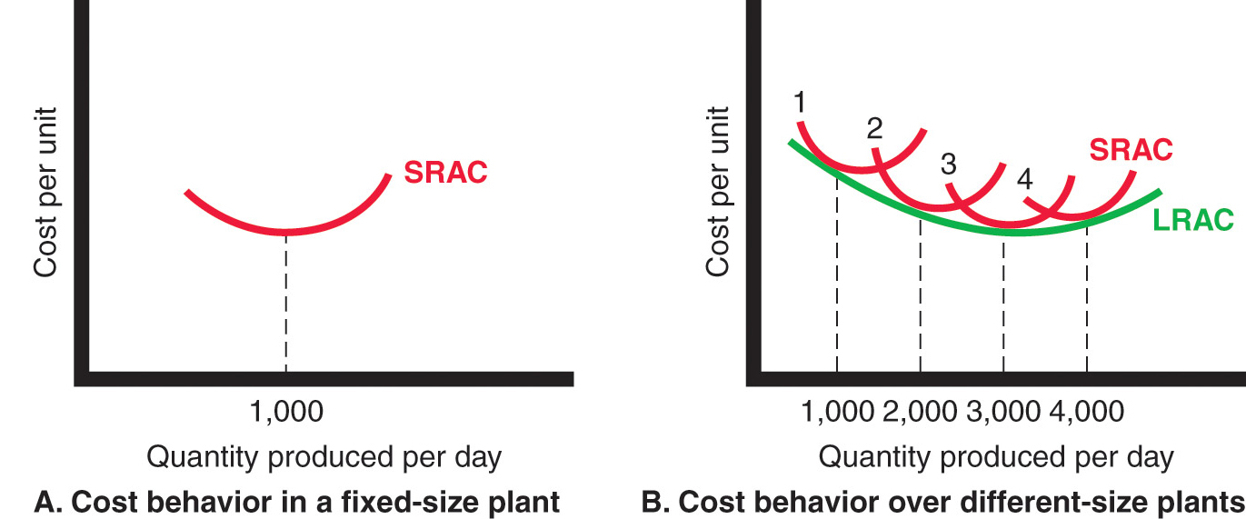
Major Pricing Strategies
Costs as a Function of Production Experience
Copyright ©2014 by Pearson Education, Inc. All rights reserved

Slide 16
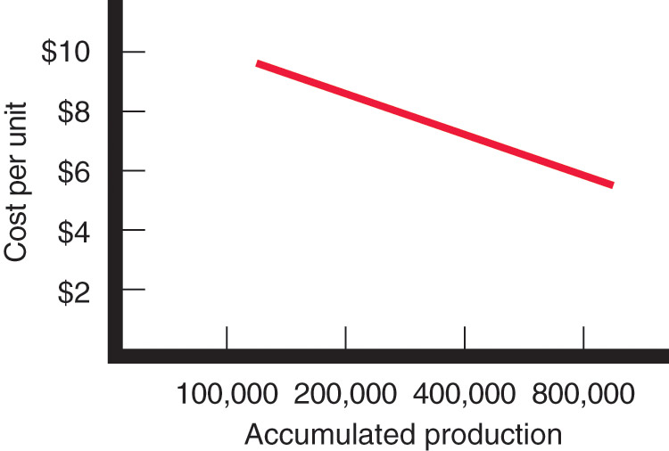
Major Pricing Strategies
Costs as a Function of Production Experience
Experience or learning curve is when average cost falls as production increases because fixed costs are spread over more units
Copyright ©2014 by Pearson Education, Inc. All rights reserved

Slide 17
Major Pricing Strategies
Cost-Plus Pricing
Cost-plus pricing adds a standard markup to the cost of the product
Benefits
Sellers are certain about costs
Prices are similar in industry and price competition is minimized
Buyers feel it is fair
Disadvantages
Ignores demand and competitor prices
Copyright ©2014 by Pearson Education, Inc. All rights reserved
Notes:
.

Slide 18
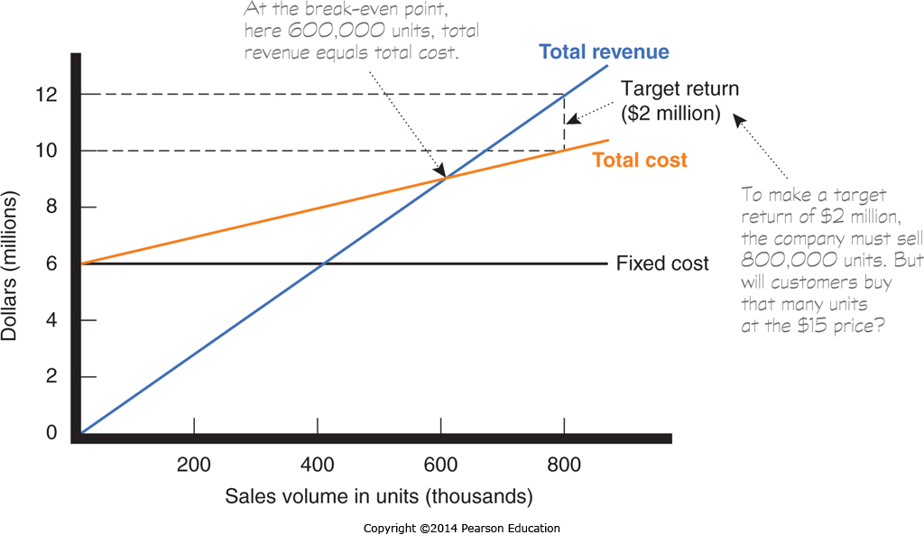
Major Pricing Strategies
Break-Even Analysis and Target Profit Pricing
Break-even pricing is the price at which total costs are equal to total revenue and there is no profit
Target return pricing is the price at which the firm will break even or make the profit it’s seeking
Copyright ©2014 by Pearson Education, Inc. All rights reserved

Slide 19
Major Pricing Strategies
Competition-based pricing
Setting prices based on competitors’ strategies, costs, prices, and market offerings.
Consumers will base their judgments of a product’s value on the prices that competitors charge for similar products.
Copyright ©2014 by Pearson Education, Inc. All rights reserved

Slide 20
Other Internal and External Considerations Affecting Price Decisions
Target costing starts with an ideal selling price based on consumer value considerations and then targets costs that will ensure that the price is met
Copyright ©2014 by Pearson Education, Inc. All rights reserved

Slide 21
Other Internal and External Considerations Affecting Price Decisions
Organizational considerations include:
Who should set the price
Who can influence the prices
Copyright ©2014 by Pearson Education, Inc. All rights reserved

Slide 22
Other Internal and External Considerations Affecting Price Decisions
The Market and Demand
Before setting prices, the marketer must understand the relationship between price and demand for its products
Copyright ©2014 by Pearson Education, Inc. All rights reserved

Slide 23
Other Internal and External Consideration Affecting Price Decisions
Competition
Pure competition
Monopolistic competition
Oligopolistic competition
Pure monopoly
Copyright ©2014 by Pearson Education, Inc. All rights reserved

Slide 24
Other Internal and External Considerations Affecting Price Decisions
The demand curve shows the number of units the market will buy in a given period at different prices
Normally, demand and price are inversely related
Higher price = lower demand
For prestige (luxury) goods, higher price can equal higher demand when consumers perceive higher prices as higher quality
Copyright ©2014 by Pearson Education, Inc. All rights reserved

Slide 25
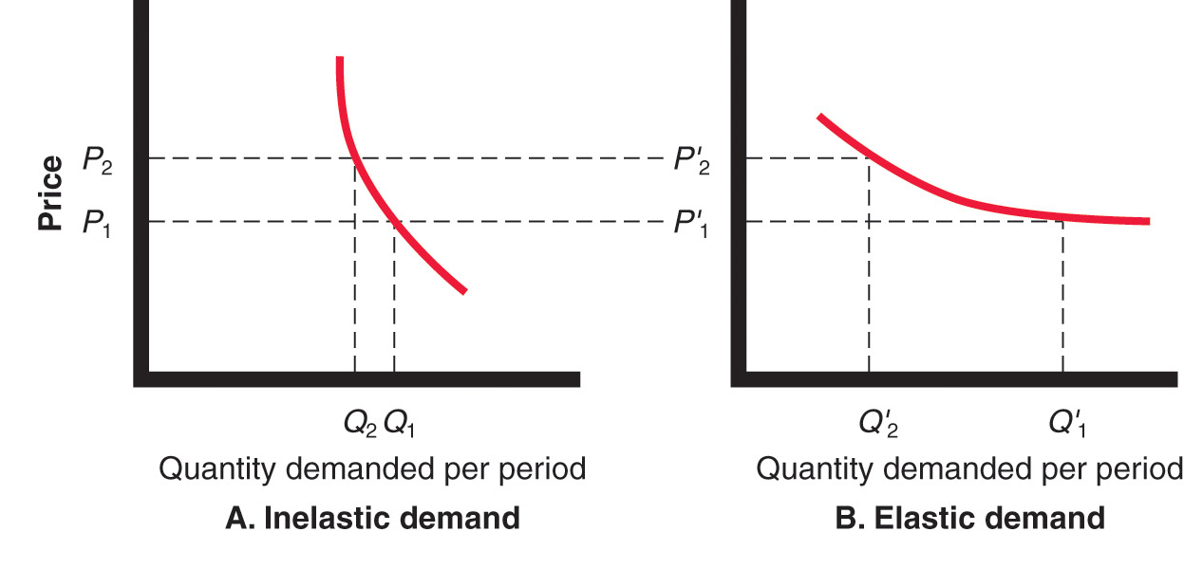
Other Internal and External Considerations Affecting Price Decisions
Copyright ©2014 by Pearson Education, Inc. All rights reserved

Slide 26
Other Internal and External Considerations Affecting Price Decisions
Price elasticity of demand illustrates the response of demand to a change in price
Inelastic demand occurs when demand hardly changes when there is a small change in price
Elastic demand occurs when demand changes greatly for a small change in price
Price elasticity of demand =
% change in quantity demand
% change in price
Copyright ©2014 by Pearson Education, Inc. All rights reserved

Slide 27
Other Internal and External Consideration Affecting Price Decisions
Economic conditions
Reseller’s response to price
Government
Social concerns
Copyright ©2014 by Pearson Education, Inc. All rights reserved

