Slide 1
Chapter Eight
Product, Services, and Brands: Building Customer Value
Copyright ©2014 by Pearson Education, Inc. All rights reserved

Slide 2
Product, Services, and Branding Strategy
Topic Outline
Product, Services, and Experiences
Product and Services Decisions
Services Marketing
Branding Strategy: Building Strong Brands
Copyright ©2014 by Pearson Education, Inc. All rights reserved

Slide 3
What Is a Product?
Products, Services, and Experiences
Product is anything that can be offered in a market for attention, acquisition, use, or consumption that might satisfy a need or want
Service is a product that consists of activities, benefits or satisfaction that is essentially intangible and does not result in the ownership of anything
Copyright ©2014 by Pearson Education, Inc. All rights reserved

Slide 4
What Is a Product?
Products, Services, and Experiences
Experiences represent what buying the product or service will do for the customer.
Companies may now focus on creating and managing customer experiences with their brands or company.
Copyright ©2014 by Pearson Education, Inc. All rights reserved

Slide 5
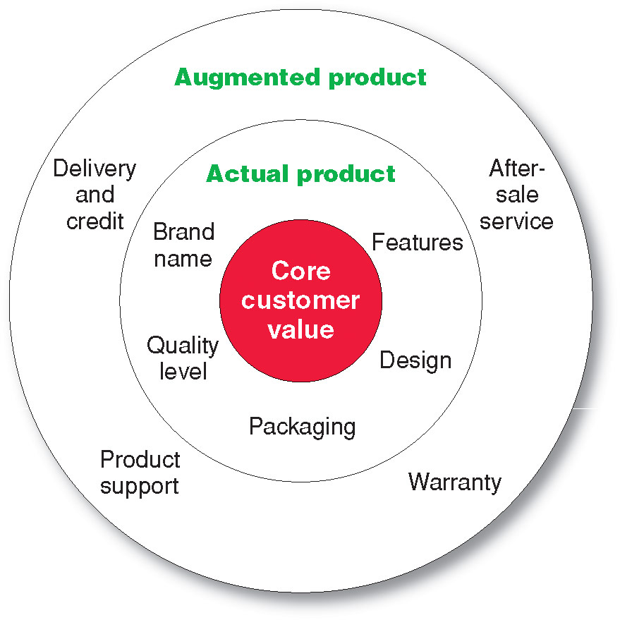
What Is a Product?
Levels of Product and Services
Copyright ©2014 by Pearson Education, Inc. All rights reserved

Slide 6
What Is a Product?
Product and Service Classifications
Consumer products
Industrial products
Copyright ©2014 by Pearson Education, Inc. All rights reserved

Slide 7
What Is a Product?
Product and Service Classifications
Consumer products are products and services for personal consumption
Classified by how consumers buy them
Convenience products
Shopping products
Specialty products
Unsought products
Copyright ©2014 by Pearson Education, Inc. All rights reserved

Slide 8
What Is a Product?
Product and Service Classifications
Convenience products
consumer products and services that the customer usually buys frequently, immediately, and with a minimum comparison and buying effort
Newspapers
Candy
Fast food
Copyright ©2014 by Pearson Education, Inc. All rights reserved

Slide 9
What Is a Product?
Product and Service Classifications
Shopping products
consumer products and services that the customer compares carefully on suitability, quality, price, and style
Furniture
Cars
Appliances
Copyright ©2014 by Pearson Education, Inc. All rights reserved

Slide 10
What Is a Product?
Product and Service Classifications
Specialty products
consumer products and services with unique characteristics or brand identification for which a significant group of buyers is willing to make a special purchase effort
Medical services
Designer clothes
High-end electronics
Copyright ©2014 by Pearson Education, Inc. All rights reserved

Slide 11
What Is a Product?
Product and Service Classifications
Unsought products
consumer products that the consumer does not know about or knows about but does not normally think of buying
Life insurance
Funeral services
Blood donations
Copyright ©2014 by Pearson Education, Inc. All rights reserved

Slide 12
What Is a Product?
Product and Service Classifications
Industrial products
products purchased for further processing or for use in conducting a business
Classified by the purpose for which the product is purchased
Materials and parts
Capital items
Supplies and services
Copyright ©2014 by Pearson Education, Inc. All rights reserved

Slide 13
What Is a Product?
Product and Service Classifications
Materials and parts include raw materials and manufactured materials and parts usually sold directly to industrial users
Capital items are industrial products that aid in the buyer’s production or operations
Supplies and services include operating supplies, repair and maintenance items, and business services
Copyright ©2014 by Pearson Education, Inc. All rights reserved
Notes:
.

Slide 14
What Is a Product?
Organizations, Persons, Places, and Ideas
Organization marketing consists of activities undertaken to create, maintain, or change attitudes and behavior of target consumers toward an organization.

Slide 15
What Is a Product?
Organizations, Persons, Places, and Ideas
Person marketing consists of activities undertaken to create, maintain, or change attitudes and behavior of target consumers toward particular people
Copyright ©2014 by Pearson Education, Inc. All rights reserved

Slide 16
What Is a Product
Organizations, Persons, Places, and Ideas
Place marketing consists of activities undertaken to create, maintain, or change attitudes and behavior of target consumers toward particular places
Social marketing is the use of commercial marketing concepts and tools in programs designed to influence individuals’ behavior to improve their well-being and that of society
Copyright ©2014 by Pearson Education, Inc. All rights reserved

Slide 17
Product and Service Decisions
Individual Product and Service Decisions
Copyright ©2014 by Pearson Education, Inc. All rights reserved

Slide 18
Product and Service Decisions
Individual Product and Service Decisions
Product or service attributes
communicate and deliver the benefits
Quality
Features
Style and design
Copyright ©2014 by Pearson Education, Inc. All rights reserved

Slide 19
Product and Service Decisions
Individual Product and Service Decisions
Product Quality Level is the level of quality that supports the product’s positioning
Product Conformance Quality is the product’s freedom from defects and consistency in delivering a targeted level of performance
Copyright ©2014 by Pearson Education, Inc. All rights reserved

Slide 20
Product and Service Decisions
Individual Product and Service Decisions
Product features
are a competitive tool for differentiating a product from competitors’ products
are assessed based on the value to the customer versus the cost to the company
Copyright ©2014 by Pearson Education, Inc. All rights reserved

Slide 21
Product and Service Decisions
Individual Product and Service Decisions
Style describes the appearance of the product
Design contributes to a product’s usefulness as well as to its looks
Copyright ©2014 by Pearson Education, Inc. All rights reserved

Slide 22
Product and Service Decisions
Individual Product and Service Decisions
Brand is the name, term, sign, or design—or a combination of these—that identifies the maker or seller of a product or service
Copyright ©2014 by Pearson Education, Inc. All rights reserved

Slide 23
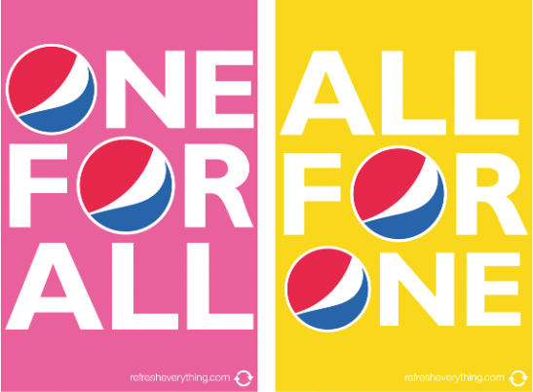
Product and Service Decisions
Individual Product and Service Decisions
Packaging involves designing and producing the container or wrapper for a product
Labels identify the product or brand, describe attributes, and provide promotion
Copyright ©2014 by Pearson Education, Inc. All rights reserved

Slide 24
Product and Service Decisions
Individual Product and Service Decisions
Product support services augment actual products
Copyright ©2014 by Pearson Education, Inc. All rights reserved

Slide 25
Product and Service Decisions
Product Line Decisions
Product line is a group of products that are closely related because they function in a similar manner, are sold to the same customer groups, are marketed through the same types of outlets, or fall within given price ranges
Copyright ©2014 by Pearson Education, Inc. All rights reserved

Slide 26
Product and Service Decisions
Product Line Decisions
Product line length is the number of items in the product line
Line stretching
Line filling
Copyright ©2014 by Pearson Education, Inc. All rights reserved

Slide 27
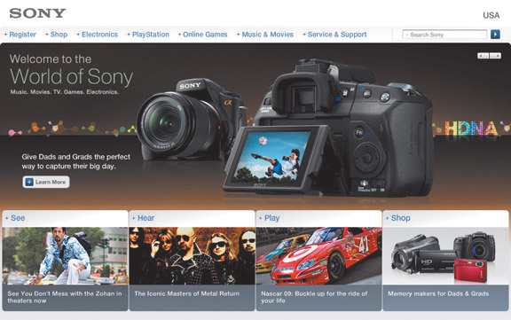
Product and Service Decisions
Product Mix Decisions
Product mix consists of all the products and items that a particular seller offers for sale
Width
Length
Depth
Consistency
Copyright ©2014 by Pearson Education, Inc. All rights reserved

Slide 28
Services Marketing
Types of Service Industries
Government
Private not-for-profit organizations
Business services
Copyright ©2014 by Pearson Education, Inc. All rights reserved

Slide 29
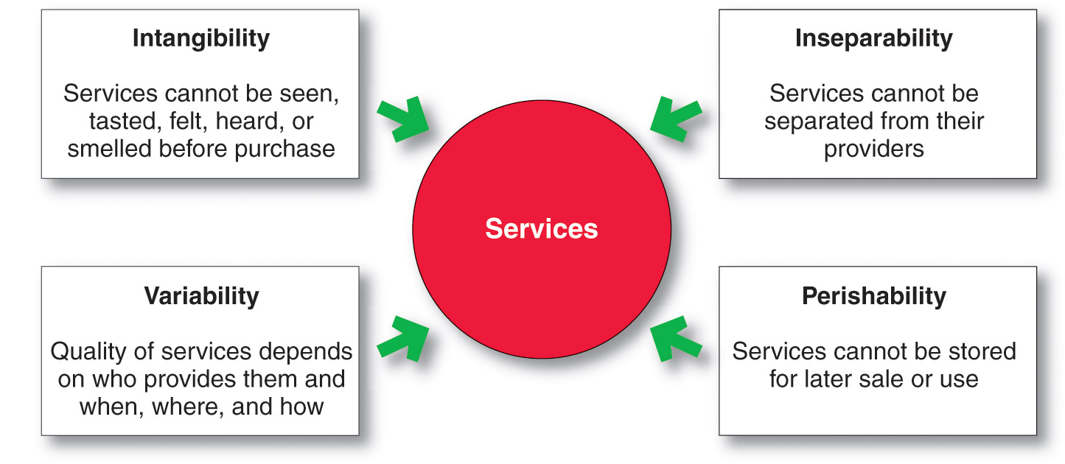
Services Marketing
Nature and Characteristics of a Service
Copyright ©2014 by Pearson Education, Inc. All rights reserved

Slide 30
Services Marketing
Marketing Strategies for Service Firms
In addition to traditional marketing strategies, service firms often require additional strategies
Service-profit chain
Internal marketing
Interactive marketing
Copyright ©2014 by Pearson Education, Inc. All rights reserved

Slide 31
Services Marketing
Marketing Strategies for Service Firms
Service-profit chain links service firm profits with employee and customer satisfaction
Internal service quality
Satisfied and productive service employees
Greater service value
Satisfied and loyal customers
Healthy service profits and growth
Copyright ©2014 by Pearson Education, Inc. All rights reserved

Slide 32
Services Marketing
Marketing Strategies for Service Firms
Internal marketing means that the service firm must orient and motivate its customer contact employees and supporting service people to work as a team to provide customer satisfaction
Internal marketing must precede external marketing
Copyright ©2014 by Pearson Education, Inc. All rights reserved

Slide 33
Services Marketing
Marketing Strategies for Service Firms
Interactive marketing means that service quality depends heavily on the quality of the buyer-seller interaction during the service encounter
Service differentiation
Service quality
Service productivity
Copyright ©2014 by Pearson Education, Inc. All rights reserved

Slide 34
Services Marketing
Marketing Strategies for Service Firms
Managing service differentiation creates a competitive advantage from the offer, delivery, and image of the service
Offer can include distinctive features
Delivery can include more able and reliable customer contact people, environment, or process
Image can include symbols and branding
Copyright ©2014 by Pearson Education, Inc. All rights reserved

Slide 35
Services Marketing
Marketing Strategies for Service Firms
Managing service quality provides a competitive advantage by delivering consistently higher quality than its competitors
Service quality always varies depending on interactions between employees and customers
Copyright ©2014 by Pearson Education, Inc. All rights reserved

Slide 36
Services Marketing
Marketing Strategies for Service Firms
Managing service productivity refers to the cost side of marketing strategies for service firms
Employee recruiting, hiring, and training strategies
Service quantity and quality strategies
Copyright ©2014 by Pearson Education, Inc. All rights reserved

Slide 37
Branding Strategy: Building Strong Brands
Brand equity
The differential effect that knowing the
brand name has on customer response to
the product or its marketing.
Copyright ©2014 by Pearson Education, Inc. All rights reserved

Slide 38
Branding Strategy: Building Strong Brands
Copyright ©2014 by Pearson Education, Inc. All rights reserved
Notes:
.

Slide 39
Branding Strategy: Building Strong Brands
Brand Positioning
Brand strategy decisions include:
Product attributes
Product benefits
Product beliefs and values
Copyright ©2014 by Pearson Education, Inc. All rights reserved

Slide 40
Branding Strategy: Building Strong Brands
Brand Name Selection
Desirable qualities
Suggest benefits and qualities
Easy to pronounce, recognize, and remember
Distinctive
Extendable
Translatable for the global economy
Capable of registration and legal protection
Copyright ©2014 by Pearson Education, Inc. All rights reserved

Slide 41
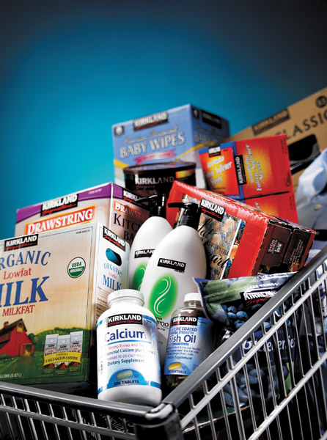
Branding Strategy: Building Strong Brands
Brand Sponsorship
Manufacturer’s brand
Private brand
Licensed brand
Co-brand
Copyright ©2014 by Pearson Education, Inc. All rights reserved

Slide 42
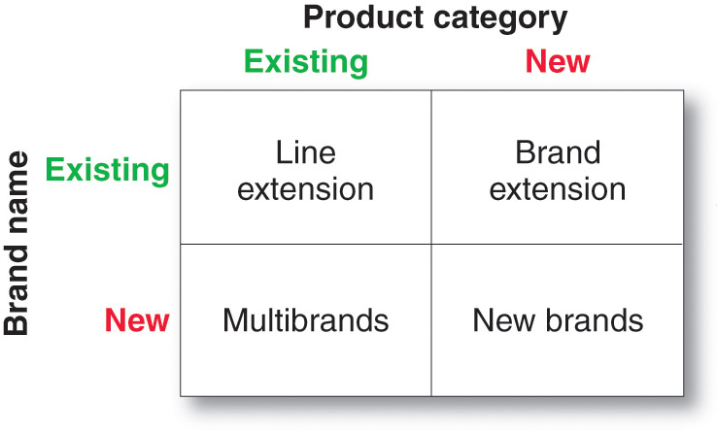
Branding Strategy: Building Strong Brands
Brand Development Strategies
Copyright ©2014 by Pearson Education, Inc. All rights reserved

