Slide 1
Chapter Seven
Customer-Driven Marketing Strategy:
Creating Value for Target Customers
Copyright ©2014 by Pearson Education, Inc. All rights reserved

Slide 2
Customer-Driven Marketing Strategy: Creating Value for Target Customers
Topic Outline
Market Segmentation
Market Targeting
Differentiation and Positioning
Copyright ©2014 by Pearson Education, Inc. All rights reserved

Slide 3
Market Segmentation
Copyright ©2014 by Pearson Education, Inc. All rights reserved

Slide 4
Market Segmentation
Market segmentation requires dividing a market into smaller segments with distinct needs, characteristics, or behavior that might require separate marketing strategies or mixes.
Copyright ©2014 by Pearson Education, Inc. All rights reserved

Slide 5
Market Segmentation
Segmenting consumer markets
Segmenting business markets
Segmenting international markets
Requirements for effective segmentation
Copyright ©2014 by Pearson Education, Inc. All rights reserved

Slide 6
Market Segmentation
Segmenting Consumer Markets
Geographic segmentation
Demographic segmentation
Psychographic segmentation
Behavioral segmentation
Copyright ©2014 by Pearson Education, Inc. All rights reserved

Slide 7
Market Segmentation
Segmenting Consumer Markets
Geographic segmentation divides the
market into different geographical
units such as nations, regions, states,
counties, or cities
Copyright ©2014 by Pearson Education, Inc. All rights reserved

Slide 8
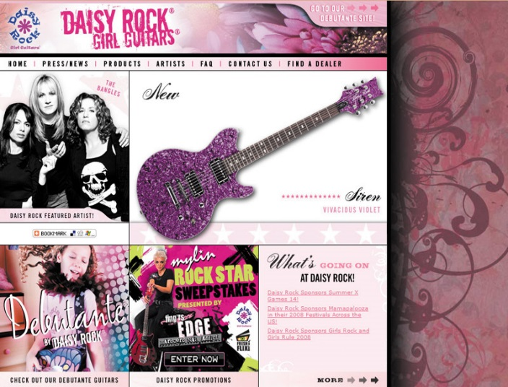
Market Segmentation
Segmenting Consumer Markets
Demographic segmentation divides the market into groups based on variables such as age, gender, family size, family life cycle, income, occupation, education, religion, race, generation, and nationality
Copyright ©2014 by Pearson Education, Inc. All rights reserved

Slide 9
Market Segmentation
Age and life-cycle stage segmentation is the process of offering different products or using different marketing approaches for different age and life-cycle groups
Gender segmentation divides the market based on sex (male or female)
Copyright ©2014 by Pearson Education, Inc. All rights reserved

Slide 10
Market Segmentation
Segmenting Consumer Markets
Income segmentation divides the market into affluent, middle-income or low-income consumers
Psychographic segmentation divides buyers into different groups based on social class, lifestyle, or personality traits
Copyright ©2014 by Pearson Education, Inc. All rights reserved

Slide 11
Market Segmentation
Segmenting Consumer Markets
Behavioral segmentation divides buyers into groups based on their knowledge, attitudes, uses, or responses to a product
Occasions
Benefits sought
User status
Usage rate
Loyalty status
Copyright ©2014 by Pearson Education, Inc. All rights reserved

Slide 12
Market Segmentation
Using Multiple Segmentation Bases
Multiple segmentation is used to identify smaller, better-defined target groups
PRIZM NE classifies every American household into 66 unique segments organized into 14 different social groups.
Copyright ©2014 by Pearson Education, Inc. All rights reserved

Slide 13
Market Segmentation
Segmenting Business Markets
Consumer and business marketers use many of the same variables to segment their markets
Additional variables include:
Customer operating characteristics
Purchasing approaches
Situational factors
Personal characteristics
Copyright ©2014 by Pearson Education, Inc. All rights reserved

Slide 14
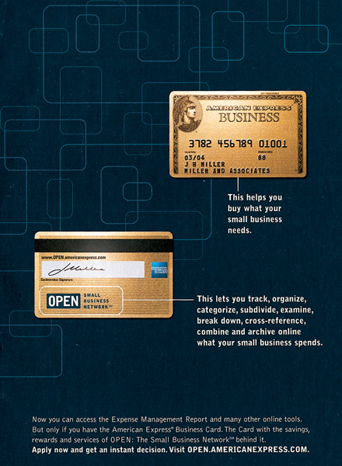
Market Segmentation
Segmenting International Markets
Geographic location
Economic factors
Political-legal factors
Cultural factors
Copyright ©2014 by Pearson Education, Inc. All rights reserved

Slide 15
Market Segmentation
Segmenting International Markets
Intermarket segmentation divides consumers into groups with similar needs and buying behaviors even though they are located in different countries
Copyright ©2014 by Pearson Education, Inc. All rights reserved

Slide 16
Market Segmentation
Requirements for Effective Segmentation
To be useful, market segments must be:
Measurable
Accessible
Substantial
Differentiable
Actionable
Copyright ©2014 by Pearson Education, Inc. All rights reserved

Slide 17
Market Targeting
Evaluating Market Segments
Segment size and growth
Segment structural attractiveness
Company objectives and resources
Copyright ©2014 by Pearson Education, Inc. All rights reserved

Slide 18
Market Targeting
Selecting Target Market Segments
Target market consists of a set of buyers who share common needs or characteristics that the company decides to serve
Copyright ©2014 by Pearson Education, Inc. All rights reserved

Slide 19
Market Targeting
Target Marketing Strategies
Undifferentiated marketing targets the whole market with one offer
Mass marketing
Focuses on common needs rather than what’s different
Copyright ©2014 by Pearson Education, Inc. All rights reserved

Slide 20
Market Targeting
Target Marketing Strategies
Differentiated marketing targets several different market segments and designs separate offers for each
Goal is to achieve higher sales and stronger position
More expensive than undifferentiated marketing
Copyright ©2014 by Pearson Education, Inc. All rights reserved

Slide 21
Market Targeting
Target Market Strategies
Concentrated marketing
targets a small share of a
large market
Limited company
resources
Knowledge of the market
More effective and efficient
Copyright ©2014 by Pearson Education, Inc. All rights reserved

Slide 22
Marketing Targeting
Target Market Strategies
Micromarketing is the practice of tailoring products and marketing programs to suit the tastes of specific individuals and locations
Local marketing
Individual marketing
Copyright ©2014 by Pearson Education, Inc. All rights reserved

Slide 23
Market Targeting
Target Market Strategies
Local marketing involves tailoring brands and promotion to the needs and wants of local customer groups
Cities
Neighborhoods
Stores
Copyright ©2014 by Pearson Education, Inc. All rights reserved
Notes:
and message vary too much in different localities.

Slide 24
Market Targeting
Target Market Strategies
Individual marketing involves tailoring products and marketing programs to the needs and preferences of individual customers
Also known as:
One-to-one marketing
Mass customization
Copyright ©2014 by Pearson Education, Inc. All rights reserved

Slide 25
Market Targeting
Choosing a Target Market
Depends on:
Company resources
Product variability
Product life-cycle stage
Market variability
Competitor’s marketing strategies
Copyright ©2014 by Pearson Education, Inc. All rights reserved

Slide 26
Market Targeting
Socially Responsible Target Marketing
Benefits customers with specific needs
Concern for vulnerable segments
Children
Alcohol
Cigarettes
Internet abuses
Copyright ©2014 by Pearson Education, Inc. All rights reserved

Slide 27
Differentiation and Positioning
Product position is the way the product is defined by consumers on important attributes—the place the product occupies in consumers’ minds relative to competing products
Perceptions
Impressions
Feelings
Copyright ©2014 by Pearson Education, Inc. All rights reserved

Slide 28
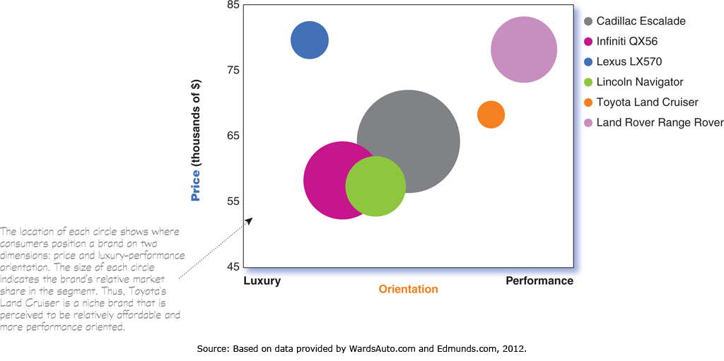
Differentiation and Positioning
Positioning maps show consumer perceptions of their brands versus competing products on important buying dimensions
Copyright ©2014 by Pearson Education, Inc. All rights reserved
Notes:
Positioning Maps
In planning their differentiation and positioning strategies, marketers often prepare perceptual positioning maps that show consumer perceptions of their brands versus competing products on important buying dimensions. Figure 7.3 shows a positioning map for the U.S. large luxury sport utility vehicle (SUV) market. The position of each circle on the map indicates the brand’s perceived positioning on two dimensions: price and orientation (luxury versus performance). The size of each circle indicates the brand’s relative market share.

Slide 29
Differentiation and Positioning
Choosing a Differentiation and Positioning Strategy
Identifying a set of possible competitive advantages to build a position
Choosing the right competitive advantages
Selecting an overall positioning strategy
Communicating and delivering the chosen position to the market
Copyright ©2014 by Pearson Education, Inc. All rights reserved

Slide 30
Differentiation and Positioning
Identifying Possible Value Differences and Competitive Advantages
Competitive advantage is an advantage over competitors gained by offering consumers greater value, either through lower prices or by providing more benefits that justify higher prices
Copyright ©2014 by Pearson Education, Inc. All rights reserved

Slide 31
Differentiation and Positioning
Choosing a Differentiation and Positioning Strategy
Identifying a set of possible competitive advantages to build a position by providing superior value from:
Product differentiation
Service differentiation
Channel differentiation
People differentiation
Image differentiation
Copyright ©2014 by Pearson Education, Inc. All rights reserved

Slide 32
Differentiation and Positioning
Choosing the Right Competitive Advantage
Difference to promote should be:
Distinctive
Superior
Communicable
Preemptive
Affordable
Profitable
Important
Copyright ©2014 by Pearson Education, Inc. All rights reserved

Slide 33
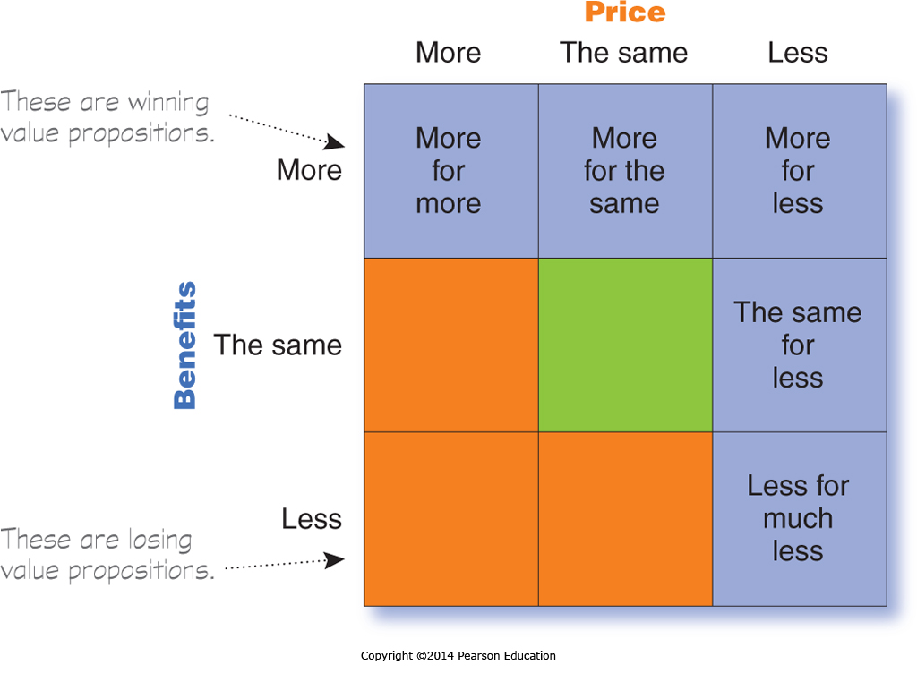
Differentiation and Positioning
Selecting an Overall Positioning Strategy
Value proposition is the full mix of benefits upon which a brand is positioned
Copyright ©2014 by Pearson Education, Inc. All rights reserved

Slide 34
Differentiation and Positioning
Developing a Positioning Statement
To (target segment and need) our (brand) is (concept) that (point of difference)
Example, for Evernote: “To busy multitaskers who need help remembering things, Evernote is a digital content management application that makes it easy to capture and remember moments and ideas from your everyday life using your computer, phone, table, and the Web.”
Copyright ©2014 by Pearson Education, Inc. All rights reserved
Notes:
Developing a Positioning Statement
Company and brand positioning should be summed up in a positioning statement. The statement should follow the form: To (target segment and need) our (brand) is (concept) that (point of difference). Here is an example using the popular digital information management application, Evernote: “To busy multitaskers who need help remembering things, Evernote is digital content management application that makes it easy to capture and remember moments and ideas from your everyday life using your computer, phone, tablet, and the Web.”
Note that the positioning statement first states the product’s membership in a category (digital content management application) and then shows its point of difference from other members of the category (easily capture moments and ideas and remember them later). Evernote helps you “remember everything” by letting you take notes, capture photos, create to-do lists, and record voice reminders, and then makes them easy to find and access using about any device, anywhere—at home, at work, or on the go.
Placing a brand in a specific category suggests similarities that it might share with other products in the category. But the case for the brand’s superiority is made on its points of difference. For example, the U.S. Postal Service ships packages just like UPS and FedEx, but it differentiates its priority mail from competitors with convenient, low-price, flat-rate shipping boxes and envelopes. “If it fits, it ships,” promises the Post Office. Based on information from Philip Kotler and Kevin Lane Keller, Marketing

Slide 35
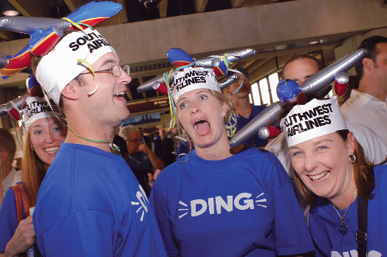
Communication and Delivering the Chosen Position
Choosing the positioning is often easier than implementing the position.
Copyright ©2014 by Pearson Education, Inc. All rights reserved

