Slide 1
Chapter Five
Consumer Markets and Consumer Buyer Behavior
Copyright ©2014 by Pearson Education, Inc. All rights reserved

Slide 2
Consumer Markets and Consumer Buyer Behavior
Topic Outline
Model of Consumer Behavior
Characteristics Affecting Consumer Behavior
Types of Buying Decision Behavior
The Buyer Decision Process
The Buyer Decision Process for New Products
Copyright ©2014 by Pearson Education, Inc. All rights reserved

Slide 3
Model of Consumer Behavior
Consumer buyer behavior : the buying behavior of final consumers, individuals and households, who buy goods and services for personal consumption
Consumer market : all of the personal consumption of final consumers
Copyright ©2014 by Pearson Education, Inc. All rights reserved

Slide 4
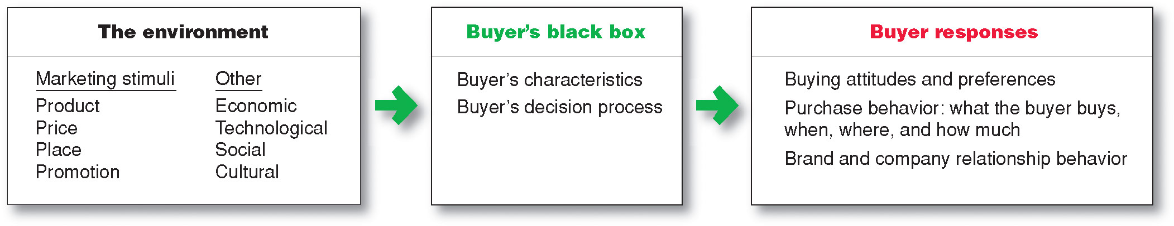
Model of Consumer Behavior
Copyright ©2014 by Pearson Education, Inc. All rights reserved

Slide 5
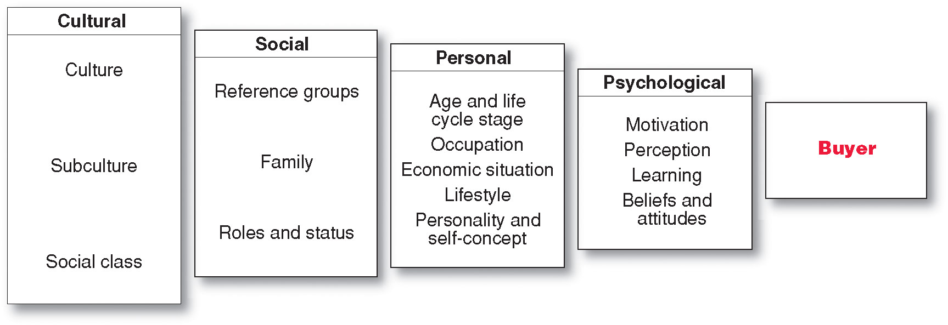
Characteristics Affecting Consumer Behavior
Factors Influencing Consumer Behavior
Copyright ©2014 by Pearson Education, Inc. All rights reserved

Slide 6
Characteristics Affecting Consumer Behavior
Culture is the learned values, perceptions, wants, and behavior from family and other important institutions and is the most basic cause of a person’s wants and behavior
Copyright ©2014 by Pearson Education, Inc. All rights reserved

Slide 7
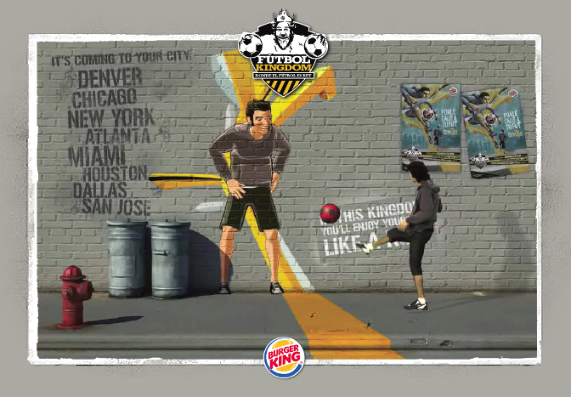
Characteristics Affecting Consumer Behavior
Subcultures are groups of people within a culture with shared value systems based on common life experiences and situations
Hispanic American
African American
Asian American
Cross-Cultural
Copyright ©2014 by Pearson Education, Inc. All rights reserved

Slide 8
Characteristics Affecting Consumer Behavior
Social classes are society’s relatively permanent and ordered divisions whose members share similar values, interests, and behaviors
Measured by a combination of occupation, income, education, wealth, and other variables
Copyright ©2014 by Pearson Education, Inc. All rights reserved

Slide 9
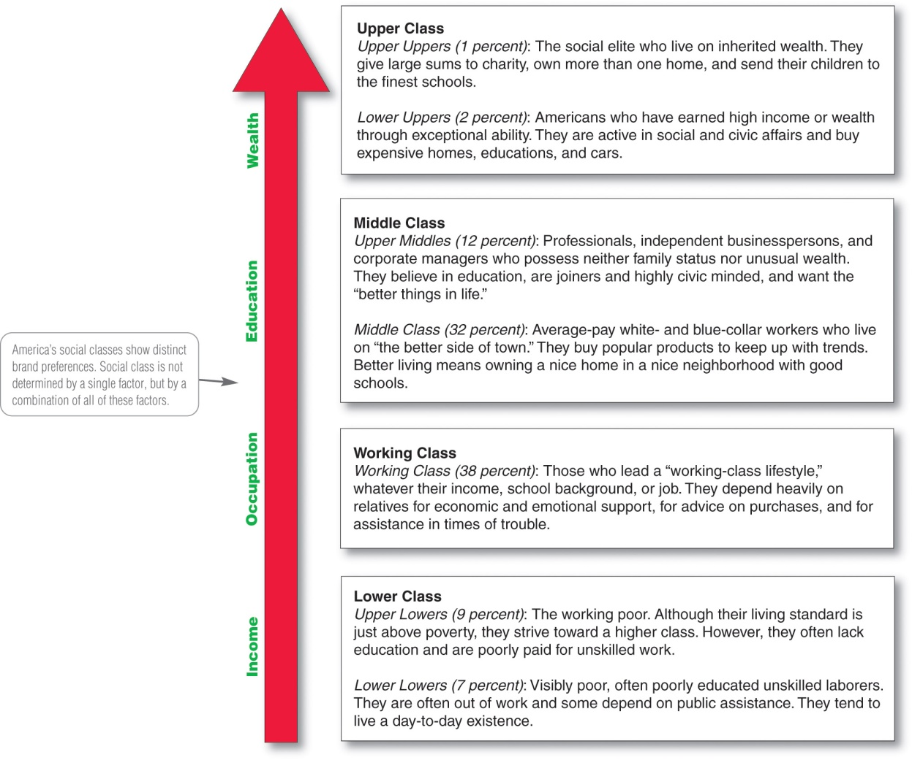
Major American Social Classes
Copyright ©2014 by Pearson Education, Inc. All rights reserved

Slide 10
Characteristics Affecting Consumer Behavior
Groups and Social Networks
Membership Groups
Groups with direct influence and to which a person belongs
Aspirational Groups
Groups an individual wishes to belong to
Reference Groups
Groups that form a comparison or reference in forming attitudes or behavior
Copyright ©2014 by Pearson Education, Inc. All rights reserved

Slide 11

Characteristics Affecting Consumer Behavior
Groups and Social Networks
Word-of-mouth influence and buzz marketing
  Opinion leaders are people within a reference group who exert social influence on others
  Also called influentials or leading adopters
  Marketers identify them to use as brand ambassadors
Copyright ©2014 by Pearson Education, Inc. All rights reserved

Slide 12
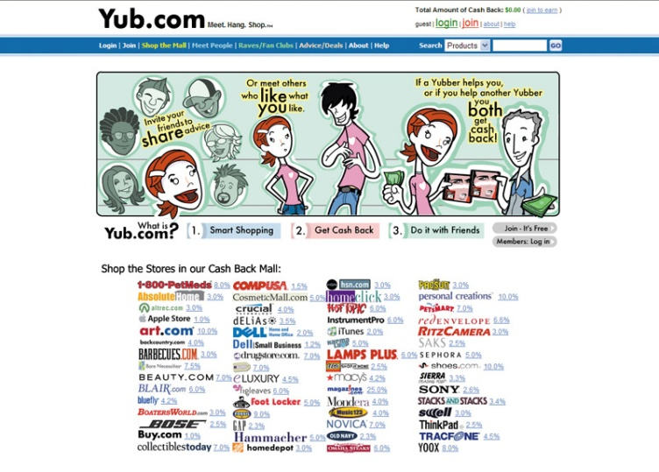
Characteristics Affecting Consumer Behavior
Groups and Social Networks
Online Social Networks are online communities where people socialize or exchange information and opinions
Include blogs, social networking sites (facebook), virtual worlds (second life)
Copyright ©2014 by Pearson Education, Inc. All rights reserved

Slide 13
Characteristics Affecting Consumer Behavior
Social Factors
Family is the most important consumer-buying organization in society
Social roles and status are the groups, family, clubs, and organizations that a person belongs to that can define role and social status
Copyright ©2014 by Pearson Education, Inc. All rights reserved

Slide 14
Characteristics Affecting Consumer Behavior
Personal Factors
Age and life-cycle stage
PersonicX life-stage segmentation system:
--70 segments
--21 life-stage groups
Includes Taking Hold (young, energetic couples and families) and Transition Blues (blue-dollar, less educated mid-income)
Copyright ©2014 by Pearson Education, Inc. All rights reserved

Slide 15
Characteristics Affecting Consumer Behavior
Personal Factors
Occupation affects the goods and services bought by consumers
Economic situation includes trends in:
Personal income
Savings
Interest rates
Copyright ©2014 by Pearson Education, Inc. All rights reserved

Slide 16

Characteristics Affecting Consumer Behavior
Personal Factors
Lifestyle is a person’s pattern of living as expressed in his or her psychographics
Measures a consumer’s AIOs (activities, interests, opinions) to capture information about a person’s pattern of acting and interacting in the environment
Copyright ©2014 by Pearson Education, Inc. All rights reserved

Slide 17
Characteristics Affecting Consumer Behavior
Personal Factors
Personality: the unique psychological characteristics that lead to consistent and lasting responses to the consumer’s environment
Copyright ©2014 by Pearson Education, Inc. All rights reserved

Slide 18
Characteristics Affecting Consumer Behavior
Personal Factors
Dominance
Autonomy
Defensiveness
Adaptability
Aggressiveness
Copyright ©2014 by Pearson Education, Inc. All rights reserved

Slide 19

Characteristics Affecting Consumer Behavior
Psychological Factors
Motivation
Perception
Learning
Beliefs and attitudes
Copyright ©2014 by Pearson Education, Inc. All rights reserved

Slide 20
Characteristics Affecting Consumer Behavior
Psychological Factors
Motivation
A motive is a need that is sufficiently pressing to direct the person to seek satisfaction
Motivation research refers to qualitative research designed to probe consumers’ hidden, subconscious motivations
Copyright ©2014 by Pearson Education, Inc. All rights reserved

Slide 21
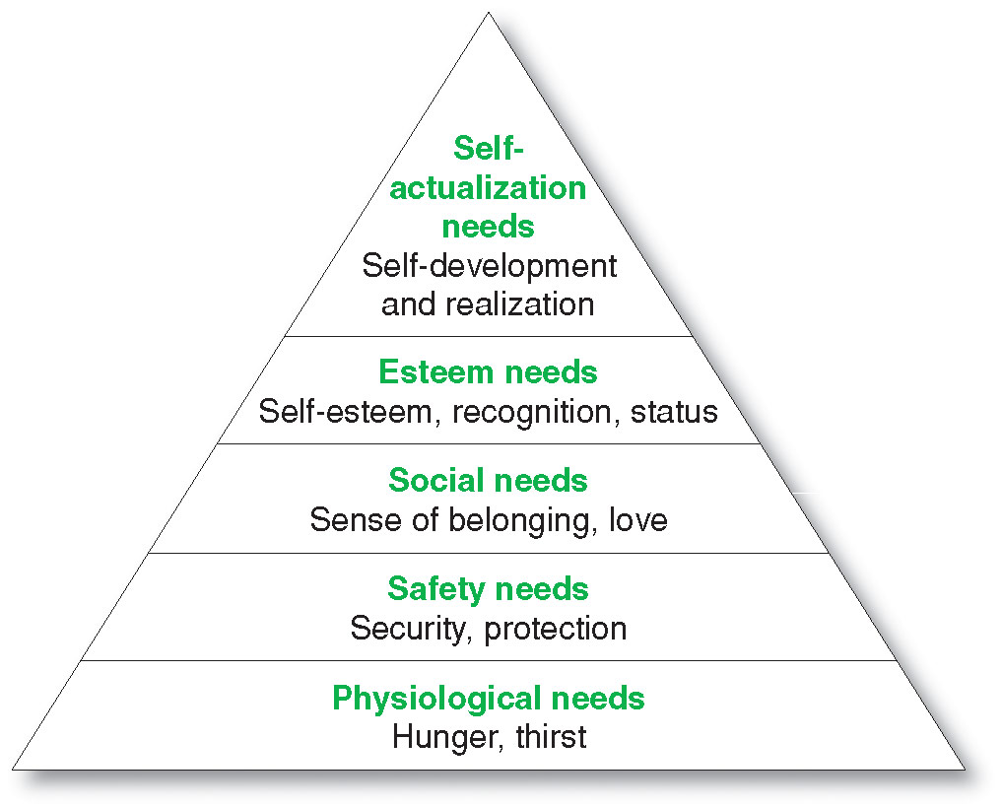
Characteristics Affecting Consumer Behavior
Maslow’s
Hierarchy of Needs
Copyright ©2014 by Pearson Education, Inc. All rights reserved

Slide 22

Characteristics Affecting Consumer Behavior
Psychological Factors
Perception is the process by which people select, organize, and interpret information to form a meaningful picture of the world from three perceptual processes
  Selective attention
  Selective distortion
  Selective retention
Copyright ©2014 by Pearson Education, Inc. All rights reserved

Slide 23
Characteristics Affecting Consumer Behavior
Psychological Factors
Selective attention is the tendency for people to screen out most of the information to which they are exposed
Selective distortion is the tendency for people to interpret information in a way that will support what they already believe
Selective retention is the tendency to remember good points made about a brand they favor and forget good points about competing brands
Copyright ©2014 by Pearson Education, Inc. All rights reserved

Slide 24
Characteristics Affecting Consumer Behavior
Psychological Factors
Learning is the change in an individual’s behavior arising from experience and occurs through interplay of:
Drives
Stimuli
Cues
Responses
Reinforcement
Copyright ©2014 by Pearson Education, Inc. All rights reserved

Slide 25
Characteristics Affecting Consumer Behavior
Psychological Factors
Beliefs and Attitudes
Belief is a descriptive thought that a person has about something based on:
Knowledge
Opinion
Faith
Copyright ©2014 by Pearson Education, Inc. All rights reserved

Slide 26
Characteristics Affecting Consumer Behavior
Psychological Factors
Attitudes
describe a person’s relatively consistent evaluations, feelings, and tendencies toward an object or idea
Copyright ©2014 by Pearson Education, Inc. All rights reserved

Slide 27
Types of Buying Decision Behavior
Complex buying behavior
Dissonance-reducing buying behavior
Habitual buying behavior
Variety-seeking buying behavior
Copyright ©2014 by Pearson Education, Inc. All rights reserved

Slide 28
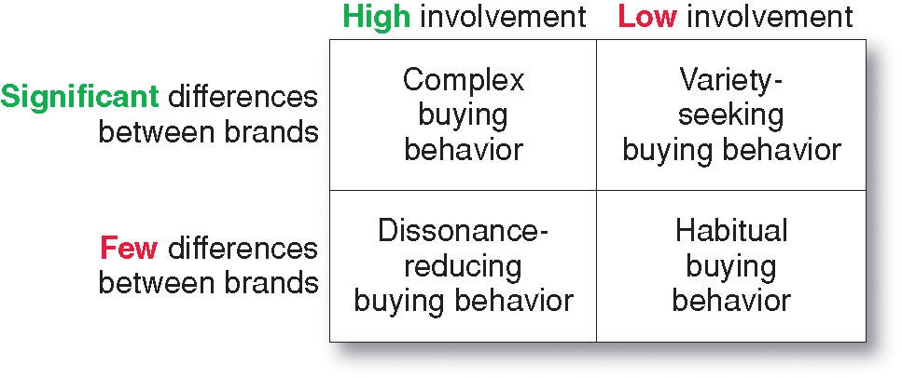
Types of Buying Decision Behavior
Four Types of Buying Behavior
Copyright ©2014 by Pearson Education, Inc. All rights reserved

Slide 29
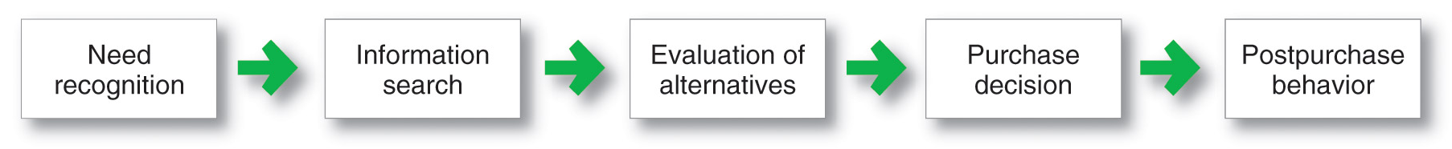
The Buyer Decision Process
Buyer Decision Making Process
Copyright ©2014 by Pearson Education, Inc. All rights reserved

Slide 30
The Buyer Decision Process
Need Recognition
Occurs when the buyer recognizes a problem or need triggered by:
  Internal stimuli
  External stimuli
Copyright ©2014 by Pearson Education, Inc. All rights reserved

Slide 31

The Buyer Decision Process
Information Search
Sources of Information
Personal sources—family and friends
Commercial sources—advertising, Internet
Public sources—mass media, consumer organizations
Experiential sources—handling, examining, using the product
Copyright ©2014 by Pearson Education, Inc. All rights reserved

Slide 32

The Buyer Decision Process
Evaluation of Alternatives
How the consumer processes information to arrive at brand choices
Copyright ©2014 by Pearson Education, Inc. All rights reserved

Slide 33
The Buyer Decision Process
Purchase Decision
The act by the consumer to buy the most preferred brand
The purchase decision can be affected by:
  Attitudes of others
  Unexpected situational factors
Copyright ©2014 by Pearson Education, Inc. All rights reserved

Slide 34
The Buyer Decision Process
Post-Purchase Decision
The satisfaction or dissatisfaction that the consumer feels about the purchase
Relationship between:
  Consumer’s expectations
  Product’s perceived performance
The larger the gap between expectation and performance, the greater the consumer’s dissatisfaction
Cognitive dissonance is the discomfort caused by a post-purchase conflict
Copyright ©2014 by Pearson Education, Inc. All rights reserved

Slide 35
The Buyer Decision Process
Post-Purchase Decision
Customer satisfaction is a key to building profitable relationships with consumers—to keeping and growing consumers and reaping their customer lifetime value
Copyright ©2014 by Pearson Education, Inc. All rights reserved

Slide 36
The Buyer Decision Process for New Products
Adoption process is the mental process an individual goes through from first learning about an innovation to final regular use.
Stages in the process include:
Awareness
Interest
Evaluation
Trial
Adoption
Copyright ©2014 by Pearson Education, Inc. All rights reserved

Slide 37
The Buyer Decision Process for New Products
Differences in Innovativeness Adopter Categories
Innovators
Early Adopters
Early Mainstream
Late Mainstream
Lagging Adopters
Copyright ©2014 by Pearson Education, Inc. All rights reserved

Slide 38
The Buyer Decision Process for New Products
Influence of Product Characteristics
on Rate of Adoption
Relative advantage
Compatibility
Complexity
Divisibility
Communicability
Copyright ©2014 by Pearson Education, Inc. All rights reserved

