Slide 1
Global Edition Chapter Two
Company and Marketing Strategy
Partnering to Build Customer Relationships
Copyright ©2014 by Pearson Education

Slide 2
Company and Marketing Strategy
Topic Outline
Companywide Strategic Planning: Defining Marketing’s Role
Planning Marketing: Partnering to Build Customer Relationships
Marketing Strategy and the Marketing Mix
Managing the Marketing Effort
Measuring and Managing Return on Marketing Investment
Copyright ©2014 by Pearson Education

Slide 3
Companywide Strategic Planning
Strategic Planning
Strategic planning is the process of developing and maintaining a strategic fit between the organization’s goals and capabilities and its changing marketing opportunities
Copyright ©2014 by Pearson Education

Slide 4
Companywide Strategic Planning
Steps in Strategic Planning
Copyright ©2014 by Pearson Education

Slide 5
Companywide Strategic Planning
Defining a Market-Oriented Mission
The mission statement is the organization’s purpose, what it wants to accomplish in the larger environment
Market-oriented mission statement defines the business in terms of satisfying basic customer needs
We help you organize the world’s information and make it universally accessible and useful.
Copyright ©2014 by Pearson Education

Slide 6
Companywide Strategic Planning
Setting Company Objectives and Goals
Business objectives
Build profitable customer relationships
Invest in research
Improve profits
Marketing objectives
Increase market share
Create local partnerships
Increase promotion
Copyright ©2014 by Pearson Education

Slide 7
Companywide Strategic Planning
Designing the Business Portfolio
The business portfolio is the collection of businesses and products that make up the company
Portfolio analysis is a major activity in strategic planning whereby management evaluates the products and businesses that make up the company
Copyright ©2014 by Pearson Education

Slide 8
Companywide Strategic Planning
Analyzing the Current Business Portfolio
Strategic business units can be
Company division
Product line within a division
Single product or brand
Copyright ©2014 by Pearson Education

Slide 9
Companywide Strategic Planning
Analyzing the Current Business Portfolio
Identify key businesses (strategic business units, or SBUs) that make up the company
Assess the attractiveness of its various SBUs
Decide how much support each SBU deserves
Copyright ©2014 by Pearson Education

Slide 10
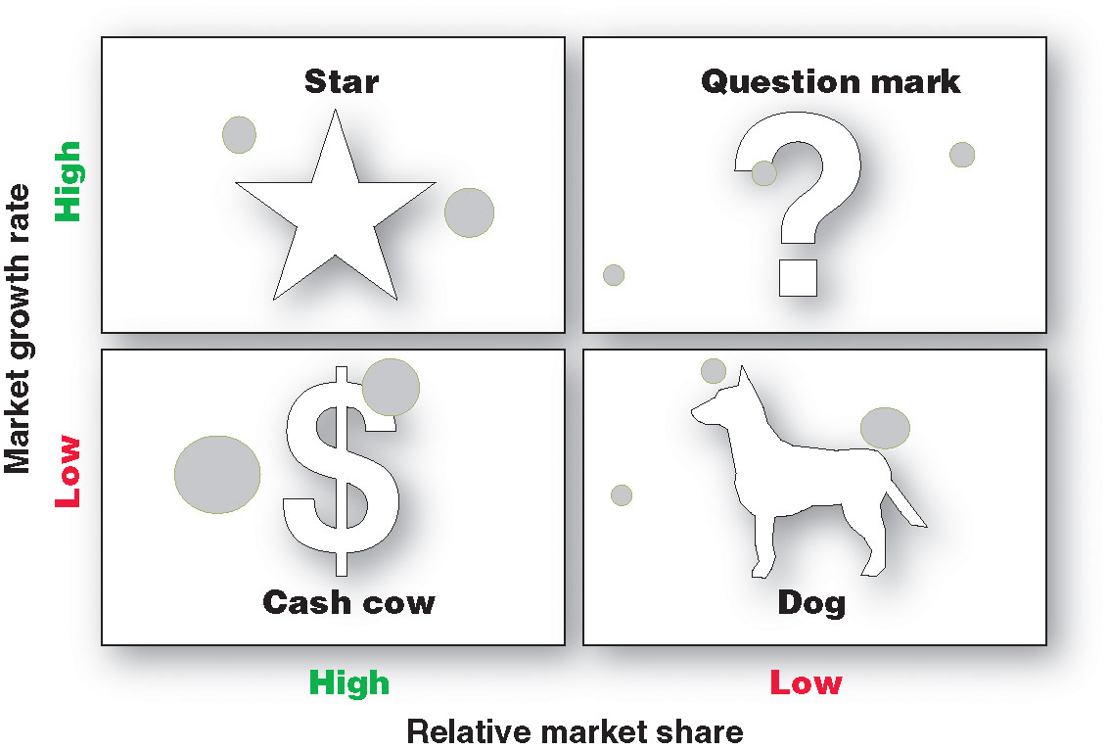
Companywide Strategic Planning:

Slide 11
Companywide Strategic Planning
Problems with Matrix Approaches
Difficulty in defining SBUs and measuring market share and growth
Time consuming
Expensive
Focus on current businesses, not future planning
Copyright ©2014 by Pearson Education

Slide 12
Companywide Strategic Planning
Developing Strategies for Growth and Downsizing
Product/Market Expansion Grid
Market penetration
Market development
Product development
Diversification
a tool for identifying company growth opportunities
Copyright ©2014 by Pearson Education

Slide 13
Companywide Strategic Planning
Developing Strategies
for Growth and Downsizing
Market penetration growth by increasing sales to current market segments without changing the product
Market development growth by identifying and developing new market segments for current products
Copyright ©2014 by Pearson Education

Slide 14
Companywide Strategic Planning
Developing Strategies
for Growth and Downsizing
Product development is a growth strategy that offers new or modified products to existing market segments
Diversification is a growth strategy through starting up or acquiring businesses outside the company’s current products and markets
Copyright ©2014 by Pearson Education

Slide 15
Companywide Strategic Planning
Developing Strategies
for Growth and Downsizing
Downsizing prune, harvest or divest businesses that are unprofitable or that no longer fit the strategy
Copyright ©2014 by Pearson Education

Slide 16
Planning Marketing
Partnering to Build Customer Relationships
Value chain is a series of departments that carry out value-creating activities to design, produce, market, deliver, and support a firm’s products
Copyright ©2014 by Pearson Education

Slide 17
Planning Marketing
Partnering to Build Customer Relationships
Value delivery network is made up of the company, suppliers, distributors, and ultimately customers who partner with each other to improve performance of the entire system
Copyright ©2014 by Pearson Education
Notes:
.

Slide 18
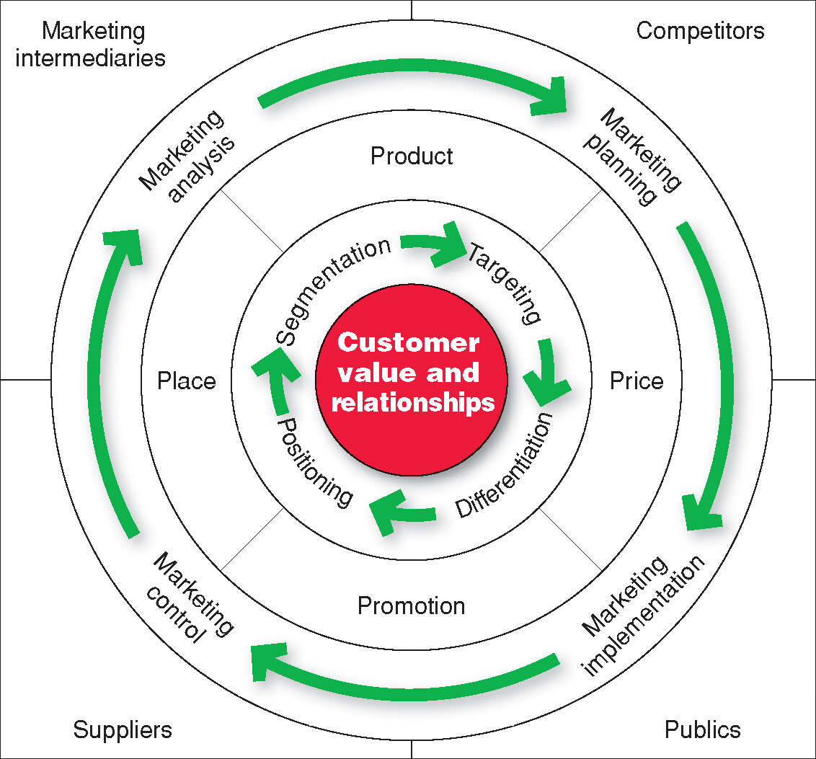
Marketing Strategy and the Marketing Mix
Copyright ©2014 by Pearson Education

Slide 19
Marketing Strategy and the Marketing Mix
Market segmentation is the division of a market into distinct groups of buyers who have different needs, characteristics, or behavior and who might require separate products or marketing mixes
Market segment is a group of consumers who respond in a similar way to a given set of marketing efforts
Copyright ©2014 by Pearson Education

Slide 20
Marketing Strategy and the Marketing Mix
Market Targeting
Market targeting
is the process of evaluating each market segment’s attractiveness and selecting one or more segments to enter
Copyright ©2014 by Pearson Education

Slide 21
Marketing Strategy and the Marketing Mix
Market positioning is the arranging for a product to occupy a clear, distinctive, and desirable place relative to competing products in the minds of the target consumer
Whole marketing plan supports the positioning strategy
Copyright ©2014 by Pearson Education

Slide 22
Marketing Strategy and the Marketing Mix
Differentiation begins the positioning process
Whole marketing plan supports the positioning strategy
Copyright ©2014 by Pearson Education

Slide 23
Marketing Strategy and the Marketing Mix
Developing an Integrated Marketing Mix
Marketing mix is the set of controllable tactical marketing tools—product, price, place, and promotion—that the firm blends to produce the response it wants in the target market
Copyright ©2014 by Pearson Education

Slide 24
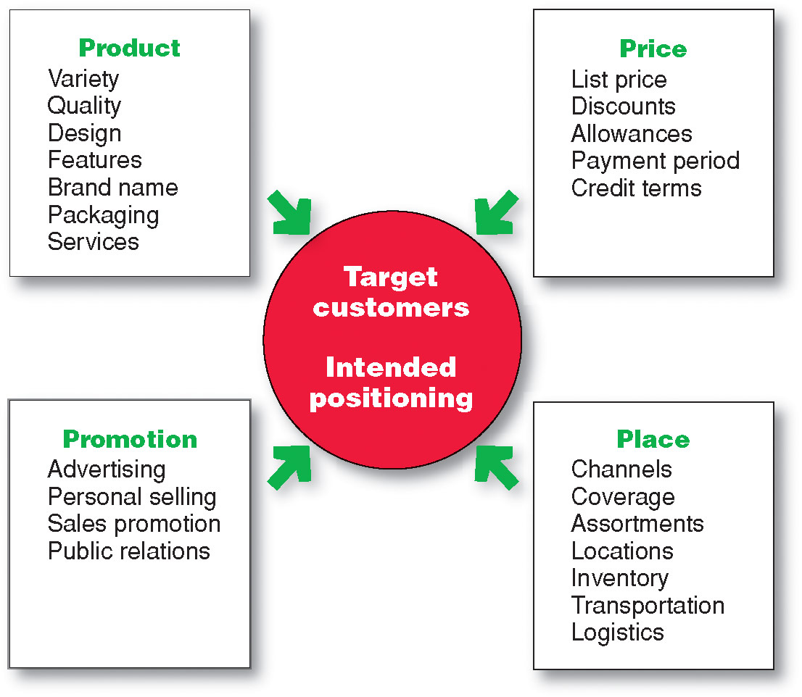
Marketing Strategy and the Marketing Mix
Developing an Integrated Marketing Mix
Copyright ©2014 by Pearson Education

Slide 25
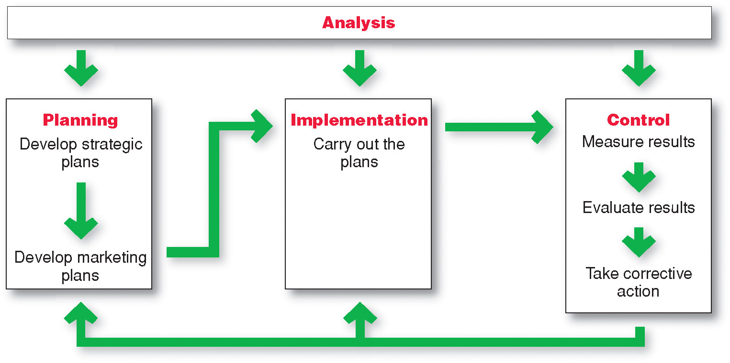
Managing the Marketing Effort
Copyright ©2014 by Pearson Education

Slide 26
Managing the Marketing Effort
Marketing Analysis – SWOT Analysis
Copyright ©2014 by Pearson Education

Slide 27
Managing the Marketing Effort
Market Planning—Parts of a Marketing Plan
Executive summary
Marketing situation
Threats and opportunities
Objective and issues
Action programs
Budgets
Controls
Marketing strategy
Copyright ©2014 by Pearson Education

Slide 28
Managing the Marketing Effort
Marketing Implementation
Implementing
Turns marketing plans into marketing actions to accomplish strategic marketing objectives
Addresses who, where, when, how
Copyright ©2014 by Pearson Education

Slide 29
Managing the Marketing Effort
Marketing Department Organization
Functional organization
Geographic organization
Product management organization
Market or customer management
Copyright ©2014 by Pearson Education

Slide 30
Managing the Marketing Effort
Marketing Control
Controlling
evaluating of results
taking of corrective action to achieve objectives
Operating control
Strategic control
Copyright ©2014 by Pearson Education

Slide 31
Measuring and Managing Return on Marketing Investment
Return on Marketing Investment (Marketing ROI)
Return on marketing investment
is net return from a marketing investment divided by the costs of the marketing investment.
provides a measurement of the profits generated by investments in marketing activities.
Copyright ©2014 by Pearson Education

