Slide 1
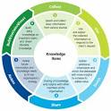
Knowledge Infrastructure Knowledge culture
Lecture (9)

Slide 2
LEARNING OBJECTIVES
To explain the nature of organisational culture
To describe different typologies of organisational culture and their roles in knowledge processes
To discuss the nature of communities of practice and the importance of storytelling

Slide 3
BUZZ GROUPS
Think of an environment with which you are familiar – work, University, home etc.
How would you describe the culture of your chosen environment?
What are the similarities and differences between the culture of this environment (KSU) and another one from your experiences?
What would you try to change in the culture of your chosen environment and why?

Slide 4
BUZZ GROUP
What is organisational culture?
What are the different aspects of culture?

Slide 5
DEFINITIONS OF CULTURE
The research of organizational culture began in the early 1930s by Elton Mayo
The term " organizational culture" has been defined as “the shared , norms, values, beliefs and practices of people in an organization”

Slide 6
Facts About Culture
The culture metaphor points towards another means of creating organised activity: by influencing the language, norms, folklore, ceremonies, and other social practices that communicate the key ideologies, values, and beliefs guiding action.
Culture is ‘how things are done around here’. It is what is typical of the organization, the habits, the attitudes, the grown-up pattern of accepted and expected behaviour.
Culture is the commonly held and relatively stable beliefs, attitudes and values that exist with the organization.

Slide 7
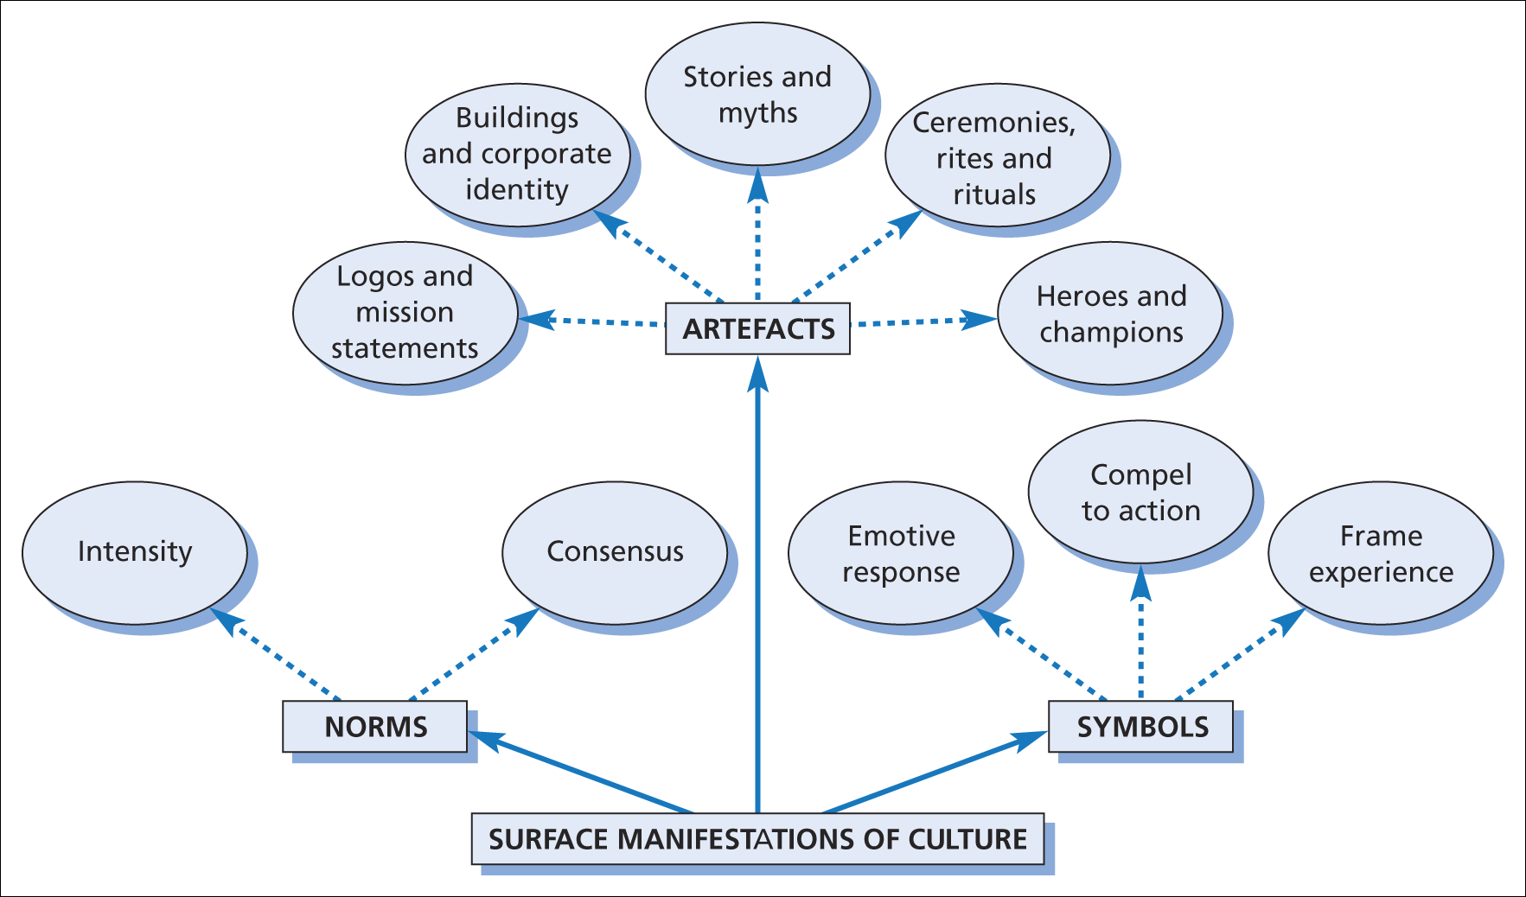
SURFACE MANIFESTATIONS OF CULTURE
Figure 9.2 Surface manifestations of organisational culture

Slide 8
CONTENTS OF CULTURE
Artefacts: corporate logos, mission statements, building architecture etc.
Language: jokes, metaphors, stories, myths and legends
Behaviour patterns in the form of rites, rituals, and celebrations
Norms of behaviour
Symbols and symbolic actions

Slide 9
Heroes
Beliefs, values and attitudes: E.g. Adaptability, autonomy, co-operation, creativity, equality, honesty, rationality etc.
History – founders of the organization as shapers of the culture

Slide 10
TYPOLOGIES OF CULTURE?
Power culture (web)
Role culture – bureaucracy (Greek Temple)
Task culture (lattice)
Person culture (cluster)
Strong or weak depending on strength of consensus and intensity of culture
Sub-cultures

Slide 11
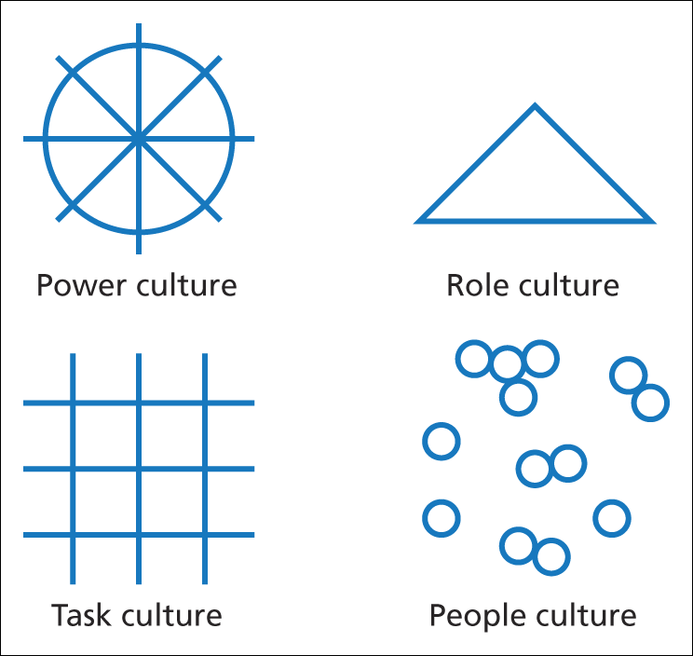
HANDY’S TYPOLOGY OF CULTURE
Figure 9.3 Handy’s typology of culture (Handy 1985)

Slide 12
Power Culture
Concentrating power among a few people
Usually is associated with autocratic leadership.
Decisions are made quickly
Managers are judged on results rather than how they obtain them.
Usually a hierarchical organization structure
Motivation is likely to focus on financial rewards like bonuses.
Analogy of spider web: there is no purpose without the spider.

Slide 13

Role Culture
Each member of staff has a clearly defined job title and role
Usually associated with bureaucratic organizations like government.
The structure of the organization is clearly defined with clear delegated authority.
Power comes from a person’s position
Decision-making and risk taking are hateful .
Tall hierarchical organization structures
Analogy big building: Solid and dependable – not going anywhere fast

Slide 14

Task Culture
Based on cooperation and team work
Groups are formed to solve problems
Communication may follow a matrix structure
Creative & problem-solving spirit
Very motivating environment that meets worker’s basic needs
Analogy of a NET: the strength is derived from the many strands

Slide 15

Person Culture
Individuals are given the freedom to express themselves and make decisions
Most creative type of culture
No emphasis on teamwork
People who thrive here may find it difficult to work in a structured environment
Analogy of a STARS: each person is different and operates alone

Slide 16
KM & CULTURE Relationship ?
There is a strong interaction relationship between organizational culture and knowledge Management
Organizational Culture greatly influences how an organization handles knowledge.
OC. can be functional to reduce need for rules and regulation etc.
OC. Can be dysfunctional – closed off, avoidance of new ideas etc.

Slide 17
OC determines the social context (norms and practices), that determines " who is expected to control the knowledge, as well as who must share it, and who can hoard it.
OC. includes elements such as the management style, modes of communication, degree of formality in operating practice, which may affect attitudes and behaviors to KM activities.
OC sets the tone for much of what occurs within the organization, and influences KM behaviors.

Slide 18
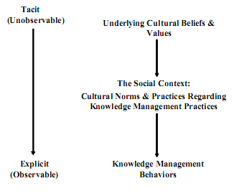
The impact of organizational culture on km

Slide 19
Empirically, organizational culture can be seen as a double-edged sword;
On one hand it is the key influence on successful km, . On other hand, OC is the main barriers and challenges to km initiatives.
Consequently; a fundamental managerial role of the km should be to foster the underlying culture that support the successful km.
Overtime the km can become an integral aspect of the organizational culture.

Slide 20
DEFINITIONS OF KNOWLEDGE CULTURE
A knowledge culture “ is one particular variety of organizational culture representing a way of organizational life that enables and motivates people to create, share and utilize knowledge for the benefit and enduring success of the organization"
It is called also; K- sharing culture , K-friendly culture , K-learning culture ,and Innovative - culture .

Slide 21
Building Knowledge Culture
Most organizations have taken the wrong approach by attempting to modify an organization's culture to fit with the objectives of a km initiative which is the main reason for failure,
For organizations to success in km initiative, they must build their km approach to fit their culture rather than the vice versa.

Slide 22
Actually the successful approach of building k. culture is depending on the ability of managing culture change, which is not easy yet, due to the existence of subcultures.

Slide 23
Knowledge Culture Components
Learning culture
Sharing culture
Doing culture

Slide 24
Learning Culture and K. Creation
Knowledge creation process is a learning process in which the creation of new knowledge is a socially constructed process that occurs through informal human network .
To push the individual knowledge into organizational purpose, an organization should develop an environment that support the integration between its members.
An organization should also encourages its people to coordinate their interactions in a meaningful way to expand its collective knowledge, and increase their desire to learn from each other
A learning-culture is playing an important role

Slide 25
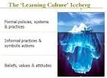
learning-culture
open informal and formal channels to dialectical thinking, debates, and critiques, which are important in fostering learning.
Enable people to manage the knowledge review process effectively.
It also can directly increase the individual learning capability.

Slide 26
CONCEPT OF Ba & K. creation (Nonaka & Konno, 1998)
Originating Ba – individuals share feelings, emotions and experiences (socialization)
Interacting Ba – selecting people with right mix of knowledge and capabilities (externalization)
Cyber Ba – virtual space of interaction supported by ICT (combination)
Exercising Ba – focused training with mentors and colleagues (internalization)

Slide 27
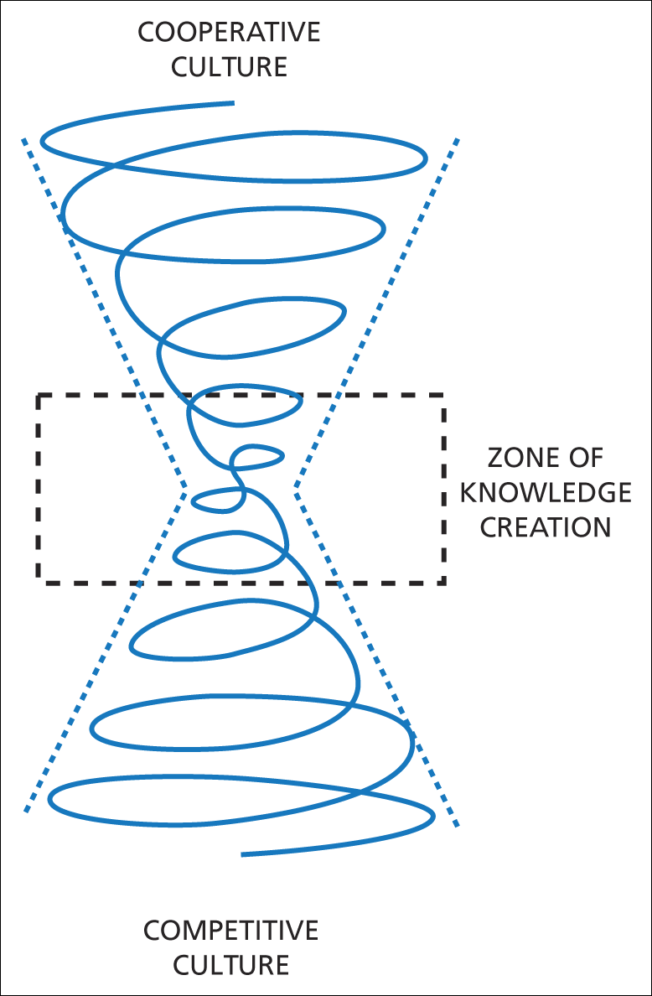
Learning culture & Knowledge creation process
Figure 9.8 The zone of knowledge creation and the dialectic between cooperation and competitive cultures

Slide 28
Sharing Culture and K. dissemination
knowledge sharing is an important aspects of knowledge dissemination process .
K. sharing involves organizational members willingly contributing their knowledge to organizational memory.
Sharing culture will influence whether individual view their knowledge as a personal possession or as an organizational assets.
It will stimulus individuals to share the knowledge

Slide 29


Sharing culture
Regarding to the tacit ness of knowledge; Sharing -culture will help to establish a shared context between both sources and recipients of knowledge through which the caring relationships,
One problem with knowledge sharing is that employees maybe unable to determine the long term benefits to be achieved from sharing their personal insights, expertise and ideas with others .
So through the sharing culture which embodiment high degree of loyalty and reward orientation, employees can be more trusted that the sharing of knowledge will benefit everyone in the company .

Slide 30
WILLINGNESS TO SHARE KNOWLEDGE (Von Krogh, 1998)
Concept of ‘care’ influences knowledge sharing
Mutual trust
Active empathy
Access to help – directly
Lenience in judgement, i.e. criticisms
Courage – voice opinions and give feedback
Sharing to help people grow

Slide 31
INSTRUMENTS TO MAKE ‘CARE’ WIDESPREAD (Von Krogh, 1998)
Incentive system rewarding cooperation or behaviour that shows care.
Mentoring programs.
Knowledge sharing and caring behaviour as part of employee assessments and career management.
Explicitly state values of trust, openness and courage.
Training programs in care behaviour.
Social events and meetings

Slide 32
BUZZ GROUP
Suppose you are a knowledge manager in an organization . How can you encourage the deferent groups in sharing their knowledge ?

Slide 33
KNOWLEDGE CULTURE THROUGH GROUPS?
Semi-autonomous groups
Multiple overlapping groups
Committees
Quality circles
Learning laboratories
Learning networks
Technology groups
Best practice teams

Slide 34
Doing Culture and K. Utilization
Doing culture may have a strong influence in motivating employees to pursue knowledge application practices.
doing culture influences the lengths to which employee will go to seek and build upon existing knowledge .
Doing culture also may increase the interpretation ability defined as "the process through which information is given meaning “
The varying interpretation lead to conflict and decrease the ability to apply knowledge.

Slide 35

Doing culture
The role of doing culture is to create the context for social interaction through which values, norms, and practices that shape highly consistent individual interpretation and increase the effectiveness of applying knowledge .
We can conclude that, k. culture in terms of, learning culture, sharing culture and doing culture can influence KM processes .

Slide 36

COMMUNITIES OF PRACTICE

Slide 37
The term "community of practice" was first coined by Etienne Wenger and Jean Lave in their 1991book “Situated learning “.
Regarding the importance of person - to person implicit and tacit knowledge exchange and shared understandings and attitudes toward innovation, putting people in touch with each other has increased in importance over the past few decades and becoming an essential method of producing new knowledge of value to innovation.
Therefore a community of practices is recognized as the most important theory the sociologist addressed to support the collaboration need to underpin high level of innovation processes in organization .

Slide 38
The community of practice Definition
Community of practice is defined as "informal groups that have some work activities in common as a consequence; these communities develop a shared body of common knowledge, a shared sense of collective identity and some overlapping values" (Hislop D., 2009 p.167).

Slide 39

What They ARE
Groups of people (network not hierarchy) that form to
share knowledge about their work (a.k.a. their “practice”),
learn from one another about that work, and
provide a social context for that work (i.e., to establish and maintain their identity)
© Copyright Fred Nickols 2010
6
Notes:
As I indicated earlier, CoPs are groups of people. They form to accomplish the three basic aims listed on this slide.
Knowledge is shared more or less informally, through casual discussions, questions asked and answered, “buddy” systems and informal mentoring.
Of more than passing importance is that the learning is situated in a social context; the members of a CoP learn from each other.
If one of the three could be said to be more important than the others, my choice would be the third bullet: identity: In large measure, people derive and maintain their identity at work as a result of being part of a CoP.

Slide 40
COMMUNITIES OF PRACTICE
Set of relations among persons, activity, world and other communities over time.
Do not appear on organization charts
Open ended without deadlines nor deliverables.
Informal and self-selecting.
Knowledge sharing facilitated by norms of community members .
Storytelling is more important way of communicating knowledge than codifying it in an ICT system.

Slide 41
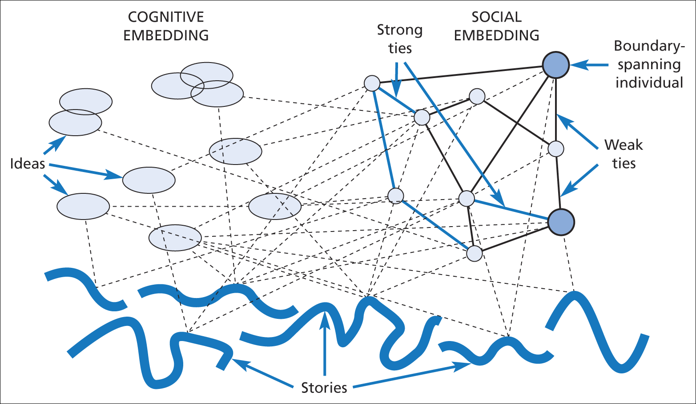
STORYTELLING
Figure 9.9 The ontology of storytelling

Slide 42
Why establish a CoP?
A mechanism to promote rapid of sharing knowledge and expertise across diverse interest groups
Provides a forum to explore and test ideas
Opportunity to generate new knowledge and practice
Notes:
Linking people who may not have day to day contact
Developing a trust between members
Practical aspects of practice, the day to day issues
Developing new knowledge
Learning from ‘what works’ and ‘what doesn’t’

Slide 43
Points of Difference
Leadership is distributed
Key principle of participation and trust
Volunteer membership
Peer to peer relationships
The knowledge and expertise is more important than position or rank

Slide 44
CoP - Examples
Xerox copier technicians
Pharmaceutical reps (“drug detailers”)
Software developers
Production line technicians
Test item writers
Research chemists
Instructional staff
© Copyright Fred Nickols 2010
10
Notes:
I will run quickly through these, primarily to illustrate the range of CoPs, both in terms of the work their members do and range of industries, organizations and functions where CoPs are found.

Slide 45





















Companies using CoPs
© Copyright Fred Nickols 2010
11
Notes:
Shell - $400 billion
IBM - $156 billion
P&G - $68.5 billion
Ford - $177 billion
J&J - $67.5 billion
Intel - $38.8 billion
Dow - $52 billion
BP - $244 billion
ETS - $750 million
Apple - $13.9 billion
Lilly - $17.1 billion
Chrysler - $259.5 billion ($82 billion)
Unilever - $ 158 billion
Pfizer - $53 billion
National Semiconductor - $2.5 billioon
Xerox - $25 billion
Schlumberger - $14.3 billion
Empire Blue Cross & Blue Shield – not available
Hill’s Pet Food – $1.3 billion
Ernst & Young - $2 billion

Slide 46
Why You Should Care
CoPs are valuable organizational assets
Decrease learning curves
Handle unstructured problems
Play a key role in developing and maintaining long-term organizational memory
Reduce rework
Increase innovation and speed
Create social and intellectual capital
Contribute to increased retention of talent
Make change “stick”
© Copyright Fred Nickols 2010
13
Notes:
This list of benefits is also illustrative.
No single CoP will generate them all and some CoPs might be focused on just one.
One of their more prominent and lasting benefits is that they make change “stick.” They head off the disconnects that so often occur between a solution and its implementation.

Slide 47
Some Do’s & Don’ts
DO
Nurture and support existing CoPs
Cultivate and support new CoPs
DON’T
Mandate CoPs
Manage them in a heavy-handed way
© Copyright Fred Nickols 2010
14
Notes:
These Do’s and Don’t all emphasize a single point: CoPs require a light hand.

Slide 48
The End

