Slide 1
Kirchhoff’s Rules
Phys 104

Slide 2
Kirchhoff’s Rules
1) Junction Rule.
2) Loop Rule .

Slide 3
Junction Rule
“ The sum of the currents entering any junction in a circuit must equal the sum of the currents leaving that junction “ .

Slide 4
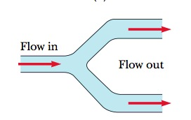
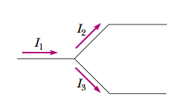
Junction Rule

Slide 5
Loop Rule
“ The sum of the potential differences across all elements around any closed circuit loop must be zero “ .

Slide 6
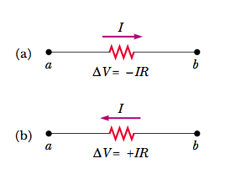
Loop Rule “ sign convention “

Slide 7
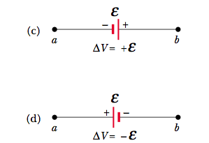
Loop Rule “ sign convention “

Slide 8
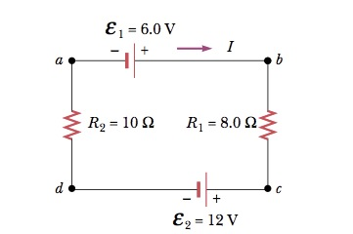
Example 1
A single-loop circuit contains two resistors and two batteries, as shown ,
# Find the current in the circuit.
# What power is delivered to each resistor?

Slide 9
Answer
I = - .33 A
…….
P₁ = .87 w
P₂ = 1.1 w

Slide 10
Problem
What if the polarity of the 12.0-V battery were reversed in the pervious example ? How would this affect the circuit?

Slide 11
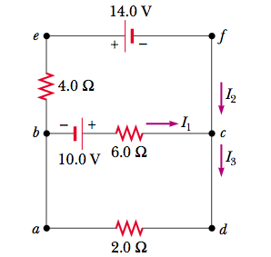
Example 2
Find the currents I₁, I₂, and I₃ in the circuit shown in figure below ,

Slide 12
Answer

Slide 13
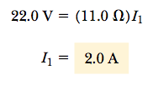
Answer

Slide 14
Thank You
Eng. Abdulsalam

