Slide 1

Chapter 6
Explanatory Models 2: Time-Series Decomposition
© 2019 McGraw-Hill Education. All rights reserved. Authorized only for instructor use in the classroom. No reproduction or further distribution permitted without the prior written consent of McGraw-Hill Education.
Notes:
1

Slide 2
Explanatory Models 2. Time-Series Decomposition(Chapter 6)
The information provided by time-series decomposition is consistent with the way managers tend to look at data.
Notes:
2
2

Slide 3
Time Series Decomposition 1
This is the classical approach to economic forecasting.
It assumes that an economic time series can be into four components:
secular trend
seasonal variation
cyclical variation
Notes:
3
3

Slide 4
Time Series Decomposition 2
For example:
The value of a company's sales could be viewed as:
Y = T • S • C where
Y= sales
T= trend
S= seasonal variation (a number slightly larger or smaller than 1)
C= cyclical variation (a number slightly larger or smaller than 1)
Notes:
4
4

Slide 5
Decomposing a Series 1
Trend: a trend is a relatively smooth long-term movement of a time series.
Seasonal variation: In a particular month, the value of an economic variable is likely to differ from what would be expected on the basis of its trend, because of seasonal factors.
Notes:
5
5

Slide 6
Decomposing a Series 2
Cyclical variation: another reason why an economic variable may differ from its trend value is that it may be influenced by the so-called business cycle.
Notes:
6
6

Slide 7
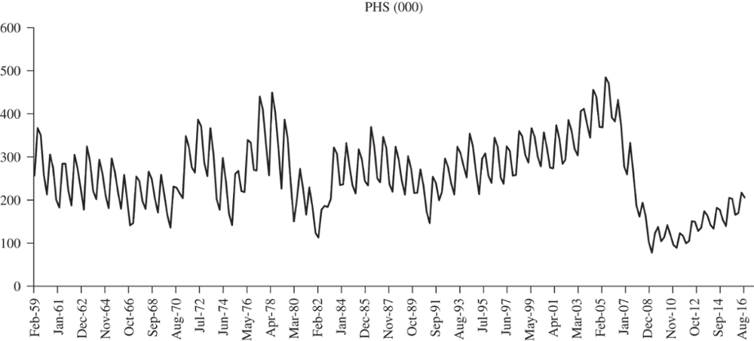
Figure 6.1 Private Housing Starts
Jump to long description
Notes:
7
7

Slide 8
Deseasonalizing the Data
For Quarterly Values:
For Monthly Values:
Notes:
8
8

Slide 9
Deseasonalizing the Data (step 2)
Because the moving averages are not really centered in the middle of the year:
The centered moving averages represent the deseasonalized data (i.e., seasonal variations have been removed through an averaging process).
Notes:
9
9

Slide 10
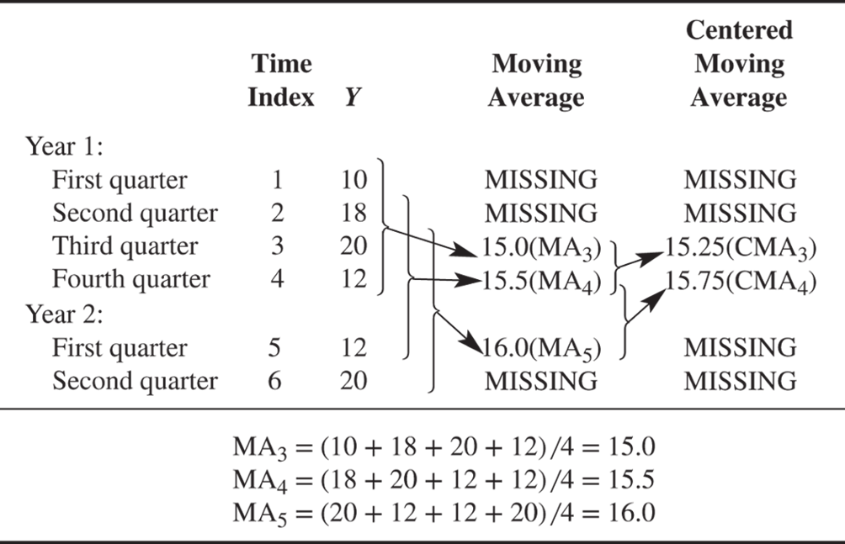
Deseasonalizing 1
Jump to long description
Notes:
10
10

Slide 11
Deseasonalizing 2
Date | Time Index | PHS (000) | PHSMA4 | PHSCMA | PHSCMAT | CF | SF | SI
Feb-59 | 1 | 256.7 |  |  | 266.20 |  |  | 0.82
May-59 | 2 | 367.3 |  |  | 266.11 |  |  | 1.19
Aug-59 | 3 | 350.8 | 308.50 | 303.09 | 266.01 | 1.14 | 1.16 | 1.11
Nov-59 | 4 | 259.2 | 297.68 | 289.96 | 265.92 | 1.09 | 0.89 | 0.89
Feb-60 | 5 | 213.4 | 282.25 | 272.70 | 265.83 | 1.03 | 0.78 | 0.82
May-60 | 6 | 305.6 | 263.15 | 255.90 | 265.73 | 0.96 | 1.19 | 1.19
Aug-60 | 7 | 274.4 | 248.65 | 244.86 | 265.64 | 0.92 | 1.12 | 1.11
Nov-60 | 8 | 201.2 | 241.08 | 238.45 | 265.55 | 0.90 | 0.84 | 0.89
Feb-61 | 9 | 183.1 | 235.83 | 237.05 | 265.45 | 0.89 | 0.77 | 0.82
May-61 | 10 | 284.6 | 238.28 | 240.93 | 265.36 | 0.91 | 1.18 | 1.19
Notes:
11
11

Slide 12
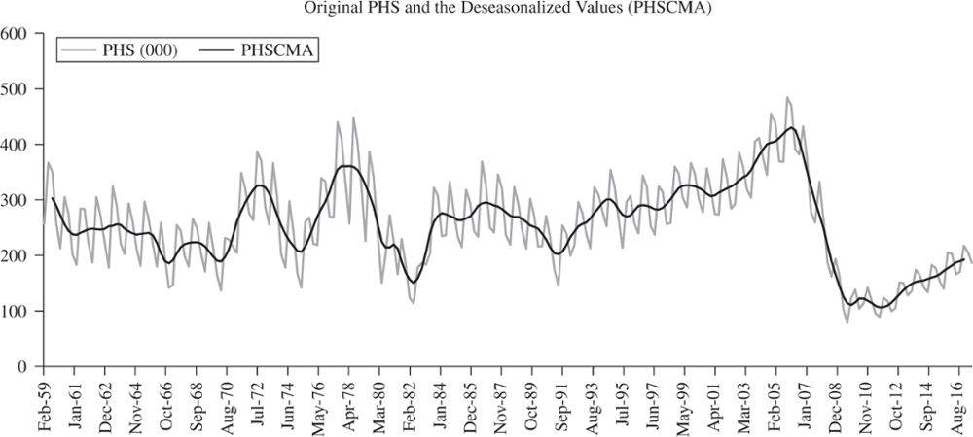
Figure 6.2 PHS and PHS Deseasonalized
Jump to long description
Notes:
12
12

Slide 13
Calculate the Seasonal Factor
By comparing the actual value of the series in any time period with the deseasonalized value (the CMA), you can get a measure of the degree of seasonality.
Notes:
13
13

Slide 14
Seasonal Indeces
Since the seasonal factors for each period are bound to have some variability, we calculate a seasonal index (SI) for each period, which is a standardized average of all of that period’s seasonal factors. As shown here, the seasonal indices for the second and third quarter are above 1 and indicate that these quarters are generally high for private housing starts.
SI
0.82
1.19
1.11
0.89
Notes:
14
14

Slide 15
Calculating the Long Term Trend
CMA = f (Time)
= a + b (Time)
PHSCMAT = 266.293 − 0.093(Time)
Notes:
15
15

Slide 16
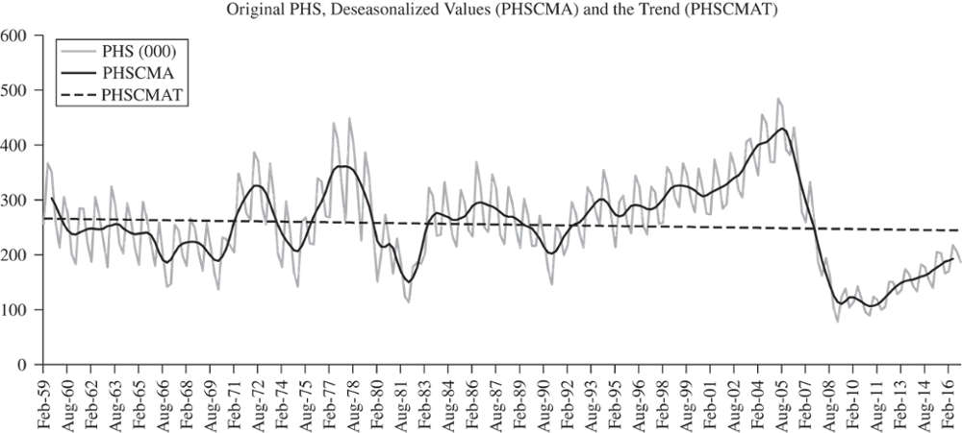
The Long Term Trend
Notes:
16
16

Slide 17
Measuring the Cyclical Component
The cyclical component of a time series is the extended wavelike movement about the long-term trend.
It is often forecasted by using Business Cycle Indicators.
Notes:
17
17

Slide 18
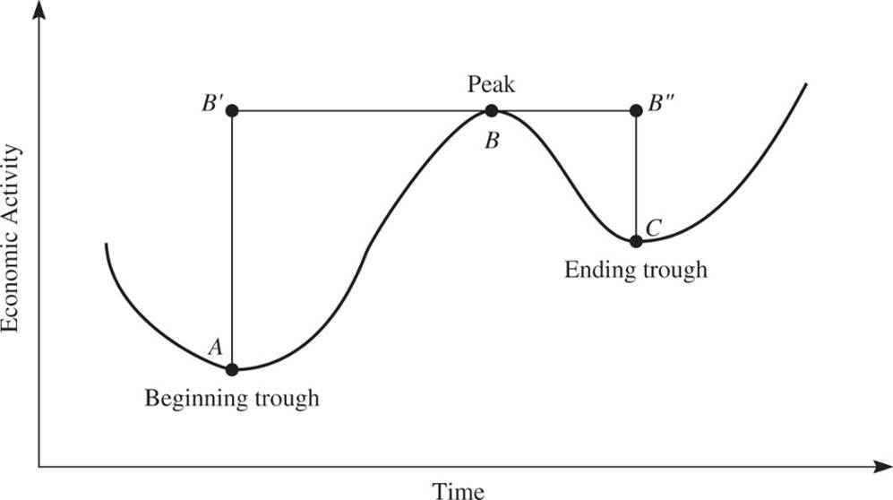
Figure 6.4 The General Business Cycle
Jump to long description
Notes:
18
18

Slide 19
Business Cycle Indicators 1
Developed by NBER
Indicators are related to turning points in business cycles
Business Cycle defined as "expansions occurring at about the same time in many economic activities"
Notes:
19
19

Slide 20
Business Cycle Indicators 2
Leading Indicators
lead turning points in economic activity
Coincident Indicators
are coincident with turning points in economic activity
Lagging Indicators
lag turning points in economic activity
Turning points are the key to forecasting with indicators.
Notes:
20
20

Slide 21
Components of the Composite Leading Index
1 Average weekly hours, manufacturing
2 Average weekly initial claims for unemployment insurance
3 Manufacturers' new orders, consumer goods, and materials
4 ISM® new orders index
5 Manufacturers' new orders, nondefense capital goods excl. aircraft
6 Building permits, new private housing units
7 Stock prices, 500 common stocks
8 Leading Credit Index™
9 Interest rate spread, 10-year Treasury bonds less federal funds
10 Avg. consumer expectations for business conditions
Notes:
21
21

Slide 22
Components of the Coincident Index
1 Employees on nonagricultural payrolls
2 Personal income less transfer payments
3 Industrial production
4 Manufacturing and trade sales
Notes:
22
22

Slide 23
Components of the Lagging Index
1 Inventories to sales ratio, manufacturing and trade
2 Average duration of unemployment
3 Consumer installment credit outstanding to personal income ratio
4 Commercial and industrial loans
5 Average prime rate
6 Labor cost per unit of output, manufacturing
7 Consumer price index for services
Notes:
23
23

Slide 24
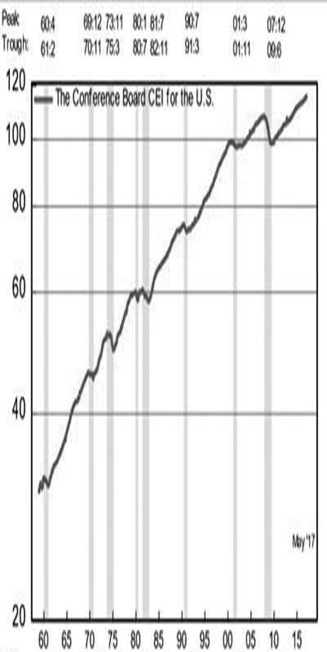
Coincident Economic Index Figure 6.5
Jump to long description
Notes:
24
24

Slide 25
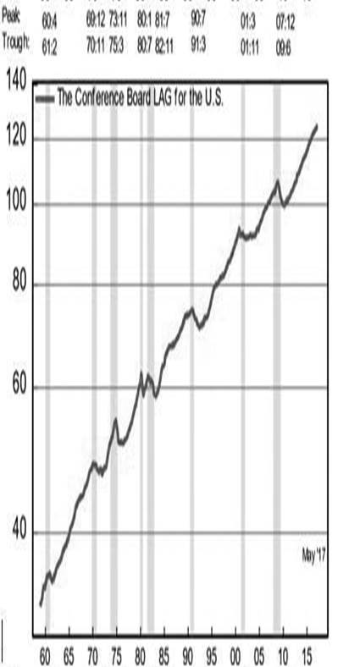
Lagging Economic Index Figure 6.5
Notes:
25
25

Slide 26
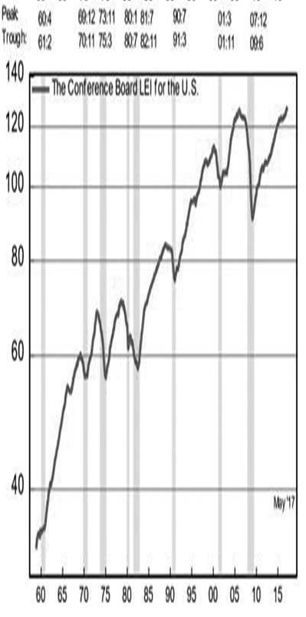
Leading Economic Index Figure 6.5
Notes:
26
26

Slide 27
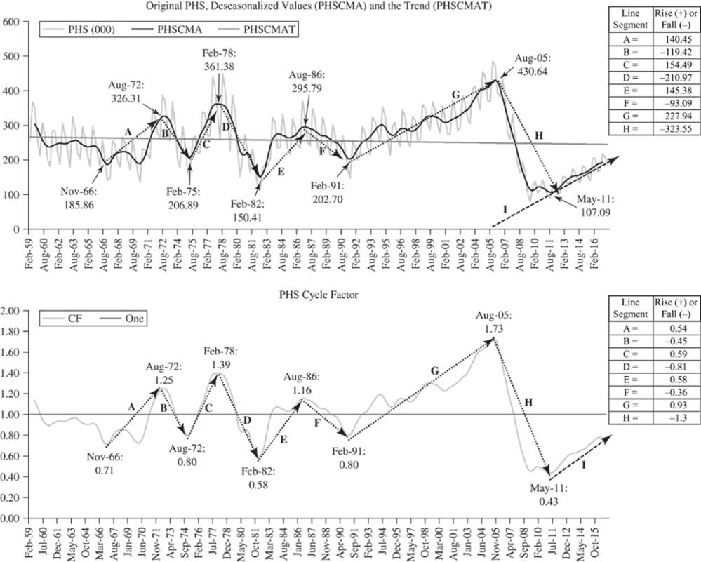
Figure 6.6A and 6.6B
Jump to long description
Notes:
27
27

Slide 28
The Components Estimated
T = The long-term trend based on the deseasonalized data. It is often called the centered moving-average trend (CMAT), since the deseasonalized data are centered moving averages (CMA) of the original Y values.
S = Seasonal indices (SI). These are normalized averages of seasonal factors that are determined as the ratio of each period’s actual value (Y) to the deseasonalized value (CMA) for that period.
C = The cycle component. The cycle factor (CF) is the ratio of CMA to CMAT and represents the gradual wavelike movements in the series around the trend line.
I = The irregular component. This is assumed equal to 1 unless the forecaster has reason to believe a shock may take place, in which case I could be different from 1 for all or part of the forecast period.
Notes:
28
28

Slide 29
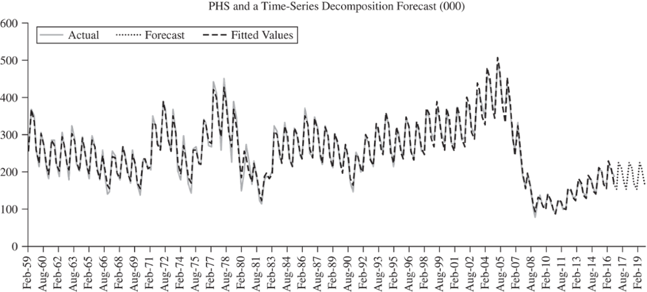
Actual, Fitted, and Forecast Figure 6.7
Jump to long description
Notes:
29
29

Slide 30
Table 6.5 PHS Time Series Decomposition
Date | Original Data | Forecasted Data | Centered Moving Average | CMA Trend | Seasonal Indices | Cycle Factors
Feb-1959 | 256.70 |  |  |  | 0.82
May-1959 | 367.30 |  |  |  | 1.19
Aug-1959 | 350.80 | 335.13 | 303.09 | 266.01 | 1.11 | 1.14
Nov-1959 | 259.20 | 258.04 | 289.96 | 265.92 | 0.89 | 1.09
Feb-1960 | 213.40 | 222.55 | 272.70 | 265.83 | 0.82 | 1.03
May-1960 | 305.60 | 304.08 | 255.90 | 265.73 | 1.19 | 0.96
Aug-1960 | 274.40 | 270.75 | 244.86 | 265.64 | 1.11 | 0.92
Nov-1960 | 201.20 | 212.20 | 238.45 | 265.55 | 0.89 | 0.90
• | • | • | • | • | • | •
• | • | • | • | • | • | •
• | • | • | • | • | • | •
Notes:
30
30

Slide 31
Appendix of Image Long Descriptions

Slide 32
Figure 6.1 Private Housing Starts - Appendix
The graph shows a great bit of seasonal variability. Until 2007 the trend was fairly horizontal, but there was a dramatic drop that occurred in 2008. Since then the trend has been positive, but still way less than prior to 2007.
Jump to the image

Slide 33
Deseasonalizing 1 - Appendix
The first column gives the time frame (year 1: first, second, third, and fourth quarter and year 2 first and second quarter). The second column gives the time index (1 through 6). The third column gives Y: 10, 18, 20, 12, 12, 20. The fourth column gives the moving average. The first two cells are missing because they cannot be calculated. The third cell in this column is 15, which is the average of the first 4 Y values. The next cell in this column is 15.5, which is the average of the 2nd through 5th Y values. The next cell is 16, which is the average of the 3rd through 6th Y values. The last column is the centered moving average. The first two cells are missing. The third cell is 15.25, which is the average of the moving average for quarter 3 and 4. The next centered moving average is 15.75, which is the average of the 4th quarter and first quarter of year 2's moving averages.
Jump to the image

Slide 34
Figure 6.2 PHS and PHS Deseasonalized - Appendix
The deseasonalized values run through the center of the actual data.
Jump to the image

Slide 35
Figure 6.4 The General Business Cycle - Appendix
This diagram displays time on the horizontal axis and economic activity on the vertical axis. The two minimum points are plotted and are labeled the beginning trough and the ending trough. The peak is between these troughs and lies labeled "B". The troughs are labeled A and C.
Jump to the image

Slide 36
Coincident Economic Index Figure 6.5 - Appendix
Periods of recession are shown with gray vertical bars. The date of each peak and trough for each recession period is provided above each graph. The top graph is the conference board C E I for the U. S. The second graph is the conference board L A G for the U. S. and the bottom graph is the conference board L E I for the U. S. All three graphs show fairly consistent positive trends.
Jump to the image

Slide 37
Figure 6.6A and 6.6B - Appendix
Two time plots showing the private housing starts and deseasonalized value and trends as well as a plot showing just the cycle factors with the deseasonalized values. Line segments are provided throughout the time plot showing the general time periods where the private housing starts rose and fell. The line segments are labeled A through H. The line segments in the first graph rise and fall by the following amounts:
A = 140.45, B = −119.42, C = 154.49, D = −210.97, E = 145.38,
F = −93.09, G = 227.94, H = −323.55
The line segments in the second graph rise and fall by the following amounts:
A = 0.54, B = −0.45, C = 0.59, D = −0.81, E = 0.58, F = −0.36, G = 0.93,
H = −1.3
Jump to the image

Slide 38
Actual, Fitted, and Forecast Figure 6.7 - Appendix
The forecast continues the variation and is fairly horizontal.
Jump to the image

