Slide 1



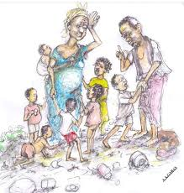

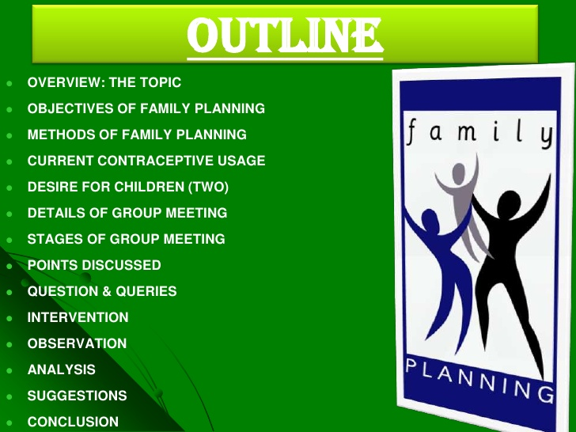

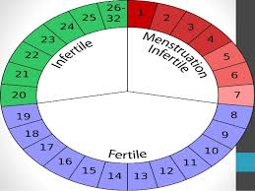

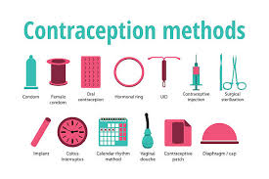
Johali FaPHE
The CHS436 Family Planning for HE 2018_2019
بسم الله الرحمن الرحيم
Do You Manage Love_ Family
HE
Plan Prevent
HE Help To Reach ZD Family Wellness
EISA ALI JOHALI عيسى بن علي الجوحلي
Notes:
نقل
The Reproductive and Child Health Programme is oriented to meet the health needs of women and children completely. With regard to family planning, the approach emphasizes the
target-free promotion of contraceptive use among eligible couples;
the provision to couples of a choice of contraception; and
the assurance of high-quality care.
An important component of the programme is the encouragement of adequate spacing of births, with at least three years between births……..

Slide 2
Course Syllabus Family Planning (CHS436)
HE
Vision, mission
Vision:
Leadership and excellence in health education and promotion
Mission:
To contribute to promote community health and secure better quality of life through qualifying globally competitive cadres specialized in health education and promotion; who are characterized by creative thinking, innovation and self-confidence, armed with values and ethics needed to practice the profession within a multidisciplinary team, and competent in planning, implementation and evaluation of health education programs and campaigns, mobilizing community participation, and conducting distinguished scientific research”.

Slide 3
Course Syllabus Family Planning (CHS436)
Course Description:
This course enhances student’s understanding of the role of family planning as a determinant of health and enables him to acquire the essential knowledge and skills to understand, explain, and evaluate its objectives.
The course includes; definition, rationale, impact of family planning, fertility motives, and role of health educator in family planning programs. Also, the course will increase student's awareness of family planning services, the population problems, and maternal & infant mortality. Furthermore, contraceptive methods: types, description, mechanism of action, effectiveness, advantages, side effects, and uses will be deeply discussed with gathering approach for counseling in family planning
Course Major Reference the Textbook
JohaliFaPHE The CHS436 Family Planning for HE 2018_2019
https://fac.ksu.edu.sa/ejohali/course/258799

Slide 4
Course Syllabus Family Planning (CHS436)
Domains | NQF Learning Domains And Course Learning Outcomes
1. Knowledge | 1.1 Recognize the concept of family planning with its objectives, concept of high risk pregnancy, population problem all over the world and recall fertility measurements with fertility motives..
 | 1.2 Describe family planning services, concept of unmet need for family planning and impact of family planning on maternal and child health.
 | 1.3 Recognize various contraceptive methods; and list reasons for the discontinuation of contraceptive methods.
 | 1.4 Outline steps for providing birth control activities and recall steps for conducting a counselling session and list items to be covered during family planning counselling.

Slide 5
Course Syllabus Family Planning (CHS436)
2. Cognitive Skills
 |  | 2.2 Explain the role of counselling in choosing the appropriate contraceptive method.
 |  | 2.3 Create an assessment of the client’s contraceptive needs and conducting a counselling session.
 |  | 2.4 Compare among different contraceptive methods, advantages, disadvantages and side effects.

Slide 6
Course Syllabus Family Planning (CHS436)
What is the main Objectives for this course? By the end of this course, students should be able to: Recognize the concept of family planning, its objectives and the concept of high risk pregnancy Recognize Population problem all over the world and strategies for solving it Appreciate the role of counselling in choosing the appropriate contraceptive method, and discuss different available contraceptive methods Evaluate the need for family planning and identify fertility measurements ..cover unmet needs
Notes:
Write at least 3 smart question covering every objective and domain

Slide 7
Teaching _ Learning Plan
Hours | Weeks | Topics
4 | 1st _2nd | Introduction and teaching plan
4 | 3rd _ 4th | The Concept of family planning
2 | 5th | Magnitude of the population problem all over the world
4 | 6th _7th | Family Planning Services
2 | Exam 1 Mid | Overview on male and female reproductive system and reproductive process (Self Study _ Independent )
2 | 9th | Principles of birth control activities
4 | 10th _ 11th | Family Planning Methods _ different contraceptive M.
2 | 12Th | Unmet need for family planning
2 | 2nd Mid Exam
4 | 14th _ 15th | Planning, implantation evaluation and development of FaPHE
Notes:
History of Family Planning

Slide 8
Johali Self Smart Assignment _ Smart Research _ Activity _ Practice
خطة وخيارات المشاركة البحثية الذاتية الذكية
وهناك فرص مشاركات بحثية مميزة كثيرة أهمها :
مقال صحفي بأي صحيفة او برسالة الجامعة وساعد من يرغب ويبدأ
فتح حساب مجاني وطرح موضوع نقاش او سؤال أو أكثر مع متابعة للحصول على تفاعل مشاركات من الآخرين لا تقل عن عشر مشاركات وذلك في:
LinkedIn : all should learn by " LinkedIn; Twitter; Face book with minimum standard below
بوابة البحث غالبا يطلب بريد رسمي بريدك الجامعي * https://www.researchgate.net/application.Login.html-
قووووقل _ ياهو
منتديات الجامعة او أي منتدى حول المقرر
فتح قروب واطساااب – تيليقرام –انستقرام .._سناب شات...يو تيوب... مع تفاعل الجميع وصور وكل الوسائط حول المقرر
فتح مجموعة تعلم الكتروني في مسنجر وتنسيق مراجعة وتعلم وتفاعل لا يقل عن ثلاث محاضرات مع تقارير
فتح صفحة أو قروب فيسبوك وتويتر صفحة او هشتاق..... مع ضم الجميع ونشاط من المقرر شرط
فتح قناة فيديو باسم المقرر في موقع يوتيوب و تسجيل واعدا فيديوهات على الأقل خمسة
تنظم لقاءات دردشة ومراجعة للجميع لا يقل عن 3 لقاءات في أي موقع
استطلاعات حول مفاهيم المقرر متفق عليها ... يتطلب نموذج استطلاع مصغر بالتشاور او احد نماذج المحملة في موقعي
بحث الكتروني إحصائي حول مكانة مفاهيم المقرر في القرآن الكريم (بحث ذاتي إحصائي)
اعداد ذاتي فيدوهاتات
أخرى وفق الخطة وتعليماتها بدقة و وفق مفاهيم المقرر اللتي تم التركيز عليها (بالتشاور اولا)
(جميع المشاركات يشترط أن تكون مبتكره وتسلم تقاريرها في الأسبوع 11 قبل التقييم 2 بأسبوع )
ضوابط وتعليمات تنفيذ الاستطلاعات كخيار مشاركة بحثية
اختيار استطلاع المتفق عليه وفق عنوانه وعلاقته بالمقرر (أقصى حد لاختيار واتفاق الأسبوع الحادي عشر) بعد لا استطلاع
ارتباط الاستطلاع بمفاهيم المقرر
الاتفاق على كان التنفيذ عام لعامة الناس او اكاديمي لجهات تعليمية هيئة تدريس فقط او هيئة تدريس و طلاب او طلاب فقط أو مهني في مرافق صحية
تحديد عينة المجتمع المستهدف عام لاي عمر في أي مجتمع او حي او مدينة او أصدقاء ..
ممكن عبر مواقع التواصل مثل واطساب او فيس و وتويتر ولينكدان أو أي موقع تواصل مع تجديد إجمالي العدد و عدد المستهدفين وعدد النماذج المرسلة والمعادة لا تقل عن 60 من الإجمالي مثال امن كان معك 100 متصل او صديق لابد تغطية 60 منهم
FaPHE تركيز على تخطيط وتنظيم الانجاب في الاسلام و مدى تقبله وعلاقته بصحة ورفاهية الاسرة والمجتمع
الحد الأدنى لنشاط Guideline For Full Mark
LinkedIn_Facebook_Twitter
More connections at least 25 new _ 50 with old
Join others related groups in LinkedIn at least 5new groups in health and education plus ' health education and promotion' Minimum 10 Groups
At least 10 discussions from the course
Follow at least 10 pioneers people, companies, organizations include 3 health education and promotion
Like 50 at least
Twitter: 50 New Twits from the course with 25 retwitte with short survey
Facebook: عشر مواضيع من المقرر/ التخصص بما لا يقل عن 50 متابع مشارك و معجب لكل موضوع
الحد الأدنى تويتر_فيس: لازم 10 منشور من المقرر، 50 مشارك _متابع_صديق نشيط معك، 50 تعليق، 50 تفضيل_إعجاب، و 25 رتويت مع استطلاع الكتروني مصغر هنا في تويتر , وفيس سهل ومتاح(

Slide 9
YOUR ROLE
Do You Remember Our National HE Definition ?
State, Think in the course cover and discover ?
-
-

Slide 10
WHY FaPHE ?
The WHO states about maternal health that:
"Maternal health refers to the health of women during pregnancy, childbirth and the postpartum period. While motherhood is often a positive and fulfilling experience, for too many women it is associated with suffering, ill-health and even death."
About 99% of maternal deaths occur in less developed countries; less than one half occur in sub-Saharan Africa and almost a third in South Asia.^{[17]}
Both early and late motherhood have increased risks. Young teenagers face a higher risk of complications and death as a result of pregnancy.^{[17]} Waiting until the mother is at least 18 years old before trying to have children improves maternal and child health.^{[18]}
Also, if additional children are desired after a child is born, it is healthier for the mother and the child to wait at least 2 years after the previous birth before attempting to conceive (but not more than 5 years).^{[18]} After a miscarriage or abortion, it is healthier to wait at least 6 months.^{[18]}
"Family planning/Contraception". World Health Organization. Retrieved 2018-03-06.; Jump up to:ª ^{b} "Maternal mortality". World Health Organization.
http://www.who.int/gho/maternal_health/mortality/maternal/en/

Slide 11
FaPHE in Saudi Vision2030
WHY FaPHE
www.vision2030.gov.sa/download/file/fid/1319
Apr 24, 2017 - What is Saudi Arabia's Vision 2030? ...
How will we develop action plans to achieve the strategic ... "Empowering our society“… "Caring for our families“
and all financial strategic planning support FP
So be aware, plan to help and promote our families to be aware

Slide 12
General Introduction Male Role to FP
https://www.youtube.com/watch?v=NF3A0r5JHYo حذف
https://www.youtube.com/user/FPNSW
Family Planning NSW is the state's leading provider of reproductive and sexual health services. We provide clinical services, information and health promotion activities, education and training for health professionals and allied groups, research and advocacy.
International Family Planning 101 ركز واكتب
https://www.youtube.com/watch?v=fKFZuRHaX2o
Male involvement in Family Planning TV Funny
https://www.youtube.com/watch?v=C4QKO4OVUpw
Notes:
History of Family Planning

Slide 13
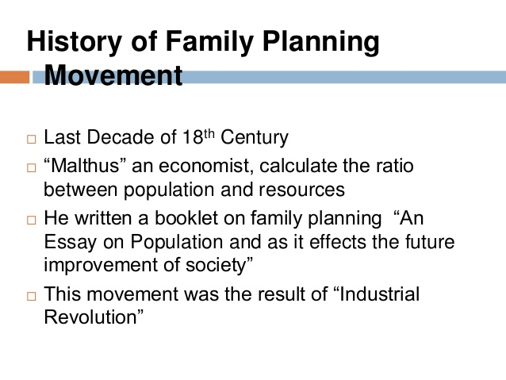
General Introduction Male Role to FP
Luqman Ali 11011518-078; 4.
Notes:
History of Family Planning

Slide 14

The Concept of Family Planning

Slide 15
The Concept of Family Planning
Misconceptions ( sterilization and birth control)
Family welfare Program. The concept of welfare is very comprehensive and is basically related to quality of life.
The family welfare program aims at improving quality of life.
So, family planning is not synonymous with birth control, but family planning includes:
Welfare = perfect healthy, wellness, happiness

Slide 16
The Concept of Family Planning
Marriage counseling.
Prior Marriage Test
Education for parenthood.
Proper spacing and limitation of births.
Advice on sterility.
Sex education.
Screening for pathological conditions related to reproductive system.
Genetic counseling.
Premarital consultation and examination.
Carrying out pregnancy test.
The preparation of couples for the arrival of their first child.
Teaching home economics and nutrition.
Draw in A One Smart Conceptual Model

Slide 17
The Concept of Family Planning
Quality
CFP
Marriage . HE
Pregnancy HE
Generic HE
Birth HE
P_Home HE
Couple Relation HE
Sterility HE
Reproductive HE
Draw Yours First
Draw in A One Smart Conceptual Model

Slide 18
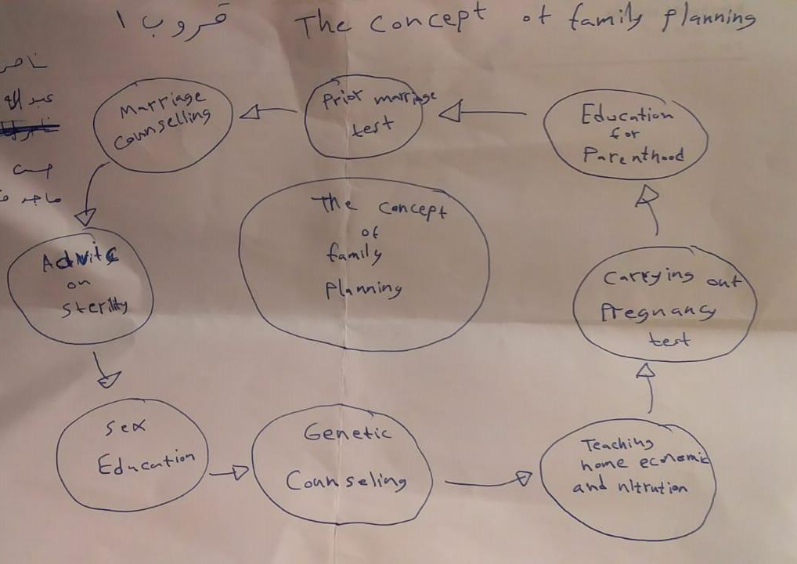
The Concept of Family Planning
The Concept of Family Planning Student Creative Model 2018

Slide 19
The Concept of Family Planning
Family planning refers to the planning of why, how and when to have children, and to the use of birth control.
WHO Definition:
Family Planning allows individuals and couples to anticipate and have their desired number of children, and to achieve healthy spacing and timing of their births (WHO Definition)
It is achieved through use of contraceptive methods and the treatment of involuntary 'infertility.

Slide 20
Definition
Practices that help individuals or couples to attain certain objectives: to avoid unwanted births, to bring about wanted births, to regulate the intervals between pregnancies, to control the time at which births occur in relation to the ages of the parent, and to determine the number of children in the family”.
A way of thinking and living adopted voluntarily, upon the basis of knowledge, attitudes and responsible decisions by individuals and couples, in order to promote the health and welfare of the family group and thus contribute effectively to the social development of a country”.
Johali FaPHE definition…think why its HE ?!

Slide 21
Objectives of
Family Planning Programs

Slide 22
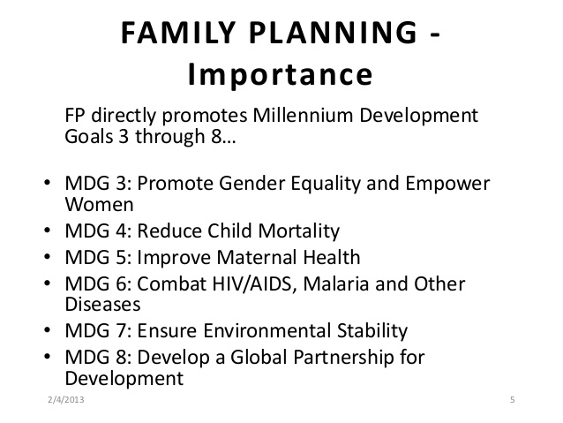
MDG 1: Eradicate Poverty and MDG 2: Achieve Universal Primary Education
Remember MDGs_ MDOs
8 MDOs = Objectives
3 MDGs + Goals
https://www.slideshare.net/HMAKhuwaja1/family-planningin-pakistan
Notes:
Remember MDGs with First Two MDG 1: Eradicate Poverty and MDG 2: Achieve Universal Primary Education 3 MDGs + Goals / 8 MDOs = Objectives So

Slide 23
WHO Goals of family planning
To improve access to the full range of affordable, equitable and high-quality family planning and reproductive health services;
To increase contraceptive use rate and reduce unwanted pregnancies.
To improve the health and nutrition status of women and children of all ages, especially pregnant and nursing women.

Slide 24
FaPHE Objectives
Family planning and Millennium Development Objectives:
1 – Eradicate poverty and hunger:
Family planning reduces the aggregate demand for scarce food products.
Better birth spacing reduces low birth weight and poor maternal nutrition.
Family planning results in more wealth and less hunger.
2 – Achieve universal primary education
Girls often drop out of school due to unintended pregnancy or to help care for younger siblings.
Family planning prolongs education and helps girls in particular to achieve their dreams for the future.
The United Nations Population Fund(UNFPA) + Human Rights
Notes:
Eradicate Poverty ( ) Reduce low birth weight
Achieve Universal Primary Education ( ) Future dreams
Reduce Mortality ( ) Reduce infants death
Promote gender equality ( ) Reduce women unemployment
Environmental sustainability ( ) Less children less food and water

Slide 25
Objectives
3 – Promote gender equality and empower women
Unplanned pregnancy diverts women from other life plans e.g employment.
Using family planning empowers women.
Involving men in family planning can lead to changes in gender norms.
4 – Reduce child mortality
Family planning prevents unintended pregnancy, thus reducing infant deaths and increasing child survival.
5 – Improve maternal health
Terminating unintended pregnancy, is associated with unsafe abortion which is one of the main cause of maternal deaths especially in young women.
Universal access to reproductive health including family planning reduces the risk of maternal morbidity and mortality.

Slide 26
Objectives
6 – Combat HIV/AIDS
Contraception is the best preventive measure against HIV.
Women with HIV who have unintended pregnancy run the risk of transmitting the virus to their children.
Preventing unwanted pregnancy among HIV positive women reduces the number of HIV positive births and is three times more effective than providing antiretroviral treatment to mothers during pregnancy, birth, and breastfeeding.
7 – Ensure environmental sustainability
A family with fewer children needs less food, land, and water.
Moreover, family planning is five times less expensive than conventional green technologies for reducing atmospheric carbon dioxide that leads to climate change.
8 – A global partnership for development
Global investment in family planning programs have contributed to strong collaboration among international agencies, governmental ministries, multinational organizations and local community groups.
Draw all 8 Objectives in one smart figure-Self Model Panning Model
Notes:
Draw all 8 Objectives in one smart figure-Self Model

Slide 27
The 3 WHO Goals MDGs Have to be achieved by the WHO 8 Objectives MDOs
FOR YOU ?!
Draw the 3 WHO MDGs with the 8 WHO Objectives MDOs
in One Smart Figure-Self Creative Model Panning Model
Notes:
Draw all 8 Objectives in one smart figure-Self Model FOR YOU

Slide 28

WHAT ARE THE BENEFITS OF USING FAMILY PLANNING?
https://www.doh.gov.ph/node/1291
Family planning provides many benefits to mother, children, father, and the family.
Mother
Enables her to regain her health after delivery.
Gives enough time and opportunity to love and provide attention to her husband and children.
Gives more time for her family and own personal advancement.
When suffering from an illness, gives enough time for treatment and recovery.
Children
Healthy mothers produce healthy children.
Will get all the attention, security, love, and care they deserve.
Father
Lightens the burden and responsibility in supporting his family.
Enables him to give his children their basic needs (food, shelter, education, and better future).
Gives him time for his family and own personal advancement.
When suffering from an illness, gives enough time for treatment and recovery.
Comply With FP = LOVE
Notes:
Comply With FP = LOVE

Slide 29
Family Planning
Risk Factors

Slide 30
Risk Factors
A couple's decision to begin, prevent, or interrupt a pregnancy may be influenced by many factors including maternal medical disorders, risks involved in the pregnancy, and socioeconomic factors. ...
If contraception fails, abortion (termination of pregnancy) may be considered.
Notes:
Feeding infants support two years pregnancy spacing time Islam rejected family preventing

Slide 31
High Risk Pregnancy
* Primi = first
Elderly primi (30 years and over).
Short statured primi (140 cm and below).
Mal-presentation e.g. breech, transverse lie.
Ante-partum hemorrhage and threatened abortion.
Pe-eclampsia and eclampsia.
Anemia.
Twins and hydramnios.
Previous still-birth, intrauterine death, manual removal of placenta.
Elderly grandmultiparas.
Prolonged pregnancy (14 days after expected date of delivery).
History of previous caesarean or instrumental delivery.
Pregnancy associated with general diseases, cardiovascular, kidney, liver diseases, diabetes and tuberculosis.
Draw all Risk Factors in one smart figure-Self Model
Notes:
Primi = first

Slide 32
FAMILY PLANNING SERVICES
Johali FAPHE the CHS436 Family Planning for HE 2018_2019
Family planning services are defined as ;
“Educational, comprehensive medical or social activities which enable individuals, including minors, to determine freely the number and spacing of their children and to select the means by which this may be achieved".
Family planning – Wikipedia
Notes:
The new National Population Policy, 2000, adopted by the Government of India, has set as its immediate objective the task of addressing unmet need for contraception in order to achieve the medium-term objective of bringing the total fertility rate down to replacement level by the year 2010.
The Reproductive and Child Health Programme is oriented to meet the health needs of women and children completely. With regard to family planning, the approach emphasizes the
target-free promotion of contraceptive use among eligible couples;
the provision to couples of a choice of contraception; and
the assurance of high-quality care.
An important component of the programme is the encouragement of adequate spacing of births, with at least three years between births……..

Slide 33
Perspectives on family planning services
Johali FAPHE the CHS436 Family Planning for HE 2018_2019
A consensus is growing that access to care may not be enough to improve poor reproductive health due to:
Perceptions of the quality of reproductive health services,
Constraints experienced by providers in the delivery of reproductive health services,
Impact of quality of care on reproductive health outcomes,
Perspectives of special populations: adolescents, men, women at the end of the reproductive lifecycle, refugees, HIV-positive men and women, and the urban and rural poor.
Notes:
As you can see…
Knowledge of contraceptive methods is nearly universal in Bihar with 99 percent of currently married women recognizing at least one method of contraception and at least one modern method, up from 95 percent in NFHS-1 respectively.
2. Two-fifths (40 percent) of women knew a traditional method, up from 29 percent in NFHS-1.
Source: Table 5.1 for NFHS-2 (p. 92); Table 6.1 for NFHS-1 – currently married women (p. 94).

Slide 34
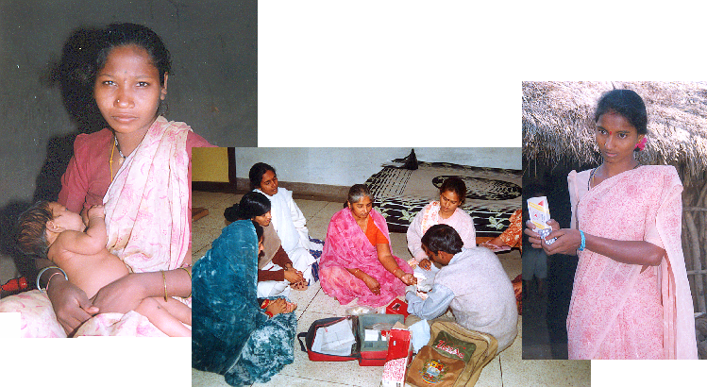
Healthcare services provided by family planning clinics
Johali FAPHE the CHS436 Family Planning for HE 2018_2019
Notes:
Female sterilization is the most widely known method of contraception, followed by male sterilization. Overall, 99 percent of currently married women know about female sterilization and 97 percent know about male sterilization.
Knowledge about spacing methods is less widespread. The best known spacing method is the pill (75 percent), followed by the condom (64 percent) and the IUD (59 percent).
Although knowledge of these spacing methods remain much lower than knowledge of sterilization, a look at trends since NFHS-1 suggests that knowledge has gone up!
- only slightly over half of women in the early 1990s knew about the pill compared to three quarters today……..
Source: Table 5.1 for NFHS-2 (P. 92); Table 6.1 for NFHS-1 (pp. 94).

Slide 35
A - MEDICAL SERVICES
Johali FAPHE the CHS436 Family Planning for HE 2018_2019
Comprehensive physical exams & health screenings
Pelvic and breast exams
Pap smear
Blood pressure & weight check
Pregnancy testing & options counseling
Preconceptual counseling
Sexually Transmitted Diseases (STDs), On-site diagnosis & treatment
Birth control instruction & counseling
Infertility education and referral
Notes:
For many years, the FP programme has been using electronic and other means of mass media to promote family planning. Studies have confirmed that exposure to electronic mass media has a substantial effect on contraceptive use.
In order to explore the reach of family planning messages disseminated through various mass media channels, NFHS-2 asked women whether they had heard or seen any message about FP in the past few months. The results indicate that:
Overall, FP messages have reached about two out of every five ever-married women in Bihar, with 72 percent of women in urban areas reporting having heard or seen a message from any source, compared to 36% in rural areas.
The most common source of recent exposure is TV, with 62% of women in urban areas reporting having seen a message, and 16% in rural areas.
Source: Table 5.13 (p. 114).

Slide 36
B - SPECIAL SERVICES
Johali FAPHE the CHS436 Family Planning for HE 2018_2019
Prenatal care & delivery program
HIV testing & counseling (Confidential testing for both you and your partner)
Colposcopy & Cryotherapy & L.E.E.P. (Loop Electrosurgical Excision Procedure)
Male services
Teen services
Prenatal substance abuse programs
Mid-Life services
C - COMMUNITY EDUCATION SERVICES
Workshops for schools, community groups, and others
Consultation and training for professionals
Parent education programs
Notes:
Moving on to current contraceptive use and trends and intention to use……………………….

Slide 37
Service delivery
Johali FAPHE the CHS436 Family Planning for HE 2018_2019
Integration of family planning in MCH care, including HIV and STI services, cervical and breast cancer screening.
Regular access to and availability of contraceptives supplies.
Integration into primary health care.
Strengthening links between different levels of health system.
Skilled health professionals: midwives, nurses and doctors trained in FP and counseling techniques that respect individual human rights.
Community health workers with proper FP training and supervision.
Notes:
Turning to the differences in use of contraceptives in urban versus rural settings:
Current use for any method is considerably higher in urban areas (39%) than in rural areas (23%).
The urban/rural difference is also true for female sterilization at 27 percent in urban areas versus 18 percent in rural areas, and for modern spacing methods with 7 percent contraceptive prevalence in urban populations and only 2 percent prevalence in rural populations.
Source: Table 5.4.

Slide 38
COVERAGE OF SERVICES
Johali FAPHE the CHS436 Family Planning for HE 2018_2019
Covered services include counseling, medical examinations, laboratory tests, and drugs and supplies furnished by the clinic in connection with family planning.
Preventing mother-child HIV transmission during breast feeding
Giving HIV positive mothers a combination of three antiretroviral drugs (ARVs) during pregnancy, delivery and breastfeeding cuts HIV infections in infants by 43% by the age of one year and reduces transmissions during breastfeeding by 54% compared with the previously recommended ARV drug regimen stopped at delivery.
Notes:
It appears that both in terms of female sterilization, as well as use of modern spacing methods, there is very little variation in contraceptive prevalence between the three regions in Bihar. Whether considered regionally or for the state as a whole, prevalence is far below the all-India average.
Source: NFHS-2 Bihar, Table 5.4, p. 98.
All India, table 5.5. in the all-India final report

Slide 39
Service Delivery System
Johali FAPHE the CHS436 Family Planning for HE 2018_2019
Professional services related to family planning are available by primary care physicians in public and private practice.
Certified nurse midwives, nurse practitioners.
Pharmacies, laboratories, outpatient hospitals are eligible to provide services.
Qualified Health Centers, Rural Health Clinics, Tribal Health Centers, private non-profit family planning agencies provide services as well.
Notes:
For women not using, but that intended to use in the future, another question asked was……What is the preferred method?
1. Not surprisingly, the large majority, 68 percent, say they intend to use sterilization. The next most preferred method is the pill (25 percent) and only 1 percent prefer that their husbands get sterilized and 1 percent prefer to use the IUD.
[Note: 25 % of intended users say they prefer the pill, while only 1 percent of current users use the pill…………..suggesting some potential underlying demand for pills!]
2. There are important differences in choice of preferred methods by timing of intended use: Women who intend to use contraception in the next 12 months stated a greater preference for spacing methods (37%). While those intending to use them later, rely primarily on female sterilization.
Source: Table 5.12 and narrative p. 112

Slide 40
Where do women get their modern contraceptive methods?
Johali FAPHE the CHS436 Family Planning for HE 2018_2019
Public medical sector
77%
Private medical sector
18%
Shop/Other
4%
Don’t know/ Missing
1%
NGO/Trust
0.4%
Notes:
Family planning methods and services in Bihar are provided primarily through a network of govt. hospitals and urban family welfare centres in urban areas, and primary health centres (PHC) and sub-centres in rural areas. They are also provided by private hospitals and clinics, as well as NGOs.
1. The public medical sector, is the source of contraception for over three-fourths (77%) of current users of modern methods. The private medical sector, including private hospitals or clinics, private doctors, private mobile clinics, private paramedics, vaidyas, hakims, homeopaths, traditional healers, and pharmacies or drugstores, is the source of 18 percent of current users. 4 percent of current users obtain their methods from other sources such as shops, friends, and relatives, and less than 1 percent from NGOs.
2 Government hospitals are the main source (70%) for female sterilization, followed by private hospitals or clinics (13%), sterilization camps (7%), and community health centers, rural hospitals, or PHC (4%). Similar sources are used for male sterilizations.
3. About half of IUD users obtain their IUDs from the public medical sector, and the other half from the private medical sector.
4. Private shops are the major source for condoms and pills (55-56%)
Source: Table 5.8, p. 106, narrative p. 103.

Slide 41
Family Planning Program planning, evaluation and develop models and steps

Slide 42
Expanding and improving family planning services is critical
Johali FAPHE the CHS436 Family Planning for HE 2018_2019
Efforts to expand and improve family planning services can have a significant impact on saving and improving the lives of women and their families. It can be achieved by :
1. Remove policy barriers limiting access, choice.
Restricting advertising for contraceptive methods, limiting contraceptive distribution only to physicians, requiring unnecessary import duties and customs regulations for contraceptives.
2. Remove medical barriers that limit access and choice.
Methods, medical recommendations and requirements should be updated to include the most appropriate and essential criteria.
Unnecessary restrictions include requiring oral contraceptive users to have blood tests every three to six months and prohibiting injectable contraceptive use in women without children
Provider bias against certain methods also influences the choices offered to clients.
Notes:
Maybe FP Program planning steps …………..
Next are some highlights on where women obtain their contraceptives and services

Slide 43
Johali FAPHE the CHS436 Family Planning for HE 2018_2019
3. Provide financial support for family planning services. Family planning is a cost-effective investment that saves lives and money.
Costs of providing family planning services can vary considerably from program to program.
Both donor agencies and country governments need to substantially increase their financial commitments to family planning to achieve this level of support.
4. Make a broad range of methods available through various delivery routes.
Clients are more likely to use contraceptives if they are presented with a choice of methods and services easily accessible.
Programs should make a wide range of contraceptives available through a variety of sources, including maternal and child health clinics, prenatal and postpartum care centres, community-based distribution systems, STD services, health services for adolescents and men, and private sector.
Notes:
Moving now to informed choice and follow-up, NFHS-2 asked users questions about who had motivated them to use their current method, the types of information given, and follow-up.

Slide 44
Johali FAPHE the CHS436 Family Planning for HE 2018_2019
5. Use appropriate information, education, and communication strategies to inform people.
Programs can help to ensure that couples have enough information to make an informed decision through face-to-face counseling with appropriate print materials and by using the mass media.
All community-based communication channels and systems should be utilized, particularly those involving local leaders, healers, and events.
All forms of communication should be culturally appropriate and respectful of the client's needs.
Counseling process should be an interactive one;
6. Support provider training and supervision.
Training workers in interpersonal communication and counseling skills as well as in technical aspects of contraceptive service provision yields positive results.
Clients who receive services from trained providers are more likely to accept and use contraception, report fewer and milder side effects, and return for regular visits.
Supportive supervision helps to reinforce skills learned in training.
Notes:
Another important element of informed contraceptive choice is explaining about any side effects at the time the method is being accepted…….
1. Only 16 percent of modern method users were informed about possible side effects of their current method by a health or family planning worker at the time of adoption of the method, less than the all-India average of 22 percent.
2. 19 percent of urban users were informed about side effects, compared to only 15 percent of rural users.
Clearly, neither public or private health workers are providing couples with all of the information they need to make an informed choice about contraceptive methods.
Source: Table 9. 10, narrative p. 224.

Slide 45
Johali FAPHE the CHS436 Family Planning for HE 2018_2019
7. Support research and evaluation of family planning methods and programs.
Research on contraceptive technologies contributes to the development of new methods, improvement of existing methods, and knowledge of method safety.
Research on how family planning programs operate can help determine the best ways of providing different contraceptive methods in diverse cultures and program settings.
Information from both types of research is critical to expanding the acceptability and impact of family planning programs.
Look tom the figure _ redraw … research and;
Redraw your smart planning and development model
Notes:
And…..[click to bring in the arrow]…… the last important aspect of family planning services is examining the unmet need for family planning.

Slide 46
Use the above 7 Steps to
Redraw your smart planning and development model it can be 7 Or 11+ Steps !?
For You

Slide 47
FAMILY PLANNING METHODS
Johali FAPHE the CHS436 Family Planning for HE 2018_2019

Slide 48
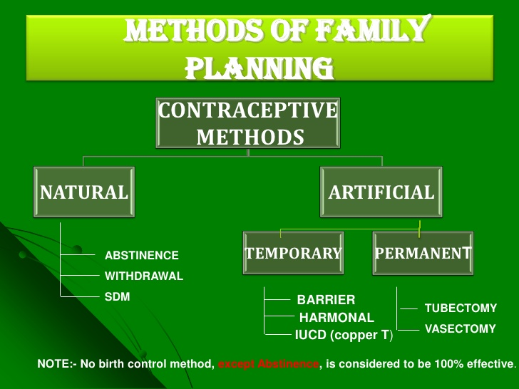
Notes:
Abstinence contraceptive what is SDM in family planning ………………..

Slide 49
The Ideal Method Should Be
Safe
100% effective
Free of Side Effect (SE)
Easily obtainable
Affordable ( reasonable price)
Acceptable to the user & sexual partner
Free of effects on future pregnancies
Abstinence :
Compliance
0 % failure rate
Most effective way to prevent (STD)
Almost all in Natural
Notes:
Almost all in Natural Abstinence is the perfect method

Slide 50
Types Of Artificial Methods
Hormonal:
Combined oral contraceptive
Progestogen only
Depot injections
Implants
Emergency oral
Intrauterine devices pictures:
Copper coils
Intrauterine systems ( Mirena )
Emergency contraception
Barrier methods:
Diaphragm
Cap
Condoms
Spermicides
Notes:
Artificial Intrauterine
Natural
Barrier

Slide 51
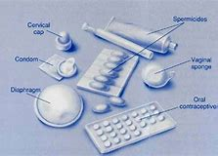
Types Of Artificial Methods
Notes:
See and draw the Pictures shown in Nasser Almalki Vedio Wasstap …

Slide 52
Methods of Natural Family Planning
Notes:
Redraw تجرأ هههه …. غريبة مع ما عرفت وخلال الشرح تفاجأت ... اذكر انني كنت اعتقد حتى درستها

Slide 53
Fertility is the quality of being fertile and productiveness
Fertility is the natural capability to produce offspring (children)
Fertility differs from fecundity, which is defined as the potential for reproduction (influenced by gamete production, fertilization and carrying a pregnancy to term).
A lack of fertility is infertility while a lack of fecundity would be called sterility
Pregnancy Anticipating a new baby is one of life's most unique and precious experience.
Notes:
Abstinence is the only method that is effective a hundred percent.
Natural Family Planning (NFP) can be 90-98% effective.
Approved by many religions and ethnic groups throughout the world.

Slide 54

Three Methods
Calendar
Temperature
Fertile Mucous.
Notes:
The three methods are = Calendar, Temperature and Fertile Mucous. I find by using these methods together, you are more accurate in predicting when you are fertile. You may also notice changes such as pain in the area of the ovaries, water retention, low backache and breast tenderness.

Slide 55

Make your Bracelets
Fertility Bracelets
Supplies per bracelet
  5 Red beads
  12 Yellow beads
  (or any color you choose).
  11 white beads
  Stretch cord
  1 safety pin
Notes:
We have found it is better to assemble the bracelets before you teach the class and give them to the women ready-made. We have found from our experience that women were too distracted making bracelets and listening to the class at the same time. Some people found that the color of beads were helpful. Red symbolized menses whereas white was purity. Yellow could mean caution…but any color does well here.
The next slide starts the presentations for your patients.

Slide 56
Make your Bracelets
We have found it is better to assemble the bracelets before you teach the class and give them to the women ready-made.
We have found from our experience that women were too distracted making bracelets and listening to the class at the same time.
Some people found that the color of beads were helpful. Red symbolized menses whereas white was purity.
Yellow could mean caution…but any color does well here.
.
Notes:
What do we do? Men are always fertile and women are fertile once a month.
Answer = When is a women fertile?

Slide 57
What do we do?
Men are always fertile and women are fertile once a month.
Answer =
When is a women fertile?
Notes:
What do we do? Men are always fertile and women are fertile once a month.
Answer = When is a women fertile?

Slide 58
Calendar
Standard Days Method
SDM is 95% effective when used correctly.
The 95% means that 5 out of 100 women practicing this method correctly for one year will get pregnant.
Day 1 = Start of Period
Day 1-7 = Intercourse is ok, low risk of conception
Day 8-19 = Abstain from intercourse
Day 20-30 = Intercourse is ok, low risk for conception
This method does not allow for women that are irregular or are having changes, so by using this method with the two other methods you will be more accurate in predicting ovulation.
Natural Family Planning: The Standard Days Method ® Georgetown University
http://www.natural-family-planning.info/standard-days-method.htm
Notes:
Standard Days Method is 95% effective when used correctly. The 95% means that 5 out of 100 women practicing this method correctly for one year will get pregnant

Slide 59
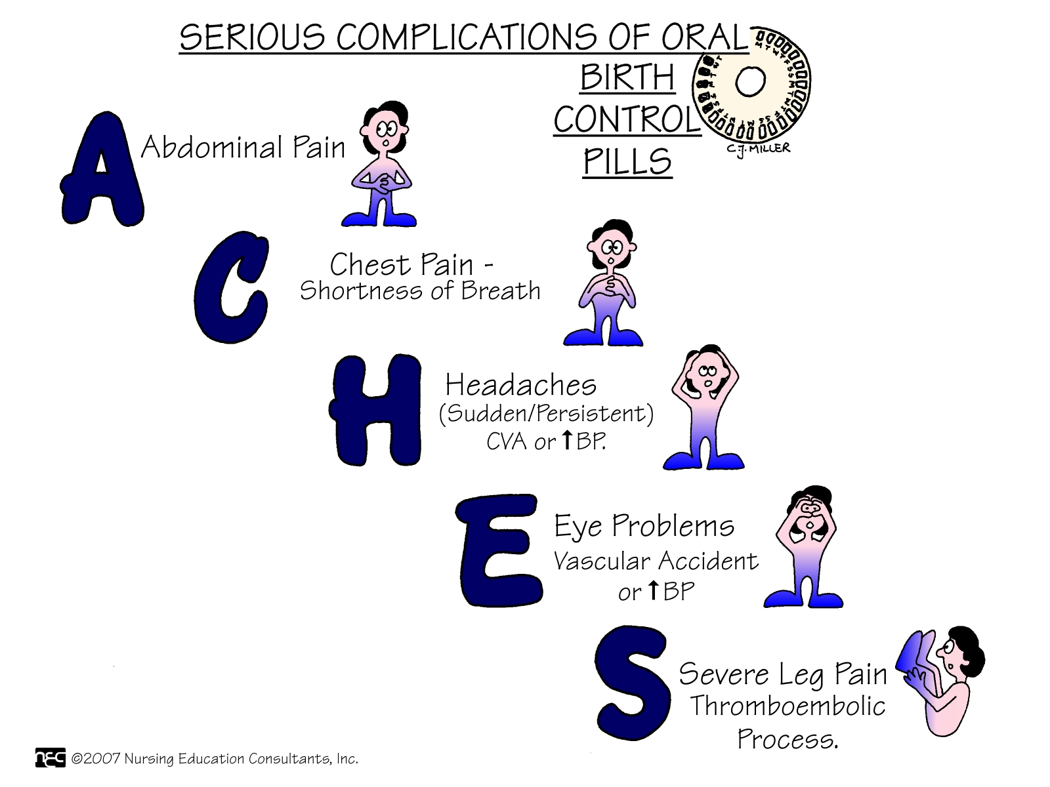
Notes:
the Model the Serious Complications of Pills the Oral Contraceptive Method

Slide 61

Read _ Training _ Play role of Practice
The Standard Days Method®
and CycleBeads®
A Simple Fertility Awareness-based Approach to Family Planning
Notes:
SDM is
Simple Day Method
S……….

Slide 62
Factors affecting fertility among Saudi women
Graduate project BySamira M. Mahboub . 2015
Publication Abstract:
Studies conducted in Saudi Arabia showed low levels of use of contraceptives. Low use of contraceptives among Saudi women might be due to religious issues. Aim of the study was to assess attitudes towards contraceptives use among Saudi women. Study design was descriptive cross sectional of ever married Saudi females living in Riyadh city. Study procedure was through self administered questionnaire uploaded via Google drive and was distributed via twitter and facebook. Sample size was 305 ever married females (who responded to the online questionnaire).
It was found that 86.6% of women have ever used contraception, and the most commonly used method were contraceptive pills (64.9%).Attitude of females towards contraception was affected by their working status. Also, husband approval was a significant factor improving female attitude towards contraceptives. It is worth mentioning that living in extended family, having chronic disease or education of either the women or her husband had no effect on women’s attitude towards contraceptives. It is recommended to conduct health education programs regarding contraceptives; their side effects and safety in all primary care clinics in Saudi Arabia. Sustained efforts should be done to increase awareness and motivation for proper contraceptive use. Men should not be ignored in receiving education on birth control methods. Initiation of specialized family planning clinics that offers better counseling might raise the rate of contraceptive use based on good decision making and choice of suitable method
https://fac.ksu.edu.sa/sababdelkader/publication/193521

Slide 63
Research the Evidence Based
Abstract
ABSTRACT Background: Thus far, international research on small groups has focused on health problems. Research on preventive, resource‐, and family‐oriented small groups and their impact on family health is scant.
Objectives: To describe the experiences of families with small children concerning resource‐enhancing small support groups, and to identify the benefits to family health described by participating parents at the end of the group processes.
Sample: The study population consisted of parents (n=123) attending 13 small groups. Participants included 63 mothers and 14 fathers (63% response rate).
Methods: Data were collected through group interviews. Qualitative content analysis of latent content was the method of analysis.
Results: Small groups provided the parents with knowledge about family life and encouraged them to seek information, made them feel refreshed, strengthened their social support networks, enhanced their awareness of their own resources and the different developmental needs at times of change in the family, and increased their confidence concerning their ability to cope.
Conclusions: Concepts from this study can be used in the future to construct instruments to evaluate the effectiveness of small groups from the perspective of families and family health. The findings add to our professional understanding of resource‐oriented family work from the perspective of families.
Perceived Benefits on Family Health of Small Groups for Families With Children by Arja Häggman‐Laitila and Anna‐Maija Pietilä. First published: 19 April 2007
https://onlinelibrary.wiley.com/doi/abs/10.1111/j.1525-1446.2007.00627.x
Notes:
Research the Evidence Based

Slide 64
Family Planning Programs
Plan _ Evaluate and Develop
https://www.healthypeople.gov
Self Learning Activities
Notes:
Self Learning Activities

Slide 65
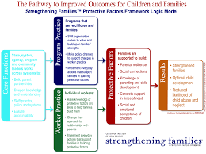
FP Developmental Programs
The Pathway to Improved Outcomes for Children an Families the Logic Model بجث اوضح او Student Work مجموعا اعادت تصميم ...

Slide 66


Framework for links between quality of family planning services and fertility
This is a conceptual framework that specifies the links between the quality of family-planning services and outcomes and impacts at the population level developed by Anrudh Jain in 1989.
On the left of the framework are the six dimensions of quality as defined in the Bruce-Jain framework.
Quality of care is hypothesized to influence both contraceptive adoption and contraceptive continuation, which in turn influences contraceptive prevalence and fertility.
There is also another “black box” for other factors that influence acceptance and continuation as well as other proximate determinants which in turn influence fertility.
These boxes are not expanded further because they are not central to the conceptualization of the impact of quality on population outcomes.
The impact evaluation question is, therefore, to demonstrate the link between quality of family planning services and population outcomes such as contraceptive adoption and continuation and current contraceptive use.
Notes:
This is a conceptual framework that specifies the links between the quality of family-planning services and outcomes and impacts at the population level developed by Anrudh Jain in 1989. On the left of the framework are the six dimensions of quality as defined in the Bruce-Jain framework. Quality of care is hypothesized to influence both contraceptive adoption and contraceptive continuation, which in turn influences contraceptive prevalence and fertility. There is also another “black box” for other factors that influence acceptance and continuation as well as other proximate determinants which in turn influence fertility. These boxes are not expanded further because they are not central to the conceptualization of the impact of quality on population outcomes. The impact evaluation question is, therefore, to demonstrate the link between quality of family planning services and population outcomes such as contraceptive adoption and continuation and current contraceptive use.

Slide 67
Framework for links between quality of family planning services and fertility
Quality of services
1) Choice
2) Information to users
3) Provider competence
4) Client-provider relations
5) Follow-up
6) Appropriate constellation of services
Acceptance
Contraceptive prevalence
Continuation
Fertility
Other proximate determinants
Other factors
Known effects
Hypothesized effects
Source: Jain, 1989
Notes:
This is a conceptual framework that specifies the links between the quality of family-planning services and outcomes and impacts at the population level developed by Anrudh Jain in 1989. On the left of the framework are the six dimensions of quality as defined in the Bruce-Jain framework. Quality of care is hypothesized to influence both contraceptive adoption and contraceptive continuation, which in turn influences contraceptive prevalence and fertility. There is also another “black box” for other factors that influence acceptance and continuation as well as other proximate determinants which in turn influence fertility. These boxes are not expanded further because they are not central to the conceptualization of the impact of quality on population outcomes. The impact evaluation question is, therefore, to demonstrate the link between quality of family planning services and population outcomes such as contraceptive adoption and continuation and current contraceptive use.

Slide 68
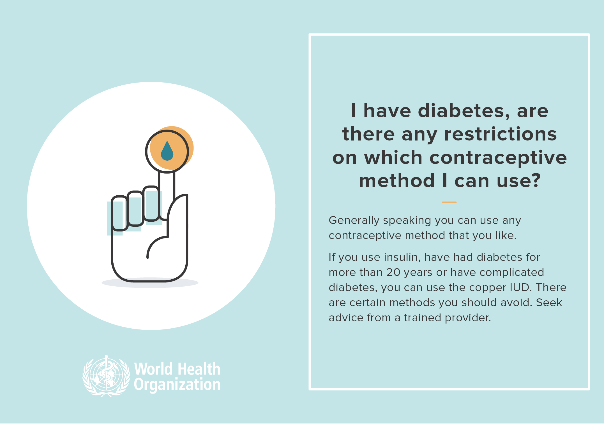
WHO Questions and Answers
http://www.who.int/reproductivehealth/topics/family_planning/contraception-infographics/en /

Slide 69
Islam and Family Planning
You have to discover more !? (smart assignments)
Med J Malaysia. 2003 Mar;58 Suppl A:49-60.
Social and religious dimensions of unwanted pregnancy: an Islamic perspective. Kasule OH.
Abstract
The concept of 'unwanted pregnancy' is a recent in human history and is associated with social stresses of modern life.
The purposes of the law, maqasid al shari'at, and its principles, qawa'id a shari'at, focus on preventing 'unwanted pregnancy', protecting the rights of the fetus and infant, and mitigating (justifying) the adverse effects of 'unwanted pregnancy' by social measures. ‘
So; the Unwanted pregnancy' is associated with:
General social determinants (hedonistic life styles “ seeking pleasure unethical to us” _ sexual transgression “ خطيئة», addiction to drugs, fear of poverty, and low female status) and’
Specific antecedent causes (sexual crimes, egoistic greed, maternal/fetal disease, and gender discrimination).

Slide 70
Islam and Family Planning
You have to discover more !? (smart assignments)
Med J Malaysia. 2003 Mar;58 Suppl A:49-60.
2) Specific antecedent causes (sexual crimes, egoistic greed “selfish greedy غريزة او خطيئة ذاتية»` , maternal/fetal disease, and gender discrimination).
These are prevented by sexual hygiene, marriage, contraception, deterring sexual crimes, and raising the status of women.
The adverse sequelae of 'unwanted pregnancy' (feticide, infanticide, or child abuse and neglect) these can be prevented by defending the basic human right of the fetus and infant to life, promoting social institutions for child welfare (nuclear family, extended family, foster care رضيع, and open adoption تبني خارجي).
Closed adoption تبني القريب is forbidden by Law but care in a foster home is allowed and is encouraged if the nuclear and extended families are unwilling or are unable to care for children.
Abortion at any stage of pregnancy is a crime against humanity. It is not a solution to the problem but is part of the problem. It will encourage more 'unwanted pregnancies'.

Slide 71
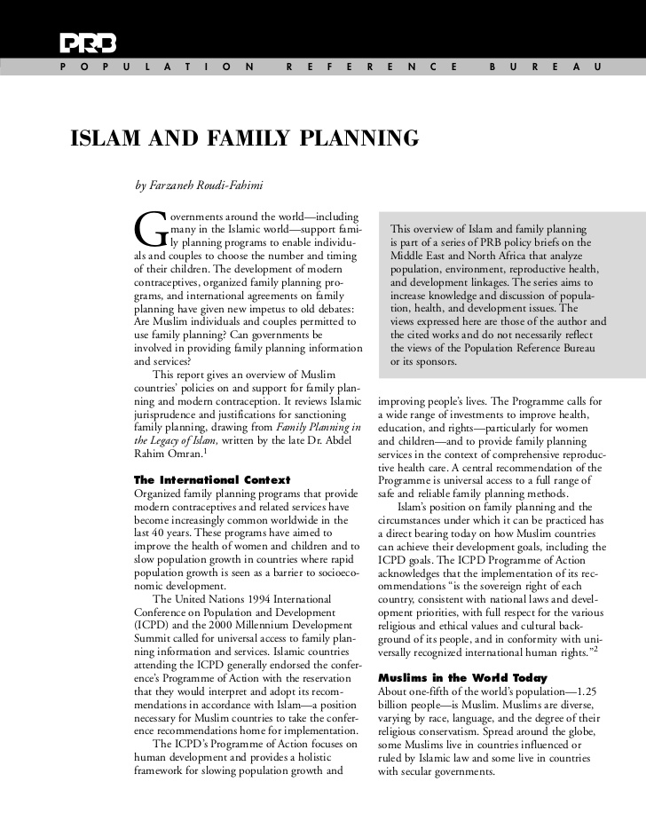
Islam and Family Planning You have to discover !?
Place of G=Family Planning and Child health in Islam ( For You Student Centred )
Notes:
Plalce of G=Family Planning and Child health in Islam ( For You Student Centred )

Slide 72
Resources _ References
The Basics of Community-Based FP Course
BASICS OF COMMUNITY-BASED
FAMILY PLANNING
TRAINING CURRICULUM
Facilitators Guide
Updated on April 27, 2009
This course was developed by the Child Survival Technical Support Plus (CSTS+) Project at Macro International, with funds from the Office of Population Reproductive Health Flexible Fund.
References
1Centers for Disease Control and Prevention. Achievements in public health, 1900–1999: Family planning. MMWR Weekly. 1999 Dec 3;48(47):1073-80. Available from: https://www.cdc.gov/mmwr/preview/mmwrhtml/mm4847a1.htm
2Sonfield A, Hasstedt K and Gold RB, Moving Forward: Family Planning in the Era of Health Reform, New York: Guttmacher Institute, 2014.
3Gipson J, Koenig M, Hindin M (2008). The effects of unintended pregnancy on infant, child and parental health: A review of the literature. Studies in Family Planning; 39(1): 18-38.
4Guttmacher Institute. In Brief: Facts on Publicly Funded Contraceptive Services in the United States. New York, NY: 2014. Available from: https://www.guttmacher.org/pubs/fb_contraceptive_serv.html
5Gavin L, Moskosky S, Carter M, et al. Providing quality family planning services: recommendations of CDC and the US Office of Population Affairs. MMWR Recomm Rep 2014;63(No. RR-04).
6Gavin L, Pazol K. Update: Providing Quality Family Planning Services — Recommendations from CDC and the U.S. Office of Population Affairs, 2015. MMWR Morb Mortal Wkly Rep 2016;65:231–234. DOI: http://dx.doi.org/10.15585/mmwr.mm6509a3 .
7Frost J. US women’s reliance on publicly funded family planning clinics as their usual source of medical care. Paper presented at National Survey of Family Growth Research Conference; 2008 Oct; Hyattsville, MD.
8Frost, J, Frohwirth L, Blades N, et al. Publicly Funded Contraceptive Services at U.S. Clinics, 2015, New York: Guttmacher Institute, 2017. Available from: https://www.guttmacher.org/report/publicly-funded-contraceptive-services-us-clinics-2015
9Lawrence B. Finer, Ph.D., and Mia R. Zolna, M.P.H. Declines in Unintended Pregnancy in the United States, 2008–2011, N Engl J Med 2016; 374:843-852 March 3, 2016 DOI: 10.1056/NEJMsa1506575. Available from: http://www.nejm.org/doi/full/10.1056/NEJMsa1506575

Slide 73


4 Pillar 1: A vibrant society
Our goals Our direction
A vibrant society...
…with strong roots
• Serve 30 Million Umrah visitors
"Focusing our efforts to serve Umrah visitors"
"Living by Islamic values"
"Taking pride in our national identity"
• Increase household spending on cultural and entertainment to 6%
…with fulfilling lives "Achieving environmental sustainability"
"Developing our cities"
"Living healthy, being healthy"
"Promoting culture and entertainment"
…with strong foundations
• Increase the average life expectancy from 74 years to 80 years
"Caring for our health"
"Developing our children’s character"
"Empowering our society"

Slide 74

SMART QUESTIONS

Slide 75
THANKS FOR BIENG READY & WELLING TO HELP and MOTIVATE FP To HAVE HEALTHY HAPPY SAUDI ARABIAN NATION

