Slide 1
JavaScript:
Functions

Slide 2
Program Modules in JavaScript
JavaScript programs are written by combining new functions that the programmer writes with “prepackaged” functions and objects available in JavaScript
The term method implies that a function belongs to a particular object
We refer to functions that belong to a particular JavaScript object as methods; all others are referred to as functions.
JavaScript provides several objects that have a rich collection of methods for performing common mathematical calculations, string manipulations, date and time manipulations, and manipulations of collections of data called arrays.

Slide 3
Program Modules in JavaScript (Cont.)
You can define programmer-defined functions that perform specific tasks and use them at many points in a script
The actual statements defining the function are written only once and are hidden from other functions
Functions are invoked by writing the name of the function, followed by a left parenthesis, followed by a comma-separated list of zero or more arguments, followed by a right parenthesis
Methods are called in the same way as functions, but require the name of the object to which the method belongs and a dot preceding the method name
Function (and method) arguments may be constants, variables or expressions

Slide 4
Function Definitions
return statement
passes information from inside a function back to the point in the program where it was called
A function must be called explicitly for the code in its body to execute
The format of a function definition is
function function-name( parameter-list )
{
declarations and statements
}

Slide 5
Function Definitions (Cont.)
Three ways to return control to the point at which a function was invoked
Reaching the function-ending right brace
Executing the statement return;
Executing the statement “return expression;” to return the value of expression to the caller
When a return statement executes, control returns immediately to the point at which the function was invoked

Slide 6
Calls function square with x as an argument, which will return the value to be inserted here
Begin function square
Names the parameter y
Returns the value of y * y (the argument squared) to the caller
End function square

Slide 7
Creates float values from user input

Slide 8
Variable maxValue stores the return value of the call to maximum
Calls function maximum with arguments value1, value2 and value3
Begin function maximum with local variables x, y and z
Calls the Math object’s method max to compare the first variable with the maximum of the other two
End function maximum

Slide 9
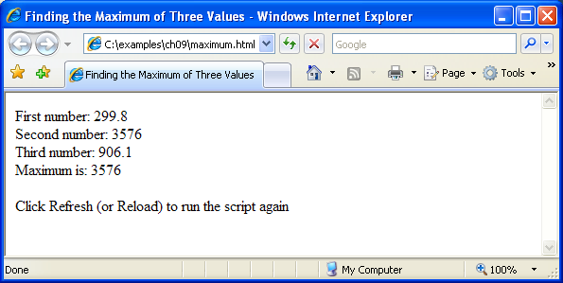

Slide 10
Example: Random Image Generator
We can use random number generation to randomly select from a number of images in order to display a random image each time a page loads

Slide 11
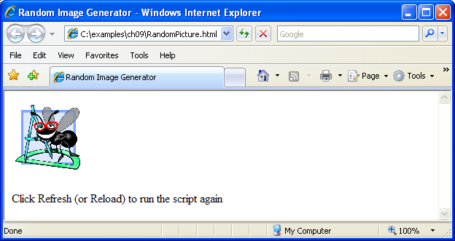
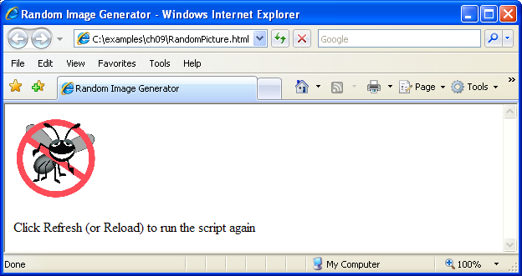
Creates an src attribute by concatenating a random integer from 1 to 7 with “.gif\” to reference one of the images 1.gif, 2.gif, 3.gif, 4.gif, 5.gif, 6.gif or 7.gif

Slide 12
Arrays Introduction
Arrays
Data structures consisting of related data items
Sometimes called collections of data items
JavaScript arrays
“dynamic” entities that can change size after they are created

Slide 13
Arrays (Cont.)
The first element in every array is the zeroth element.
The ith element of array c is referred to as c[i-1].
Array names follow the same conventions as other identifiers
A subscripted array name
can be used on the left side of an assignment to place a new value into an array element
can be used on the right side of an assignment operation to use its value
Every array in JavaScript knows its own length, which it stores in its length attribute and can be found with the expression arrayname.length

Slide 14
Declaring and Allocating Arrays
JavaScript arrays are Array objects.
Creating new objects using the new operator is known as creating an instance or instantiating an object
Operator new is known as the dynamic memory allocation operator

Slide 15
Operator new allocates an Array called n1 with five elements
Operator new allocates an empty Array called n2
Zero-based counting used in for loop to set each element’s value equal to its subscript
Five elements added and initialized in n2, which dynamically expands

Slide 16
Outputs the subscript and value of every array element in a table

Slide 17
Examples Using Arrays (Cont.)
Arrays can be created using a comma-separated initializer list enclosed in square brackets ([])
The array’s size is determined by the number of values in the initializer list
The initial values of an array can be specified as arguments in the parentheses following new Array
The size of the array is determined by the number of values in parentheses

Slide 18
Creates an array with four elements, all of which are defined
Creates an array with four elements, all of which are defined in an initializer list
Creates an array with four elements, two of which reserve space for values to be specified later

Slide 20
References and Reference Parameters (Cont.)
All objects are passed to functions by reference
Arrays are objects in JavaScript, so Arrays are passed to a function by reference
a called function can access the elements of the caller’s original Arrays.
Name of an array
actually a reference to an object that contains the array elements and the length variable

Slide 21
Passing Arrays to Functions
Pass an array as an argument to a function
Specify the name of the array (a reference to the array) without brackets
Although entire arrays are passed by reference, individual numeric and boolean array elements are passed by value exactly as simple numeric and boolean variables are passed
Such simple single pieces of data are called scalars, or scalar quantities
To pass an array element to a function, use the subscripted name of the element as an argument in the function call
join method of an Array
Returns a string that contains all of the elements of an array, separated by the string supplied in the function’s argument
If an argument is not specified, the empty string is used as the separator

Slide 22
Passes array a to function modifyArray by reference
Passes array element a[3] to function modifyElement by value

Slide 23
Creates a string containing all the elements in theArray, separated by “ ”
Multiplies each element in theArray by 2, which persists after the function has finished
Multiplies the array element by 2, but only for the duration of the function

Slide 24
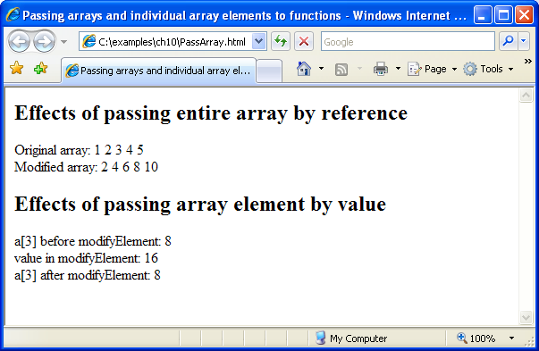

Slide 25
Multidimensional Arrays
To identify a particular two-dimensional multidimensional array element
Specify the two subscripts
By convention, the first identifies the element’s row, and the second identifies the element’s column
In general, an array with m rows and n columns is called an m-by-n array
Two-dimensional array element accessed using an element name of the form a[ i ][ j ]
a is the name of the array
i and j are the subscripts that uniquely identify the row and column
Multidimensional arrays are maintained as arrays of arrays

Slide 26
Multidimensional Arrays (Cont.)
Multidimensional arrays can be initialized in declarations like a one-dimensional array, with values grouped by row in square brackets
The interpreter determines the number of rows by counting the number of sub initializer
The interpreter determines the number of columns in each row by counting the number of values in the sub-array that initializes the row
The rows of a two-dimensional array can vary in length
A multidimensional array in which each row has a different number of columns can be allocated dynamically with operator new

Slide 27
Initializes array1 with an initializer list of sub initializer lists
Initializes array2 with rows of different lengths
Nested for…in statements traverse the arrays by iterating through the sets of one-dimensional arrays, then through the elements of each of those one-dimensional arrays

Slide 28
