Slide 1
JavaScript:
Control Statements

Slide 2
Control Structures
JavaScript provides three selection structures.
The if statement either performs (selects) an action if a condition is true or skips the action if the condition is false.
Called a single-selection structure because it selects or ignores a single action or group of actions.
The if…else statement performs an action if a condition is true and performs a different action if the condition is false.
Double-selection structure because it selects between two different actions or group of actions.
The switch statement performs one of many different actions, depending on the value of an expression.
Multiple-selection structure because it selects among many different actions or groups of actions.

Slide 3
Control Structures Cont:
JavaScript provides four repetition statements, namely, while, do…while, for and for…in.
Keywords cannot be used as identifiers (e.g., for variable names).

Slide 5
if...else Selection Statement
Conditional operator (?:)
Closely related to the if…else statement
JavaScript’s only ternary operator—it takes three operands
The operands together with the ?: operator form a conditional expression
The first operand is a boolean expression
The second is the value for the conditional expression if the boolean expression evaluates to true
Third is the value for the conditional expression if the boolean expression evaluates to false

Slide 6
if...else Selection Statement (Cont.)
Nested if…else statements
Test for multiple cases by placing if…else statements inside other if…else structures
The JavaScript interpreter always associates an else with the previous if, unless told to do otherwise by the placement of braces ({})
The if selection statement expects only one statement in its body
To include several statements, enclose the statements in braces ({ and })
A set of statements contained within a pair of braces is called a block

Slide 7
if...else Selection Statement (Cont.)
A logic error has its effect at execution time.
A fatal logic error causes a program to fail and terminate prematurely.
A nonfatal logic error allows a program to continue executing, but the program produces incorrect results.

Slide 8
while Repetition Statement
while
Allows the programmer to specify that an action is to be repeated while some condition remains true
The body of a loop may be a single statement or a block
Eventually, the condition becomes false and repetition terminates

Slide 9
Formulating Algorithms:
Counter-Controlled Repetition
Counter-controlled repetition
Often called definite repetition, because the number of repetitions is known before the loop begins executing
A total is a variable in which a script accumulates the sum of a series of values
Variables that store totals should normally be initialized to zero before they are used in a program
A counter is a variable a script uses to count—typically in a repetition statement

Slide 10
Stores the sum of grades
Sets total to 0
Sets gradeCounter to 1 in preparation for the loop
Continues the cycle until gradeCounter is greater than 10

Slide 11
Increments gradeCounter by 1 after each iteration of the loop

Slide 12
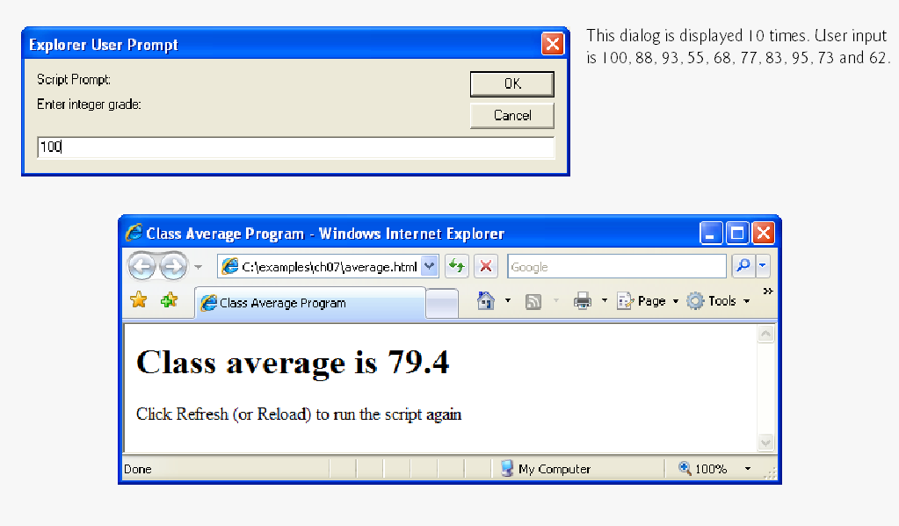

Slide 13
Outer control structure
Start nested control structure
End nested control structure
Increment for while loop

Slide 14
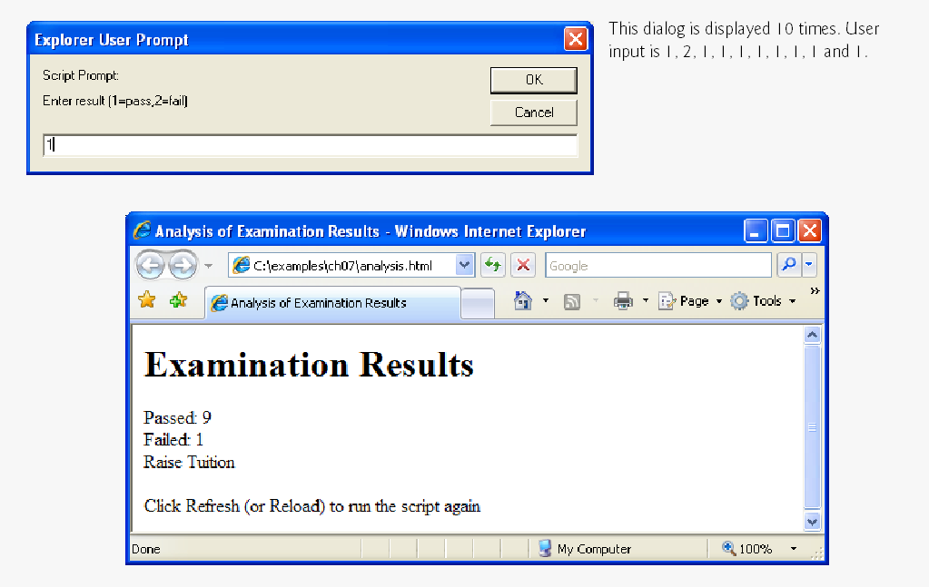
Additional control structure

Slide 15
Essentials of Counter-Controlled Repetition
Counter-controlled repetition requires
name of a control variable
initial value of the control variable
the increment (or decrement) by which the control variable is modified each time through the loop
the condition that tests for the final value of the control variable to determine whether looping should continue

Slide 16
Initializes counter
Precedes the “ with a \ to create an escape sequence so that it can be used in the string
Condition to be fulfilled with every iteration
Incrementing statement

Slide 17
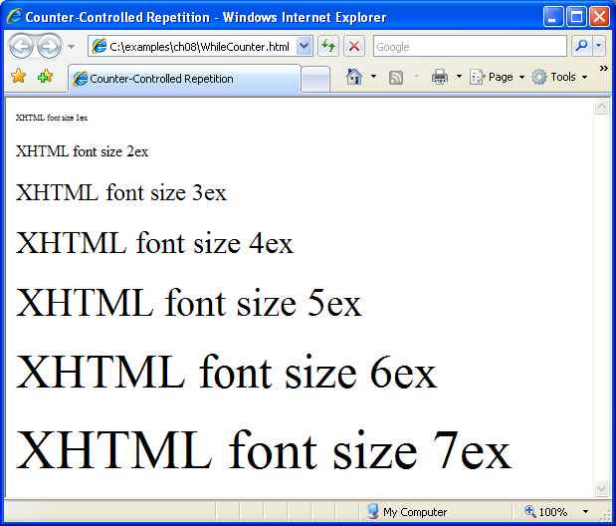

Slide 18
for Repetition Statement
for statement
Specifies each of the items needed for counter-controlled repetition with a control variable
Can use a block to put multiple statements into the body
If the loop’s condition uses a < or > instead of a <= or >=, or vice-versa, it can result in an off-by-one error
for statement takes three expressions
Initialization
Condition
Increment Expression
The increment expression in the for statement acts like a stand-alone statement at the end of the body of the for statement
Place only expressions involving the control variable in the initialization and increment sections of a for statement

Slide 19
Initial value of the control variable
Condition to test whether looping should continue
Increment to occur after each iteration of the loop
Statement inside the for loop

Slide 22
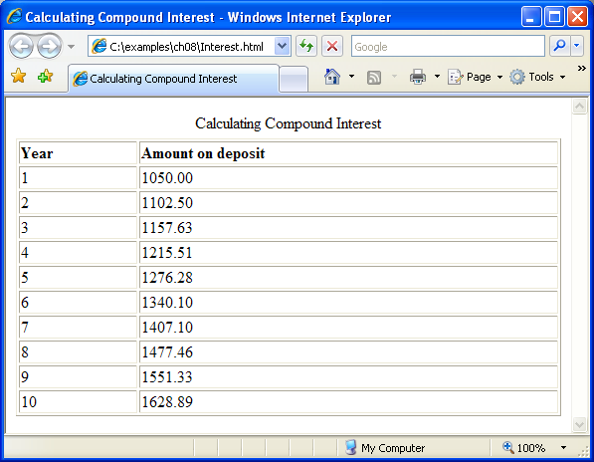
Control variable year begins with a value of 1
Continue to execute the loop while year is less than or equal to 10
After each loop iteration, increase the value of year by 1

Slide 23
switch Multiple-Selection Statement
switch statement
Consists of a series of case labels and an optional default case
When control reaches a switch statement
The script evaluates the controlling expression in the parentheses
Compares this value with the value in each of the case labels
If the comparison evaluates to true, the statements after the case label are executed in order until a break statement is reached
The break statement is used as the last statement in each case to exit the switch statement immediately
The default case allows you to specify a set of statements to execute if no other case is satisfied
Usually the last case in the switch statement

Slide 24
switch Multiple-Selection Statement (Cont.)
Each case can have multiple actions (statements)
Braces are not required around multiple actions in a case of a switch
The break statement is not required for the last case because program control automatically continues with the next statement after the switch
Having several case labels listed together (e.g., case 1: case 2: with no statements between the cases) executes the same set of actions for each case

Slide 25
Beginning of switch statement
Beginning of statements to be executed if choice equals “1”
Beginning of statements to be executed if choice equals “2”
Statements
Break out of switch statement

Slide 26
Beginning of statements to be executed if choice is anything other than “1”, “2” or “3”
No break is necessary, since we’ve come to the end of the switch anyway

Slide 27
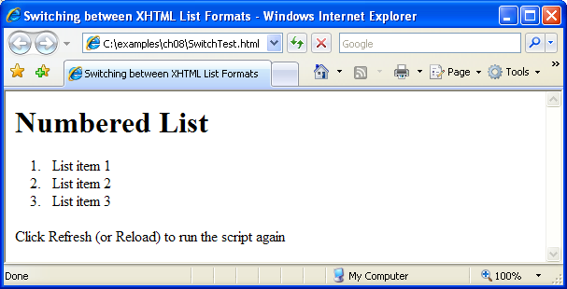
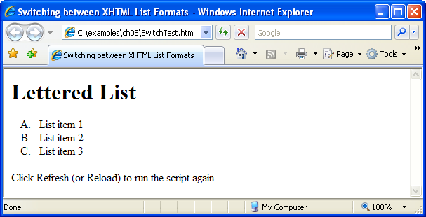

Slide 28
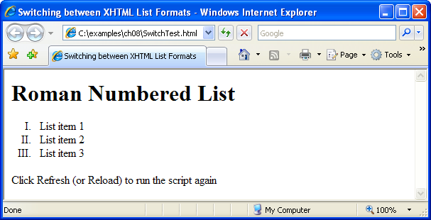
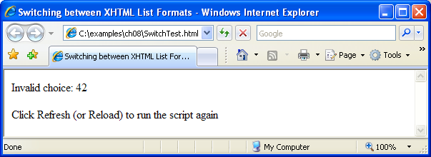

Slide 29
do…while Repetition Statement
do…while statement
tests the loop-continuation condition after the loop body executes
The loop body always executes at least once

Slide 30
Perform the following actions…
Then check to see if counter <= 6. If it is, iterate through the loop again.

