Slide 1
Isotopes

Slide 2
The atom
Atom:
It is a unit of matter that is the smallest unit of an element, having all the characteristics of that element and consisting of a dense, central, positively charged nucleus surrounded by a system of electrons.
-The nucleus is at the centre of the atom and contains the protons and neutrons. Protons and neutrons are collectively known as nucleons.

Slide 3
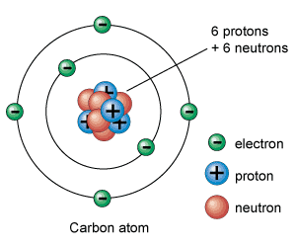
The sub-atomic particles:
Protons are positively charged
Neutrons don't have a charge
Electrons are negatively charged
-In a neutral atom:
number of electrons = number of protons

Slide 4
Atomic number: is the number of protons
Mass number of the atom = number of protons + number of neutrons
(Atomic mass)
(Atomic weight)

Slide 6
Isotopes
Isotopes:
Are atoms that contain the same number of protons (have
the same atomic number) but different numbers of neutrons
(have different atomic weight).
not all atoms of the same element have identical
masses as first suggested by Dalton, so these different kinds of atoms are isotopes.

Slide 7
-Most naturally occuring elements exist as mixture of isotopes.
-Because of the existence of isotopes, the mass of a collection of atoms has an average value.
Example:
Mg²⁴ , Mg ²⁵ , Mg²⁶ Which account for about 78.6, 10.11, 11.29% , respectively, of the total magnesium in nature.
-Because of the mass distribution, the weighted average atomic weight of magnesium is 24.31
- The chemical properties of an element are determined by its atomic number, not its atomic weight. Consequently, all three isotopes of magnesium react identically.

Slide 8
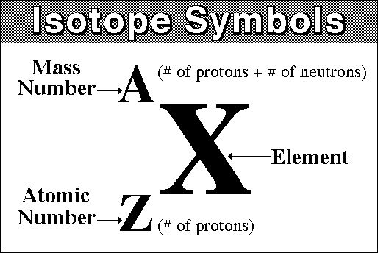
-Isotope symbol can be represented by writing its mass
number as a superscript and its atomic number as
a subscript, both preceding the atomic symbol.

Slide 9
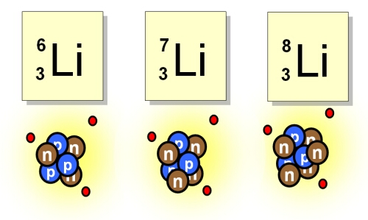
Example:

Slide 10
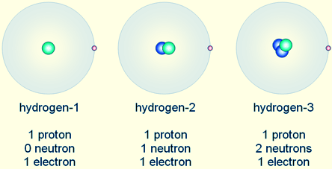
Example:

Slide 11
Radioactivity:
Unstable atomic nuclei will spontaneously decompose (decay)
to form nuclei with a higher stability. The decomposition
process is called radioactivity.
- The energy and particles which are released during the decomposition process are called radiation.
●When unstable nuclei decompose in nature, the process is referred to as natural radioactivity.
- When the unstable nuclei are prepared in the laboratory, the decomposition is called induced radioactivity.

Slide 12
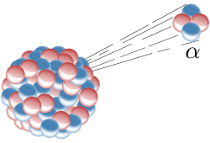
Modes of radioactive decay:
-There are three major types of natural radioactivity:
a) Alpha Radiation:
-Alpha radiation consists of a stream of positively charged
particles, called alpha particles, which have an atomic mass of
4 and a charge of +2 (a helium nucleus).
-When an alpha particle is ejected from a nucleus, the mass
number of the nucleus decreases by four units and the atomic
number decreases by two units.
For example:
-The helium nucleus is the alpha particle.

Slide 13
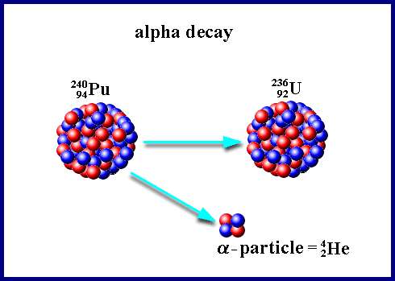
Example:

Slide 14
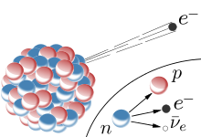
b) Beta Radiation:
-Beta radiation is a stream of electrons, called beta particles.
When a beta particle is ejected, a neutron in the nucleus is
converted to a proton, so the mass number of the nucleus is
unchanged, but the atomic number increases by one unit.
For example:
-The electron is the beta particle.

Slide 15
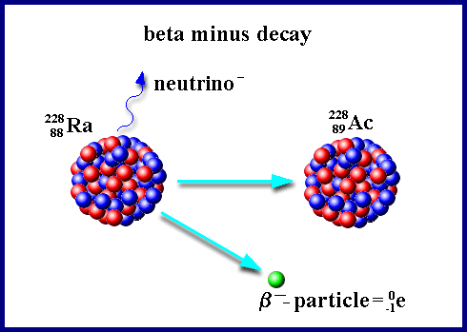
Example:

Slide 16
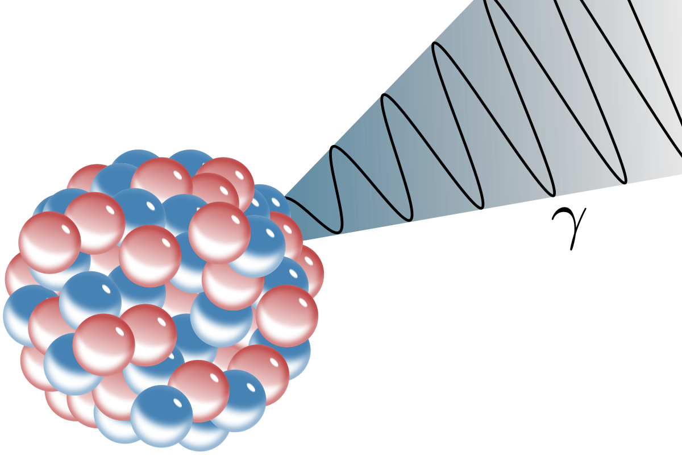
c) Gamma Radiation:
-Gamma rays are high-energy photons with a very short
wavelength (0.0005 to 0.1 nm).
The emission of gamma radiation results from an energy
change within the atomic nucleus.
Gamma emission changes neither the atomic number nor the
atomic mass.

Slide 17
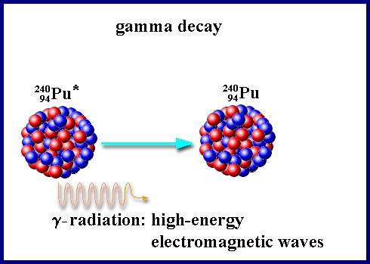
Example:

Slide 18
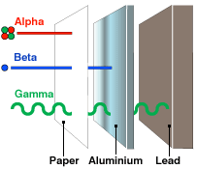
Alpha particles are stopped by a sheet of paper and cannot pass through unbroken skin
Beta particles are stopped by an aluminium sheet
Gamma rays are stopped by thick lead

Slide 19
●Most radioisotopes used in biochemical studies are beta
and/or gamma emitters.
Example:
C¹⁴ , P³² , S³⁵ , and H³ are radioisotopes commonly used in
biological research. All are β emitters.
Write the nuclear reactions by which they decay.

Slide 20
Half-life: (t_{1/2})
The “Half-life” (t_{1/2}) of a radioactive isotope is the time
required for half of the original number of atoms to decay.
-The relationship between t_{1/2} and λ is:

Slide 21
Half Life

Slide 23
Example:
Ca⁴⁵ has a half-life of 163 days.
Calculate:
a) The decay constant (λ) in terms of day⁻¹ and sec⁻¹.
b) The percent of the initial radioactivity remaining
in a sample after 90 days.
a) λ= 0.693 = 0.693 = 4.26x10-3 day -1
t1/2 163
0.693 = 4.92x10-8 sec -1
163x24x60x60

Slide 24
b)The percent of the initial radioactivity remaining
in a sample after 90 days.
b) 2.3 log N0 = λt
N
Let N0= 100%
2.3 log 100 = (4.26x10-3 )(90) 0.3834
N
Log100 = 0.3834= 0.167
N 2.3
Log 100 – log N = 0.167
Log N = 2.000 – 0.167 = 1.83
N = 68.1%

Slide 25
The curie: (Ci)
The curie or Ci is the standard unit of radioactive decay
• It describes the rate at which a certain radioactive substance decay DPM ( decay per min)
• DPM = - dN/dt = λN
• The negative sign indicates that the number of radioactive atoms decreases with time
• 1 μ Ci = 2.22x106 DPM

