Slide 1
Is customized excimer ablation combined with CXL in irregular corneal topography safe and predictable ?
Abdulrahman Al-Muammar
المدينة الطبية الجامعية
University Medical City

Slide 2
 | VA sc | SPH | CYL | SPH.E | VA cc
Pre | 20/200 | -6.25 | -3.5 | -8 | 20/60
المدينة الطبية الجامعية
University Medical City

Slide 3
Is it Safe?
9% of patients with keratoconus who underwent PRK did have progression
Kasparova et al JRS 2003
Another study with 10 years follow up and no sign of progression
Alpins et al. JCRS 2007
المدينة الطبية الجامعية
University Medical City

Slide 4
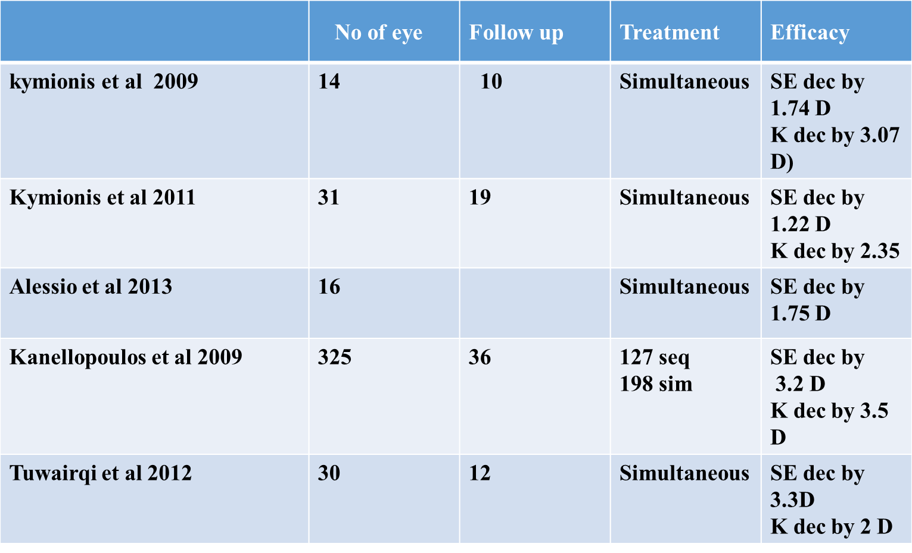
Is it Safe?
Using combined treatment, maximum reported follow up was 3 years with no progression
المدينة الطبية الجامعية
University Medical City

Slide 5
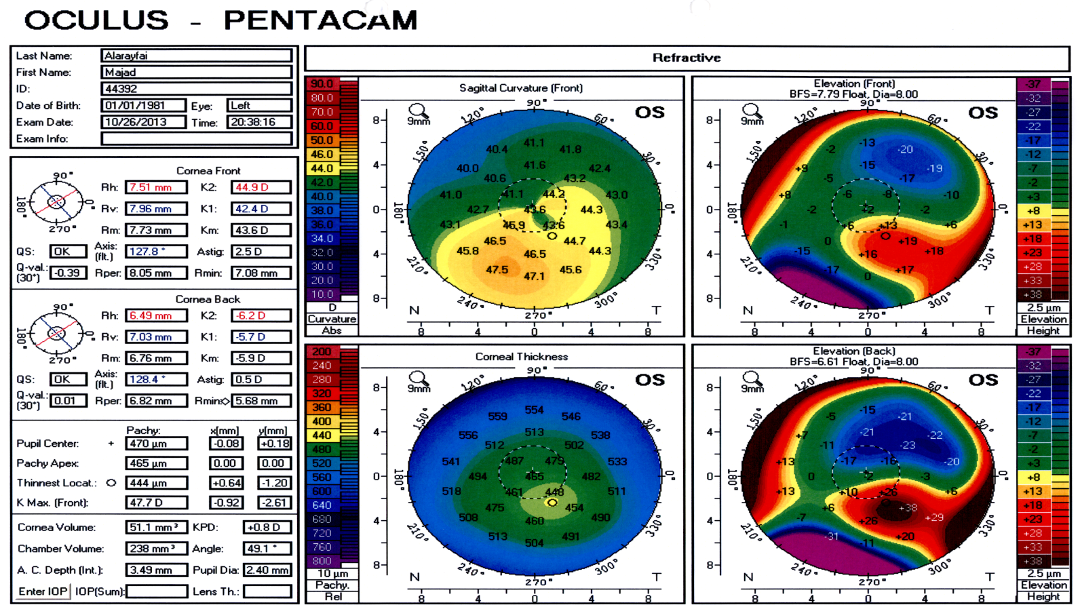
Is it Predictable?
Changing corneal shape will induce refractive changes that we did not count for
المدينة الطبية الجامعية
University Medical City

Slide 6
Is it Predictable?
Actual tissue ablation rate may differ in keratoconic tissue, with unexpected topographic effects
المدينة الطبية الجامعية
University Medical City

Slide 7
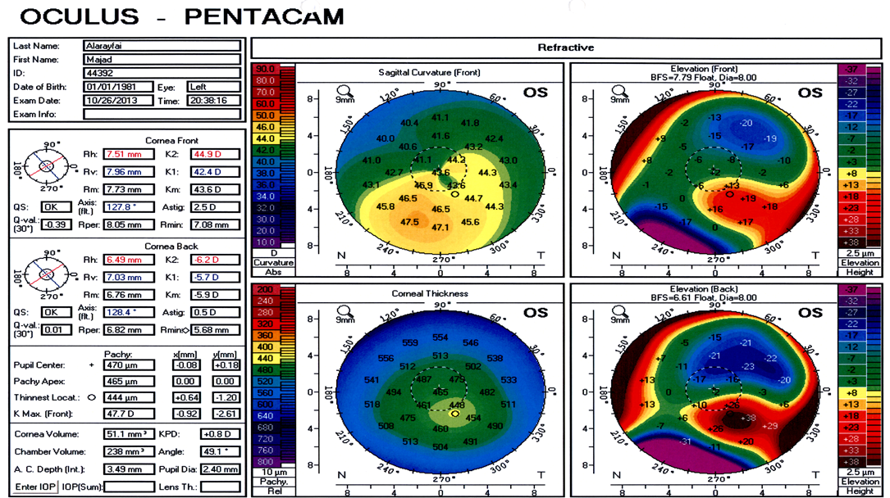
Is it Predictable?
Role of the epithelium in the irregularity measured by topography
المدينة الطبية الجامعية
University Medical City

Slide 8
Is it Predictable?
Cross-linking has progressive effect on keratoconic topography, which are not accounted for
المدينة الطبية الجامعية
University Medical City

Slide 9
Is it Predictable?
المدينة الطبية الجامعية
University Medical City

Slide 10
Is it Predictable?
Outcome measured focused on SE, cylinder, keratometry, UCVA, BCVA
Visual function
Glare and halos
Contrast
Higher order aberration
المدينة الطبية الجامعية
University Medical City

Slide 11
Is it Predictable?
Non-topographic PRK, minimized stromal ablation while preserving the beneficial effects of combined PRK and CXL
Fadlallah et al 2014, with non TPRK and CXL
SE dec by 1.37 (mean stromal ablation per SE was 17.9 µm centrally and 14.7 µm in the thinnest point)
المدينة الطبية الجامعية
University Medical City

Slide 12
Is it Predictable?
Different platform available with scanty to evidence to support each one
Pupil size is not taking in consideration
Lack of consistency as in some treatment we partially treat refractive error and other we don’t to maintain maximum depth of 50 micro
المدينة الطبية الجامعية
University Medical City

Slide 13
Is it Predictable?
Sequential and simultaneous treatment
المدينة الطبية الجامعية
University Medical City

Slide 14
Summary
Safety
Proven up to 3 years follow with residual corneal thickness >400 µm
Predictability
More studies
Patients with predictable outcome
To include other visual parameteres
Is it superior to non TPRK guided treatment?
Epithelial removal technique
المدينة الطبية الجامعية
University Medical City

Slide 15
Thank you
المدينة الطبية الجامعية
University Medical City

