Slide 1
IE 314: Operations Management
Lecture
7
Inventory Management
KAMAL

Slide 2
EXERCISE 12.2
Given:
Item | Dollar Value | Annual Usage
A2 | $50 | 3,000
B8 | $12 | 4,000
C7 | $45 | 1,500
D1 | $10 | 6,000
E9 | $20 | 1,000
F3 | $500 | 500
G2 | $1,500 | 300
H2 | $20 | 600
J5 | $10 | 1,750
J8 | $5 | 2,500
Boreki Enterpise has the following
10 items in inventory. Theodore Boreki asks you to divide these items into ABC classifications. What do you report?

Slide 3
EXERCISE 12.2
Solution:
Item | Dollar Value | Annual Usage | Annual Usage Cost $
A2 | $50 | 3,000 | 150,000
B8 | $12 | 4,000 | 48,000
C7 | $45 | 1,500 | 67,500
D1 | $10 | 6,000 | 60,000
E9 | $20 | 1,000 | 20,000
F3 | $500 | 500 | 250,000
G2 | $1,500 | 300 | 450,000
H2 | $20 | 600 | 12,000
J5 | $10 | 1,750 | 17,500
J8 | $5 | 2,500 | 12,500
Item | Dollar Value | Annual Usage | Annual Usage Cost $
G2 | $1,500 | 300 | 450,000
F3 | $500 | 500 | 250,000
A2 | $50 | 3,000 | 150,000
C7 | $45 | 1,500 | 67,500
D1 | $10 | 6,000 | 60,000
B8 | $12 | 4,000 | 48,000
E9 | $20 | 1,000 | 20,000
J5 | $10 | 1,750 | 17,500
J8 | $5 | 2,500 | 12,500

Slide 4
EXERCISE 12.2
Solution:
Item | Annual Usage | Annual Usage Cost $ | % of total value | Cumulative Percentage | Class
G2 | 3,000 | 450,000 | 41.84% | 65.09% | A
F3 | 4,000 | 250,000 | 23.25% |  | A
A2 | 1,500 | 150,000 | 13.95% | 25.81% | B
C7 | 6,000 | 67,500 | 6.28% |  | B
D1 | 1,000 | 60,000 | 5.58% |  | B
B8 | 500 | 48,000 | 4.46% | 9.11% | C
E9 | 300 | 20,000 | 1.86% |  | C
J5 | 600 | 17,500 | 1.63% |  | C
J8 | 1,750 | 12,500 | 1.16% |  | C
 | 18,650 | 1,075,500

Slide 5
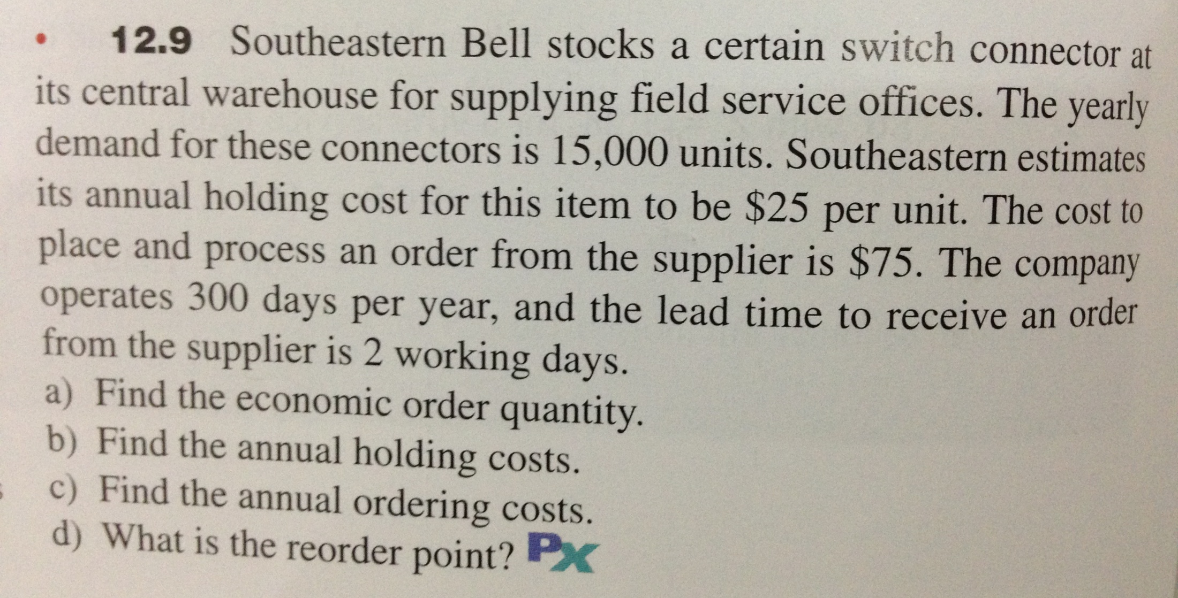
EXERCISE 12.9

Slide 6
EXERCISE 12.9
Given:

Slide 7
EXERCISE 12.9
Solution:
a) EOQ = Q* = √ 2DS/H = 300 units
b) Ann. Holding Cost = (Q*/2) H = 3,750 $
c) Ann. Ordering Cost= (D/Q*) S = 3,750 $
d) d = D/ working days per year = 15,000 / 300 = 50 units
ROP = d * L = 50 * 2 = 100 units

Slide 8
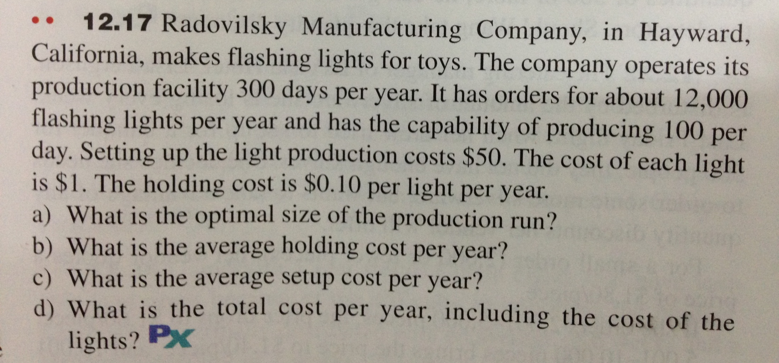
EXERCISE 12.17

Slide 9
EXERCISE 12.17
Given:

Slide 10
EXERCISE 12.17
Solution:
a) d = 12,000 / 300 = 40 units / day
POQ = Q* = 4,472 units
b) Avg. Ann. Holding Cost = (Q*/2) H [1 – (d/p)] = 134.16 $
c) Avg. Ann. Ordering Cost= (D/Q*) S = 134.16 $
d) Total cost=Lights cost+Avg. Ann. Holding Cost+Avg. Ann. Order Cost
= 12,000 * 1 + 134.16 + 134.16 = 12,268.32 $

Slide 11
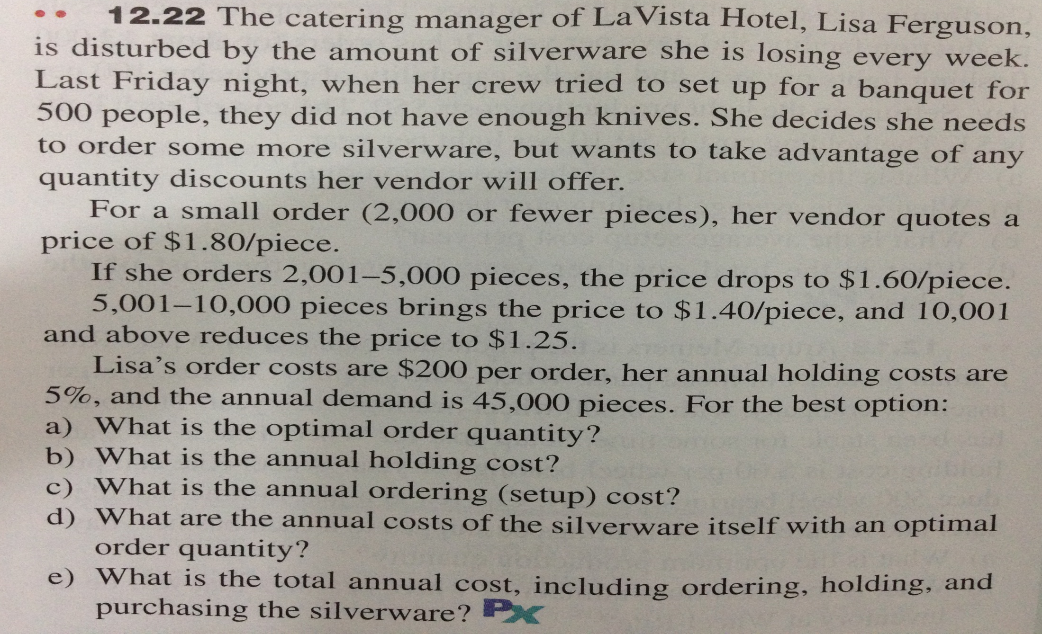
EXERCISE 12.22

Slide 12
EXERCISE 12.22
Given:
The discount options are :

Slide 13
EXERCISE 12.22
Solution:
Discount Options | P | Q* | TC
2,000 < X | 1.8 | 14142.14 | 1272.79
2,001 < X < 5,000 | 1.6 | 15000 | 1200
5,001 < X < 10,000 | 1.4 | 16035.68 | 1122.5
10,001 < X | 1.25 | 16970.56 | 1060.66

Slide 14
EXERCISE 12.22
Solution:
b) Ann. Holding Cost = (Q*/2) H = (16971/2)*(1.8*0.05) = 530.34 $
c) Ann. Ordering Cost= (D/Q*) S = (45000/16971)*200 = 530.32 $
d) Ann. Cost of Silverware itself = 45000*1.25 = 56,250 $
e) Total Ann. Cost = 530.34 + 530.32 + 56,250 = 57,310.66 $

Slide 15
HW
12.12
12.13
12.39
12.25

