Slide 1
Radiation Protection RAD 453 2014
Alhanouf Alshedi
Email: aalshedi@ksu.edu.sa

Slide 2
Aims of the course
At the end of the semester the students should be able to identify radiation dangers and promote health at work.
At the end of the semester the students should be able to institute methods of prevention from accident and minimize radiation effect by attending lectures and hospital sessions.
At the end of the semester the students should be able to develop and use methods to measure as well as minimize the effects of these radiation hazards.

Slide 3
Topics to be covered
INTRODUCTION TO RADIATION PROTECION.
BASIC INTERACTION OF RADIATION WITH MATTER.
RADIATION UNITES & QUANTITIES (1).
RADIATION UNITES & QUANTITIES (2).
BIOLOGICAL EFFECTS OF IONIZING RADIATION.
RADIATION PROTECION OF THE PATIENT DURING DIAGNOSTIC RADIOLOGICAL PROCEDTURE (1).
RADIATION PROTECION OF THE PATIENT DURING DIAGNOSTIC RADIOLOGICAL PROCEDTURE(2).

Slide 4
Cont.
BASIC PRINCIPLES OF RADIATION PROTECION.
PERSONEL AND ENVRONMENTAL MONITORING (1).
PERSONEL AND ENVRONMENTAL MONITORING (2).
SAFETY IN VARIOUS IMAGING MODALITIES

Slide 5
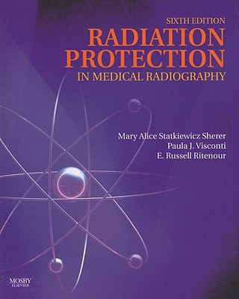
Useful Book

Slide 6
Introduction to Radiation Protection
1st Lecture
Alhanouf Alshedi
Email: aalshedi@ksu.edu.sa

Slide 7
What is Radiation Protection?
Science and practice of limiting harm to the human beings from ionizing radiation.
In all radiological activities it is important to have some idea of the risk associated with the use of ionizing radiation.
Risk: a combination of the probability that a harmful consequences may occur and the size of that consequences.

Slide 8
Exposure
Types of Exposure
Occupational Exposure
Medical Exposure
Public Exposure

Slide 9
1. Occupational Exposure
Exposure of persons in work place as part of the work they perform.
It can be controlled by three levels :
(1) At the source (shielding).
(2) At the environment (ventilation).
(3) At the work place (Practice Radiation Protection).

Slide 10
2. Medical Exposure
It is the exposure of a person as part of a medical diagnosis or treatment.
The exposure is controlled as the same three levels as for occupational exposure but is included as part of the diagnosis or treatment plan not as part of a radiation protection system.
3. Public Exposure
It is the exposure of a person by means other than occupational or medical exposure.
The controls should be applied at the source. They should only be applied to the environment or to the individuals if source controls are not effective.
Notes:
as for example in serious accident such as Chernobyl.

Slide 11
Introduction to radiation hazards
Since the early 1900s, scientists have been aware of beneficial as well as the destructive potential of ionizing radiation. By using the knowledge of radiation hazards which has been gained over the years from:
Radium-dial painters.
Uranium miners .
Early medical radiation workers .
Japanese atomic bomb survivor
Evacuees from the Chernobyl nuclear power station disaster.

Slide 12
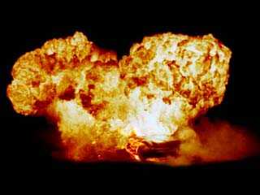
Atomic bomb

Slide 15
Justifications and Responsibility for Radiological Procedures
Ionizing radiation possesses a beneficial as well as destructive potential, the potential benefits of exposing the patient to radiation outweigh the risk involved.
Applying ALARA principle:
ALARA means As Low As Reasonably Achievable.

Slide 16
Who is responsible?
Physicians who order radiological examination.
Radiological Technologist accept a portion of responsibility by providing quality patient care and radiological services.
The radiologist & Technologist share the responsibility for keeping medical radiation exposure to the lowest level possible.
Notes:
How we avoid over exposure? Provide correct and high quality images Repeat examination (because of technical errors or carelessness = must be avoided.
This will increase radiation exposure to both the patient and radiation workers.

Slide 17
Ionizing Radiation
In simple term radiation is transfer of energy that results either because of a change occurring naturally within an atom (e.g. radioactive decay) or a process caused by the interaction of a particle with an atom.
The latter occurs most commonly when a beam of high-energy electrons bombards the atom composing the target of an x-ray tube. When radiation passes through matter produces positively and negatively charged particles (ions), it is called ionizing radiation.

Slide 18
Radioactive Atom
Ionizing Radiation
X-ray
alpha particle
beta particle
gamma ray

Slide 19
Not all forms of radiation are capable causing ionization e.g. microwaves, radio waves, and UV rays.
X-ray has the ability to cause ionization by removal orbital electron from the atom, this electrically charged particle possess the potential to cause biological damage in human.
by ionizing the atoms which tissues are composed results in a molecular change and this in turn can cause cellular damage which in turn may cause abnormal cell function. When sufficient cellular damage, the living organism may show signs of organic damage (genetic or somatic changes).

Slide 20
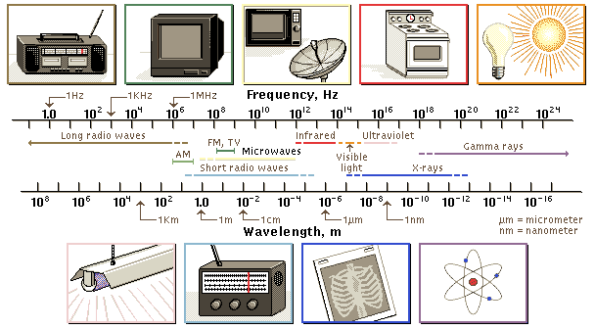

Slide 21
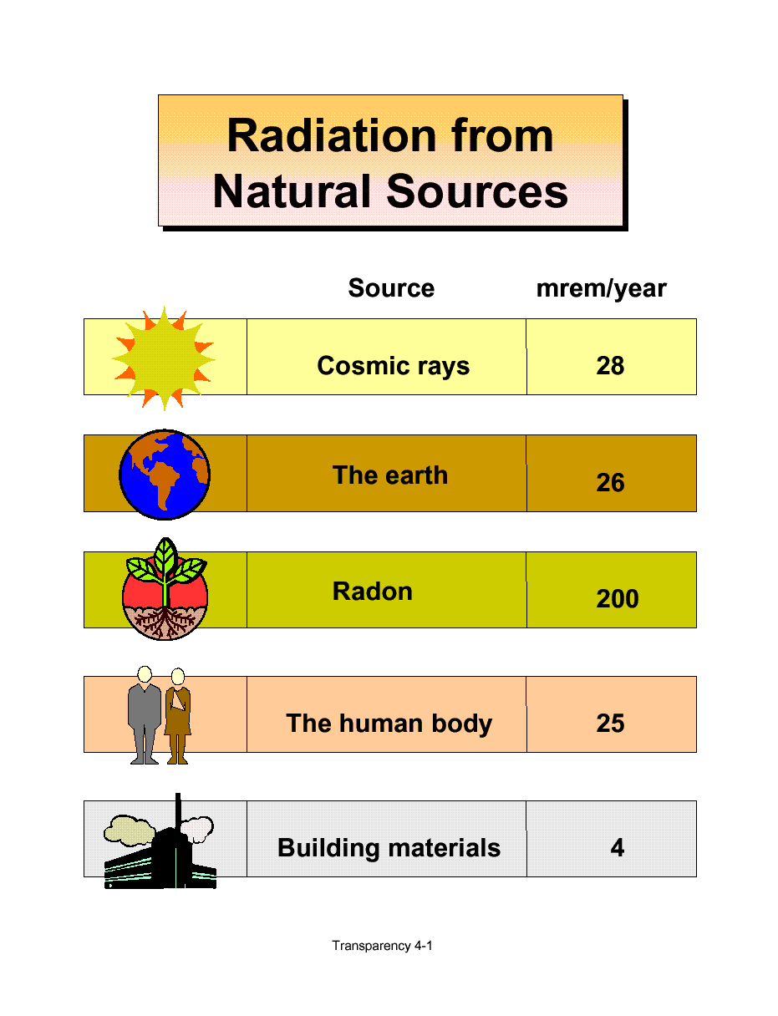
Sources of Ionizing Radiation

Slide 22
Natural radiation:
The main natural sources of radiation are cosmic radiation, radiation from terrestrial sources and radioactivity in the body. The average dose rate from these sources is about 1 mSv/year.
A.1 Cosmic radiation:
Cosmic radiation reaches the earth from interstellar space and from the sun. The atmosphere acts as a shield and reduces the amount of cosmic radiation reaching the Earth’s surface. The average dose rate at sea-level is about 0.25 mSv/year and it increases with altitudes.

Slide 23
A.2 Radiation from terrestrial sources:
The rocks and soil of the Earth’s strata contain small quantities of the radioactive elements uranium with daughter products.
The dose rate from this source is about 0.2 mSv/year.
A.3 Radiation from terrestrial sources:
The ingestion and inhalation of naturally occurring radionuclides gives rise to a dose which depends on the location and diet.

Slide 24
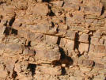
Rock
Uranium
Lead

Slide 25
B. Man-made Radiation:
B.1 Diagnostic Radiology.
B.2 Therapeutic Radiology.
B.3 Uses of isotopes in Nuclear medicine.
B.4 Radioactive Waste.
B.5 Fall-out from nuclear tests.
B.6 Occupational exposure.
The average dose rate from these sources is about 0.4 mSv/year.

Slide 26
B.1 Diagnostic radiology:
It has been estimated that about 90% of the total exposure of the population from medical uses of radiation results from the diagnostic use of x-rays.
The most critical parts of the body are the bone marrow, the gonads and the fetus in pregnant women.
The dose rate from this source is about 0.2 mSv/year.
B.2 Therapeutic radiology:
Although large exposures may be used in radiotherapy, the average dose to the population is much less than that from diagnostic radiology, because a small number of people are involved.

Slide 27
B.3 Uses of radioisotopes:
Radioisotopes are used in medicine to trace the path and location of specific chemicals in the body or to show lesions in the body.
This is achieved by an internal administration of a radioisotope into the body, and then images of the body are acquired using gamma camera.
The radionuclides used in nuclear medicine are all of man-made variety, and they are produced by nuclear reactors, harged-particles accelerators and radionuclide generators.
The dose rate from this source is about 0.03 mSv/year.

Slide 28
B.4 Occupational exposure
Occupational exposure for medical workers results from exposure to x-rays, dealing with radioactive materials (labelling, preparing vials and syringes), being close to injected patients, etc.
Atomic energy workers or researchers receive appreciable doses as well.
B.5 Radioactive waste
In nuclear medicine, radioactive waste is not a significant problem because medical radioisotopes used are normally of short half-life.

Slide 29
B.5 Fall-out from nuclear tests:
Some radioactive fall-out from nuclear weapon tests disperse into the atmosphere and are carried around the Earth several times. They gradually return to the Earth over a period of a few years giving doses to the world’s population.
The most important radioactive fall-out are strontium-90 (90Sr, T½=29 years), which concentrates in the skeleton, and caesium-137 (137Cs, T½=30 years), which is distributed uniformly in the body.
The dose rate from this source is about 0.05 mSv/year.

Slide 30
Suggested topics for your research
Radiation Protection for the pregnant patient.
Radiation protection for Radiological Technologist.
Radiation Protection Lecture for the new radiological science Students.
The hazards associated with the ultrasound or MRI.
Protection offered for the sick children.
Protection for the visitors of radiology dept.

Slide 31
Cont.
The radioactive waste management
Evaluation of the radiological sciences department labs.

Slide 32
Any Question?
Thank You

