Slide 1
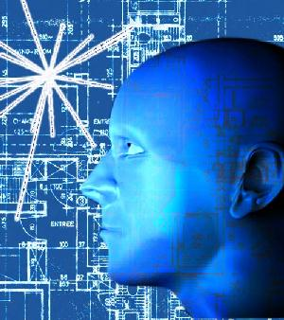
Lecture 1:
Introduction to IT443
(Advanced Human Computer Interaction)

Slide 2
Course Instructor
Dr. Balsam AlSugair
Office: 6T60
Office Hours:
Sunday : 9-10, 12-1
Tuesday: 9-10, 12-1
Wednesday: 10-12 By Appointment only
Thursday: 9-10, 12-1
Email: balsugair@ksu.edu.sa
Webpage: fac.ksu.edu.sa/balsugair/

Slide 3
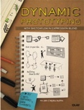
Course Syllabus (1/2)
Primary Books:
Interaction Design: Beyond Human Computer Interaction, by Y. Rogers, H. Sharp, J. Preece, 4TH Edition, Wiley (2015).
Dynamic Prototyping with SketchFlow in Expression Blend: Sketch Your Ideas and Bring Them to Life, by Chris Bernard & Sara Summers.
Source: eu.wiley.com
Source: quepublishing.com

Slide 4
Course Syllabus (2/2)
Supplementary Materials:
Human-Computer Interaction, by Alan Dix et al, 3rd Edition, Prentice Hall (2004).
Designing the User Interface: Strategies for Effective Human-Computer Interaction, 4th Edition, Shneiderman and Plaisant , Addison-Wesley (1998).
Measuring the User Experience: Collecting, Analyzing, and Presenting Usability Metrics, by Tullis and Albert, Interactive Technologies (2008).

Slide 5
What is HCI?
Human-Computer Interaction draws on the fields of computer science, psychology, cognitive science, and organizational and social sciences in order to understand how people use and experience interactive technology.
HCI applies this understanding in the design, evaluation and implementation of interactive technologies for human users.

Slide 6
Course Outcomes
By the end of this course you will be able to:
Understand the practical and theoretical aspects of Human Computer Interaction (HCI)
Recognize and outline principles related to HCI and User Centered Design (UCD)
Apply HCI principles to practical problems
Understand the role of users in the design process
Use data gathering techniques to analyze and design solutions for applications
Evaluate the usability of interactive systems

Slide 7
Grades Distribution
MidTerms : 30%
Quizes: 7%
Assignment: 3%
Project: 20%
Final Exam: 40%

Slide 8
Important Dates !!
Assignment: Due Sunday 9 Oct 2016
Quiz 1: around Week 5 – exact date TBC
Midterm 1 : Tuesday 8 Nov. 2016 (8 Safar 1438H)
3-5 pm
Quiz 2: around Week 10 – exact date TBC
Midterm 2 : Tuesday 13 Dec. 2016 (14 Rabi I 1438H)
3-5 pm
Final Exam : Finals Week 3 Tuesday 8-11 am (Period 21)

Slide 9
Considerations
If you have any questions during the lecture, please raise your hand to alert me.
Please be on time! Lectures will begin on the hour
Attendance will be recorded
Deadlines (assignment, project phases, etc. )are final!
Office Hours are in place to support you, please make use of them ☺

