Slide 1
Introduction to Image recording
1st Lecture
Alhanouf Alshedi
Email: aalshedi@ksu.edu.sa

Slide 2
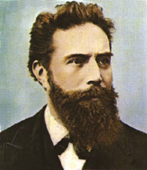
The discovery of X-rays
-X-rays was discovered by a German physicist called Roentgen in1895 .
-He named the new ray X-ray, because in mathematics "X" is used to indicated the unknown quantity.
In his discovery Roentgen found that the X-ray would pass through the tissue of humans leaving the bones and metals visible.
Wilhelm Konrad Roentgen

Slide 3
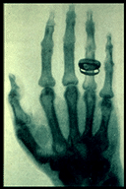
Cont.
One of Roentgen’s first experiments late in 1895 was a film of his wife Bertha's hand with a ring on her finger. The news of Roentgen’s discovery spread quickly throughout the world.

Slide 4
X-ray
X-rays are a form of electromagnetic energy just like light-rays and micro-waves are except that they travel with shorter wave length and with greater energy.
X-rays have more energy than light-rays so they can penetrate and travel through materials that light-rays cannot.

Slide 5
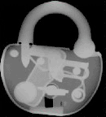
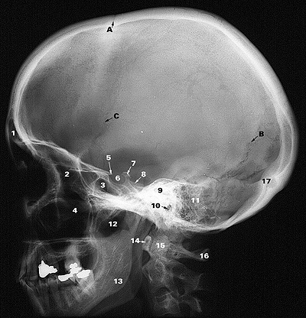
Radiographs VS photographs
similarity:
Radiographic and photographic both often use some type of film to record the image.
The difference is in how this image is recorded on the film.

Slide 6
In photography, the image on the film is produced due to reflection of light.
The amount of light that interacts with the film determines how the image appears on the film .

Slide 7
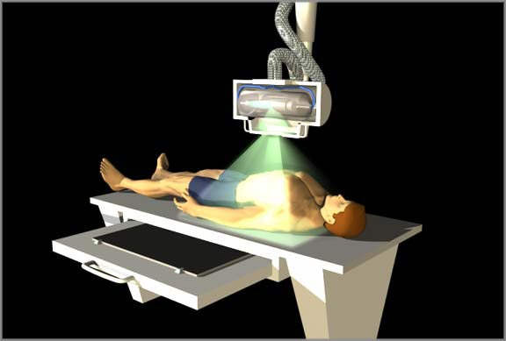
In Radiography
We use a radiation source (x-ray tube) and a film which is placed on the opposite site of the object being imaged.
The radiation is not reflected to the film, but rather passes through the object and then strikes the film.

Slide 8
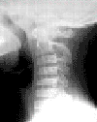
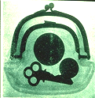
The image on the film is dependent upon how much of the radiation pass through the object and to the film.
Some materials like bone and metal stop more of the radiation from passing through
The amount of material that the X-rays must travel through also affects how many X-rays reach the film.
Differences in the type of material and the amount of material that the X-rays must penetrate are responsible for the details in the image.

Slide 9
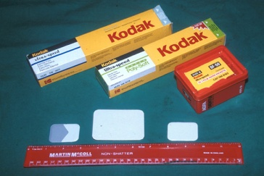
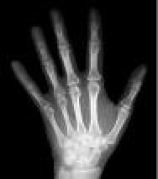
X-ray films:
The major recording media used in medical radiology is X-ray film - although the situation is changing with the introduction of new technologies in recent years.
The film can be exposed by the direct action of X-rays, but more commonly the X-ray energy is converted into light by intensifying screens and this light is used to expose the film.

Slide 12
Types of radiographic films
There are tow main groups of films, according to the effect towards light :
- Non screen or direct exposure film -Film expose to x-ray only such as dental films.
- Screen film -Film expose to light and x-ray such as general radiology films.
Film are also two types according to manufacturer
Single emulsion such as : Mammographic films, duplication film, subtraction films, radiographic films used in CT, MRI and nuclear medicine.
Double emulsion such as dental film.

Slide 13
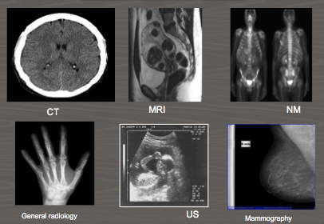
Films: (images on films)

Slide 14
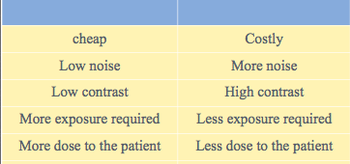
Advantage and disadvantage of single and double emulsion films
Single emulsion films
Double emulsion films

Slide 15
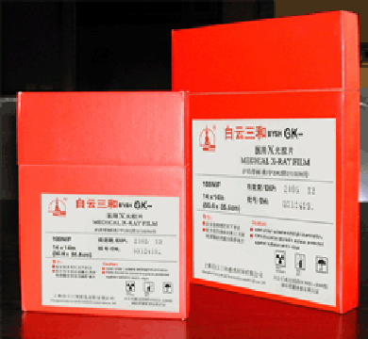
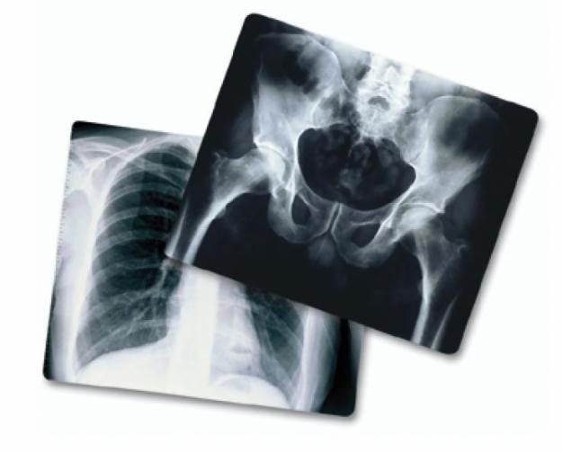
Common sizes of medical x-ray films
The following is example for some of the medical common sizes used in medical radiology field:
31x41 mm
57x76 mm
18x24 cm
24x30 cm
30x40 cm
35x35 cm
35x43 cm

Slide 16
Any Question?
Thank You

