Slide 1
BIOCHEMISTRY OF BLOOD
471 BCH
[Practical]
Nora Aljebrin
Office: Building 5, 3rd floor, 5T304
E.mail: naljebrin@ksu.edu.sa

Slide 2
Course Outline
 | Title of the Experiments
1 | Separation of plasma and serum from whole blood
2 | Separation of main proteins in plasma and serum
3 | Hemolysing agents and detection of blood
4 | Determination of plasma enzymes (Lactate dehydrogenase)
5 | Prothrombin time and coagulation time
6 | ABO blood grouping and Rh groups
7 | Hemoglobin, anemia, HCT and ESR
8 | Glucose-6-phosphate dehydrogenase deficiency, sickle cell test, and determination of iron serum
9 | Estimation of serum bilirubin ( total and direct )
10 | Red and white blood cell count
11 | Electrophoretic separation of serum proteins

Slide 3
Mark Distribution
 | Marks
Conducting the experiment | 1 Mark
Report | 6 Marks
Quiz | 8 Marks
Final | Practical | 10 Marks
 | Theoretical | 5 Marks
Total | 30 Marks
Final exam date:
Sunday / / 1437 H - / /2015

Slide 4
How to write a scientific report?
The laboratory reports should contain the following sections:
Title
Brief Introduction [ Theoretical background information around 15 -20 lines ]
Materials and Methods [ As seen in the lab sheet ]
Results [ Tables, Graphs and/or Calculations ]
Discussion
In this section you are required to describe of what happened in the experiment, explain your results and make conclusions by comparing your results to expected values (calculated or from the literature).
Even if you obtained unexpected results, the discussion section is the section to justify or explain the reasons why you have obtained such results.
Questions

Slide 5
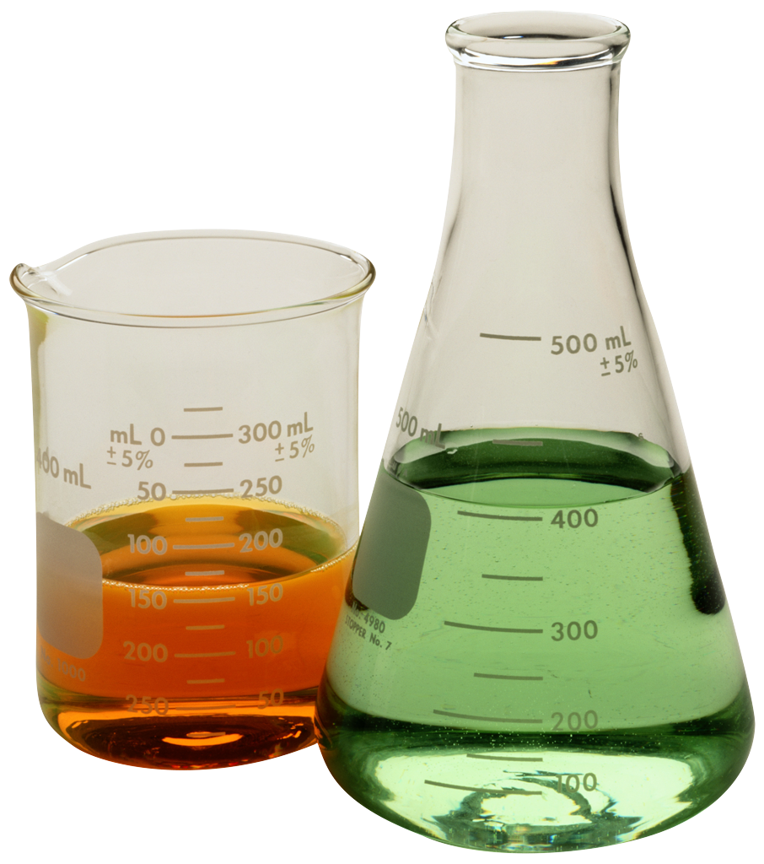
Safety in the Lab
You must wear a lab coat and hand gloves.
Open toed shoes must not be worn because they cannot protect you against chemical spills.
Long hair should be tied back to avoid any interference with the experiment.
In case of acid or base contact with your skin, wash it with large amount of clean, cold water and inform the instructor immediately.
Do not handle broken glassware with your bare hands.
Do not eat, drink, or chewin the laboratory.
Do not depart from the lab leaving an experiment unattended. If you need to leave the lab you must inform your instructor before leaving the lab.
You must wash your hands with soap after finishing the experiment.

Slide 6
Download of ALL the lectures and Lab sheet from website :
http://fac.ksu.edu.sa/naljebrin
Good luck

