Slide 1
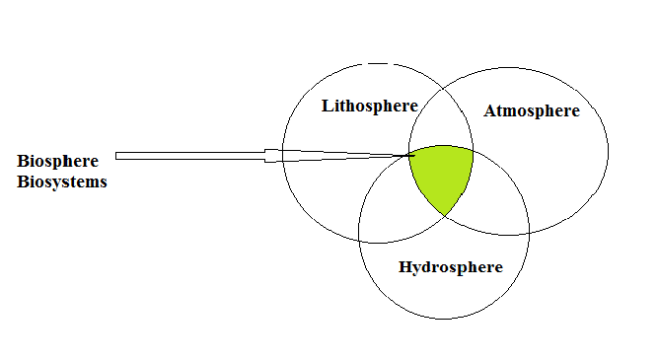
Biosystems engineering
Heat Transfer in biosystems

Slide 2
Biosystems engineering begins to appear as a result of development and controlling environment, food quality and safety, and water usage and safety.
Biosystems engineering: can be defined as the science that includes analysis, design, and control of systems that has biological base to achieve sustainable production and manufacturing food and biological materials as will as proper usage of renewable resources to support the human health.

Slide 3
Analysis :
Design:
Control:
Input
process
Output??
Input
Process??
Output
Input??
process
Output

Slide 4
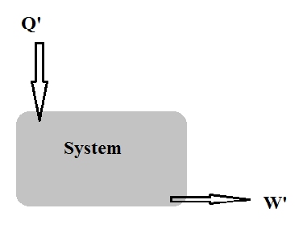
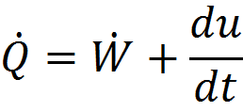
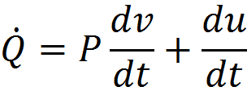
Heat Transfer and thermodynamics
∆E=Q+W =∆KE+∆PE+ ∆ IE
This equation includes two cases

Slide 5
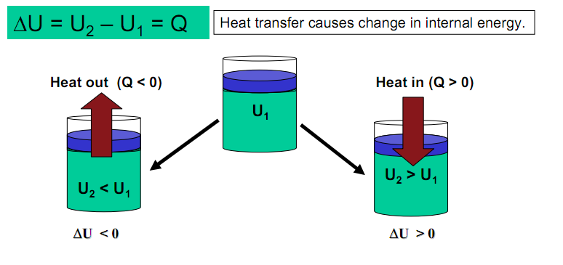
1) Constant volume process
C_{v}: specific heat capacity at constant volume [kJ/kg.k]

Slide 6
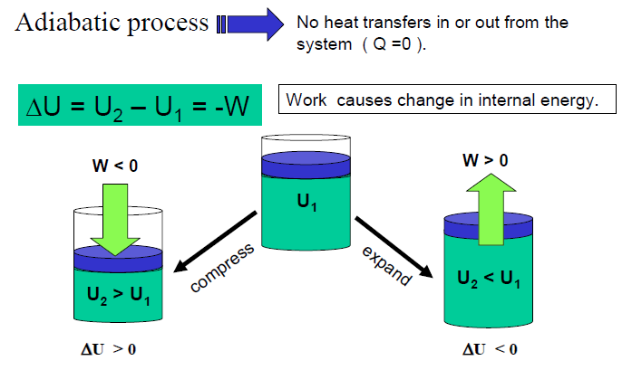
2) Constant pressure process
C_{p}: specific heat capacity at constant pressure [kJ/kg.k]

Slide 7
Enthalpy: H=U+PV
Processes: steady state and unsteady state.
Types of coordinates:
Cartesian coordinates (X,Y,Z)
Cylindrical coordinates (Z, r, Ѳ)
Spherical coordinates (r, Ѳ, ф)

Slide 8
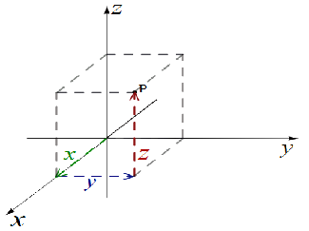
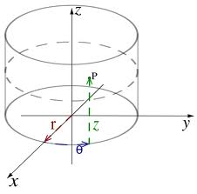
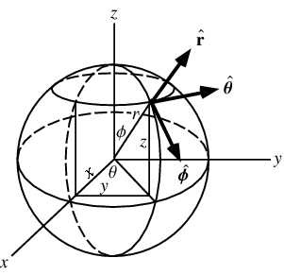
Cartesian
Cylindrical
Spherical

Slide 9
Modes of heat transfer
OBJECTIVES:
To study different modes of heat transfer.
To determine rate of heat transfer in food and non-food materials
Why study heat transfer?
to examine how foods are heated and cooled
to calculate the rate of heating and cooling
to design new heat transfer equipment
to assess the performance of existing heat exchange equipment

Slide 10
CONDUCTION
Energy transfer at a molecular level
Heating/Cooling of the solid material
The rate of heat flux (rate of heat transfer per unit area) in a solid object is proportional to the temperature gradient, this can be stated mathematically as

Slide 11
We may remove the proportionality by using a constant 'k', to obtain, Fourier’s Law
where
q_{x} = rate of heat transfer in the x direction by conduction, W
k = thermal conductivity, W/m.C
A = area (normal to x-direction) through which heat flows, m²
T = temperature, C
x = length, variable, m

Slide 12
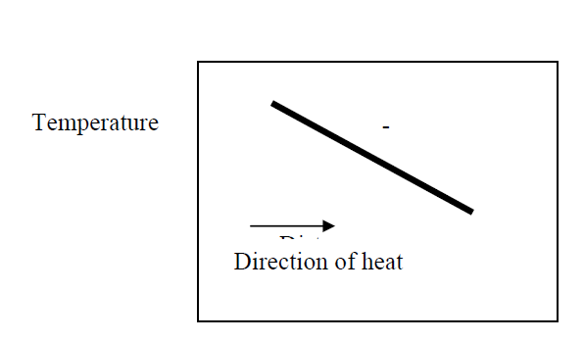
SIGN CONVENTION
Thermal Conductivity, k unit: W/mC
Metals: k = 50-400 W/mC
Water: k = 0.597 W/mC
Air : k = 0.0251 W/mC
Insulating materials: k = 0.035 - 0.173 W/mC

Slide 13
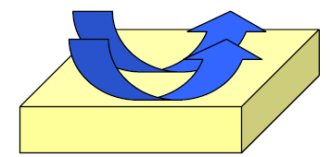
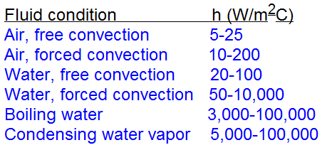
CONVECTION
Fluid flow over a solid body -- heat transfer between a solid and a fluid
Newton’s Law of Cooling:
q = h A (T_{p}-T_{α})
where: h is convective heat transfer coefficient (W/m²C), A is area (m²), T^{p} is plate surface temperature (°C), T^{α} is surrounding fluid temperature (°C).
Forced Convection - artificially induced fluid flow
Free (Natural) Convection -- caused due to density differences

Slide 14
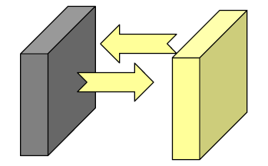
RADIATION
Heat transfer between two surfaces by emission and later absorption of electromagnetic radiation
requires no physical medium
n Stefen-Boltzmann Equation:

Slide 15
End of chapter

