Slide 1
Introduction To MATLAB
Lab 1 – 2019/1440
By: Elham Sunbu

Slide 2
OUTLINE
Matlab introduction
Why Matlab
Matlab Software install and interface

Slide 3
Matlab introduction
MatLab : Matrix Laboratory
Numerical Computations with matrices
    Every number can be represented as matrix
Why Matlab?
    User Friendly (GUI)
    Easy to work with
    Powerful tools for complex mathematics
    It was originally designed for solving linear algebra type problems using matrices

Slide 4
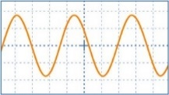
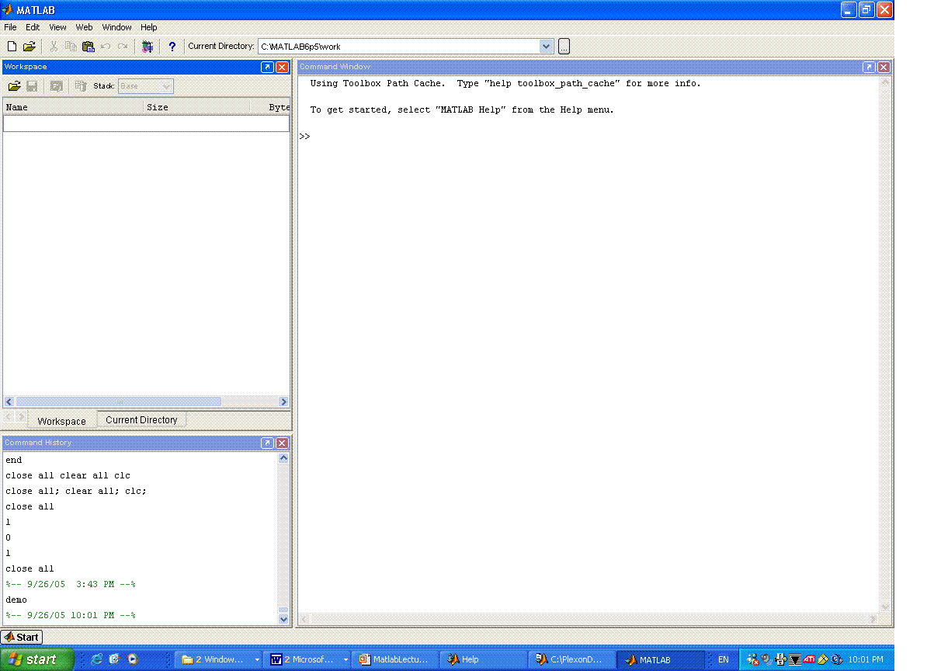
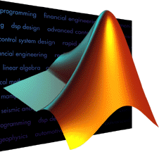
Why Matlab?
Typical uses include:
• Math and computation
• Algorithm development
• Modeling, simulation, and prototyping
• Data analysis, exploration, and visualization
• Scientific and engineering graphics
PC
100101010
UNIX
Subject 1 143
Subject 2 982
Subject 3 87 …

Slide 5
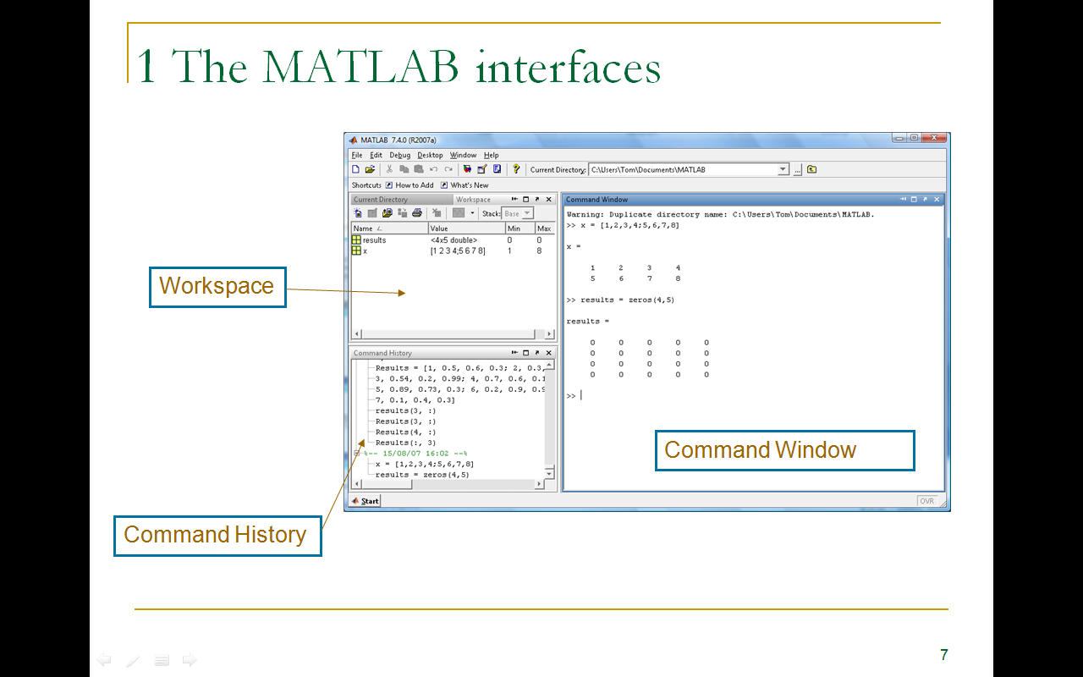
The MATLAB interface
Current Directory
  View folders and m-files
View program variables
  type commands
  view past commands save a whole session using diary

Slide 6
Matlab Special Variables
ans: default variable name
pi: ratio of circle circumference to its diameter, π = 3.1415926...
eps: smallest amount by which two numbers can differ
inf or Inf: infinity
nan or NaN: not-a-number, e.g. 0/0
date: current date in a character string format, such as 19-Mar-1998

Slide 7
Commands Involving Variables
who: lists the names of defined variables
whos: lists the names and sizes of defined variables
clear: clears all variables, resets default values of special variables
clear var: clears variable var
clc: clears the command window, homes the cursor (moves the prompt to the top line), but does not affect variables
clf: clears the current figure and thus clears the graph window.
more on: enables paging of the output in the command window
more off: disables paging of the output in the command window.

Slide 8
Introduction To Simulink
Lab sheet 3 – 2017/1439
By: Elham Sunbu

Slide 9
OUTLINE
Contents
Simulink
SIMULINK
Modeling examples

Slide 10
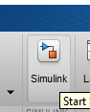
Simulink
Simulink
  Used to model, analyze and simulate dynamic systems using block diagrams.
  Fully integrated with MATLAB , easy and fast to learn and flexible.
  Provides a graphical user interface for constructing block diagram of a system – therefore is easy to use.
  C codes can be generated from Simulink models for embedded applications and rapid prototyping of control systems.

Slide 11
Simulink
  Model – simplified representation of a system – e.g. using mathematical equation.
  We simulate a model to study the behavior of a system – need to verify that our model is correct – expect results.
Knowing how to use Simulink or MATLAB does not mean that you know how to model a system

Slide 12
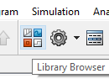
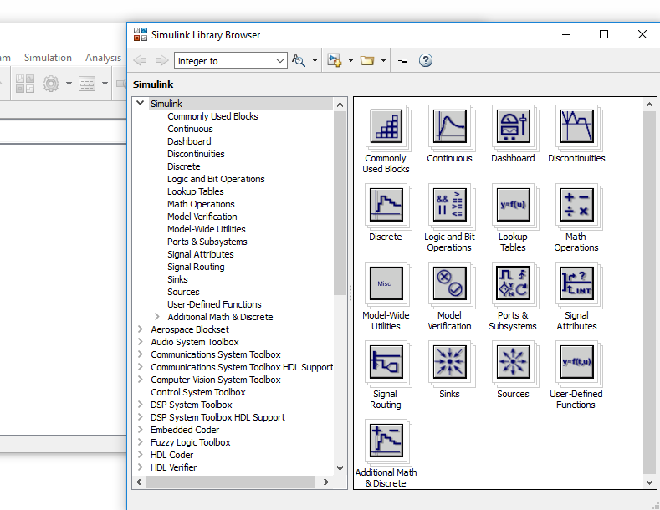

Slide 13
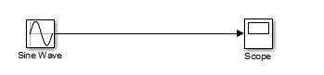
Example
Chose the blocks from Simulink:
  Simulink -> source -> sine wave
  Simulink -> commonly used blocks -> Scope

Slide 14
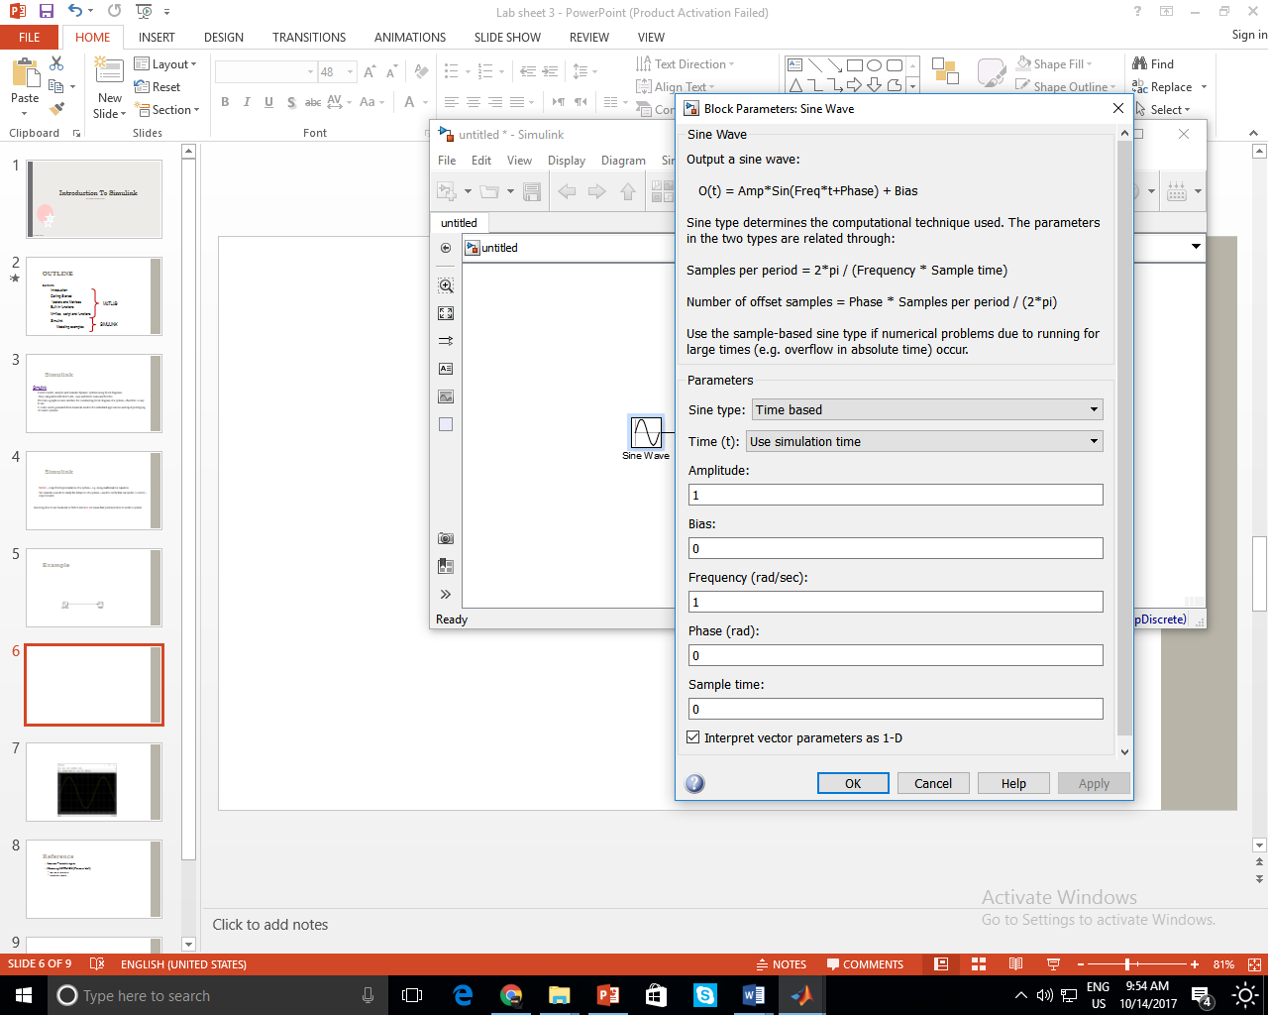
Change some sittings

Slide 15
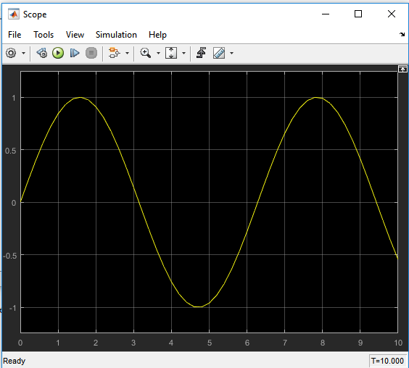
Result

Slide 16
Reference
Internet – search engine
Mastering MATLAB 6 (Prentice Hall)
  Duane Hanselman
  Bruce Littlefield

Slide 17
Thank You

