Slide 1
Lab # 4

Slide 2
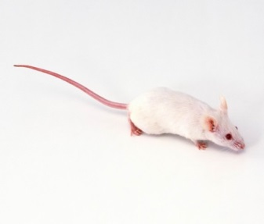
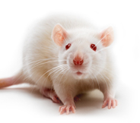
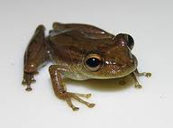
Lab Animals will be used in PHL 322
Exam
Don’t worry you will see it again in
Mouse
Today
Rat
Last lab.
Frog

Slide 3
Etiology
1- pathogenic organism
2- trauma
Mechanical
Thermal
Chemical / toxic …etc
3- ischemia
4- immunologic
It is a reaction of living tissue to an injury.
Inflammation
Causes
Types
L. Inflammo
Acute
Chronic
Rapid onset ,
Short duration
Gradual onset ,
long duration
set on fire
Cardinal signs of acute inflammation:
Redness
Hotness
Swelling
Pain and tenderness
Medical terms
Itis- This suffix has come to mean "inflammation of”
- Hepatitis= inflammation of liver
- Meningitis= inflammation of mening

Slide 4
Component of Inflammation
1. Vascular
Increased vasodilatation leads to increased permeability of the vascular to plasma protein.
2. Cellular
Involves migration of tissue macrophages and polymorphonuclear leukocytes (PMNL) to the inflamed area.
Inflammatory Mediators
Mediator | Main activity
Histamine | Vasodilation, increase permeability
Prostaglandins ( PGs ) | Vasodilation, pain, fever
Leukotrienes (LKs) | Increase permeability
Bradykinin | Vasodilation, increase permeability, pain
Serotonin
Cytokines (IL-1, TNF)
Complement
Nitric oxide

Slide 5
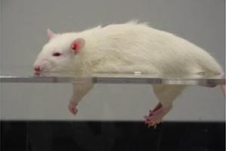
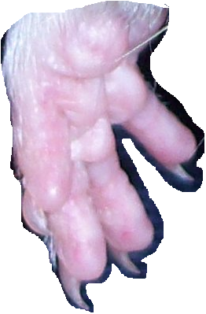
Inflammatory process (( vascular phase))
Tissues damage
Release inflammatory mediators
Histamine
PGE2
LKs
Bradykinin
Vasodilation (V.D.)
Increase blood flow
Cardinal signs of acute inflammation:
Redness: due to V.D
Hotness: due to V.D. and increase blood flow
Swelling: due to vascular leakage
Pain and tenderness: due to irritation by chemical mediators and pressure of swelling
Increase vascular permeability lead to formation of fluid exudate((plasma protein))
Edema Formation
Very important symptom to measurement effect of anti-inflammatory

Slide 6
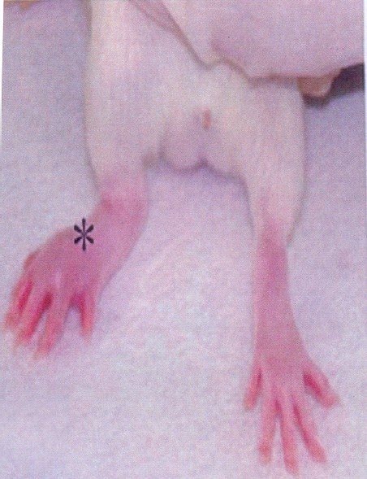

Slide 7
http://faculty.riohondo.edu/rbethel/videos/micro_inflammation.swf

Slide 8
Inflammatory process
Dilation of the blood vessels increase the blood flow to the area, accounting for redness and heat observed. Increased permeability of the capillaries allows plasma to leak from the blood stream into the tissue spaces, causing local edema (swelling) that also activates pain receptors in the area.
Aiming of the inflammation response
prevents the spread of damaging agents to nearby tissues,
disposes of cell debris and pathogens, and
sets the stage for repair.

Slide 9
Anti-inflammatory
NSAIDS
Antihistamines
Corticosteroids
Immunosuppressant
Newer biologic agents
Drugs for gout

Slide 10
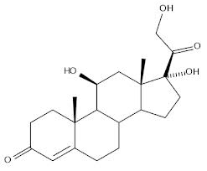
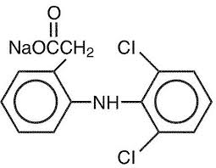
Anti-inflammatory drugs
Steroidal
Non-steroidal
Glucocorticoids
NSAIDs like
Aspirin
aspirin
Containing steroid moiety
don’t contain steroid moiety

Slide 11
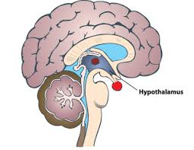
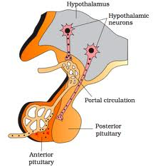
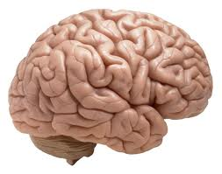
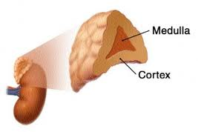
Under CNS control
Trigger to
Secreted CRH from hypothalamus
Stimulation to
Secreted ACTH from anterior pituitary gland
Adrenal gland
cortisol : is predominant glucocorticoids in human
Stimulation to
glucocorticoids : are steroids hormones which include cortisone and cortisol (hydrocortisone)
Secreted glucocorticoids from adrenal cortex
Notes:
glucocorticoids : A corticosteroid hormone secreted by adrenal cortex that influences glucose metabolism and immune function
Corticosteroids : A family of steroids synthesized by and released from the adrenal cortex.
CRH= Corticotropin-releasing hormone
ACTH =Adrenocorticotropic hormone

Slide 12
Glucocorticoids
Clinical uses
A- adrenal disorders: like Addison's disease
B- Nonadrenal disorders :
Anti-inflammatory for treatment asthma as example
Immunosuppression: to prevent organ transplant rejection
…..etc.
Natural
Cortisol
Cortisone
Synthetics
Prednisone
Dexamethasone
Beclomethasone
Flunisolide
Fluticasone
One of the MOA
They act by indirect inhibition of the enzyme phospholipase A2 by induce synthesis of a protein “lipocortin-1” which has the inhibitory effect on phospholipase A2.
Some Adverse Effects
Hyperglycemia
Osteoporosis
Moon face, buffalo hump

Slide 13
NSAIDs
Non- Steroidal
Anti-Inflammatory
Drugs
Cox-2 selective inhibitor
(coxib)
Cox non-selective inhibitors
Example
Celecoxib ((has a FDA initiated “black box” warning concerning cardiovascular risk))
Example :
Aspirin,
Ibuprofen,
Diclofenac …etc
MOA
Inhibit synthesis of PGs through inhibition of COX

Slide 14
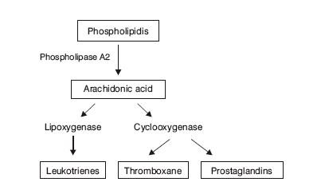

Slide 15
glucocorticoids | NSAID
Containing steroid moiety in their structure | They don’t contain steroid moiety
Powerful anti-inflammatory , immunosuppression, adrenal disorder | anti-inflammatory, analgesic, antipyretic anti-platelet ((only aspirin))
Prevent synthesis of LKs and PGs | Prevent synthesis of PGs
Treatment of asthma | Can be caused asthma

Slide 16
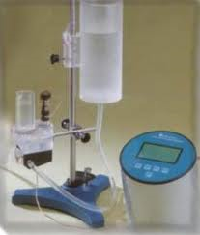
Measurement the activity of anti-inflammatory drugs
Method : Paw Oedema Method
Equipment : Plethysmometer
Any instrument designed to measure small changes in volume, usually via the displacement of water
Principle : Induction a chemical inflammation by injecting an
irritant ( formalin ) into rat’s paw
Objective : Measure the anti-inflammatory activity of aspirin
and hydrocortisone (cortisol) with different doses
Notes:
Plethysmometer : Any instrument designed to measure small changes in volume, usually via the displacement of water

Slide 17
Procedure :
1- select 5 rats
2- inject each rat 1 ml urethane for anesthesia.
3- select one as control and inject the rest of them Intraperitoneal (IP)
rat 1 >>> control
rat 2 >>> 40 mg/kg aspirin
rat 3 >>> 80 mg/kg aspirin
rat 4 >>> 20 mg/kg hydrocortisone
rat 5 >>> 40 mg/kg hydrocortisone
4- after 1 hr. , inject 0.1 ml formalin in each rat into
their paws >>> to induce inflammation.
5- after 1 hr. , take the reading using the plethysmometer of each
rat paw ( right and left ).
6- calculate the inflammation and response % for each drug.

Slide 18
Control
aspirin
Hydrocortisone
1
2
3
4
5
Each Rat 1 ml Urethane
control (IP) 40 mg/kg 80 mg/kg 20 mg/kg 40 mg/kg
No drug
After 1 hr.
Each rat 0.1 ml Formalin in one paw
After 1 hr.
Take the reading using the plethysmometer for right paw (RP) and left paw (LP)

Slide 19
Response% | inflammation | RP | LP | Dose
---------- | C |  |  | control
 | T1 |  |  | 40 mg/kg asp.
 | T2 |  |  | 80 mg/kg asp.
 | T3 |  |  | 20 mg/kg hydro.
 | T4 |  |  | 40 mg/kg hydro.
Inflammation = LP - RP
Response % $=\frac{C − T }{C}× 100$

Slide 20
Response% | inflammation | RP | LP | Dose
--------- | 0.53 | 1.02 | 1.55 | control
37.74 | 0.33 | 1.2 | 1.53 | 40 mg/kg asp.
69.81 | 0.16 | 1.25 | 1.41 | 40 mg/kg hydro.
Inflammation for
Control ((C)) : 1.55-1.02 = 0.53
Asprirn : 1.53- 1.2 = 0.33
Hydrocortisone : 1.41-1.25 = 0.16
Inflammation = LP - RP
Response % of aspirin $=\frac{0.53 − 0.33 }{0.53}× 100 =37.74\%$
Response % $=\frac{C − T }{C}× 100$
Response % of hydro. $=\frac{0.53 − 0.16}{0.53}× 100 =69.81\%$
Response % Anti-inflammatory activity

