Slide 1
INFLAMMATION 2

Slide 2
Another classification of inflammation:
1- Serous inflammation
2- Fibrinous inflammation
3- Suppurative inflammation
4- Ulcerative inflammation

Slide 3
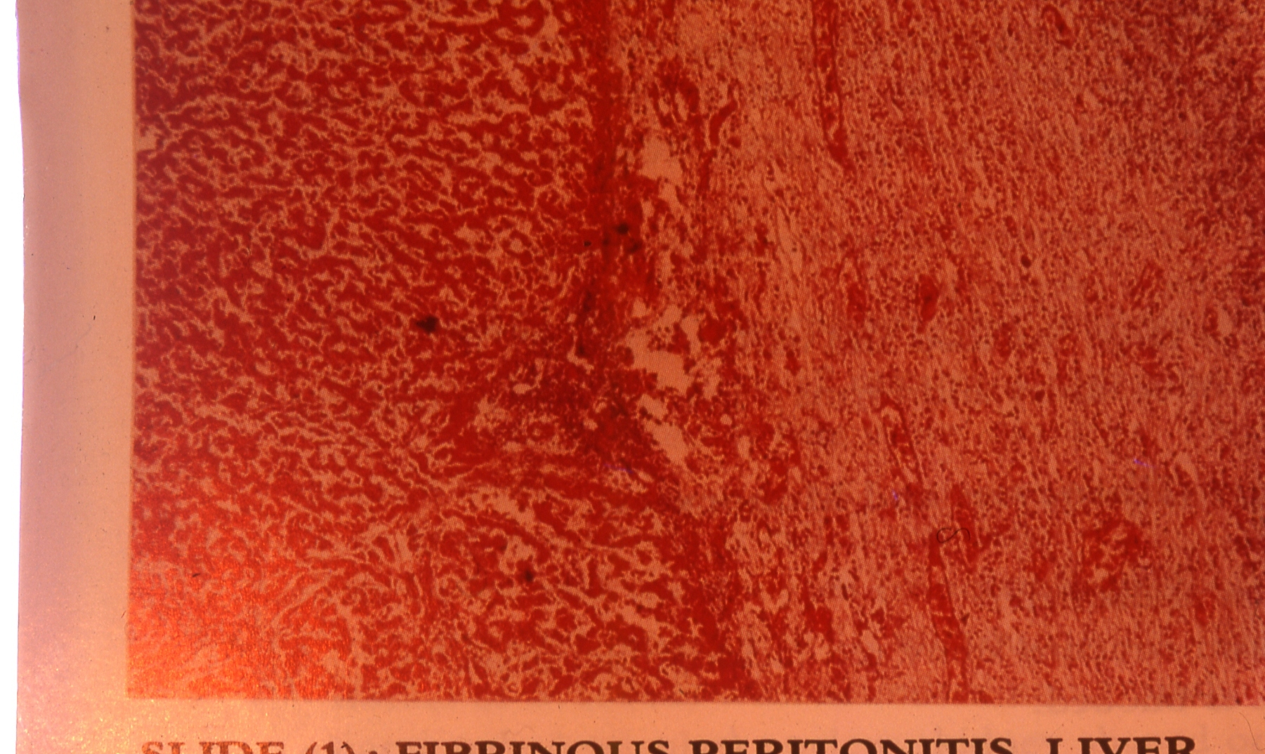
1- serofibrinous peritonitis in liver:

Slide 4
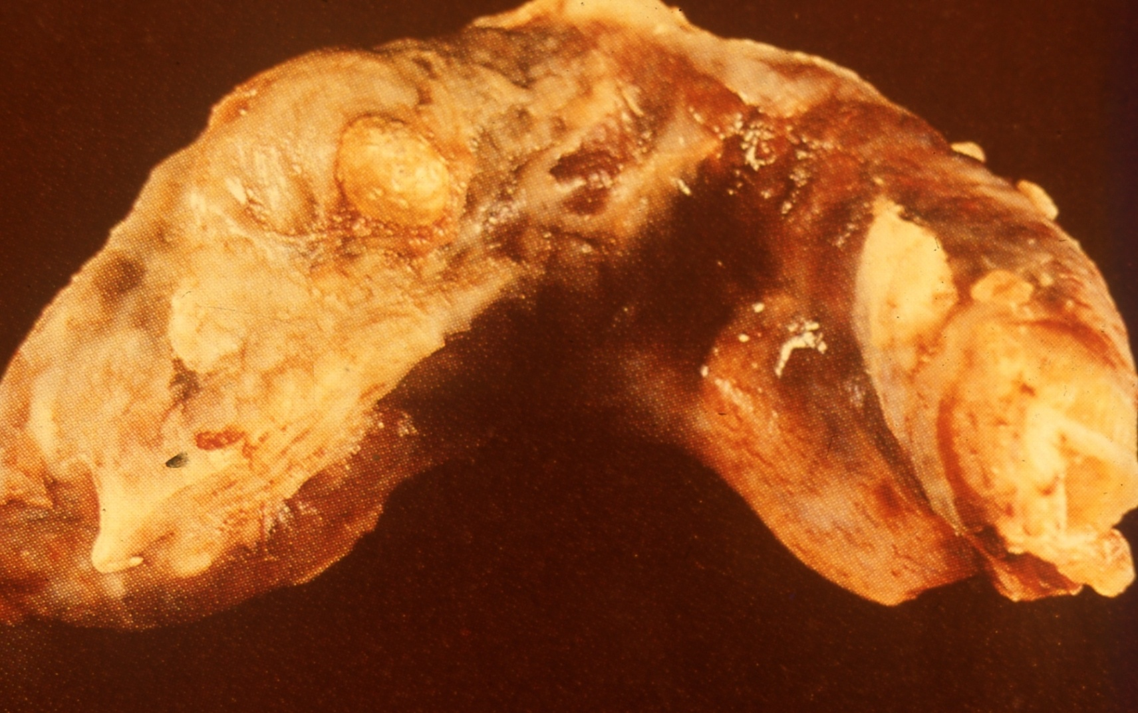
2- Acute diffuse suppurative appendisitis “Gross pic”:

Slide 5
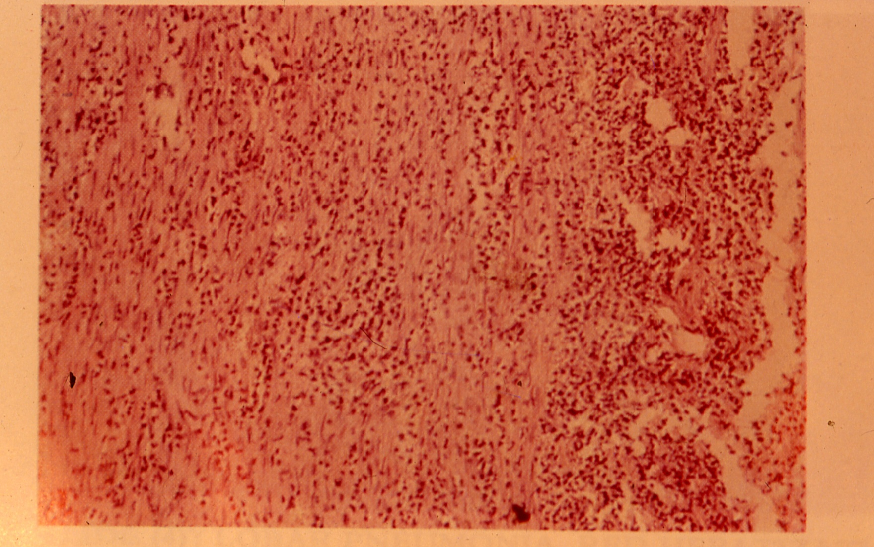
3- Acute diffuse suppurative appendisitis :

Slide 6
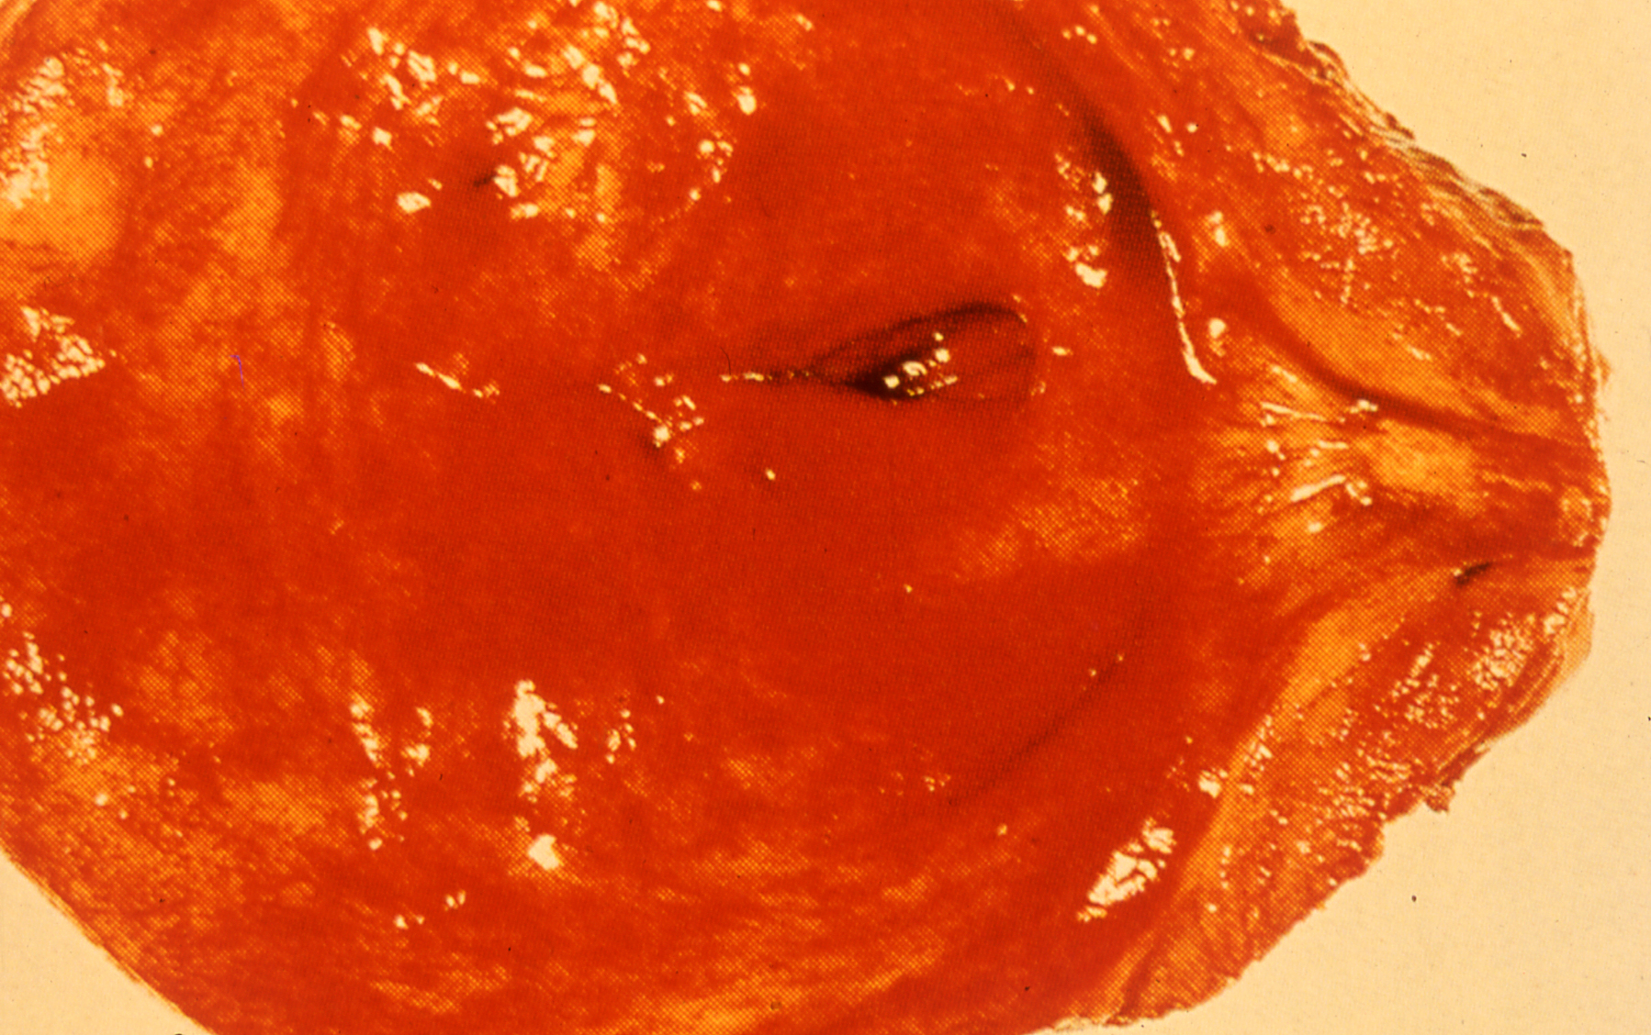
4- Severe acute cystitis:

Slide 7
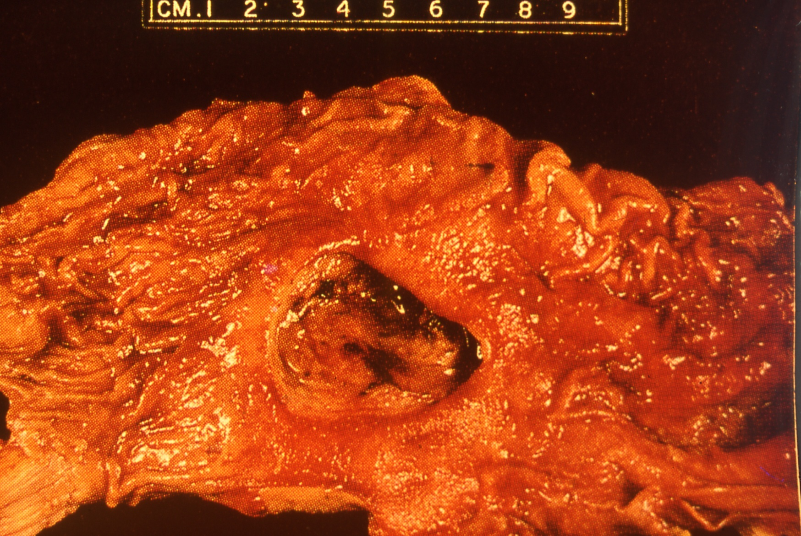
5- Stomach ulcer:

Slide 8
