Slide 1
INFLAMMATION 2

Slide 2
classification of acute inflammation:
according to the inflammatory fluid exudates,
-Exudates are any fluid that filters from the circulatory system into lesions or areas of inflammation

Slide 3
  1- Serous inflammation: Clear watery fluid. It is due to mild increase in vascular permeability.
  2-Fibrinousinflammation : Marked fibrin formation: e.g. in case of pericarditis, peritonitis, pleurisy.

Slide 4
3- Suppurative inflammation : Characterized by presence of pus , ↑ WBC
-Abscess is the localized tissue their collection of pus
-Pus consists liquefied dead tissue mixed with dead or dying neutrophils and living or dead bacteria
4-Ulcerative inflammation: Inflammation occurring near an epithelium surface.

Slide 5
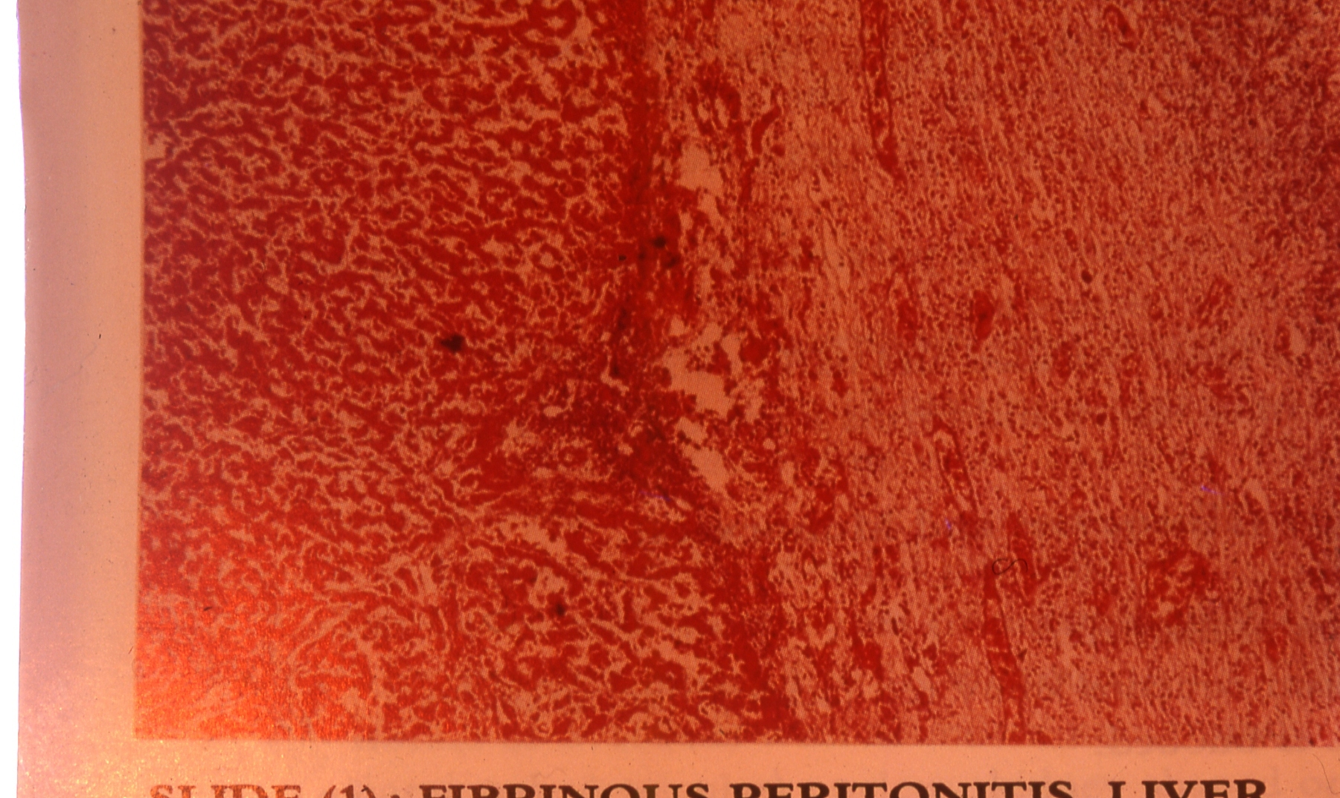
1- fibrinous peritonitis in liver:
- inflammation of the peritoneum, the thin membrane that lines the abdominal wall and covers the organs within it.
-marked by precipitation of fibrin & infiltration by polymorphs, pus cells and few macrophages.

Slide 6
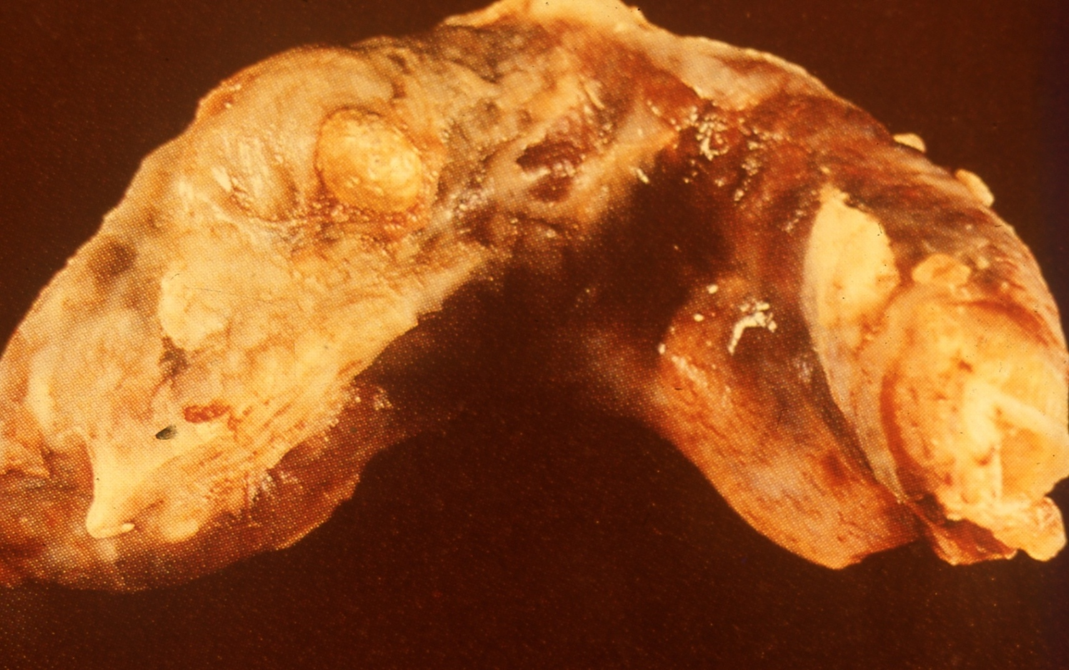
2- Acute diffuse suppurative appendicitis “Gross pic”:
Appendicitis infection of the appendix . Appendix is swollen and elongated, a bright red color with purulent or fibrous exudates on the surface.

Slide 7
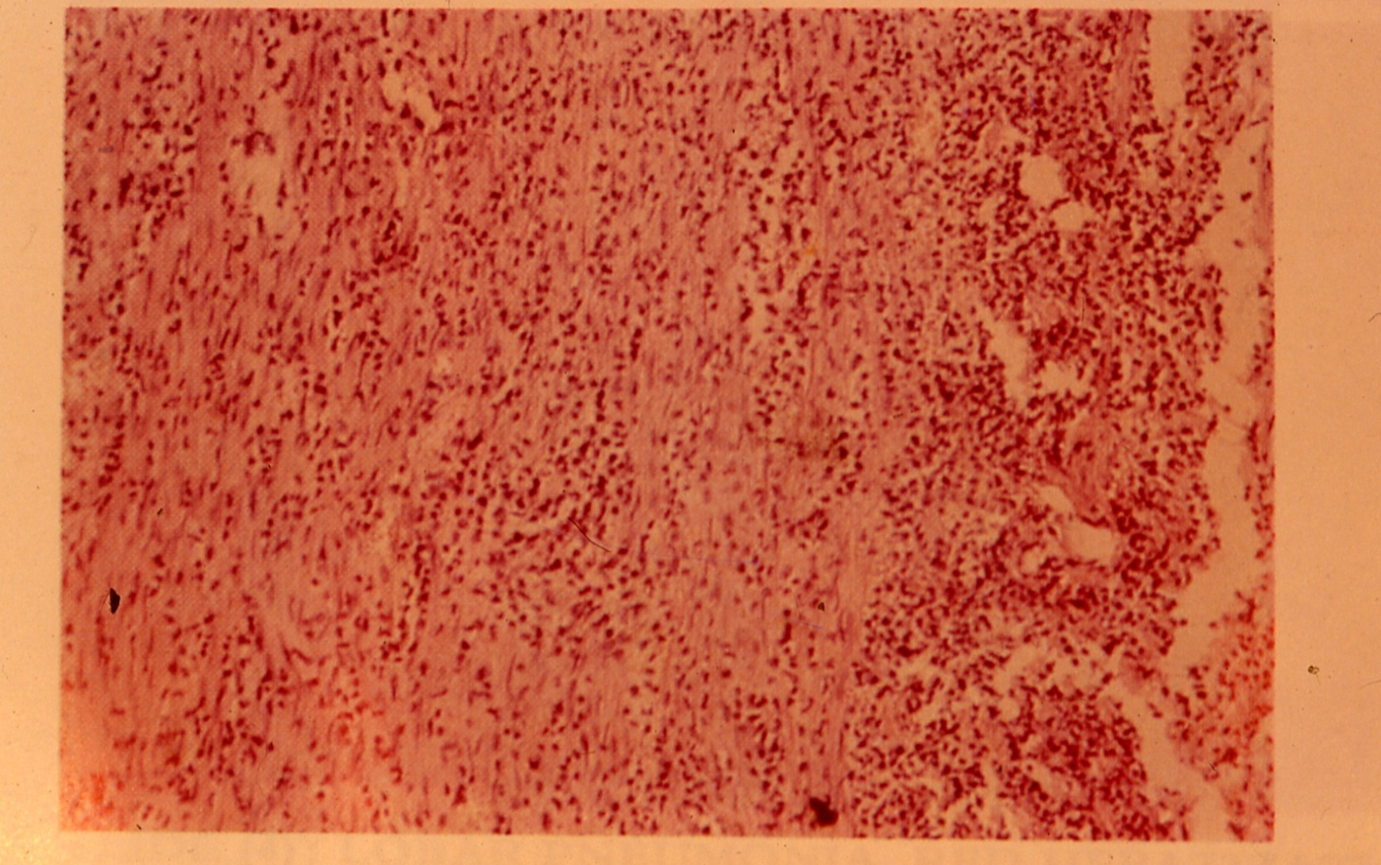
3- Acute diffuse suppurative appendicitis ( Microscopic pic) :
It is edematous and infiltrated with polymorphonuclear leucocytes , pus cells and few macrophages.

Slide 8
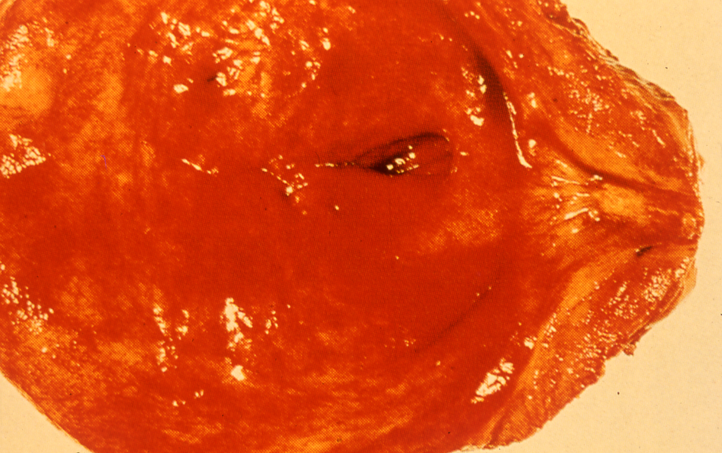
4- Severe acute cystitis:
It is a bacterial infection of the bladder , membrane being smooth, red, and edematous, and covered with a mucopurulent secretion.

Slide 9
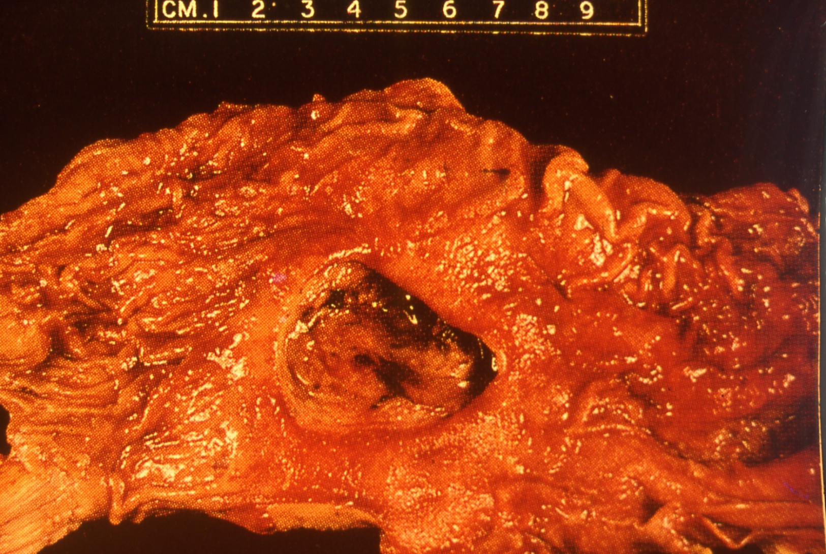
5- Stomach ulcer:
The ulcer is a round to oval parietal defect ("hole"), 2 to 4 cm diameter, with a smooth base and perpendicular borders. Surrounding mucosa may present folds, as a consequence of the parietal scarring.

Slide 10
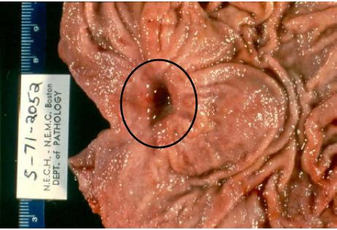
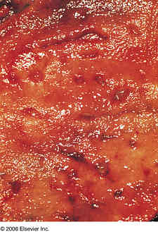
6- Stomach ulcer:
-70-90% of ulcers are associated with Helicobacter pylori,
.

