Slide 1
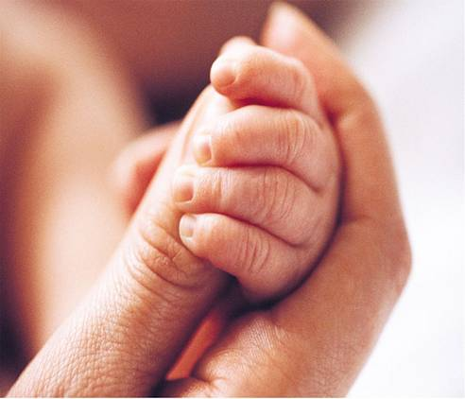
Infant Reflexes lecture Three
Clinical Application Child Health Nursing

Slide 2
What are Infant Reflexes?
A reflex is an involuntary muscle reaction to a certain type of stimulation.
Occur subcortically (below the level of the higher brain centers)
Newborns’ reflexes to evaluate neurological function and development

Slide 3
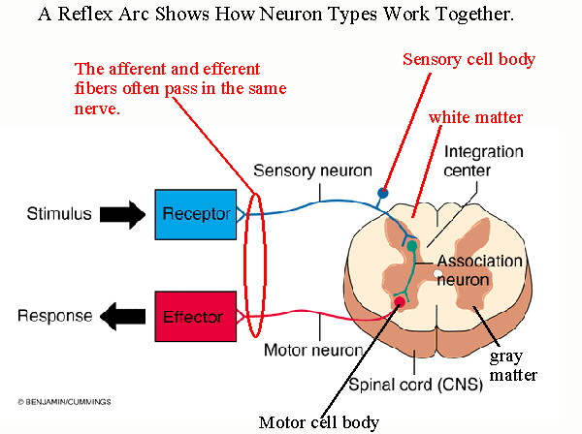

Slide 4
Infant vs. Lifespan Reflexes
Most “infant” reflexes do not last beyond the first year.
Infant reflexes may not completely disappear.
May be inhibited by maturing CNS.
May be integrated into new movements.
Reflexes that are called “lifespan” reflexes.

Slide 5
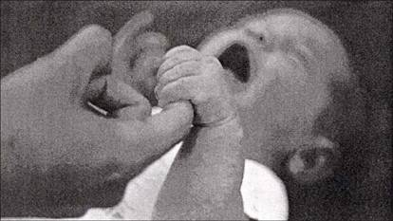
Palmar Grasp
Stimulus / Response | S: Touching palms R: 4 fingers (not thumb) close
Disappearance | 3- 4 months postpartum
Concerns | No palmer grasp may indicate neurological problems

Slide 6
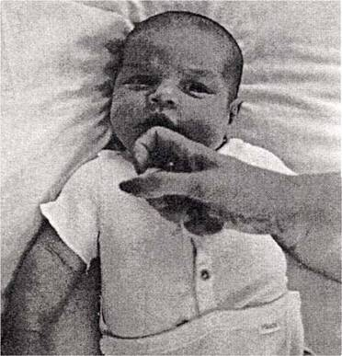
Sucking
Stimulus / Response | S: touch of lips R: sucking action
Disappearance | 3 months postpartum
Concerns | No reflex problematic for nutrition
http://newborns.stanford.edu/PhotoGallery/SuckingReflex1.html

Slide 7
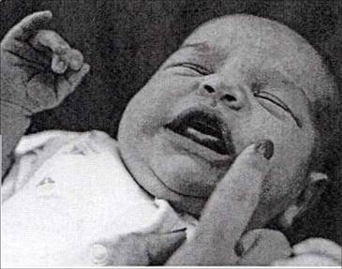
Rooting
Stimulus / Response | S: touching the cheek R: head moves toward stimuli
Disappearance | 4 to 6 months postpartum
Concerns | No reflex problematic for nutrition No reflex or lack of persistence may be sign of CNS.
http://newborns.stanford.edu/PhotoGallery/RootingReflex2.html

Slide 8
Moro
Stimulus / Response | S: Suddenly but gently lower baby’s head R: Arms and legs extend
Disappearance | 3-6 months postpartum
Concerns | May signify CNS dysfunction May indicate injury to one side of brain

Slide 9
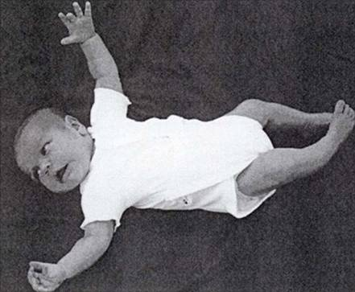
Moro

Slide 10
Startle
Stimulus / Response | S: sudden loud noise R: Arms and legs flex
Disappearance | 4 months

Slide 11
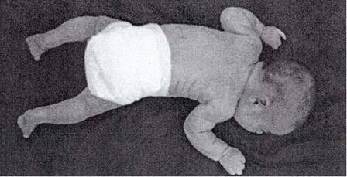
Tonic Neck
Stimulus / Response | S: turn head to one side R: Limbs flex on one side, extend on other side
Disappearance | 3- 4 months
Concerns | Facilitates bilateral body awareness Facilitates hand-eye coordination
http://newborns.stanford.edu/PhotoGallery/ATNReflex1.html

Slide 12
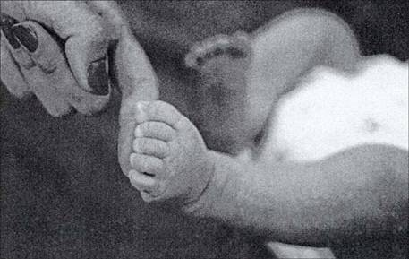
Plantar Grasp
Stimulus / Response | S: Touching the ball of foot R: Toes grasp
Disappearance | 3-4 month
Other | Must disappear before the baby can stand or walk.
http://newborns.stanford.edu/PhotoGallery/FootGraspReflex1.html

Slide 13
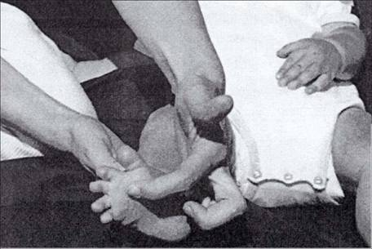
Babinski
Stimulus / Response | S: Stroking outer sole of upward R: toes to hyper extended
Duration | 12 months

Slide 14
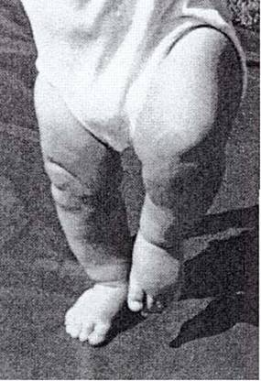
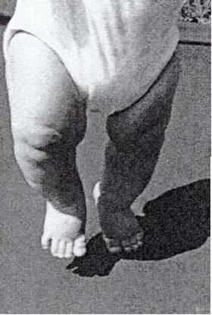
Stepping
Stimulus / Response | S: Infant upright with feet touching surface R: Legs lift and descend
Disappearance | 1 – 2 moths
Other | Sometimes called walking reflex Developmental changes in reflex over time
http://newborns.stanford.edu/PhotoGallery/StepReflex1.html

Slide 15
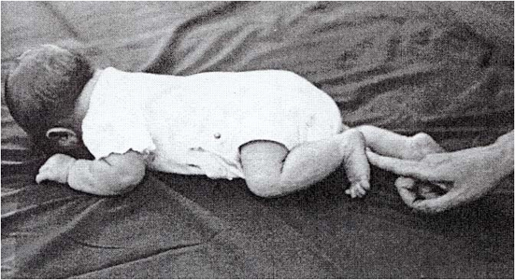
Crawling
Stimulus / Response | S: place on abdomen R: Legs and arms move in crawling action
Duration | 2 months

Slide 16
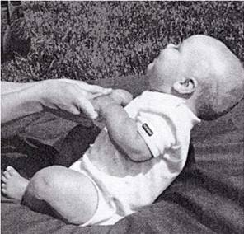
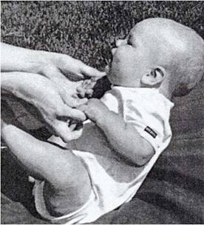
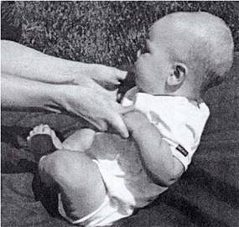
Pull Up
Stimulus / Response | S: Sitting/standing, hold hands, tip in one direction R: Arms flex or extend in to maintain upright position
Duration | 3 months – 1 year

Slide 17
Eyes reflex
Blinking or corneal reflex Infant blinks at sudden appearance of a bright light or at approach of an object toward cornea, persists throughout life
Papillary: Pupil constricts when a bright light shines toward it, persists throughout the life.

Slide 18
Nose:
Sneeze: spontaneous response of nasal passages to irritation or obstruction persists throughout life.
Glabellar: tapping briskly on glabella (bridge of nose) causes eyes to close tightly

Slide 19
Mouth & throat
Gag: stimulation of posterior pharynx by food, suction, or passage of a tube causes eyes to close tightly.

Slide 20
Mouth & throat
Yawn: spontaneous response to decreased oxygen by increasing amount of inspired air persists throughout life.
Cough: irritation of mucous membranes of larynx or tracheobronchial tree causes coughing persists throughout life, usually present after first day of birth.

