Slide 1
Implementing Standard and Extended Access Control List (ACL) in Cisco Routers

Slide 2
Objective
Introduce standard and extended ACLs as a means to control network traffic, and how ACLs are used as part of a security solution.

Slide 3
Introduction
Network administrators must figure out how to deny unwanted access to the network while allowing internal users appropriate access to necessary services.
Routers provide basic traffic filtering capabilities, such as blocking Internet traffic, with access control lists (ACLs).
ACL is a sequential list of permit or deny statements that apply to addresses or upper-layer protocols.
ACLs are lists of conditions that are applied to traffic traveling across a router's interface. These lists tell the router what types of packets to accept or deny.
ACLs filter network traffic by controlling whether routed packets are forwarded or blocked at the router's interfaces.
If ACLs are not configured on the router, all packets passing through the router will be allowed onto all parts of the network.

Slide 4
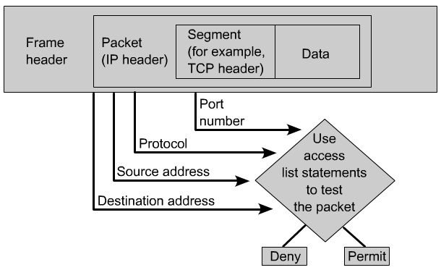
The router examines each packet to determine whether to forward or drop it, based on the conditions specified in the ACL. Some ACL decision points are source and destination addresses, protocols, and upper-layer port numbers.
ACLs must be defined on a per-protocol, per direction, or per port basis.

Slide 5
Why ACLs must be created?
Limit network traffic and increase network performance. By restricting video traffic, for example, ACLs could greatly reduce the network load and consequently increase network performance.
Provide traffic flow control. ACLs can restrict the delivery of routing updates. If updates are not required because of network conditions, bandwidth is preserved.
Provide a basic level of security for network access. ACLs can allow one host to access a part of the network and prevent another host from accessing the same area. For example, Host A is allowed to access the Human Resources network and Host B is prevented from accessing it.
Decide which types of traffic are forwarded or blocked at the router interfaces. Permit e-mail traffic to be routed, but block all telnet traffic.
Allow an administrator to control what areas a client can access on a network.
Screen certain hosts to either allow or deny access to part of a network. Grant or deny user permission to access only certain types of files, such as FTP or HTTP.

Slide 6
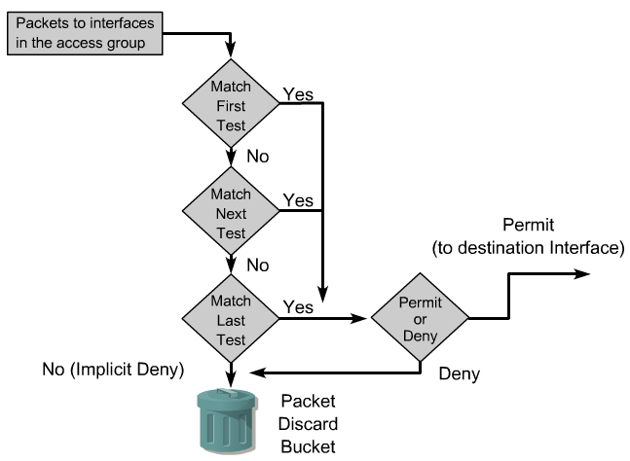
- An ACL is a group of statements that define whether packets are accepted or rejected at inbound and outbound interfaces. - These decisions are made by matching a condition statement in an access list and Then performing the accept or reject action defined in the statement.
The order in which ACL statements are placed is important. The Cisco IOS software tests the packet against each condition statement in order from the top of the list to the bottom. Once a match is found in the list, the accept or reject action is performed and no other ACL statements are checked. If a condition statement that permits all traffic is located at the top of the list, no statements added below that will ever be checked.

Slide 7
Creating ACLs
Each ACL must be uniquely identified by assigning a number to it that identifies the type of access list created.
ACLs are created in the global configuration mode
Router> enable,
Router# configt
Router (config)#
The user enters the access list statements using the keyword access-list, followed by the proper parameters.
Router(config)#access-list 10 permit 172.16.0.0 0.0.255.255
“All packets with a source IP address of 172.16.x.x will be permitted to continue through the internetwork.”
Creating the access list is the first half of using them on a router. The second half of the process is assigning them to the proper interface.

Slide 8
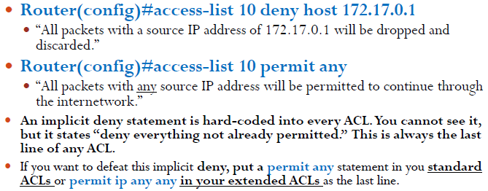

Slide 9
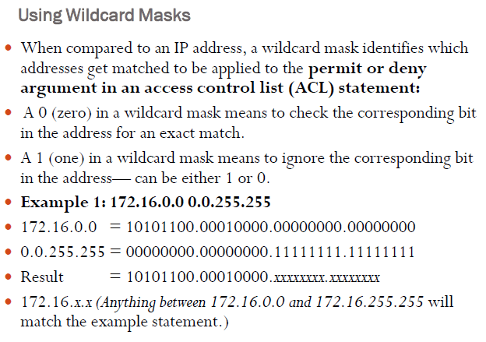

Slide 10
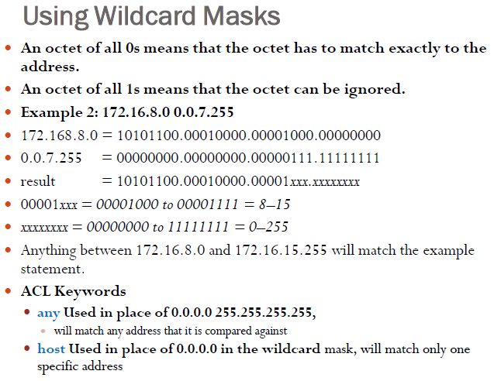

Slide 12
Standard ACLs check the source address of IP packets that are routed. The comparison will result in either permit or deny access for an entire protocol suite, based on the network, subnet, and host addresses.
For example, packets coming in Fa0/0 are checked for source address and protocol. If they are permitted, the packets are routed through the router to an output interface. If they are not permitted, they are dropped at the incoming interface.
Extended ACLs are used more often than standard ACLs because they provide a greater range of control. Extended ACLs check the source and destination packet addresses as well as being able to check for protocols and port numbers. This gives greater flexibility to describe what the ACL will check. Packets can be permitted or denied access based on where the packet originated and its destination as well as protocol type and port addresses.
An extended ACL can allow e-mail traffic from Fa0/0 to specific S0/0 destinations, while denying file transfers and web browsing.
When packets are discarded, some protocols send an echo packet to the sender, stating that the destination was unreachable.

Slide 14
Applying Extended ACLs to an Interface
Router(config)#interface fastethernet 0/0
Router(config-if)#ip access-group 110 out
Moves to interface configuration mode and takes all access list lines that are defined as being part of group 110 and applies them in an outbound manner. Packets going out fastethernet 0/0 will be checked.

Slide 15
Named ACLs
IP named ACLs were introduced in Cisco IOS Software Release 11.2, allowing standard and extended ACLs to be given names instead of numbers.
Router(config)#ip access-list extended serveraccess
Creates an extended named ACL called serveraccess and moves to named ACL configuration mode.
Router(config-ext-nacl)#permit tcp any host 131.108.101.99 eq smtp
Permits mail packets from any source to reach host 131.108.101.99.
Router(config-ext-nacl)#deny ip any any log
Denies all other packets from going anywhere. If any packets do get denied, this logs the results for you to look at later.
Router(config)#interface fastethernet 0/0
Router(config-if)#ip access-group serveraccess out
Moves to interface configuration mode and applies this ACL to the fastethernet interface 0/0 in an outbound direction.

