Slide 1
Hystrosalpingography
Manal ALOSAIMI

Slide 2
Definition
Hysterosalpingography, is an x-ray examination of a woman's uterus and fallopian tubes that uses a special form of x-ray called fluoroscopy and a contrast material.

Slide 3
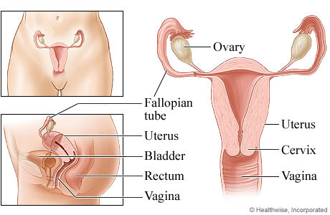
Anatomy
Vagina
Uterus
Uterine tubes
Ovaries

Slide 4
Technique
This test provide to see the structures of the uterus and fallopian tubes and to determine if there are any blockages or other problems.

Slide 5
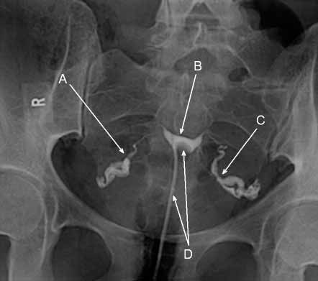
Anatomy
A = RT fallopian tube.
B = Uterine cavity .
C = LT fallopian tube.
D = Catheter.

Slide 6
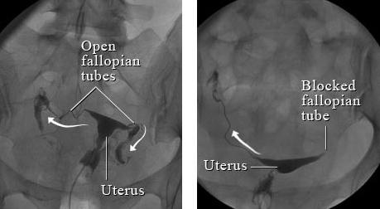
Anatomy

Slide 7
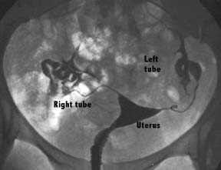
Anatomy

Slide 8
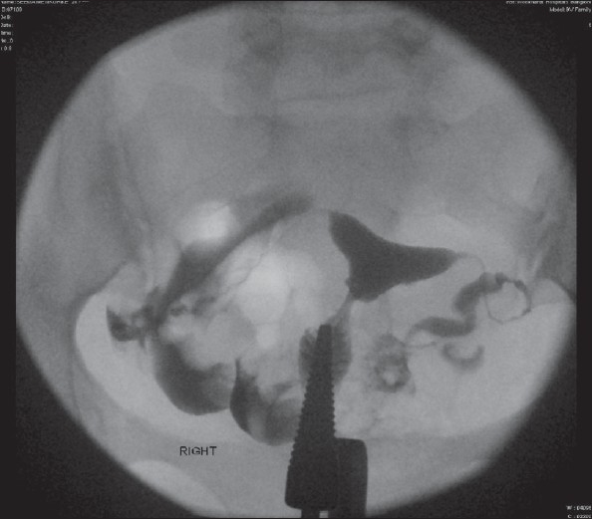
Anatomy

Slide 9
Thank You

