Slide 1
Human Chromosomes and Karyotyping

Slide 2
Chromosomal Disorders
Chromosome abnormalities occur as a result of chromosome mutations brought on by mutagens (like radiation) or problems that occur during cell division.
The defects are classified as abnormalities of number or structure and content
Numerical defects - are abnormalities of the euploid number of chromosomes (46)
Structural defects - result from chromosome breakage and rearrangement.

Slide 3
Chromosomal Disorders
One type of mutation is caused by chromosome breakage. The broken chromosome fragment may be deleted, duplicated, inverted, or translocated to a non-homologous chromosome.

Slide 4
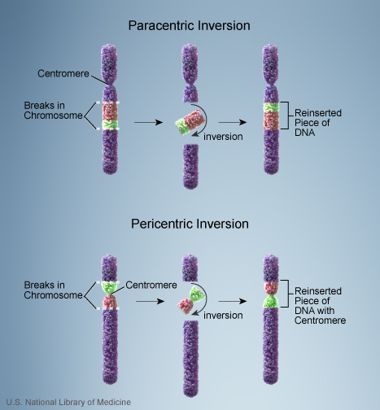

Slide 5
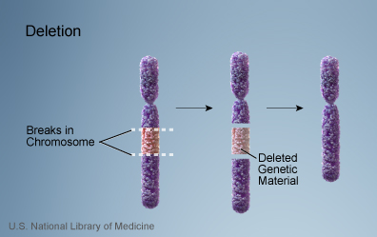

Slide 6
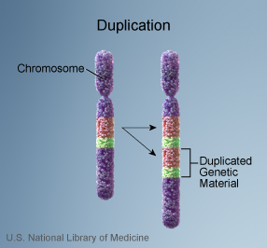

Slide 7
Classification of chromosomes diseases
Sex linked
  As the name implies, the sex-linked inheritance is determined by the sex chromosome of either X or Y.
Autosomal inheritance
  Autosomal inheritance is the transmission of traits on a particular locus on an autosomal chromosome pair.

Slide 8
Autosomal Chromosomes Aberrations

Slide 9
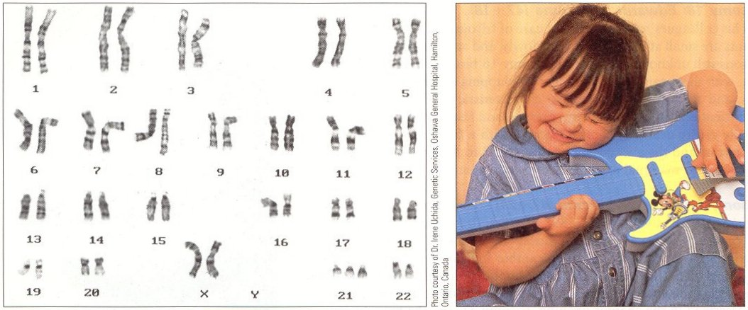
Down Syndrome: 47, +21
1 in 600-700 births
Epicanthic fold of skin over corner of each eye
wide, flattened skull
Protruding, furrowed tongue causes mouth to remain partially open
Retarded growth and mental development
Fertile

Slide 10
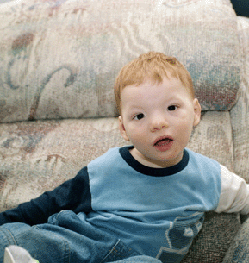
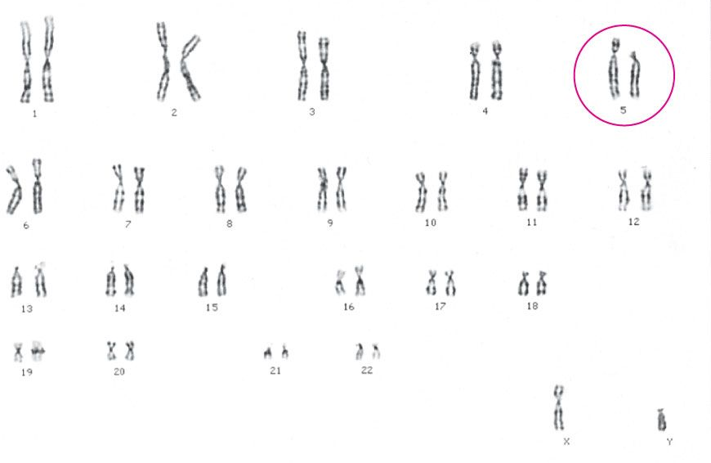
Cri du chat syndrome: 46, 5p deletion
Cri-du-chat is caused by a deletion on the short arm of chromosome 5p
Babies with cri-du-chat are usually small at birth, and may have respiratory problems. Often, the larynx doesn’t develop correctly, which causes the signature catlike cry.
Mental retardation: the more extensive the deletion is of chromosome 5p, the more severe this symptom.
Downward slant of the eyes.
Abnormally shaped/positioned ears.
Webbed fingers or toes.

Slide 11
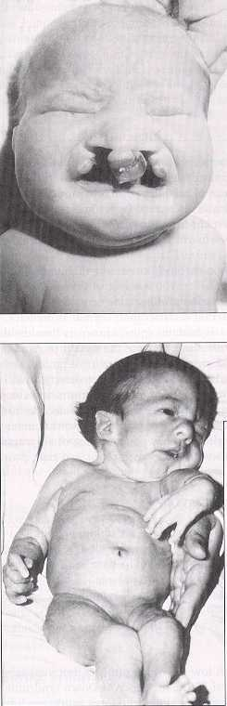
Patau Syndrome: 47, +13
1 in 15,000 live births
Cleft lip and palate
eye defects
Malformation of internal organs (brain, nervous system, heart)
Survival rarely past 1 year
Edwards Syndrome: 47, +18
1 in 11,000 births
Small at birth, growth retarded
Malformed hands and feet
Heart malformations
Death within first year usually caused by heart failure or pneumonia

Slide 12
Sex Linked Aberrations

Slide 13
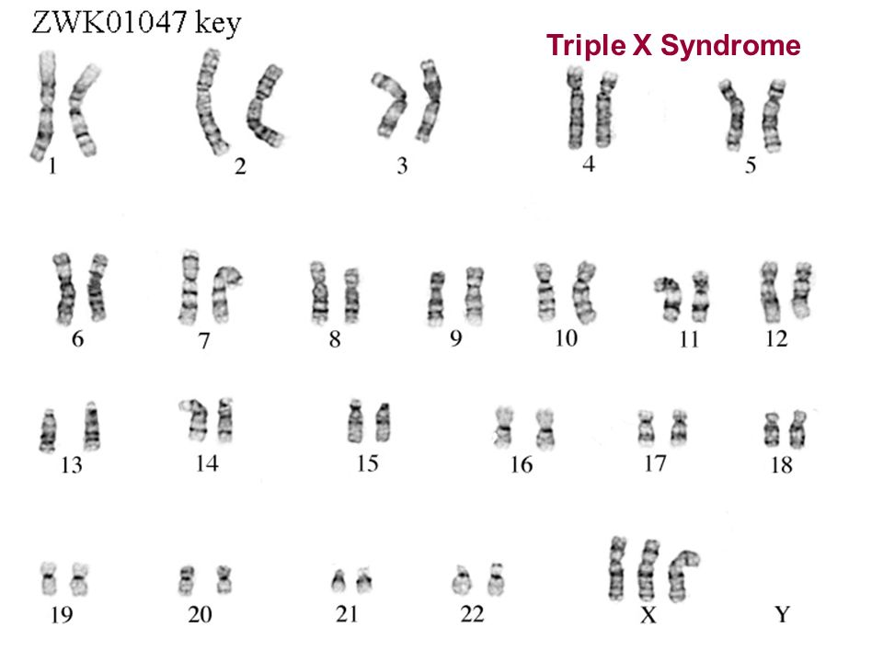
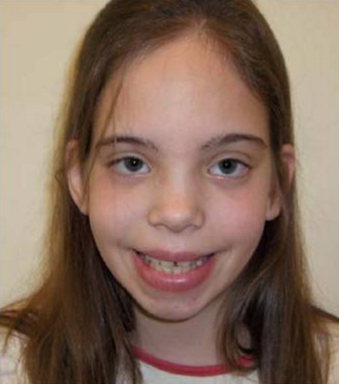
Triple X syndrome or Trisomy X: 47, XXX
Triple X syndrome may not cause any signs or symptoms. If symptoms do appear, they may include:
Tall stature.
Vertical skinfolds that may cover
the inner corners of the eyes.
Delayed development of speech and language skills.
Weak muscle tone .
Curved pinky fingers.
Behavior and mental health problems.
Premature ovarian failure or ovary abnormalities.

Slide 14
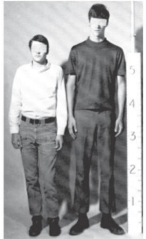
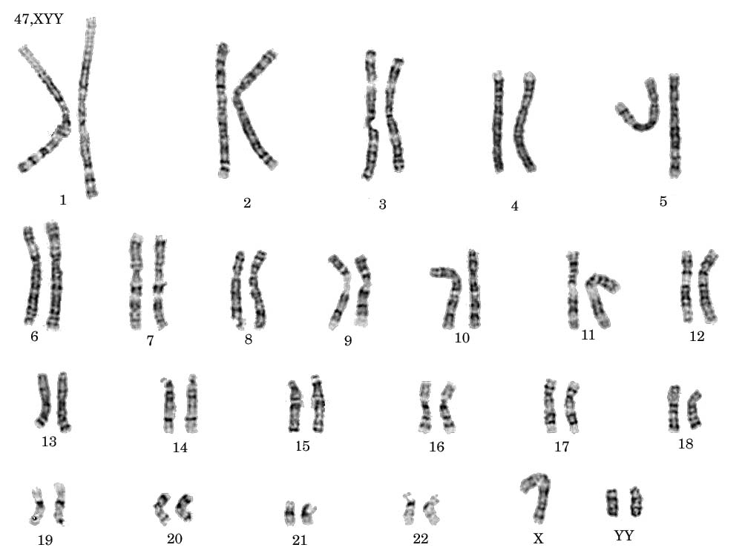
Jacob’s Syndrome: 47, XYY
XYY syndrome is an aneuploidy of the sex chromosomes in which a human male receives an extra Y chromosome, giving a total of 47 chromosomes instead of the usual 46.
Survival to adulthood
Average height, thin, personality disorders, some form of mental disabilities, and adolescent acne
Some may have very mild symptoms
1/1,000 male births

Slide 15
KARYOTYPEING

Slide 16
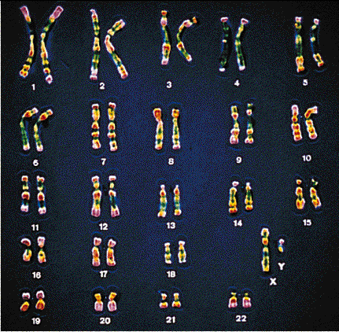
Identifying chromosomes
Chromosomes can be identified by:
Their size.
Their shape (the position of the centromere) .
Banding patterns produced by specific stains (Giemsa).
Chromosomes are analysed by organising them into a KARYOTYPE.

Slide 17
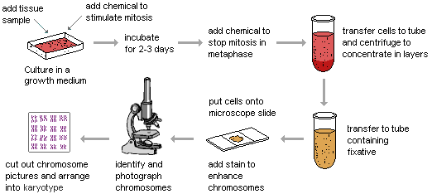
PREPARATION OF CHROMOSOMES

Slide 18
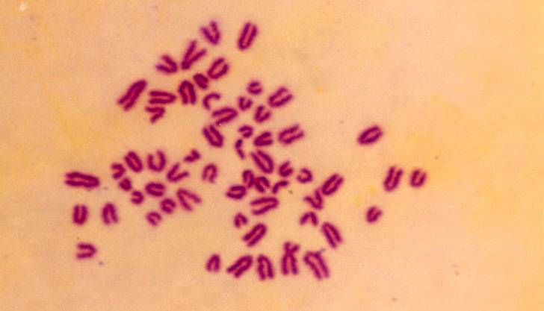
MITOTIC CHROMOSOMAL SPREAD OF CATTLE

Slide 20
Chromosome Groups
Group | Chromosomes | Description
A | 1–3 | Largest; 1 and 3 are metacentric but 2 is submetacentric
B | 4,5 | Large; submetacentric with two arms very different in size
C | 6–12,X | Medium size; submetacentric
D | 13–15 | Medium size; acrocentric with satellites
E | 16–18 | Small; 16 is metacentric but 17 and 18 are submetacentric
F | 19,20 | Small; metacentric
G | 21,22,Y | Small; acrocentric, with satellites on 21 and 22 but not on the Y

Slide 21
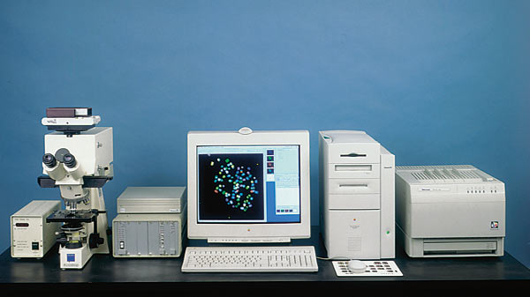


Slide 22
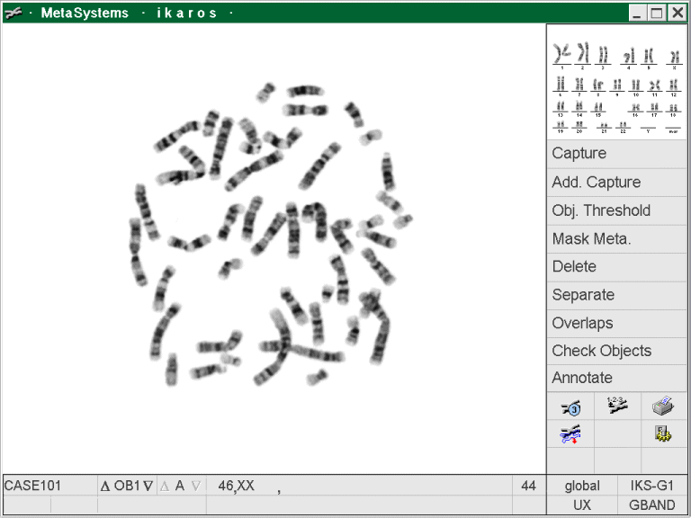
Metaphase chromosomes

Slide 23
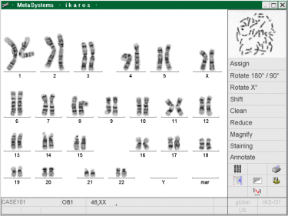
Karyotyped chromosomes

Slide 24

Exercise

Slide 25
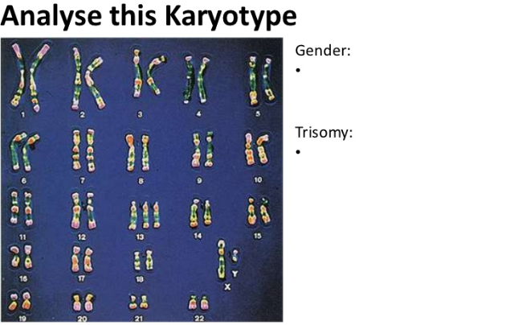

Slide 26
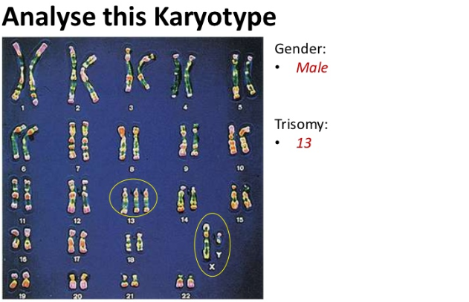
Patau syndrome

Slide 27
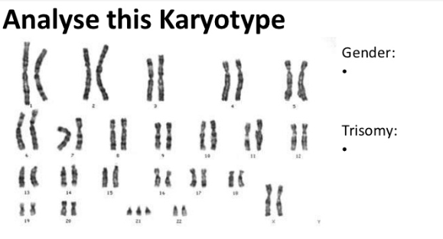

Slide 28
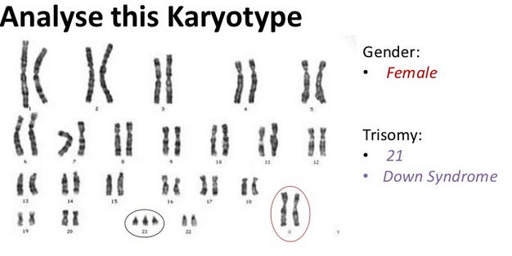

Slide 29
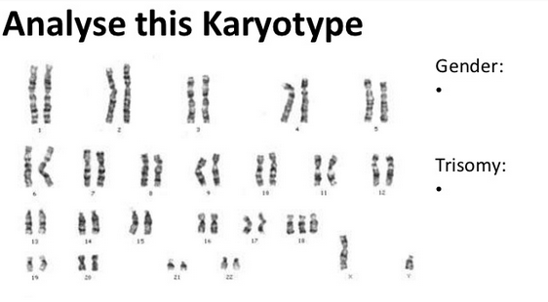

Slide 30
