Slide 1
Histology and biochemistry of the adrenal gland
By: abdulaziz abdullah almanie

Slide 2
HISTOLOGY

Slide 3
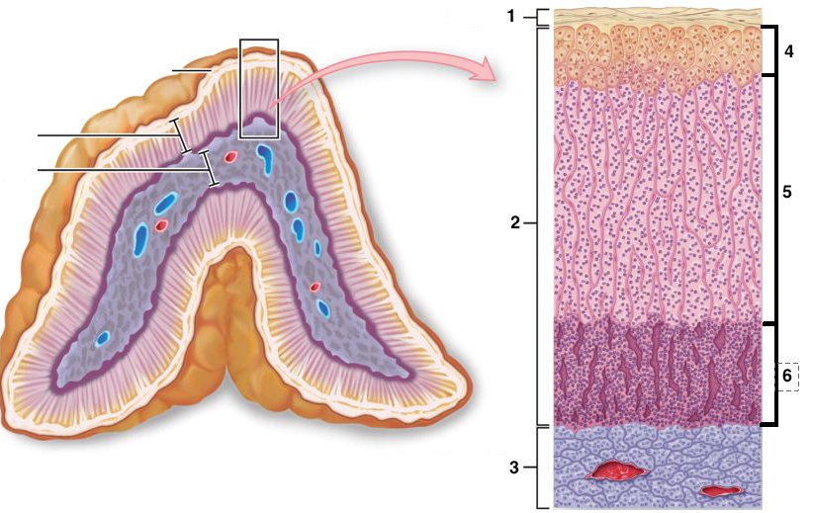
Adrenal gland
It is formed of:
1-Stroma.
2-Parenchyma: that is divided into
I. Cortex that is composed of:
A-Zona glomerulosa.
B-Zona fasciculata.
C-Zona reticularis.
II. Medulla:
It is the central portion of the adrenal gland.It is completely invested with adrenal cortex (not separated from it by CT. septa)
It contains: Chromaffin cells (Pheochromocytes): (They produce epinephrine and norepinephrine).
2. Sympathetic ganglion cells :

Slide 4
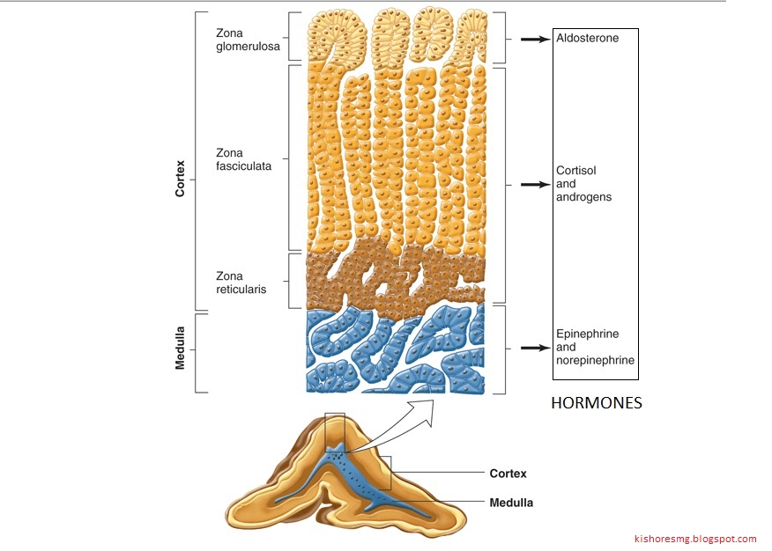
1- zona glomerulosa:clusters of small columnar cells that are rich in SER and mitochondria.
Produces mineralocorticoids e.g. aldosterone hormone
2. zona fasciculata:It is the intermediate and the largest layer of the cortex.
*It is formed of columns of large polyhedral cells that are separated by longitudinal sinusoidal capillaries.
Its cells secrete glucocoticoids
3. zona reticularis: It is the innermost layer of adrenal cortex.It is formed of anastomosing cords of deep acidophilic cells . The cells secrete androgens.

Slide 5
BIOCHEMISTRY

Slide 6
Glucocorticoid
*function
Normal values:
Serum cortisol:
Morning - 7-28 μg/dL
Afternoon - 2-18 μg/dL
Investigations:
1-Screening tests: assess the clinical diagnosis
Include:1-low DXM
2-24-hour urinary free cortisol
2-Confirmatory tests: rule out pseudo-Cushing's syndrome
1-Insulin-induced hypoglycemia: INCREASE CRH
Basal serum cortisol: at least 145 nmol/L
At 60 - 90 minutes: the level > 425 nmol/L
Plasma ACTH:
Morning- 10 - 60 pg/mL
Afternoon-5-10 pg/mL
*Regulation of ACTH and Cortisol Secretion:
1-Negative feedback control
2-Stress
3-The diurnal rhythm of plasma cortisol
Tests used to determine the cause of Cushing's syndrome:
1-Plasma ACTH (Diurnal rhythm)
2-High-dose dexamethasone suppression test
3-CRH stimulation test
4-Radiological tests: MRI of pituitary and ultrasound or CT of adrenals
*Cortisol and ACTH measurements:
1-Serum [cortisol] and plasma [ACTH]
2-Urinary cortisol excretion
(UFC) is < 250 nmol/24 h

Slide 7
THANK YOU

